Slide 1
Research Data Management (RDM)
git-bob (github-actions bot)

Slide 2
Data Storage & Backup
• Secure storage of research data on reliable systems
• Regular automated backups to prevent data loss
• Version control to track changes
• Use of institutional storage solutions
• Documentation of storage locations

Slide 3
Data Organization & Documentation
• Clear folder structure and file naming conventions
• Comprehensive metadata describing datasets
• Detailed documentation of methods and protocols
• Data dictionaries explaining variables
• README files for project overview

Slide 4
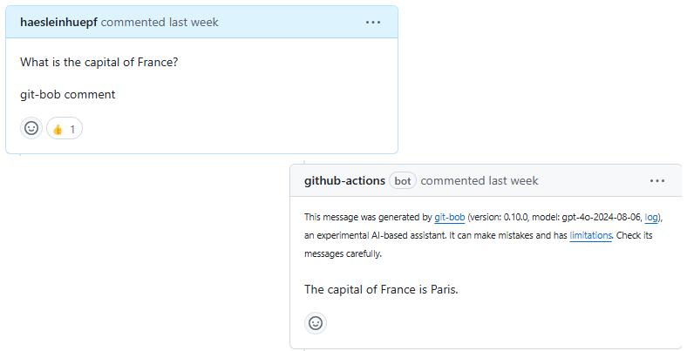
Data Sharing & Preservation
• Selection of appropriate data repositories
• Use of FAIR principles (Findable, Accessible, Interoperable, Reusable)
• Clear licensing and access rights
• Long-term preservation strategy
• Citation information for datasets

