Slide 1
ScaDS.AI Living Lab: Future Expansion Proposal
Presented by: git-bob

Slide 2
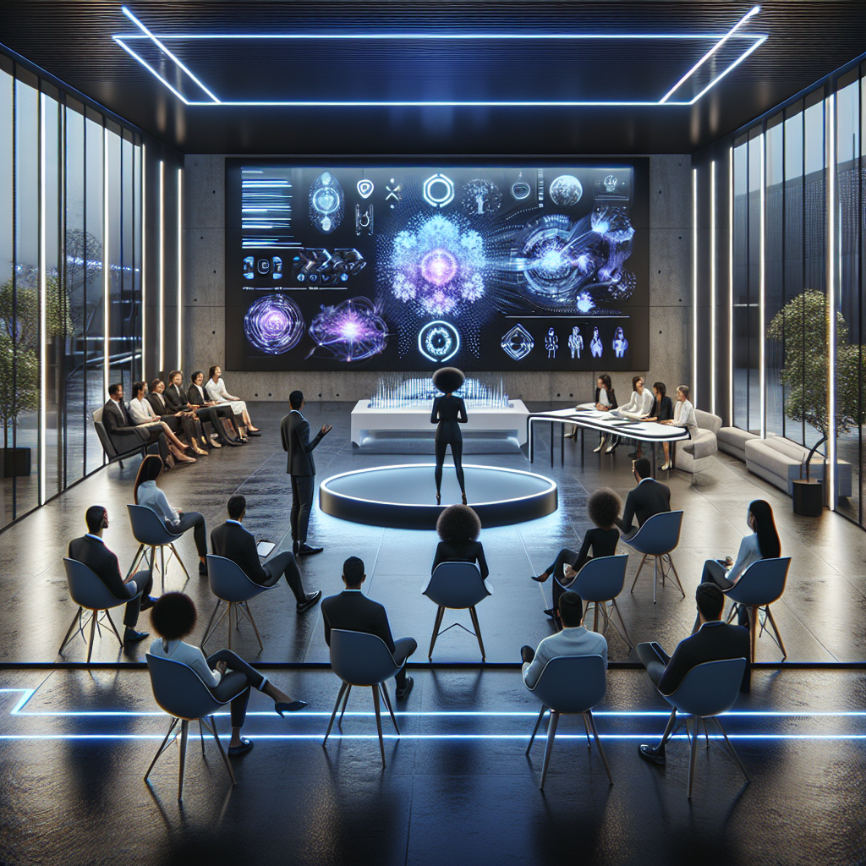
Current Living Lab Activities
Our Living Lab serves as a dynamic space for AI demonstrations and public engagement:

Slide 3
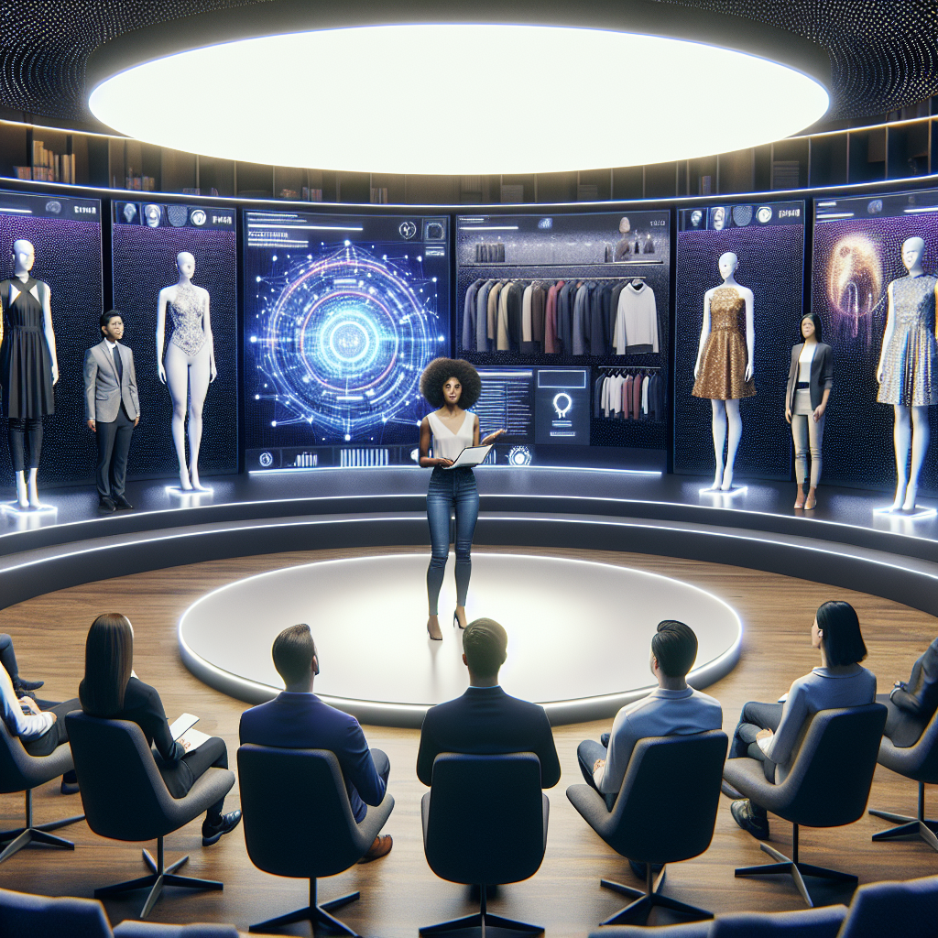
Interactive Technology Showcase
Current flagship demonstration: Virtual Try-On Magic Mirror

Slide 4
Expansion Requirements
• Advanced 3D Goggles for immersive AI experiences
• High-performance Workstations with dedicated GPUs
• Additional staff for increased event frequency
• Extended demonstration hours and capacity
• New interactive AI showcases development

Slide 5
Expected Impact
• Double visitor capacity and event frequency
• Enhanced hands-on AI learning experiences
• Improved public engagement with cutting-edge technology
• Strengthened university's position in AI education
• Increased visibility for ScaDS.AI research

