Slide 1
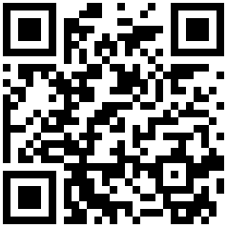


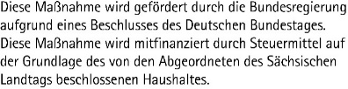
How Generative AI impacts [BioImage] Data Science
Robert Haase
These slides, excluding logos, can be reused under the terms of the CC-BY 4.0 license unless mentioned otherwise.
https://doi.org/10.5281/zenodo.20527125
Funded by

Slide 2




Quiz: Dealing with AI
How often do you use AI (ChatGPT, etc)?
< 1x per week
approx. 1x per day
Several times per day
Constantly

Slide 3
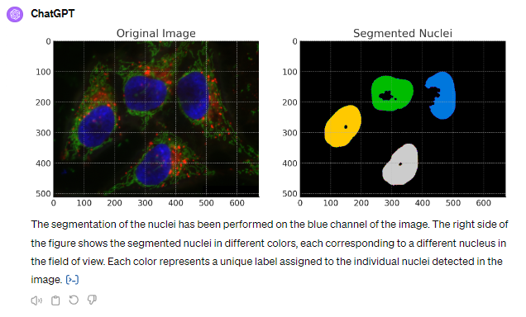
Bio-Image Analysis
My job …

Slide 4
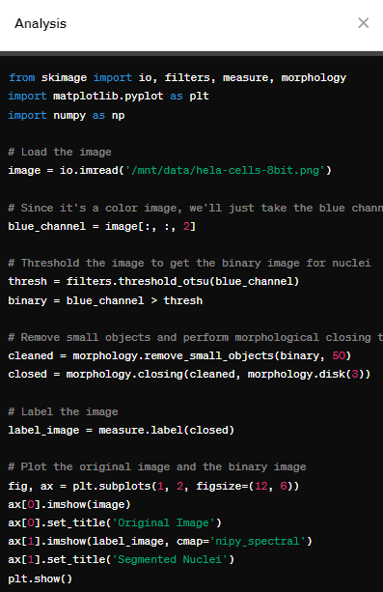
Bio-Image Analysis
My job is changing, since we have ChatGPT
Prompt: “Please segment the nuclei in the blue channel of the image”

Slide 5
Code generating language models
Translating from human language to computer language
How can I segment nuclei in a fluorescence microscopy image using Python?
from skimage.io import imread, imshow
from skimage.filters import threshold_otsu
# load image
image = imread(‘your_image.tif‘)
# segment image
binary_image = image > threshold_otsu(image)
# show result
imshow(binary_image)

Slide 6
Code generating language models
Translating from human language to computer language
How can I segment nuclei in a fluorescence microscopy image using Python?
from skimage.io import imread, imshow
from skimage.filters import threshold_otsu
# load image
image = imread(‘your_image.tif‘)
# segment image
binary_image = image > threshold_otsu(image)
# show result
imshow(binary_image)

Slide 7
Summary
Using AI / LLMs for [bioimage] data analysis code generation seems increasingly unavoidable
Maintaining good scientific practice is challenging (esp. peer-review)
Compare LLMs / service providers
Learn how to use AI responsibly
Explore multiple solutions
Apply good scientific practice (question methods!)
Use sovereign infrastructure
Use resources wisely!
We may be on the edge towards AI-agents analyzing image data autonomously.
https://doi.org/10.5281/zenodo.20527125

Slide 8



Bio-Image Analysis Communities
Image/data analysis + data management support
Use networking opportunities
Receive trainings
National Infrastructure for Research Data Management in BioImaging
Image Science Community Forum
https://image.sc/
https://www.globias.org/about-globias/globias-association
https://nfdi4bioimage.de/help-desk/

