Slide 1
From measurement to kinetic modelling
7th EnzymeML Workshop · Rüdesheim · Hands-on session 2 · 16 September 2026
Max Häußler
  University of Freiburg
Notes:
9:00 · 1 min. Welcome to hands-on session 2 (9:00–12:00). The session is shared with Sascha Gabriel (Stuttgart); this deck is my part. Plan: 15 min of introduction, a live demo, two hands-on tasks with a break in between, comparison of results at 11:25, wrap-up at 11:50.

Slide 2
Last year the code was the hurdle
Looking back
Previous hands-on sessions: we installed, read the docs and wrote the analysis code ourselves
Install
Python, packages, a working environment
Read the docs
how the tools are used
Write the code
Python, by hand, for your data
Debug, repeat
errors, versions, time
Your analysis
structured data, a kinetic model
Failing installs and unfamiliar code: a hurdle for everyone who does not code daily
So the data stayed unstructured, and the contemporary methods out of reach
Since then: the models got better, and so did the harnesses that let them run tools
Notes:
9:01 · 2 min. Recap of the earlier sessions: we, as humans, wrote the code. Before the first plot everyone had to set up a computing environment, read the documentation of the tools for extracting and modelling data, and write Python. Installations failed, the code was unfamiliar, and for people who do not work with code every day this was a burden. That kept many from structuring their data at all, and so from using contemporary data-science methods on it. Bridge: since then a lot has happened with language models and AI agents; the models got better, and the harnesses that let a model execute tools got much better. Next slide shows the models.

Slide 3
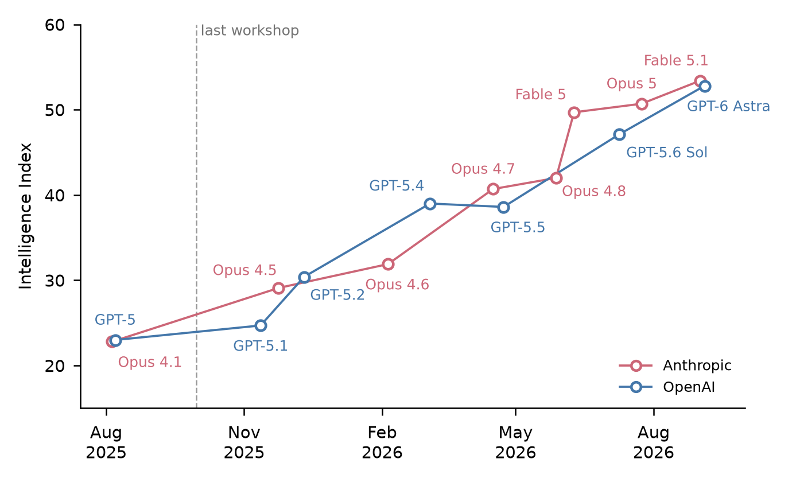
From 23 to 53 in one year
Language models since the last workshop
The two labs traded the lead several times; the biggest single step was Fable 5 in June 2026
The Intelligence Index is an independent score from 0 to 100 that combines many tests of knowledge, reasoning, coding and agentic work, with every model tested the same way.
Shown are the flagship models of Anthropic and OpenAI that anyone can use, each at its strongest public setting.
Artificial Analysis Intelligence Index v4.3, artificialanalysis.ai; release dates from the vendors
Notes:
9:03 · 2 min. Dashed line: the 6th workshop, 29 Sep – 2 Oct 2025. Since then the flagship models went from about 23 to 53 on the index. The index is an independent benchmark, every model tested the same way. The point is that the tool changed a lot in one year, not which lab leads. Keep it short.

Slide 4
The assistant types, you decide
Motivation
Today's models write correct code against our Python APIs from a one-page card
They do not know where the peak is, which model is right, when a result is wrong
So the scientist decides and checks; the assistant executes
EnzymeML is the document that travels between the steps and the tools
Notes:
9:05 · 2 min. What this enables for us: from a one-page description a model writes correct code against Chromhandler and Catalax. What it does not do: know where the peak is, which model is right, whether a result is wrong. So today the assistant executes, you decide and check. EnzymeML is the document that travels between the steps and the tools.

Slide 5
Tools act, skills instruct, you decide
Concept
You
the task, the decisions, the checks
Tools
Skills
read files
task
results
chromhandler.md
peak tables → EnzymeML
actions
Language model
ChatGPT, Claude, Gemini, …
run Python
instructions
catalax.md
EnzymeML → k_{cat}, K_{M} by Bayesian inference
results
make plots
Tools let the model read the data and run code; skills tell it how our libraries turn data into insight
Notes:
9:07 · 2 min. A language model on its own only writes text. Tools are functions it can call and whose output it sees: read a file, run Python, make a plot; that is how it reads the peak tables and runs Chromhandler and Catalax. Skills are instructions in plain text: our two tool cards, chromhandler.md and catalax.md, tell it how each library turns data into insight, peak tables into an EnzymeML document, the document into kcat and Km by Bayesian inference. You give the task, take the decisions and check the results; the model executes.

Slide 6
Two tasks, one document in between
Workflow
Task 1 ends with the EnzymeML document; task 2 starts from it
Raw HPLC chromatograms
24 reactions × 6 injections, 5 standards
Chromhandler
peaks, calibration
EnzymeML document
24 Neu5Ac time courses
Catalax
ODE model, Bayesian inference
k_{cat}, K_{M}^{ManNAc}, K_{M}^{PEP}
posterior distributions
Task 1 · chromatograms to EnzymeML
Task 2 · EnzymeML to k_{cat} and K_{M}
Notes:
9:09 · 1 min. Walk through the five boxes left to right. Task 1 covers the first three, task 2 the last three; the EnzymeML document is the handover, which is why anyone stuck in task 1 can start task 2 from the checkpoint. Timing: task 1 9:15–10:15, task 2 10:30–11:25.

Slide 7
Chromhandler: from peak tables to concentrations
Tool 1 · Chromhandler
Reads the instrument's exports, assigns and calibrates one peak per compound, writes EnzymeML
Input
Steps
Output
Peak tables
one export per injection, the time in the file name
Read the exports
read_shimadzu, reaction or calibration mode
EnzymeML document
time courses with their initial conditions
Set the retention window
your decision, per measurement session
Calibration standards
exports with known concentrations
Checks
one peak per chromatogram, R², values per reaction
Assign the peak
auto_assign: the peak inside the window
Initial concentrations
what was in each reaction at t = 0
Calibrate
add_standard, area against concentration; you accept R²
Export
to_enzymeml: areas become concentrations
Notes:
9:10 · 1 min. Left: what goes in, the peak tables the instrument software exported (one per injection, the reaction time in the file name), the standards with known concentrations, and the initial concentrations. Middle: the steps in order; two of them are the scientist's decisions, the retention window per session and accepting the calibration. Right: the EnzymeML document and the checks the task card asks for.

Slide 8
Catalax: from time courses to kinetic parameters
Tool 2 · Catalax
Builds the ODE model from a rate law and samples the posterior of its parameters
Input
Steps
Output
EnzymeML document
time courses and initial conditions
Load the dataset
Dataset.from_enzymeml
Posterior
k_{cat}, K_{M}^{ManNAc}, K_{M}^{PEP}: mean ± sd, intervals
Define the model
add_state, add_ode; your decision
Rate law
one equation; states and ODEs follow from it
Plots
corner plot; data with the model on top
Set the priors
LogUniform per parameter, yerrs; your decision
Priors and noise
what you assume before seeing the data
Sample
run_mcmc: chains, warmup, samples
Check and plot
r-hat, divergences, bounds, correlations
Notes:
9:11 · 1 min. Left: the EnzymeML document, the rate law, and the assumptions, priors and noise. Middle: load, define the model, set the priors, sample with Hamiltonian Monte Carlo, then check and plot. The model, the priors and the noise are the scientist's decisions; the checks say whether the posterior can be trusted. Right: posterior distributions, not point estimates, and the plots.

Slide 9
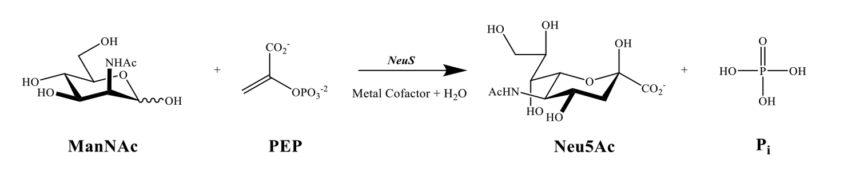
ManNAc + PEP → Neu5Ac + Pi, followed by HPLC
The experiment
HPLC-PDA at 215 nm; only the product Neu5Ac is quantified
ManNAc series: 13 reactions, ManNAc 0–100 mM at 20 mM PEP
PEP series: 11 reactions, PEP 0–20 mM at 50 mM ManNAc
Six injections per reaction; five calibration standards, 1–5 mM
Notes:
9:12 · 2 min. Neu5Ac synthase condenses ManNAc and PEP to Neu5Ac and phosphate (metal cofactor, water). HPLC-PDA at 215 nm. Two series: ManNAc varied at fixed PEP (13 reactions), PEP varied at fixed ManNAc (11 reactions); six injections each; five standards with 1–5 mM. Only the product is quantified; the substrates enter the model as their known initial values.

Slide 10
Two series, one substrate varied at a time
The dataset
 | Samples | What varies | What is fixed
ManNAc series | 13 reactions | ManNAc 0–100 mM | PEP 20 mM
PEP series | 11 reactions | PEP 0–20 mM | ManNAc 50 mM
Calibration standards | 5 standards | Neu5Ac 1–5 mM, with ManNAc and PEP | no enzyme
24 reactions sampled six times: 144 chromatograms
Per injection you get the instrument's peak table, not the raw trace
Initial concentrations are in conditions.csv
Notes:
9:14 · 1 min. Two series: ManNAc varied at fixed PEP (13 reactions), PEP varied at fixed ManNAc (11 reactions); six injections each, 144 chromatograms; five standards with 1–5 mM Neu5Ac that also contain the substrates, no enzyme. Participants do not get the raw traces: the instrument software exported a peak table per injection, and that is the input of task 1. Initial concentrations are in conditions.csv. Where Neu5Ac elutes is in the task card and comes up in the demo.

Slide 11
What we do today
Today
Task 1: from the peak tables to an EnzymeML document (Chromhandler)
Task 2: from the EnzymeML document to k_{cat} and K_{M} by Bayesian inference (Catalax)
A live demo of each task first, then you work in pairs
The checks in the task card say when you are done
At the end we compare everybody's parameters and discuss
Notes:
9:15 · 1 min. Task 1 with Chromhandler, task 2 with Catalax. Live demo first, then you work in pairs; the checks in the task card decide when you are done. Timing: demo 9:15, hands-on 9:30, break 10:15–10:30, demo 10:30, hands-on 10:40. At 11:25 we collect everybody's kcat and Km on one slide or the whiteboard, wrap-up 11:50.

Slide 12
One repository, two ways to work
Toolkit
tinyurl.com/enzymeml2026 · start with the README
With a language model
Any chat model, free or by subscription: ChatGPT, Claude, Gemini, …
Paste the tool card and the task card; run the code, paste errors back
The checks decide when you are done
notebooks/ are the reference solutions, checkpoints/ the result of task 1
Without writing code
Open the Colab link: a prepared notebook, tools installed, data loaded
Run it cell by cell; change a window, a prior, a series
Ask the model in Colab to explain any cell
Notes:
9:16 · 3 min. README first. Two ways. With a language model: any chat model, free or by subscription (ChatGPT, Claude, Gemini, …); paste the tool card, then the task card; run the code it writes; paste errors back; the checks decide. Without writing code: the Colab link opens a prepared notebook with the tools installed and the data loaded; run it cell by cell, change a window, a prior, a series; ask the model inside Colab to explain any cell. notebooks/ are the reference solutions, open to everyone; checkpoints/ holds the result of task 1. Locally: uv sync.

Slide 13
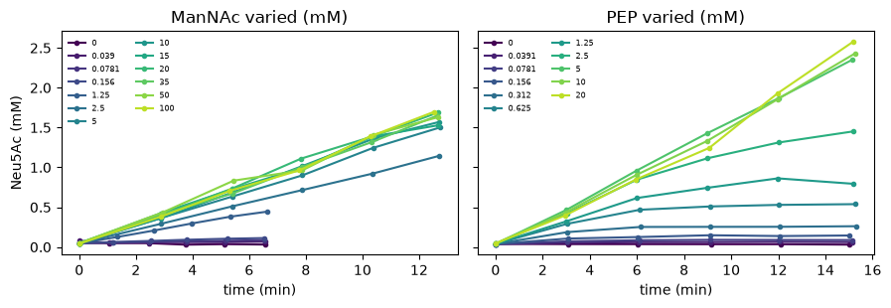
Task 1: from chromatograms to EnzymeML
Task 1
Goal: an EnzymeML document with 24 calibrated Neu5Ac time courses
Your decision: the Neu5Ac retention window, different in standards and reactions
Checks: slope ≈ 239 000 area per mM, R² ≥ 0.99; 24 measurements, six increasing time points each
Live demo: one deliberate mistake, the standards window used for the reactions
Notes:
9:15 · Live demo 15 min, then hands-on 9:30–10:15. Demo: paste chromhandler.md, then the task card, then 'Let's start with task 1'. Show the count (24 reactions, 5 standards) and the peak plot. Accept the calibration explicitly ('my decision, not the assistant's'). Deliberate mistake: when asked for the reaction window, say 'the same as the standards, 11.41 ± 0.05'; chromhandler warns 'No peaks found for Neu5Ac in 6 measurement(s)' per reaction, the document has 0 Neu5Ac values, the check '6 values per reaction' fails. Say why (the shift on the peak plot), correct to 10.05 ± 0.20, continue. Export, run the checks, show this plot.

Slide 14
Task 2: kinetic parameters by Bayesian inference
Task 2
v = k_{cat} · [NeuS] · [ManNAc] · [PEP] / ((K_{M}^{ManNAc} + [ManNAc]) (K_{M}^{PEP} + [PEP]))
Goal: posterior distributions of k_{cat}, K_{M}^{ManNAc} and K_{M}^{PEP}, with a fit plot
Model: the enzyme is in the rate law, only Neu5Ac is measured, the metal cofactor is left out (a simplification)
Your decisions: the priors, the assumed measurement noise, the sampler settings
Checks: r-hat near 1, no divergences, posterior clear of the prior bounds
Notes:
10:30 · Live demo 10 min, then hands-on 10:40–11:25. Paste catalax.md, then the task card. enable_x64 first. Only Neu5Ac has data; in Catalax 0.5.5 every state stays observable and the unmeasured ones get NaN arrays (observable=False breaks the sampler in this version). The priors and the sampler settings are in the card; they are decisions, say so. Show the posterior table, the trace and the fit plot. Those who did not finish task 1 start from checkpoints/neus_enzymeml.json.

Slide 15
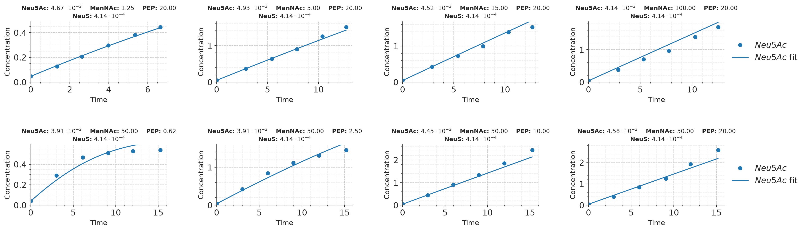
The reference fit, and an open question
Reference result
Parameter | Posterior mean ± sd
k_{cat} | 364 ± 6 min⁻¹ (6.1 s⁻¹, 9.4 U/mg)
K_{M}^{ManNAc} | 1.53 ± 0.19 mM
K_{M}^{PEP} | 0.59 ± 0.07 mM
One shared k_{cat} over-predicts the ManNAc series and under-predicts the PEP series
The two series were measured on different days and differ by roughly 25 % in activity
What would you do next?
Notes:
11:25 · 25 min. First collect everybody's kcat, Km_ManNAc, Km_PEP: how much do they differ and why (windows, priors, reactions used)? Then the misfit: one shared kcat over-predicts the ManNAc series and under-predicts the PEP series; the series were measured on different days and differ by roughly 25 % in activity. Ask: a per-day activity factor, a new experiment, both? Which decisions did the assistant try to make for you, and which did you take back?

Slide 16
What to take home
Wrap-up
A one-page card is enough for an assistant to drive our tools
The decisions and the checks stay with the scientist
The cards are reusable as SKILL.md or AGENTS.md in coding agents
What did not work for you today is the most useful feedback for us
Notes:
11:50 · 10 min. Take-home and feedback round. Ask explicitly what did not work: that is what we need to improve the cards. The cards are reusable as SKILL.md / AGENTS.md for coding agents.

Slide 17
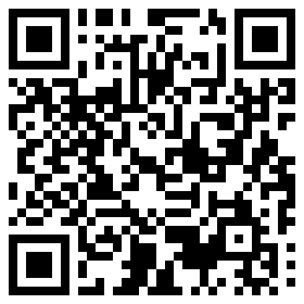
Thank you
tinyurl.com/enzymeml2026
  Max Häußler · University of Freiburg
Notes:
11:58 · Close. The repository stays up: tinyurl.com/enzymeml2026, or the QR code. Questions in the break or by mail.

