Slide 1

CS 261
Program Development 3
dev3

Slide 2

Agenda
Manipulating Bits
Managing Storage

Slide 3

Manipulating Bits
Bit twiddling!
101

Slide 4
Data Representations
Integer
32 bits (also 16, 64)
signed, unsigned
2's complement
0 ... 101
32 bit range:  _____
Float
32 bits (also 64)
IEEE 764
Inf, NaN
sign
exponent
fraction
32 bit range:  1.4*10⁻⁴⁵ to  3.4*10⁺³⁸
64 bit:  4.9*10⁻³²⁴ to  1.8*10⁺³⁰⁸
Chars
8 bits (Unicode = 16)
signed, unsigned
00100101
'E'
BCD
nibbles
uncommon
0001
0101
0111
157
Address
32 bits (also 64)
various (flat, segmented, ...)
aligned, unaligned
flat = 0, 1, ..., 0xFFFFFF

Slide 5
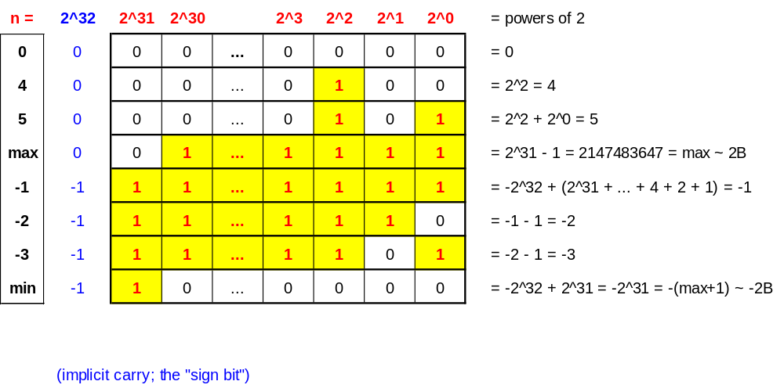
2's Complement Used for Signed Integers
Binary with implicit carry:
how about unsigned integers?

Slide 6
What Can You Assume for Portability?
Signed Integers:
  representation is almost certainly binary 2's complement
  lengths probably: short = 16, int = 32, long = 32 or 64
  bytes may be in any order if treated as a char array!
    use networking routines to put into known order
Unsigned Integers:
  representation is always unsigned binary
  length and byte issues same as for signed int's
  when signed & unsigned mixed, things become unsigned!
    put in explicit casts
Chars:
  representation is almost certainly 8 bits using ASCII values
  char might be signed or unsigned!
    use unsigned if need 0 .. 255
    use int if –1 can be a value
    is our getline OK? (see next slide ...)
short int t;
int i;
long int g;
unsigned short int ut;
unsigned int ui;
unsigned long int ug;
which int's are optional? (here and above)
(unsigned) (-1)
what is value?
char a;
unsigned char b;
signed char c;

Slide 7
Example: Getline
Is this code portable? If not, how fix?
#include <stdio.h>
int getline(char s[]) {
  char c;
  int i = 0;
  while (c = getchar(), (c != EOF) && (c != '\n')) {
    s[i] = c;
    ++i;
  }
  if ((c == EOF) && (i == 0)) {
    return 0;
  } else {
    s[i] = '\0';
    return 1;
  }
}

Slide 8
Bit Operations
Basic operations:
  not ~ x result: opposite bit
  and x & y result: 1 if both bits 1, else 0
  (inclusive) or x | y result: _________________
  exclusive or x ^ y result: _________________
  shift left x << i result: add 0 bits on right
  shift right x >> i result: _________________
Examples:
  assume:
results:
int x, y, z;
unsigned int a, b;
x = 10; y = 3; z = -2;
a = 10;
b = (unsigned) (–2);
x & y == ____
x & z == ____
x | y == ____
x | z == ____
x ^ y == ____
x ^ z == ____
x << 2 == ___
z << 2 == ___
x >> 2 == ___
z >> 2 == ___
a >> 2 == ___
b >> 2 == ___
puzzles:
set x to max integer
set y to min integer
true or false?
what is z set to?
x = ___
y = ___
a > -1
z = 012;
regardless of int size!

Slide 9
Example: Count Bits
Write a function to count how many 1 bits are in an unsigned integer
Examples:
Plan:
Variables:
Logic:
/*
Return number 1 bits in x
*/
int numberOneBits(unsigned int x) {
}

Slide 10
Conditional Operations
Basic rule:
  always return 1 or 0
  always short circuit
Operations:
  not ! x
  and x && y
  or x || y
  if-then-else x ? y : z
Precedence:
  highest to lowest: && ... || ... == etc
Examples:
  assume:
when should you use parentheses?
results:
int x, y;
int i;
int a[] = {0, 0, 0, 64};
x = 10; y = 3;
i = 4;
x & (y > 6) == ___
x && (y > 6) == ___
(i < 4) && (a[i] < 100) == ___

Slide 11
Constant Expressions
Define constants to make your code clear:
Compilers are helpful regarding constants:
Use #define to abbreviate a simple expression:
#define N 1024
enum {JAN = 1, FEB, MAR, APR, MAY, JUN, JUL, AUG, SEP, OCT, NOV, DEC} ;
enum {BLANK = ' ', TAB = '\t', VTAB = '\v', NEWLINE = '\n'} ;
enum Color {RED, GREEN, BLUE}; /* "Color" now abbreviation for "int" */
int a[N];
int m = FEB;
int x = getchar(); if (x == BLANK || x == NEWLINE) ...
Color c;
int b[N+1];
static int day[] = {0, 31, 28, 31, 30, 31, 30, 31, 31, 31, 30, 31};
int nbytes = sizeof(int); /* number of bytes in an integer on this machine*/
int *p = &b[N]; /* == &(*(b+N)) == b + N */
why so many ()'s ?
#define isalpha(c) (('A' <= (c) && (c) <= 'Z') || ('a' <= (c) && (c) <= 'z'))
char a = getchar(); if (isalpha(a)) ...

Slide 12
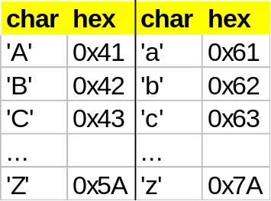
Using Bits
Speed computation: transform input bits into output bits
  e.g.: set x to lower case of c
  w/o using locase (x) ...
Use sets: assign states to bit positions
  e.g.: a Person is male or female, is alive or dead, and is a royal or commoner
Save space: combine small
values into a single integer
  e.g.: define macros to store
  a RGB color as three 8 bit
  unsigned numbers inside
  a single unsigned integer
#include <ctype.h>
x = ________________________
#define MALE 1
#define ALIVE 2
#define ROYAL 4
typedef struct _person {
...
int state;
} Person;
Person *p = personNew (...);
p->state = (MALE | ALIVE);
if (p->state & ALIVE) ...
p->state = p->state & ~ALIVE;
p->state &= ~ALIVE;
typedef unsigned int Color
#define colorNew(r,b,g) __________________
#define Red(c) __________________
#define Blue(c) __________________
#define Green(c) __________________
Color yellow = colorNew (255, 255, 0);
printf("%d", Blue(yellow));

Slide 13

Managing Storage
Storage architecture
Allocating and freeing storage

Slide 14
Usual Memory Layout for a Program
linear array of bytes
address
space layout:
000 ...
... fff
code
data
heap 
avail
✶ stack
shell stuff
environment
variables
static data: initialized and un-initialized
Memory is a linear array of bytes
Stack changes with call/return
Heap changes with malloc/free
key addresses
  current instruction counter (IC)
  stack pointer (SP)
  frame pointer (FP)
  heap bottom, stack bottom, etc.
register values
scheduling priority
current working directory
process id's (me & parent)
user & group id's
file descriptors
  0: ...
  1: ...
  2: ...
other state:

Slide 15
Using the Stack
The stack organizes the function calls:
Notes:
  local data goes *poof* when a function returns
  functions can be recursive
bottom
void main() {
printf ("%d\n", A(5));
}
int A(int x) {
int y = 1;
return (y + B(2*x));
}
int B(int z) {
return (3*z);
}
...
A's frame:
  x
  y
  ...
~~~
~~~
5
1
B's frame:
  old FP
  return
  z
  ...
~~~
~~~
FP
10
IC
top
SP

Slide 16
Using the Heap
Sometimes you need to put data on the heap:
  data needs to persist after function returns
  size of data not known until execution time
Use "malloc" and "calloc" to get an area from the heap:
Use "free" to return the area:
  not returned until you do this
#include <stdlib.h>
typedef struct _point {
int x, y;
} Point;
Point *p;
p = (Point *) malloc(sizeof (Point));
p->x = 0;
can malloc fail?
what happens?
why the cast?
Should be "Point *" ?
int i, n = ...;
int b[] = (int *) calloc(n, sizeof (int));
for (i = 0; i < n; ++i) b[i] = ...;
free(p);

Slide 17
Some Pointer Techniques
Adding 1 means "next storage unit"
The type "void *" means "pointer to anything"
The macro "NULL" is defined in <stdio.h> and <stdlib.h>
int i, n = ...;
char a[] = (char *) malloc(n);
int b[] = (int *) calloc(n, sizeof (int));
a
a+1
a+2
b
b+1
b+2
extern void poke(void *q, unsigned char byte);
#include <stdio.h>

Slide 18
Pointers to Constant Storage
You will see heavy use of "const" in the C library routine interfaces
This attribute tells you if an area of memory will be changed by the routine
Example: the "strcmp" routine doesn't change any memory:
However, the "strcpy" routine overwrites memory:
extern int strcmp(const char* string1, const char * string2);
extern char* strcpy(char* string1, const char * string2);
Is using const a good programming practice?

