Slide 1

CS 360
Files & Directories 1
dir1

Slide 2




Course Topics
C
Program development review
Files & Directories
Tool Building
Processes
Networking
OS Implementation

Slide 3

Reading For Lectures I/O ... Dir2
Subject: The file system
In Unix Programming Environment:
Chapter 2, The File System
  2.1 The basics
  2.2 What's a file
  2.3 Directories
  2.3 Permissions
  2.5 Inodes
  2.6 The hierarchy
  2.7 Devices
Chapter 7, Unix System Calls
  7.1 Low-level I/O
  7.2 Directories
  7.3 Inodes
In Unix Systems Programming:
Chapter 2, The File
  2.1 Access primitives
  2.4 Errno
Chapter 3, The File in Context
  3.1 Multi-user environment
  3.2 Multiple names
  3.3 Obtaining information
Chapter 4, Directories
  4.2 User view
  4.3 Implementation

Slide 4

Agenda
This week we learn the details of Unix directories.
Directory concepts
String tricks
Directory operations
Lab assignment
Wrap-up

Slide 5


The File System is a Tree
you are here
Navigate with "change directory" command:
% cd a/b/c
% cd ..
% cd .
See file attributes with "list" command, long form:
% pwd
/home/roger/two
% ls -l
-rw-r--r-- 1 roger cs360 2 Sep 17 11:10 x
-rw-r--r-- 1 roger cs360 3 Sep 17 11:10 y
-rw-r--r-- 1 roger cs360 4 Sep 17 11:10 z
drwxr-xr-x 2 roger cs360 8192 Sep 17 11:10 three/
ownership
size & creation date
name
permissions & other information

Slide 6
Manipulate with Basic Shell Commands
Copy a file:
  cp old-file new-file → copy "old-file" contents and make a new file
Move a file:
  mv old-file new-file → change name of "old-file" into "new-file"
Link a file:
  ln old-file new-file → create duplicate name for "old-file"
Remove a file:
  rm old-file → delete "old-file"
Make a directory:
  mkdir xyz → create "xyz" as directory
Remove a directory:
  rmdir xyz → delete "xyz", if it is empty
what are error conditions for each command?

Slide 7





Directory Design Issues
How files are organized is a key operating system design decision
  how big can files get?
  how fast will access be? optimize average, min, or max?
  how will files be shared? how secure are they?
  how resilient will the design be to disk errors? user mistakes? virus attacks?
  how long can filenames get?
  are binary files different from text files?
  are the needs of database apps met? web apps? media-centric apps?
  is the clip board part of the file system? MIME types? versions?
  can programmers create new types of files?
  will local and distant files be different?
  how is the file system administered on 1 machine? a group? a company?
...
Unix

Slide 8



File Structure
"logical" viewpoint
Regular files appear as a contiguous array of bytes to programmer:
bytes:
offset:
Now is a good
time to code.
/abc/foo
"physical" viewpoint
However, these files are implemented as blocks scattered around the disk:
block 1001:
block 2999:
2999
1513
a common size
is 512 bytes/block
block 1513:
0
Design Advantages:
Design Disadvantages:

Slide 9

Disk Structure: Physically
The disk is organized hierarchically:
1 disk drive:
partition
partition
...
1 "file system":
boot & super blocks
ilist
data blocks
(a Unix file system)
"information nodes":
inode
inode
...
inode
1 file:
status
block[0] address
block[1] address
...
block[n] address
Key points:
  the disk is arranged into blocks (some for data, some for management)
  one inode for each file (more precisely: a file is an inode + the data blocks)
  the physical layout is not consecutive

Slide 10
Disk Structure: Abstractly
inode 1
inode 3000
data
blocks
data
blocks
inode 2
inode 3001
data
blocks
data
blocks
....
inode 273
inode 4752
data
blocks
inode 390642
data
blocks
data
blocks
super block
free space
Key points:
  the programmer gets to data only via an inode
  to programmer, the data is a simple (expandable) array of bytes
  physical and housekeeping details are invisible to programmer

Slide 11

Directory Structure
A directory is just a table of inodes paired with filenames:
{
inode number
filename
1 directory:
inode number
filename
...
inode number
filename
For example:
/home/roger/one contents:
% pwd
/home/roger/one
% ls -i
3496 andy
3100 bob
3077 charles
3496
andy
3100
bob
3077
charles
("ls -i" lists inodes)

Slide 12
How Does a Move Operation Work?
Before picture:
/home/roger/one contents:
/home/roger/two contents:
3496
andy
3476
xena
3100
bob
3075
yolanda
3077
charles
3074
zapata
Move command:
Design consequences:
  move speed is independent of file size
  easy to implement as atomic operation
% pwd
/home/roger
% mv one/charles two/carla
After picture:
/home/roger/one contents:
/home/roger/two contents:
3496
andy
3476
xena
3100
bob
3075
yolanda
3074
zapata
3077
carla

Slide 13
How Does a Link Operation Work?
Before picture:
/home/roger/one contents:
/home/roger/two contents:
3496
andy
3476
xena
3100
bob
3075
yolanda
3074
zapata
3077
carla
Link command:
% pwd
/home/roger
% ln two/xena one/david
Design consequences:
  files can be shared, appearing with several multiple names and in multiple directories
After picture:
/home/roger/one contents:
/home/roger/two contents:
3496
andy
3476
xena
3100
bob
3075
yolanda
3476
david
3074
zapata
3077
carla

Slide 14
How Does a Remove Operation Work?
Before picture:
/home/roger/one contents:
/home/roger/two contents:
3496
andy
3476
xena
3100
bob
3075
yolanda
3476
david
3074
zapata
3077
carla
Remove command:
% pwd
/home/roger
% rm one/david
Design consequences:
  remove time independent of file size
  easy to implement as atomic operation
  recycle bin would be easy to implement
After picture:
/home/roger/one contents:
/home/roger/two contents:
3496
andy
3476
xena
3100
bob
3075
yolanda
3074
zapata
3077
carla

Slide 15
When Is Space Actually Freed?
Before picture:
/home/roger/one contents:
/home/roger/two contents:
inode 3476
3496
andy
3476
xena
data
blocks
3100
bob
3075
yolanda
3476
david
3074
zapata
3077
carla
link count: 2
Remove command:
% pwd
/home/roger
% rm one/david
Each inode has a link count:
  = number of directories that mention this inode
After picture:
/home/roger/one contents:
/home/roger/two contents:
inode 3476
3496
andy
3476
xena
data
blocks
3100
bob
3075
yolanda
3074
zapata
space is not reclaimed!
3077
carla
link count: 1

Slide 16
When Is Space Actually Freed?
Before picture:
/home/roger/one contents:
/home/roger/two contents:
inode 3476
3496
andy
3476
xena
data
blocks
3100
bob
3075
yolanda
3074
zapata
3077
carla
link count: 1
Remove command:
% pwd
/home/roger
% rm two/xena
Each inode has a link count:
  space reclaimed only when
  link count becomes 0
After picture:
/home/roger/one contents:
/home/roger/two contents:
inode 3476
3496
andy
* poof *
3100
bob
3075
yolanda
3074
zapata
space is now reclaimed!
3077
carla
link count: 0

Slide 17

... The Complete Story on Freeing Space
The inode & the data blocks are reclaimed only when both:
  the link count becomes 0
  the number of opens becomes 0
Notes:
  each "open" increases this count
  each "close" decreases
  at process termination, the kernel automatically closes if you forgot to do so
% ls -l somefile
-rwxr-x--- 1 roger cs360 123 Feb 15 somefile
access modes
(u g o)
link
count
user
group
size
time last mod
name
Review: how do the following operations change link counts?
  mv abc xyz --
  ln abc uvw --
  rm abc --
Design consequences:
  while a process has a file open, it is still safe to do all the basic operations
  no special cases for "sharing violations" etc.
  all operations are atomic (more on this when discuss processes)

Slide 18
Each Basic Operation Has a Program & Routine
Shell command:
C code:
% mv old new
rename ("old", "new");
% ln old new
link ("old", "new");
% rm old
unlink ("old");
% cp old new
... use read/write ...
% cd place
chdir ("place");
% mkdir new
mkdir ("new", 0777);
% rmdir old
rmdir ("old");
% rm -r old
remove ("old");
Each routine returns error codes
  0 if OK; -1 on error
Don't forget header files:
  <unistd.h> link, unlink, chdir, mkdir, rmdir
  <stdio.h> rename, remove

Slide 19
Think: What Is The Logic Behind This Code?
... program initialization ...
fd = open ("/home/roger/foo", O_RDWR|O_CREAT|O_TRUNC, 0644);
unlink ("/home/roger/foo");
... read and write using fd ...
close (fd);
exit (0);
Discussion:

Slide 20
Directory Structure, Once More
We have seen that a directory is just a table of inodes paired with names:
{
inode number
filename
...
1 directory:
inode number
filename
/home/roger/one contents:
And, even "." + ".." are listed!
4067
.
1514
..
% pwd
/home/roger/one
% ls -ia
4067 ./
1514 ../
3496 andy
3100 bob
3077 charles
3496
andy
3100
bob
3077
charles
Design consequence:
  "." and ".." in pathnames are not special cases
("ls -a" means "list all")

Slide 21

Summary of Inode Consequences ...
Directories reference files only through inode numbers
  ∴ moving files between directories is very fast
  and, the operation is atomic (as are link and remove)
Two directories can include the same inode number
  ∴ a file can be shared, appearing in several places with same or different name
  also, no special cases for "shortcuts" etc.
Space is freed only when inode link & open counts are both 0
  ∴ removing a file may not create free space
  ∴ files can't disappear while a process is working on them
  also, no special cases for "sharing violation" etc.
An inode number is unique only within a file system
  ∴ files can't span partitions or disks, or be moved to new disks
  and, files can't be bigger than a single physical disk
Files don't have "type" (beyond regular vs. directory)
  ∴ no optimizations for databases, no self-identifying objects, no new types
  but, easy to code general programs such as "cp", "mv"
Plus, as we will see, file security information is in the inode
  ∴ data is protected even when files are shared (details later)

Slide 22

File Sizes
Efficiently handling files of different types
is a key OS design decision:
  what is biggest allowed?
  what is range of sizes to be optimized?
  what space does an empty file consume?

Slide 23

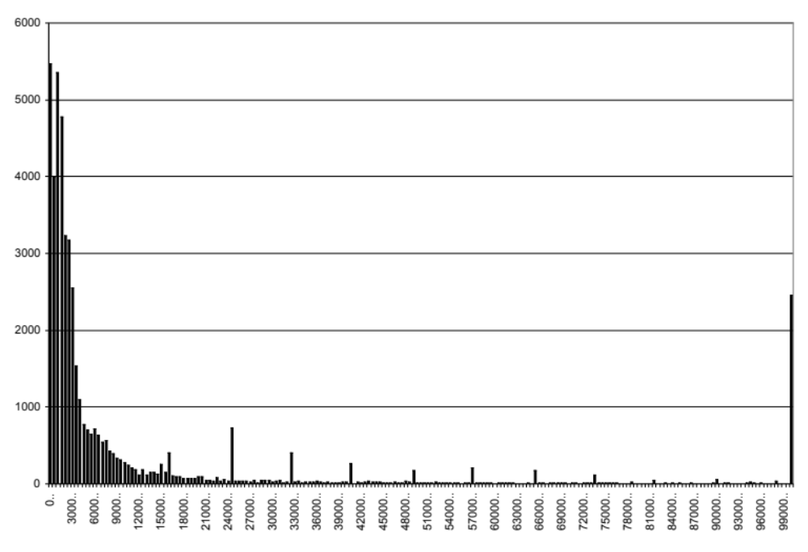
Distribution of File Sizes
On Feb 8 1999, for all files on "neon":
  number of files: 47,398
  biggest size: 76,095,488
  average size: 60,072
biggest 15:
25608192
25698304
25788416
26689536
27566080
34349056
34652160
35225600
35657217
35657217
35657217
36265984
43335680
43524096
76095488
over 100K

Slide 24

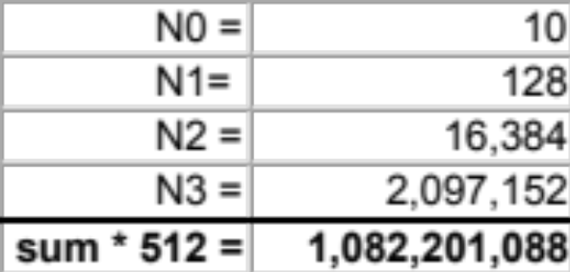
Maximum File Size
How big are the units?
  An inode holds 13 pointers (aka slots) to data blocks
  A common data block size is 512 bytes
  A data block pointer is often 4 bytes in size
How big can a Unix file be?
  But, 13 * 512 = 6656 is a very small maximum file size!
  So, an indirect approach is used
    a data block can hold up to 512/4 = 128 pointers to other blocks
  This is how the inode slots are often used:
    10 L0 slots: 10 pointers to data blocks N0 = 10 blocks
    1 L1 slot: 1 pointer to a block of pointers N1 = 128 blocks
    1 L2 slot: 1 pointer to a block of L1 slots N2 = 128 * N1 = 16,384 blocks
    1 L3 slot: 1 pointer to a block of L2 slots N3 = 128 * N2 = 2,097,1522 blocks
... L0 ... L1 L2 L3
this is typical,
some systems
allow much
bigger files
...
...
...
...
...
...

Slide 25

Performance Consequences
Disk usage:
  most files are small
  every file with non-zero size consumes at least 1 data block = 512 bytes
  bigger data blocks would allow bigger max file size, but more wasted space
  some implementations collapse a small file into the inode (no data blocks at all)
Disk layout:
  blocks for a file can be scattered, so disk head has to move between reads/writes
  some implementations can cluster blocks together ("defragment")
Disk caching:
  to speed operation, data is moved between memory & disk in whole blocks
  a memory copy may not be written for sometime ("caching" & "scheduling"); ditto for reads
Disk robustness:
  the Unix file management scheme seems fragile with single points of failure:
    data block corrupted: lose part of a file
    inode corrupted: lose whole file or whole directory
    ilist or superblock corrupted: lose whole partition
  to reduce risk, most Unix implementations provide some redundancy:
    superblock has internal check codes and is replicated several places on disk
    an allocation bit map replicates much of inode links
File system data structures continue to be a key OS design issue

Slide 26


Summary
A file system is a key OS design decision providing users
with specific advantages and disadvantages
The Unix design is notable for it's simplicity:
  No distinction between binary and text files
  Files are implemented using fixed size blocks
  Protects files very simply (more next week ...)
The Unix design decisions make some operations very fast and convenient, but several emerging issues are perhaps not well addressed
  clipboard, MIME, database support
  media-centric apps
Navigating nested directory structures needs recursive logic
File system design continues to be a key research topic
  no best approach!
One inode for each file (the inode DEFINES the file)
File name and directory are NOT in inode
File ownership and access permissions are in inode
Key Unix design decisions

