Slide 1

MOHAN BABU UNIVERSITY
Sree Sainath Nagar, Tirupati – 517102
DEPARTMENT OF COMPUTER APPLICATIONS
Community Detection In Online Social Media Using Social Networking Analysis
ROLL NO : 23102C010114 ( K. Reddy Theja )
23102C010137 ( D. Manisha )
23102C010173 ( P. S.G. Hafeefa )
23102C010191 ( B. Bhavya Sree )
PROJECT SUPERVISOR : Dr. Aaquib Hussain Ganai
BRANCH : Bachelor Of Computer Applications
SECTION : 3 , 4 BATCH NUMBER : 43

Slide 2
ABSTRACT
Group of users that are intra densely connected with each other are termed as the community over an online social network. People over an online social network group together in these communities and most of the time they share similar interests. In this project we are going to detect these communities over these online social networks using the techniques of Social Network Analysis (SNA) such as Clique Percolation Method, Random Walks and Louvain Methods. The proposed approach will be tested on real social network datasets, and the experimentation will be done in python. The empirical venture will show the best results and can have best implications in real world situations.
Keywords : Online Social Networks, Social Graphs, Community Detection, Influential user , Social Network Analysis , Clique Percolation Method, Random Walks and Louvain Methods.

Slide 3
Contents
Abstract
Introduction
Review of Literature
Proposed System
Execution
Result
conclusion
References

Slide 4
Introduction
Online Social Networks (OSNs) like Twitter, Facebook, and Instagram generate massive user interaction data.
Users are connected through follows, likes, comments, and shares, forming complex networks.
A key feature of these networks is communities — groups of users closely connected with similar interests or behaviors.
Community detection helps understand information flow, user influence, and group behavior.
Recommendation systems
Targeted advertising
Viral marketing
Detecting harmful activities (e.g., hate speech)
OSNs spread information faster than traditional media, making community detection highly important.

Slide 5
Review of Literature
SNO | YEAR | AUTHOR | TITLE | OUTCOME
1. | 2002 | Michelle Girvan | Community structure in social and biological networks | Proposed the Girvan–Newman algorithm using edge betweenness to detect communities in complex networks.
2. | 2002 | M. E. J. Newman | Community structure in social and biological networks | Introduced modularity concept foundation and improved community detection using graph theory.
3. | 2006 | M. E. J. Newman | Modularity and community structure in networks | Developed the modularity optimization method, which became a standard metric for evaluating community structure.
4. | 2008 | Vincent D. Blondel | Fast unfolding of communities in large networks | Proposed the Louvain Method, a fast and efficient algorithm for large-scale network community detection.

Slide 6
SNO | YEAR | AUTHORS | TITLE | OUTCOMES
5. | 2008 | Jean-Loup Guillaume | Fast unfolding of communities in large networks | Contributed to scalable modularity-based clustering for large social networks.
6. | 2008 | Renaud Lambiotte | Fast unfolding of communities in large networks | Enhanced hierarchical community detection for complex graphs.
7. | 2010 | Jure Leskovec | Empirical comparison of algorithms for network community detection | Compared multiple algorithms and analyzed their performance on real-world datasets.
8. | 2024 | Mohammad Nooribakhsh | Community detection in social networks using | Reviewed ML-based community detection techniques and highlighted deep learning advancements in social networks.

Slide 7
Proposed System
Proposed System
Detects communities in social networks using Social Network Analysis (SNA)
Process includes: Data Collection → Preprocessing → Algorithms → Evaluation
1. Data Collection
Data from SNAP repository (Facebook, Twitter, etc.)
Nodes = Users, Edges = Connections
Imported into Python (edge-list format)
2. Data Preprocessing
Convert data into graph (NetworkX)
Remove duplicates & self-loops
Clean missing/irrelevant data
Remove isolated nodes
Represent as adjacency list/matrix

Slide 8
3. Community Detection Methods
Clique Percolation (CPM): Detects overlapping communities using k-cliques (fully connected groups)
Random Walk Method: Based on idea that nodes in same community have higher transition probability
Louvain Method: Optimizes modularity score to find best community structure
Helps identify hidden patterns and group behavior in networks
4. Implementation
Developed using Python libraries: NetworkX, Louvain, NumPy, Matplotlib
Algorithms applied on same dataset for fair comparison
Results visualized using graph plots
Performance evaluated using modularity and accuracy

Slide 9
Execution
System Execution
Convert data into graph (nodes = users, edges = connections)
Clean data (remove duplicates, self-loops, isolated nodes)
Apply algorithms:
Clique Percolation → overlapping groups
Random Walk → dense regions
Louvain → best community structure
Visualize results:
Nodes grouped into colored clusters
Outcome: Easy understanding of community patterns

Slide 10
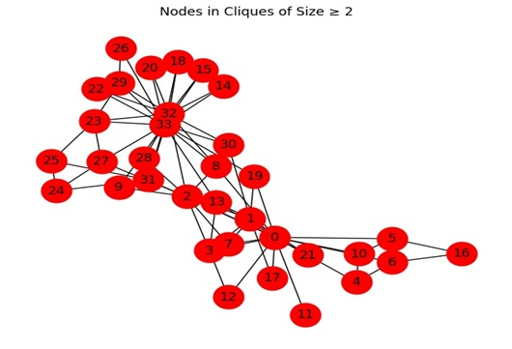
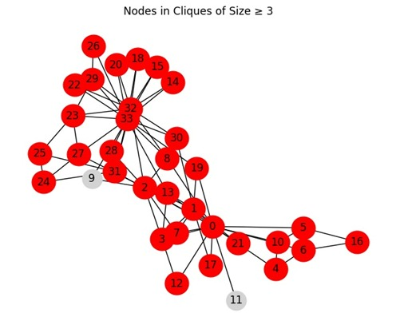
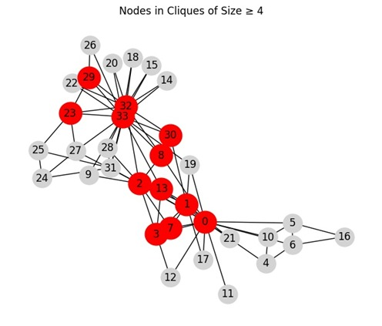
Results

Slide 11
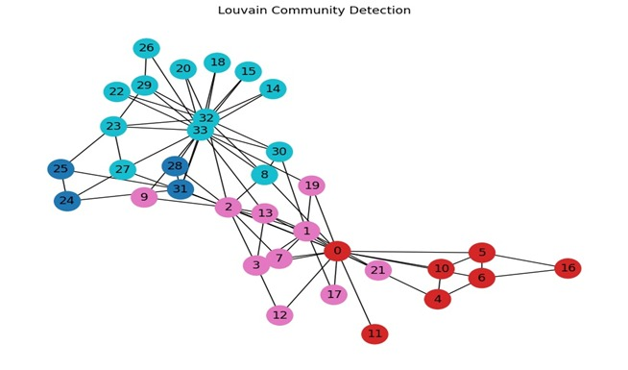
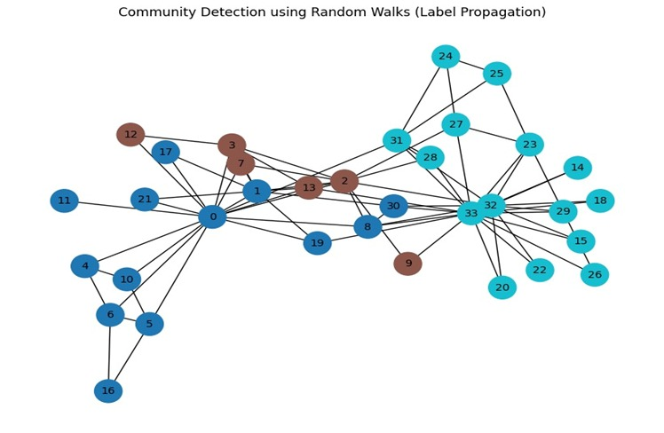
Results

Slide 12
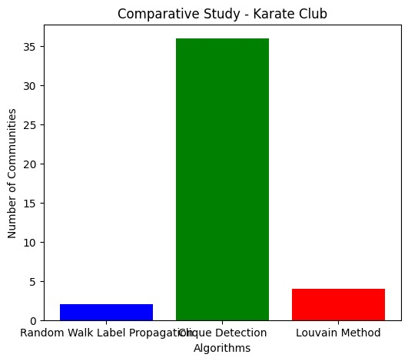
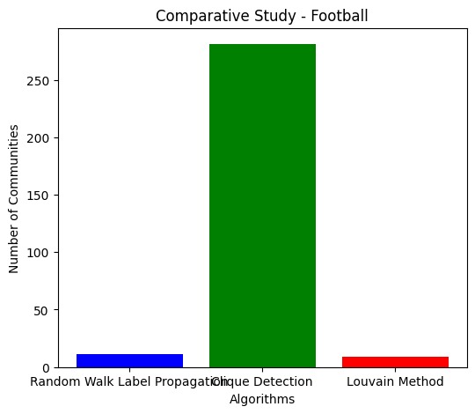
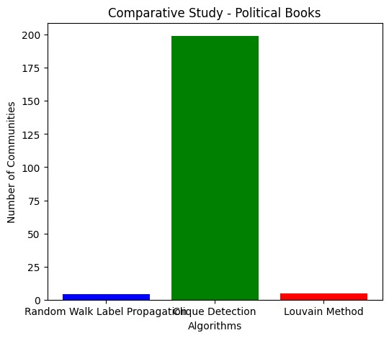
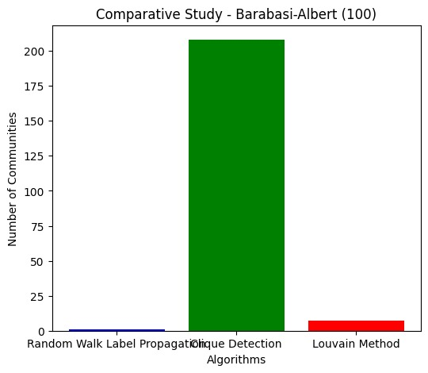
Results

Slide 13
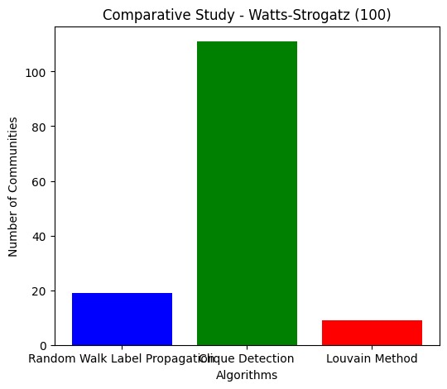
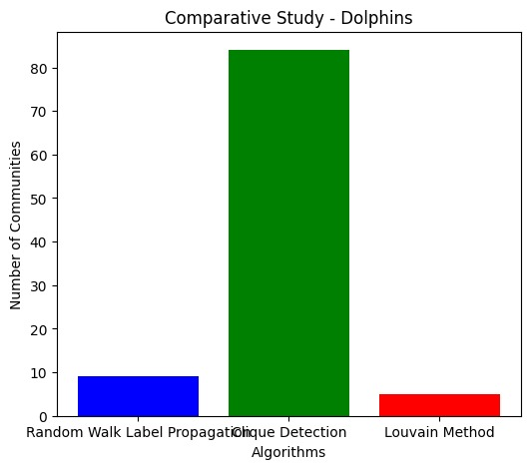
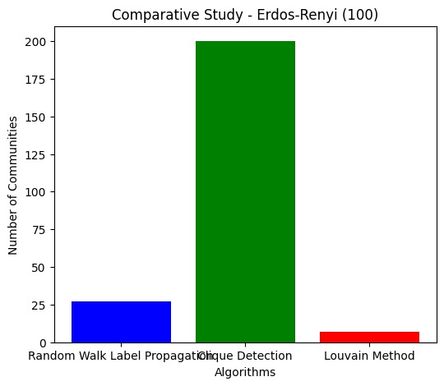
Results

Slide 14
Results
The datasets are uploaded and the code is executed in the Google Colab environment. Using 7 datasets and 3 different community detection methods, graph outputs are generated for each dataset.
Louvain Method
Clique Percolation Method
Random Walk Method
are used to generate the community detection results and graph outputs.
It reveals hidden patterns in user behavior
Detects overlapping groups (a user can belong to multiple communities)
Community detection helps in targeted marketing, content recommendations, spam detection, and understanding user interests in social networks.

Slide 15
Conclusion
The system successfully detects communities in social networks based on user connections.
Visual outputs clearly show grouped users, making hidden patterns easy to understand.
Among all methods, the Louvain algorithm performed best, producing clear , well-structured , detect large network communities and helps to maximizes the Modularity.
Overall, community detection techniques effectively analyze complex networks and provide valuable insights into user behavior and relationships.

Slide 16
References
[1] Michelle Girvan and M. E. J. Newman, “Community structure in social and biological networks,” Proceedings of the National Academy of Sciences, 2002. https://www.pnas.org/content/99/12/7821
[2] M. E. J. Newman, “Modularity and community structure in networks,” Proceedings of the National Academy of Sciences, 2006. https://www.pnas.org/content/103/23/8577
[3] V. D. Blondel, J.-L. Guillaume, R. Lambiotte, and E. Lefebvre, “Fast unfolding of communities in large networks,” Journal of Statistical Mechanics: Theory and Experiment, 2008. https://iopscience.iop.org/article/10.1088/1742-5468/2008/10/P10008
[4] U. N. Raghavan, R. Albert, and S. Kumara, “Near linear time algorithm to detect community structures in large-scale networks,” Physical Review E, 2007. https://journals.aps.org/pre/abstract/10.1103/PhysRevE.76.036106
[5] S. Fortunato, “Community detection in graphs,” Physics Reports, 2010. https://www.sciencedirect.com/science/article/pii/S0370157309002841

Slide 17
[6] J. Leskovec, K. J. Lang, and M. Mahoney, “Empirical comparison of algorithms for network community detection,” WWW Conference, 2010. https://dl.acm.org/doi/10.1145/1772690.1772755
[7] S. Fortunato and D. Hric, “Community detection in networks: A user guide,” Physics Reports, vol. 659, pp. 1–44, 2016. https://doi.org/10.1016/j.physrep.2016.09.002
[8] A. Dhumal and P. Kamde, “Survey on community detection in online social networks,” International Journal of Computer Applications, vol. 121, no. 9, pp. 35–41, 2015. https://www.ijcaonline.org/archives/volume121/number9/21571-4609/

Slide 18

This Photo by Unknown Author is licensed under CC BY-SA

