Slide 1

AUTOSAR

Slide 2
Agenda
PART - 1
AUTOSAR Tools
Vector AUTOSAR Tools
Vector license Client
Vector SIP(Stack files & Module Definition files)
Creating New Project
Workspace Structure
Input Files & Importing Process
Errors after Import
Code Generation
Davinci Configuration Demo
PART – 2
Classic vs. Adaptive

Slide 3






AUTOSAR Tools
Companies | BSW Configurator | RTE Generator | SWC System Tooling
 | DaVinci Configurator Pro | RTE Generator | Davinci Developer
 | Volcano VSTAR | Volcano VSTAR | Volcano VSTAR
 | EB Tresos Studio | EB Tresos Studio | -
 | ISOLAR – B | RTA- RTE | ISOLAR - A
 | Arctic Studio | Arctic Studio | Arctic Studio
 | K-SAR Editor | K-SAR Editor | K-SAR Editor

Slide 4


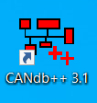
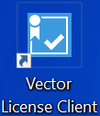
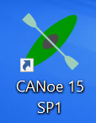
Vector AUTOSAR Tools
Vector Davinci Configurator – To Configure BSW Module (e.g : CAN, CanIf, Com, Os, Dem)
Vector Davinci Developer – To Configure Application & Service software components (SWC’s)
Vector Dbc++ – To Edit and Preview the Communication Database.
Vector License Administrator – To manage the licensing of above tools
Vector Canoe – Testing tool

Slide 5
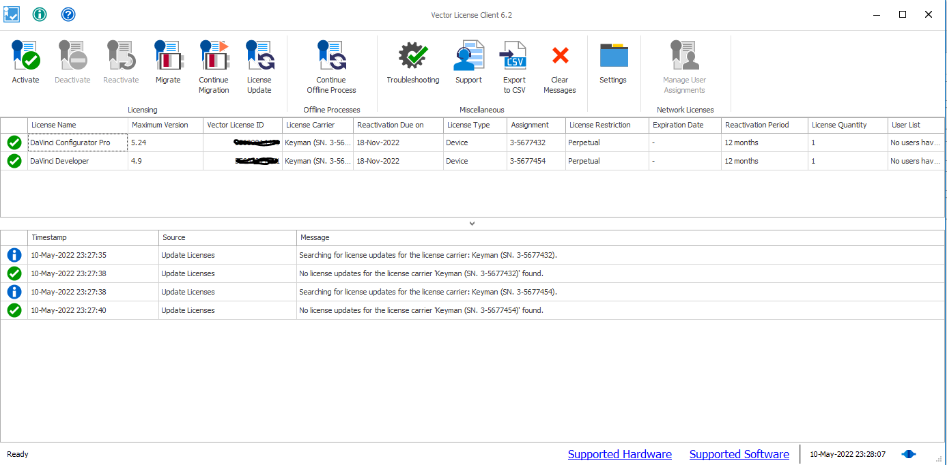
Vector license Client

Slide 6
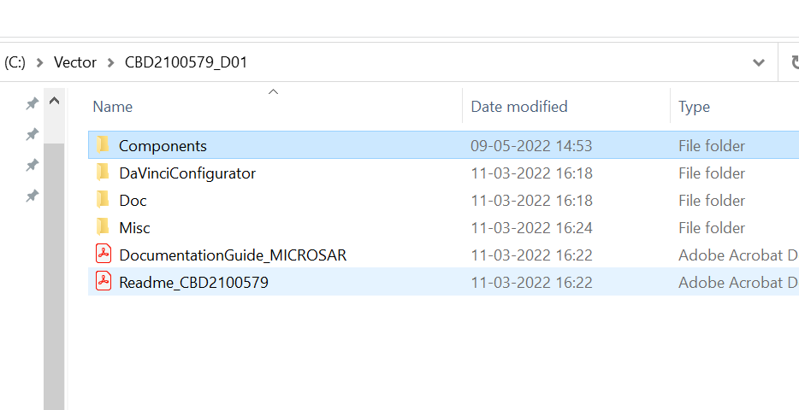
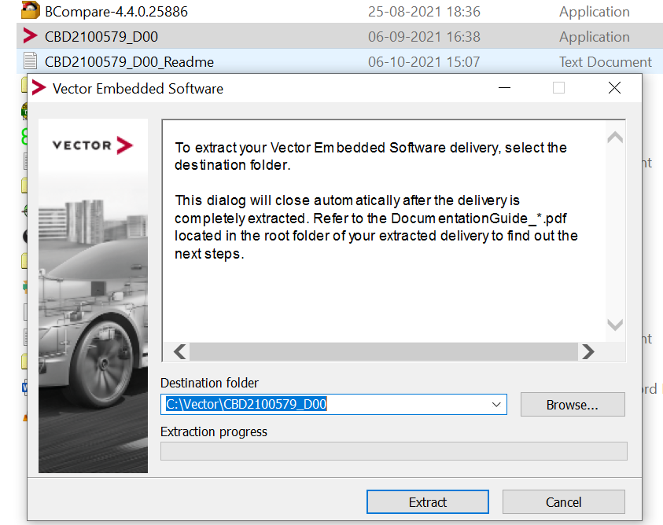
Vector SIP(Stack & Module Definition file)
SIP Extraction:
SIP Folder Structure:
- MICROSAR is the AUTOSAR solution from Vector for ECU software.
MICROSAR consists of the MICROSAR. RTE and MICROSAR basic software modules (BSW), which cover all aspects of the AUTOSAR standard and many extensions.
Each AUTOSAR BSW module is assigned to a MICROSAR package.

Slide 7
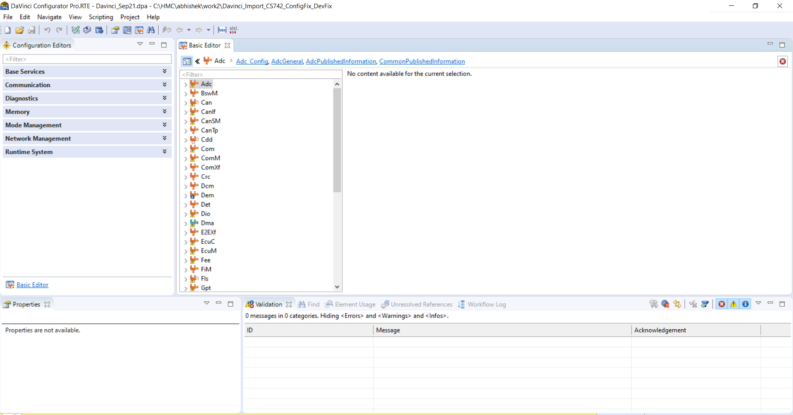
Interface of Davinci Configurator

Slide 8
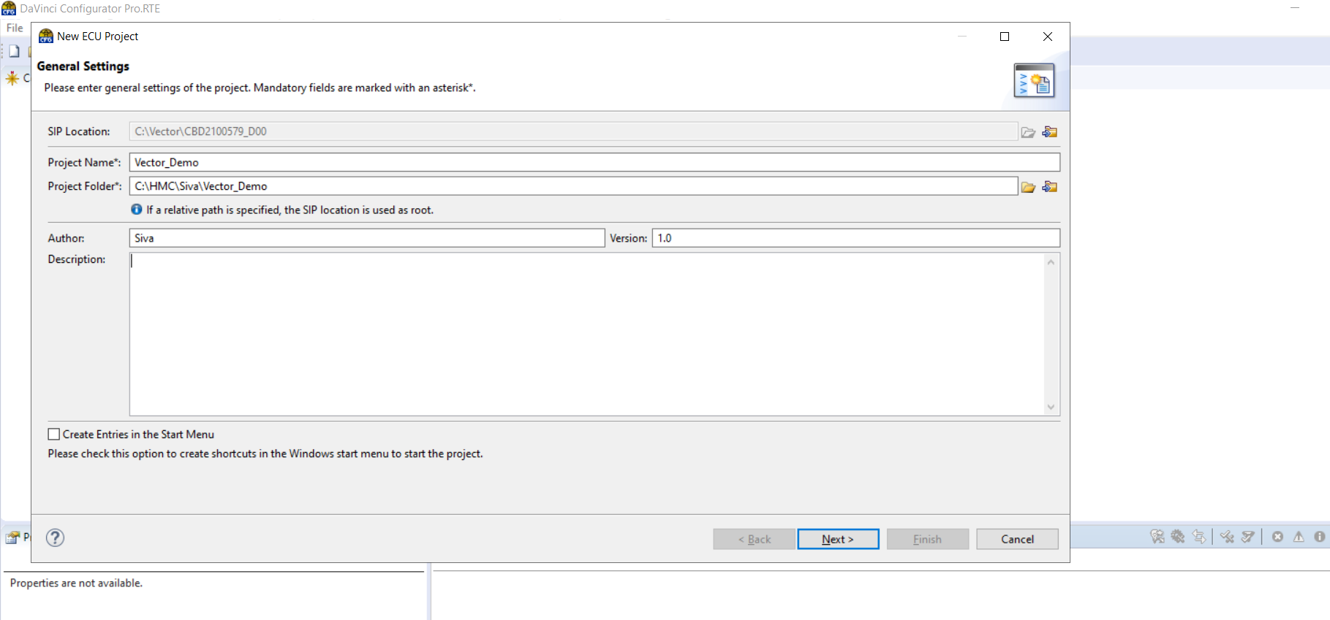
Creating New Project – From Scratch
File -> New ECU Project

Slide 9
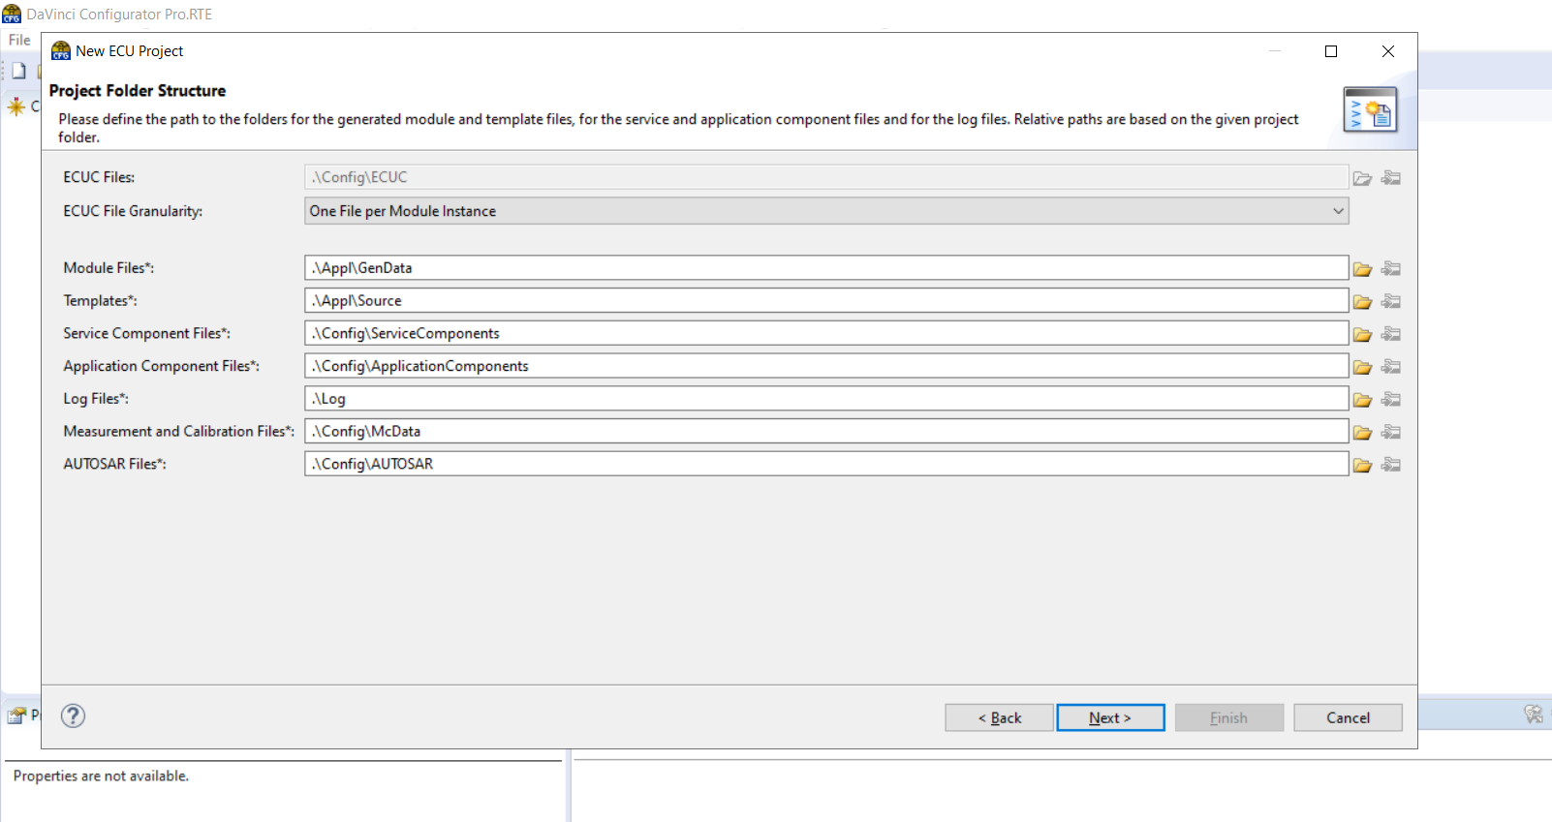
Folder Structure

Slide 10
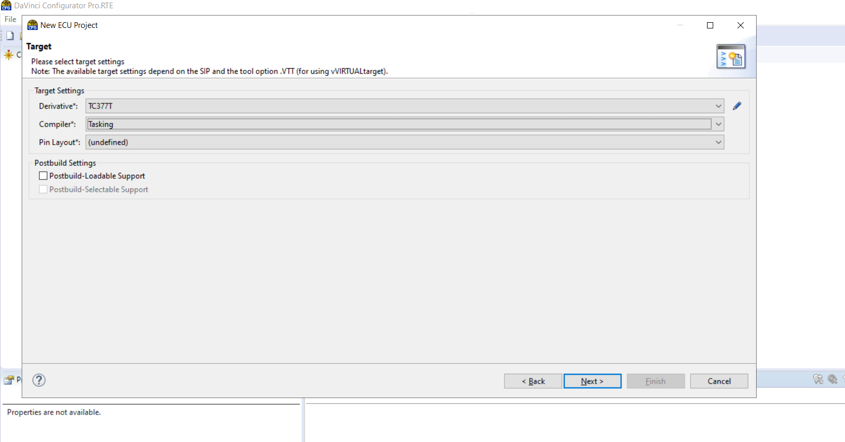
Target Selection

Slide 11
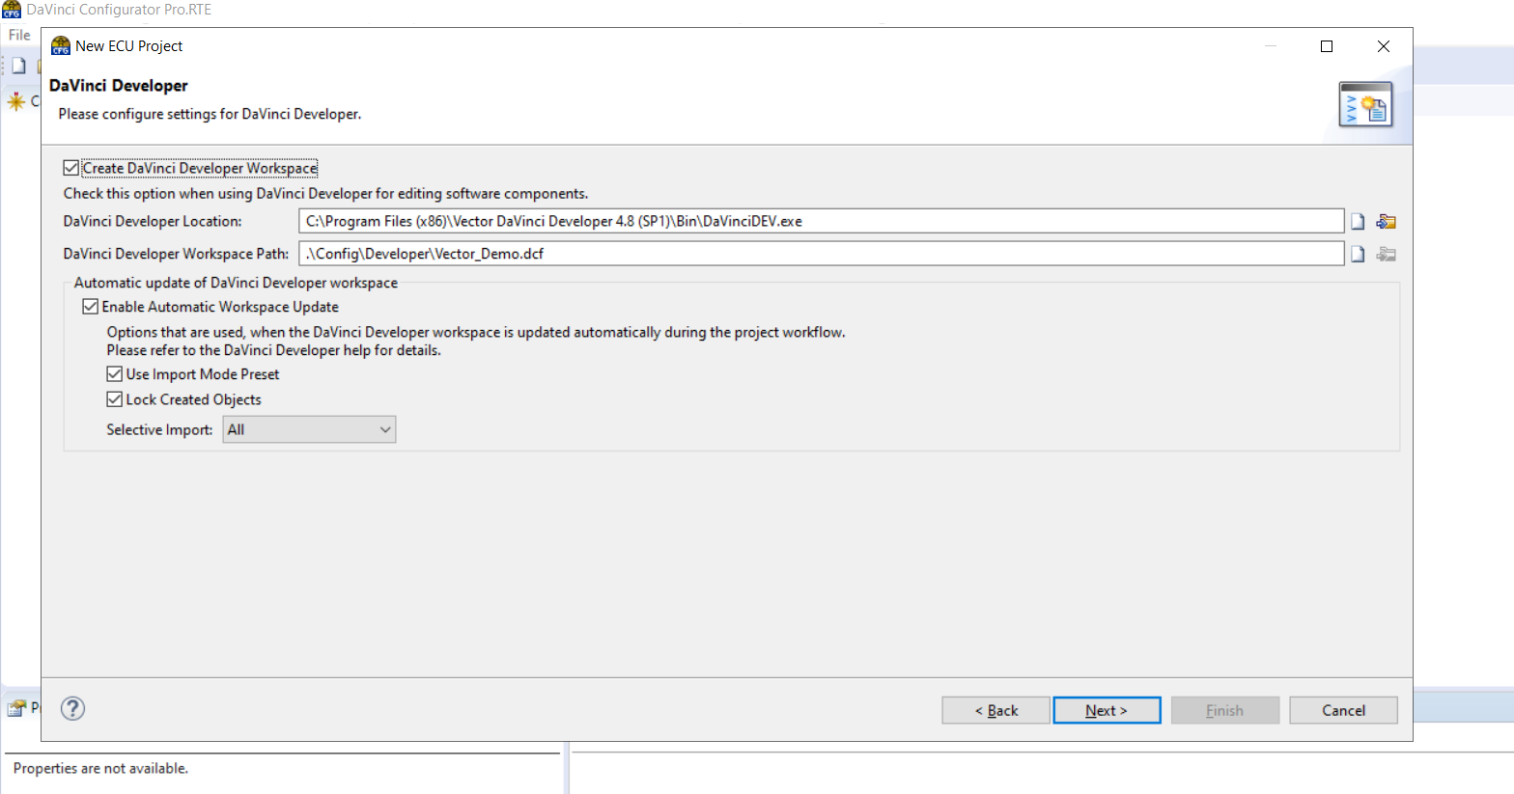
Developer Setting

Slide 12
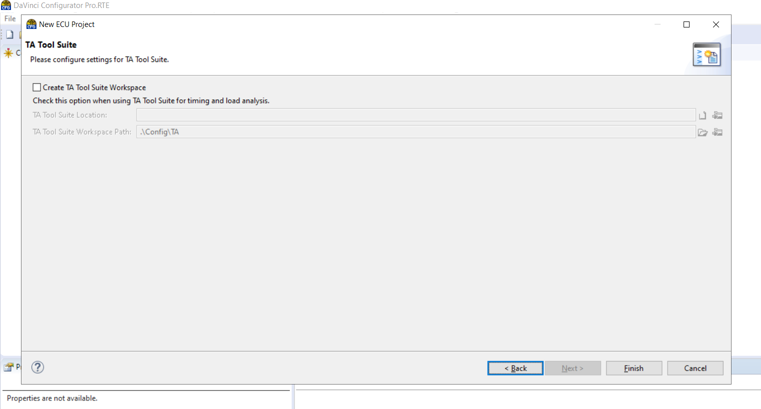
TA Tool Suite

Slide 13
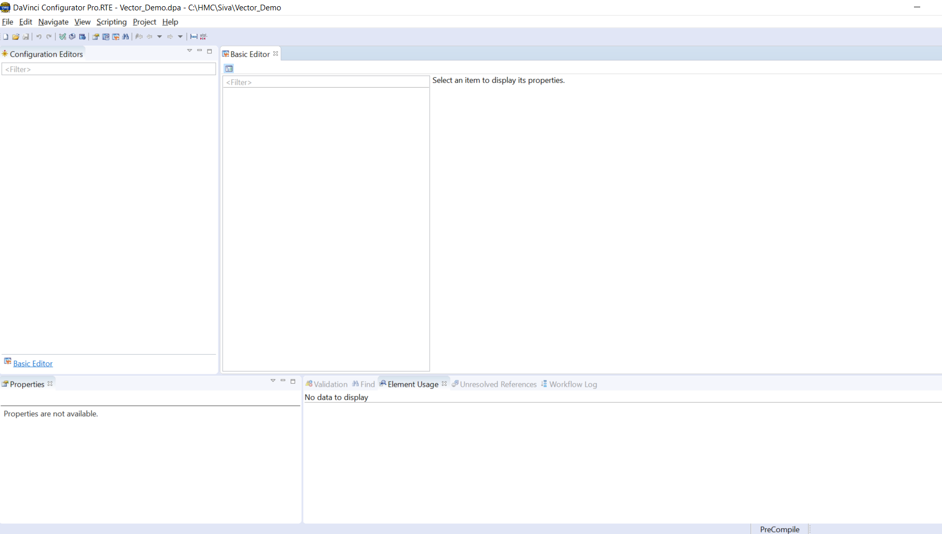
New Project GUI

Slide 14
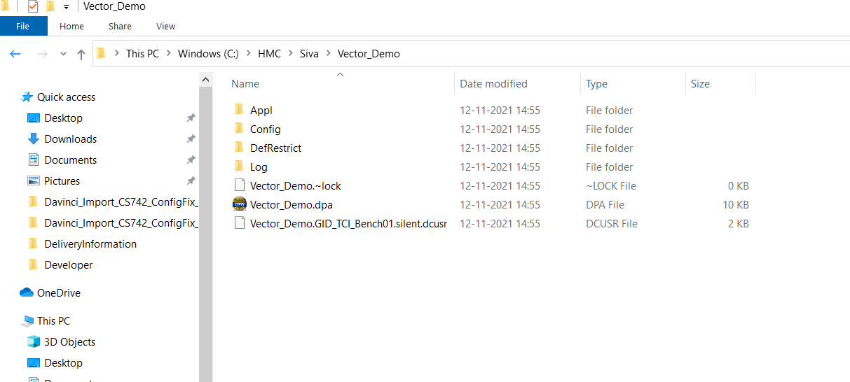
Workspace Structure

Slide 15


Input Files & Importing Process
ECU Extract(.arxml)
Module Definition file
Stack File
.c and .h
DBC(.dbc)
Generated .c and .h Files
.exe File
Add New Bsw Modules
Compilation
Process
Configuration Tool
Import existing BSW_XXX.arxml
Vector Specific Files & Tools
Import Existing Project .dpa
Application SWC’s(.arxml)
Generic File

Slide 16
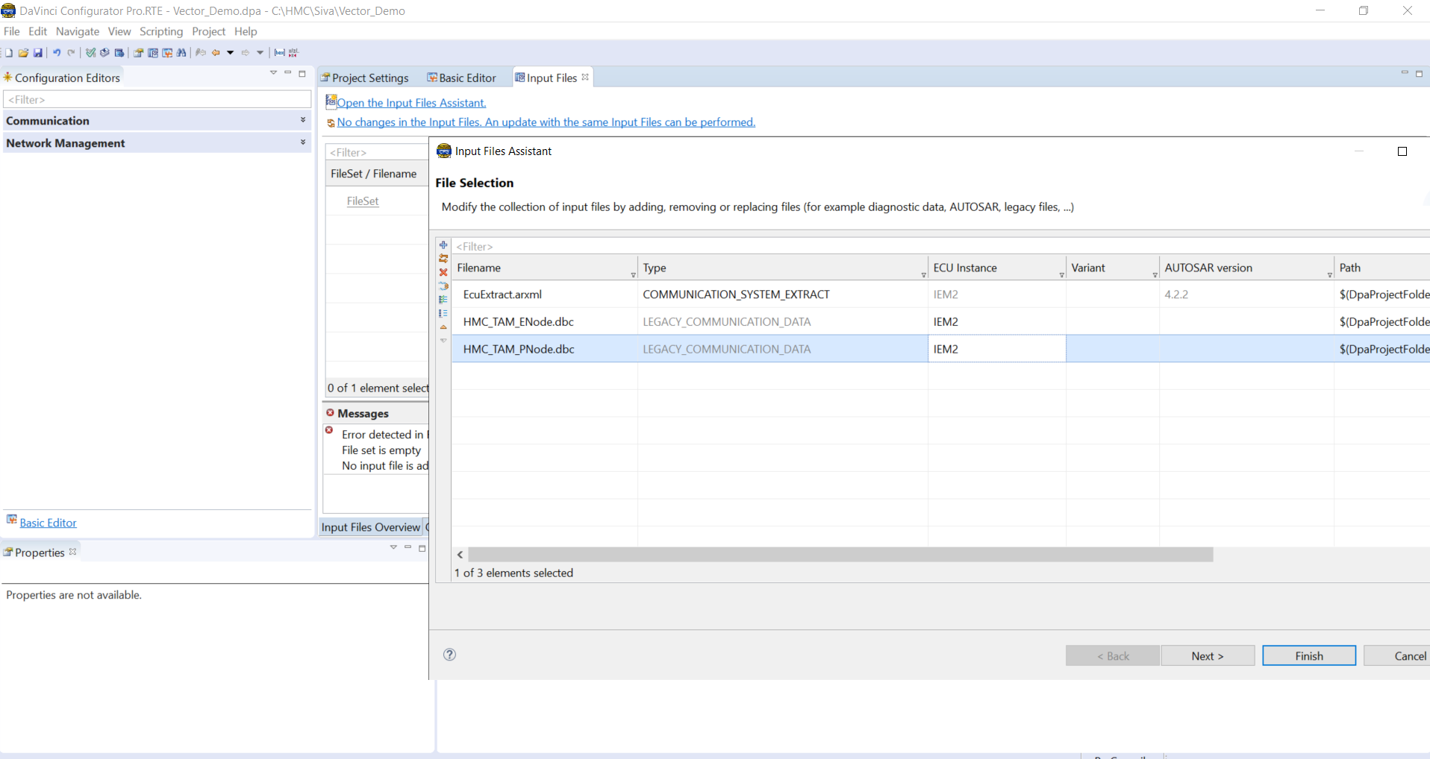
Importing System Description & dbc Files
Project-> Project setting

Slide 17
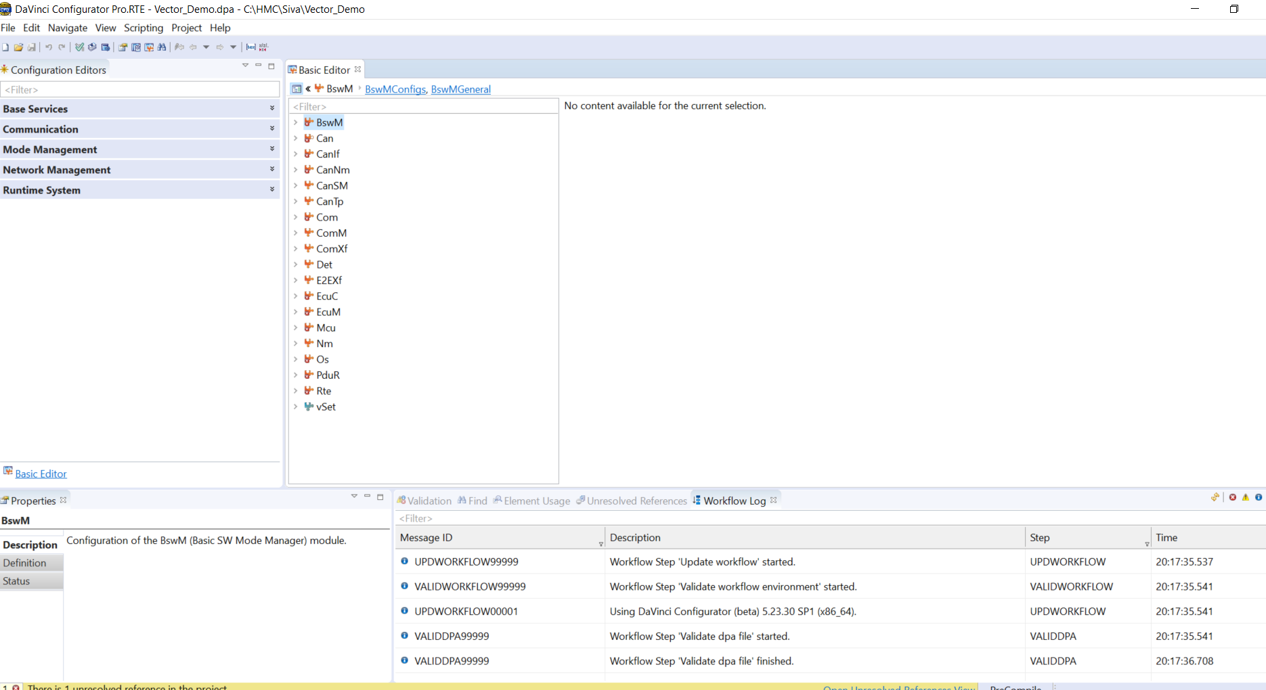
After Import
Project-> Project setting

Slide 18
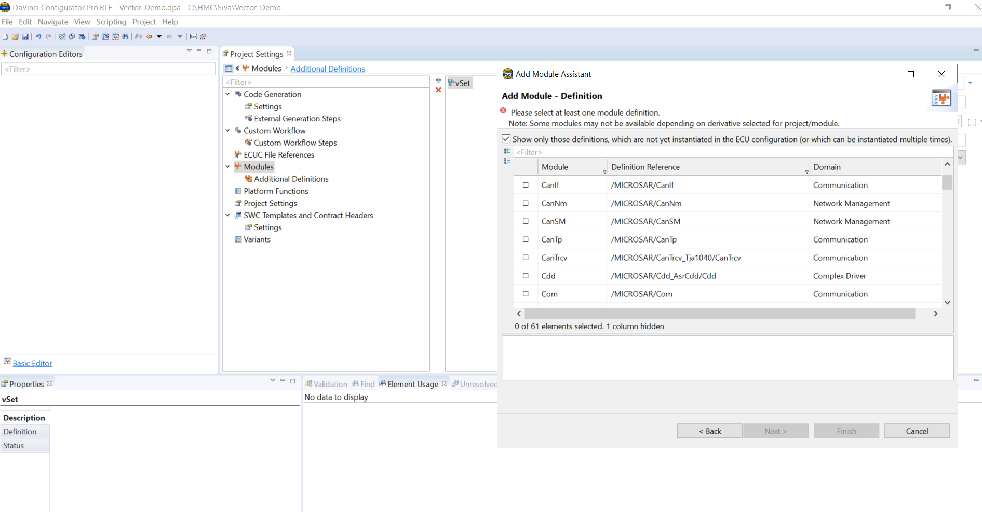
Adding New MICROSAR BSW Modules
Project-> Project Settings-> Modules -> Add Modules

Slide 19
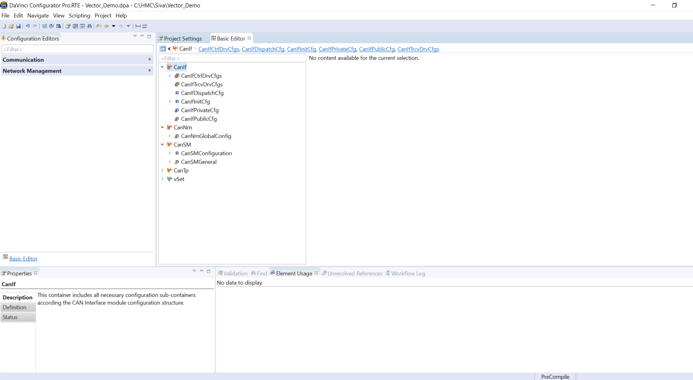
After Adding New MICROSAR Module

Slide 20
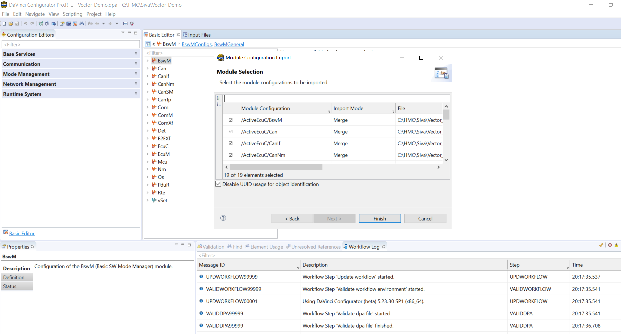
Import Existing Project File
File-> Import (.dpa, .arxml)

Slide 21
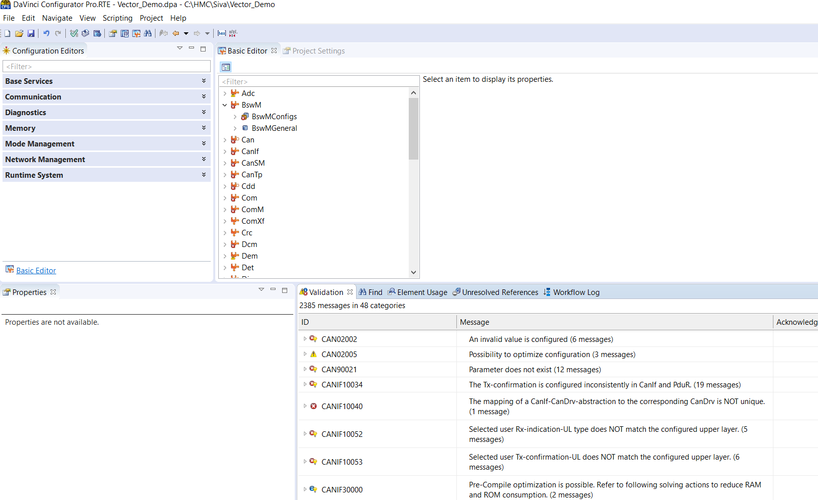
Errors After Import

Slide 22
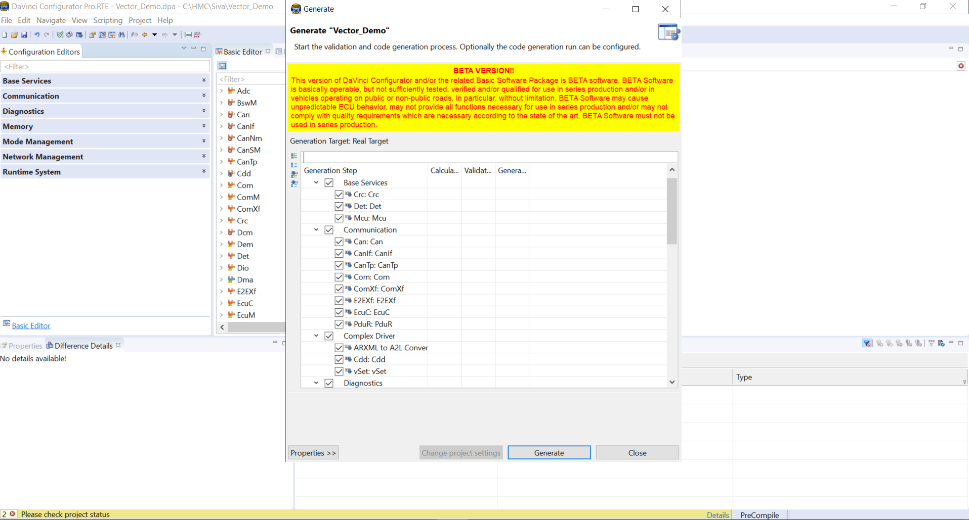
Generating code in Davinci Configurator

Slide 23
Davinci Configurator Demo

