Slide 1
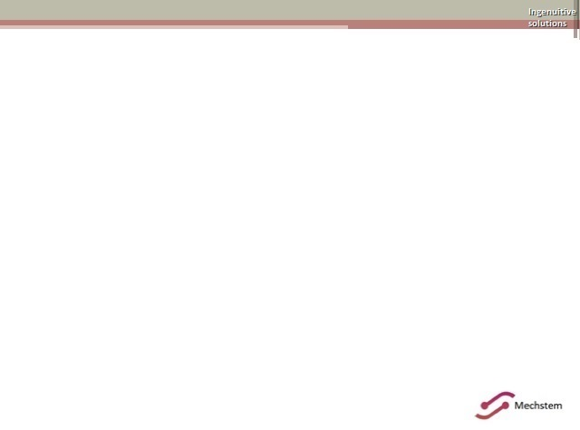
Model Based Engineering
-Embeddeds world🌍

Slide 2
CONTENTS:
Model based Design
Matlab Basics
Simulink Basics
Simulink
XIL(MIL,SIL,PIL,HIL)
EVs
BMS
ADAS(Adaptive cruise control)
Camera,Radar,Lidar
MAAB guidelines
Requirement Engineering
Systems engineering

Slide 3
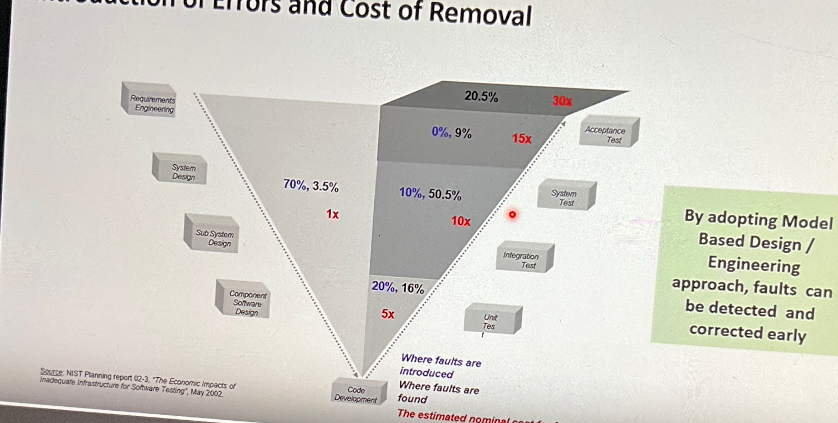
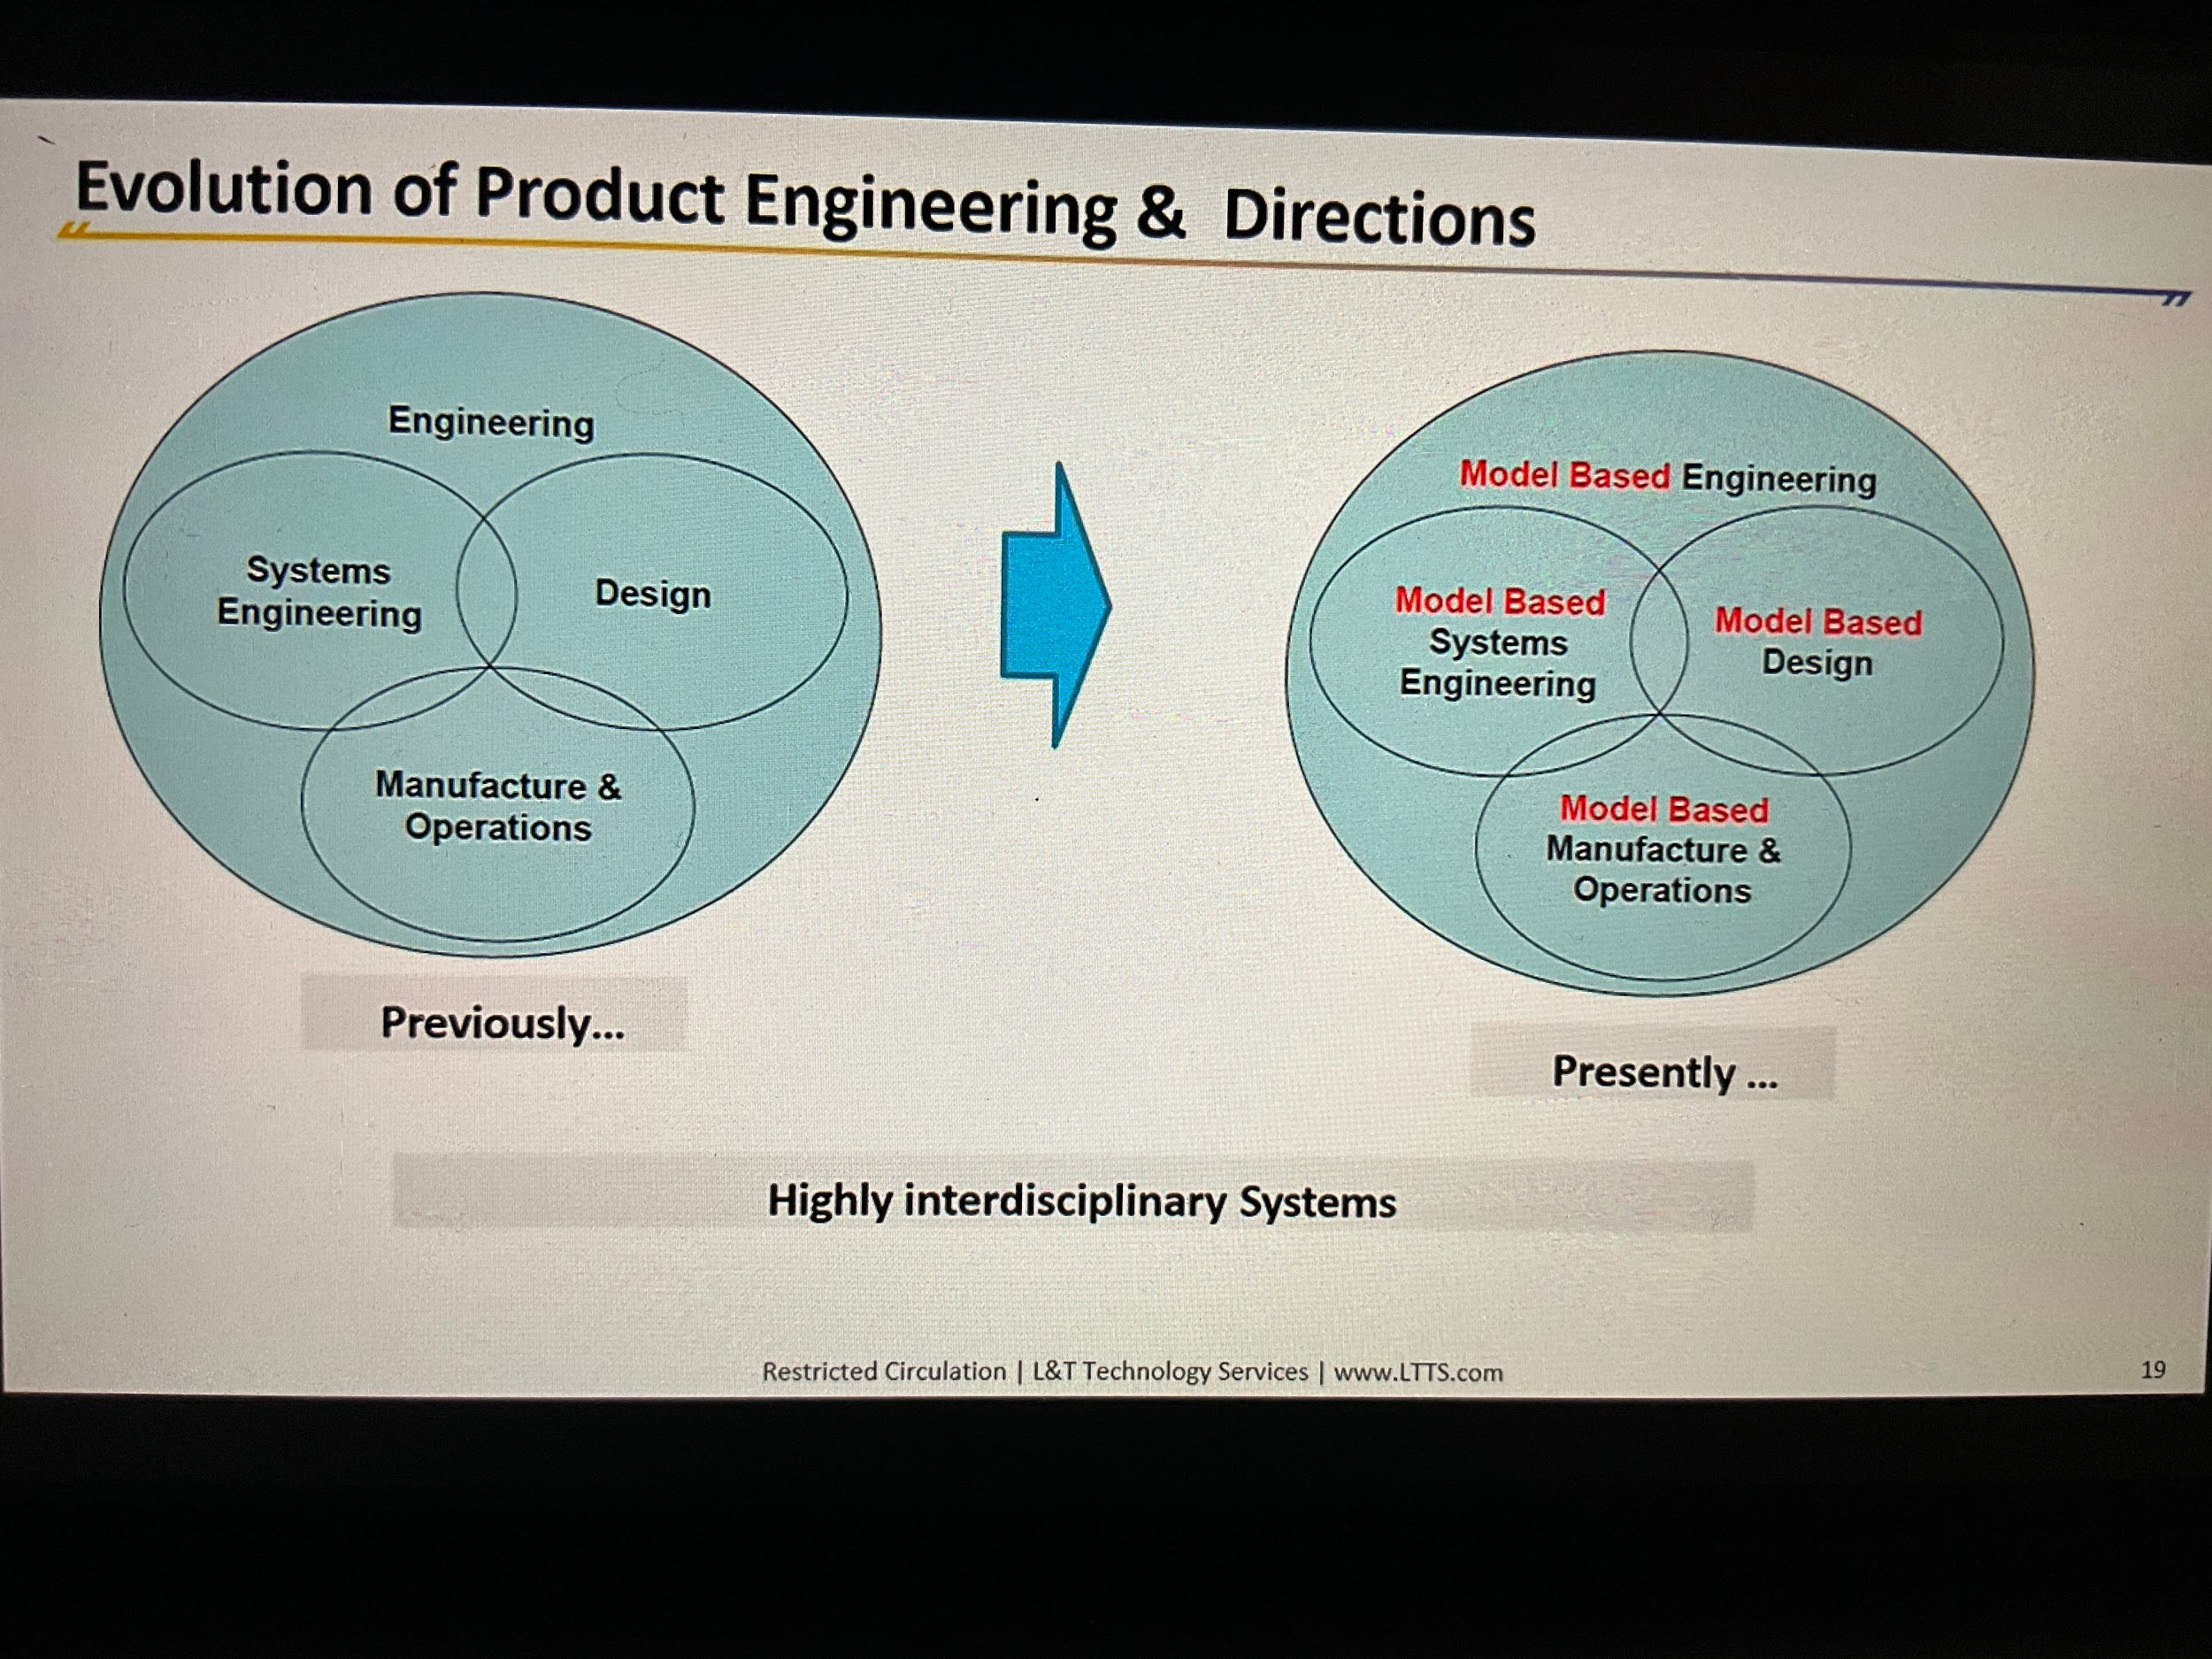
MBD
Model based engineering : An approach to engineering that uses models as an integral part of the technical baseline that includes the requirements,analysis,design, implementation and verification of capability, system, and/or product throughout life cycle.
Requirements model
System model(car)
Sub system models(power train etc..)
Function simulation model(functionality in Simulink)
Analysis model(structural/heat analysis ANSYS).
Test simulation models(suspension simulations).
Hardware simulation model.
System integration model.
Communication gap between Engineers, b/w mechanical,software,electronic engineers- just show them image all of them will understand.
Improve quality by early identification of requirement issues,reduce rework(redesign),improved requirement traceability improved system specs,maintenance ,planning,impact analysis, documentation etc..
Complexity in systems being designed and developed face issues
Business Based
Shorter development cycle
Delivering on schedule
Cost reduction demands
Risk/cost associated with delays and cancellations.
Larger and more distributed teams
Communication & collaboration
Implementing common architectural goals.
Quality assurance
Risk of building wrong system
Increase cost of later stage errors
Applying Model-Based Product Engineering & design can reduce Total development cost,and deliver more projects on time
Everything cannot be modelled(non functional requirements hard to model/simple problems don’t need models)

Slide 4
MBD
Application of control system in model based development
Control systems: A device help other devices work to achieve efficiency, their will be parameters we can call them variables,parameters responsible for functionality of system are called control parameters,Generally control parameters are of two types one is input and output.
A typical block diagram of control system is made up of 3 blocks input block, control/logic block,output block (Eg: in remote pressing a button is input to system ,the logic what button has to happen ,and increasing of volume is action or output).
What is plant And a plant model? (Plant is system performing action based on input given by controller)
What is controller and a controller model? (It’s incharge of the functionality of system (tells how it should work)(logic))
Set point(input (button in remote)) and feedback loop(closed loop system)
Set point
Controller
Plant

Slide 5
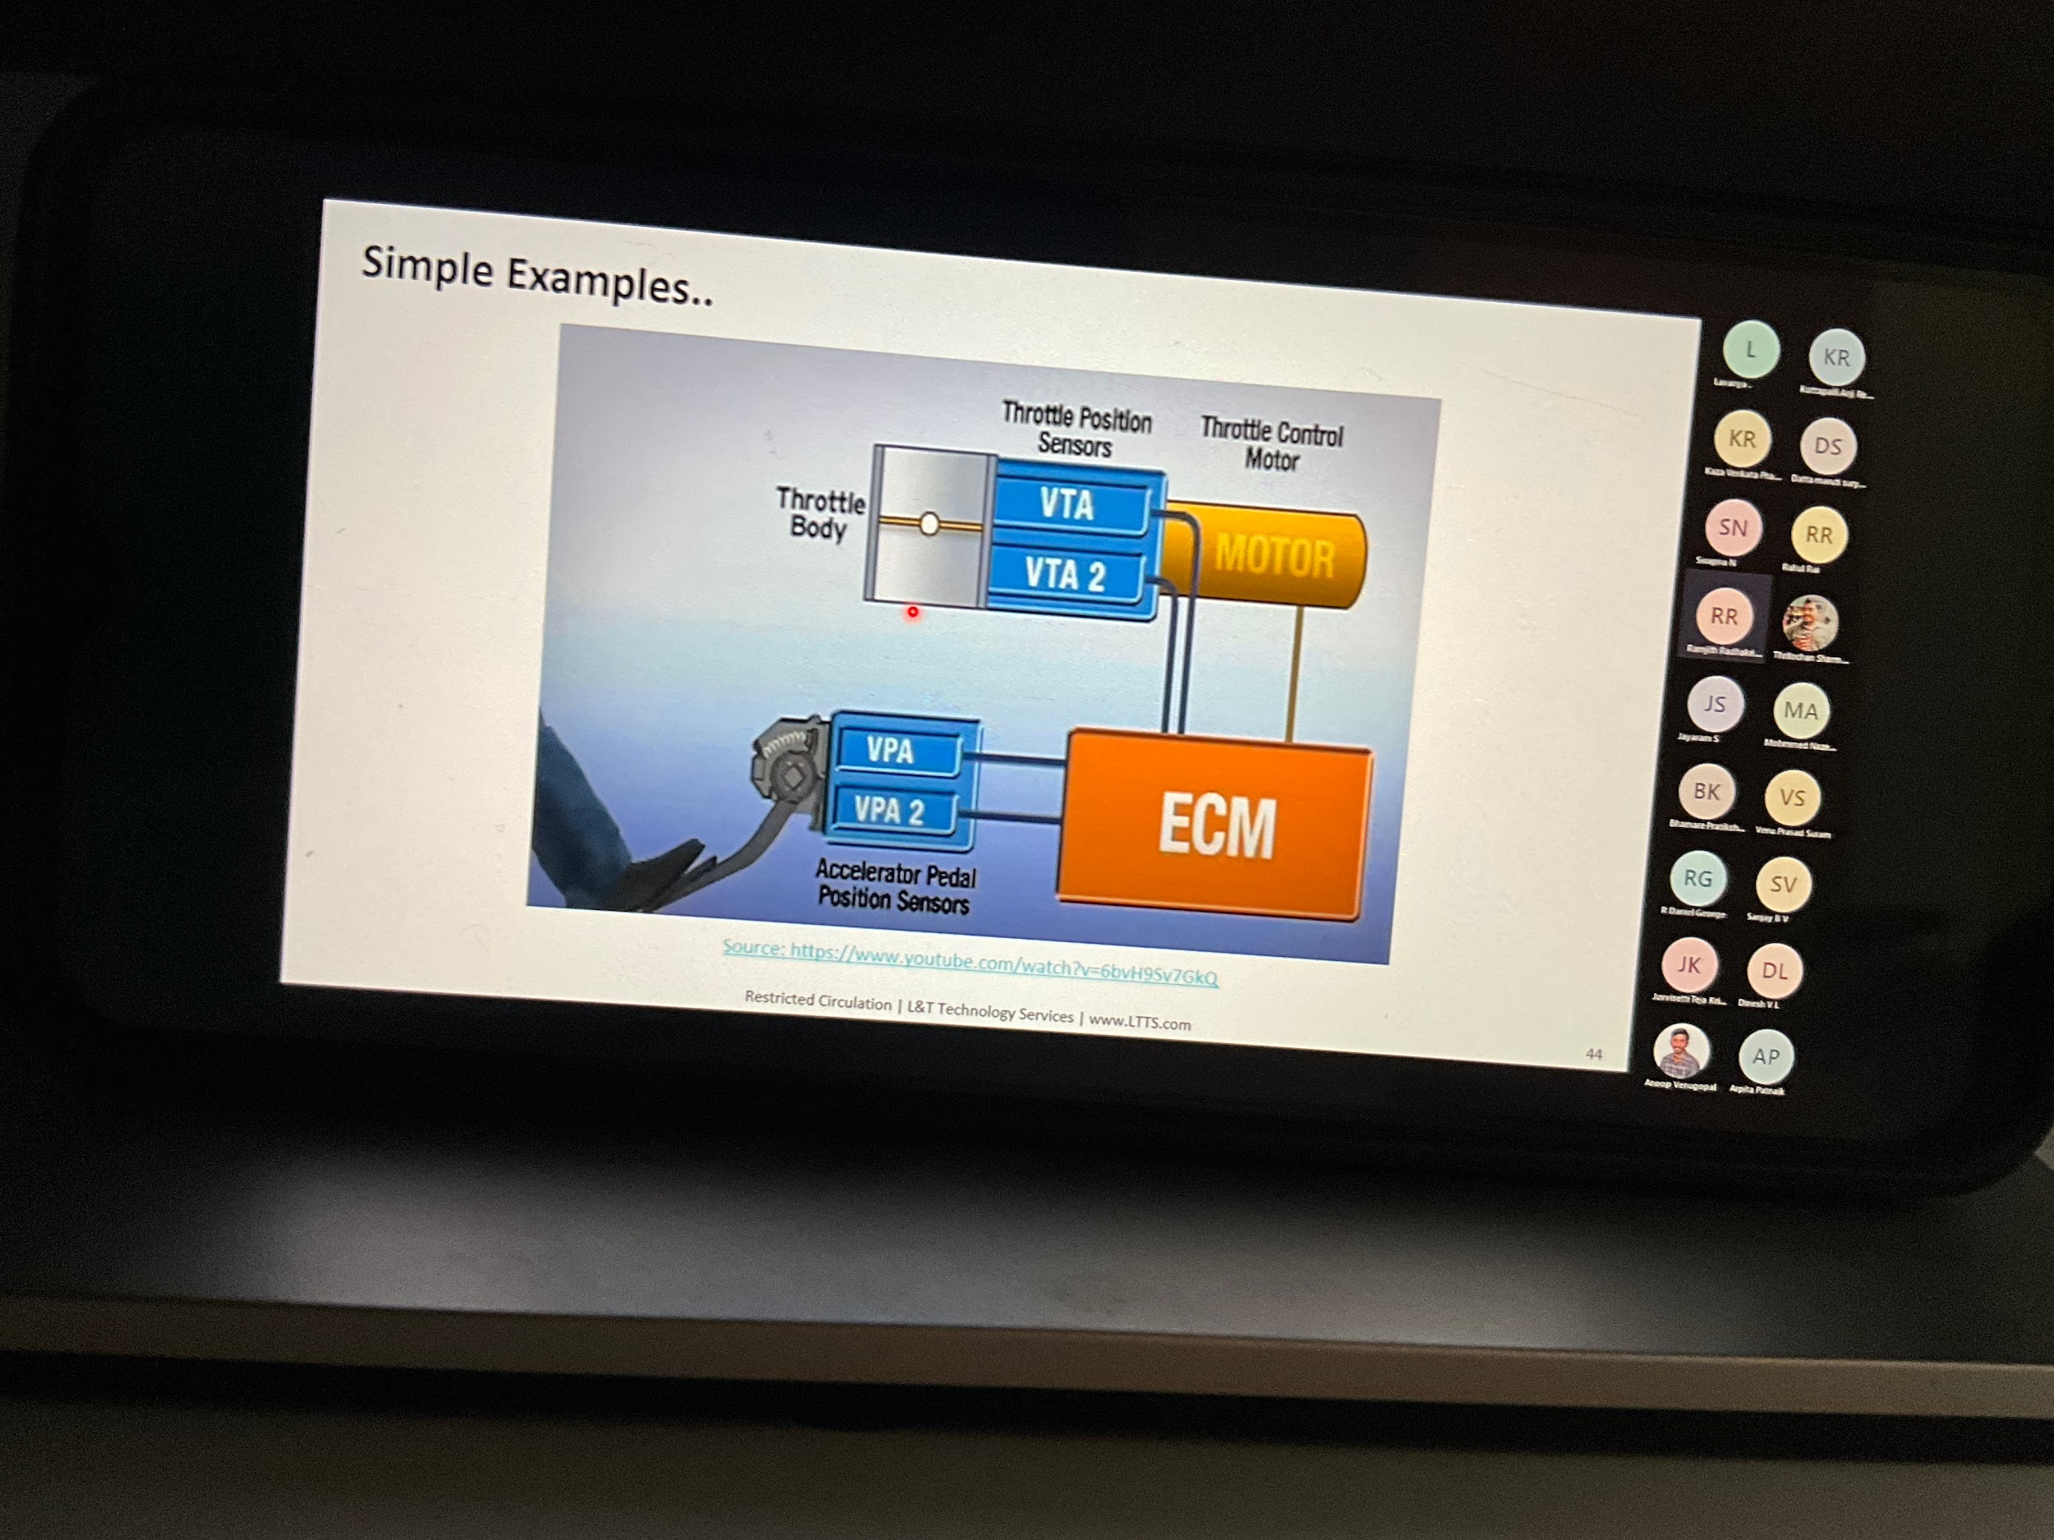
MBD
Scenario of HVAC system in automotive systems
I/p → temp sensor, switches (if user wants to heat it /cool it etc ..)
Control logic → comparison of temperature (flags if temperature really really high or low)
O/p → compressor /motor
Let's say created model and code now time for test.
Testing: we have motor, sensor, microcontroller etc..
We need to check motor has some voltage beyond which it can burn.
So let's say whatever motor u select in real-world is modelled as mathematical equation in simulink for simulation and model logic control block which takes input
While selecting a Motor torque required , weight capacity,load etc.. is considered.once motor is selected getting equation of motor and factors it affected ,transfer function (ctms motor model) we have final equation based on which we can model simulink modl,now given output of logic controller to motor (change in x which changes y)
Testing is done by varying input and expecting output,
Mil,SIL,PIL,HIL,VIL
https://youtu.be/6bvH9Sv7GkQ
Jmob guidelines

Slide 6
MBD

Slide 7
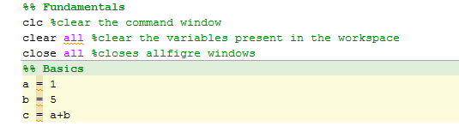
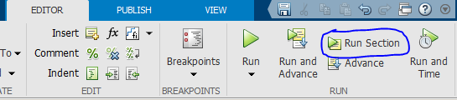
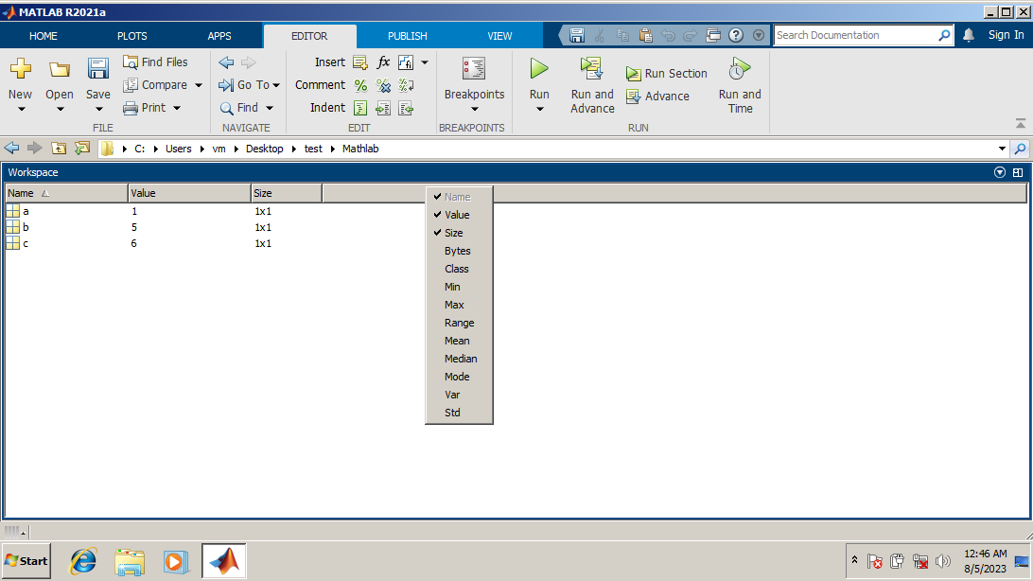
MATLAB Basics
Change the current working path
Create script
%% -> indicates section
Each section can be executed individually
‘Ctrl+enter’ runs whichever section is selected
% - > indicates comment
By default value is stored as double
‘d=class(a)’ in script will gives data type of variable ‘a’
‘F = size(a)’ gives matrix (rows x column)

Slide 8
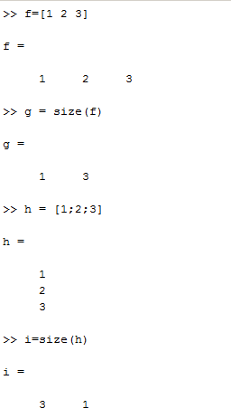
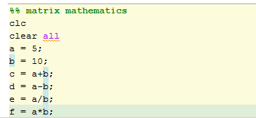
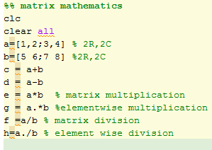
MATLAB Basics
‘;’ suppresses o/p in command window

Slide 9
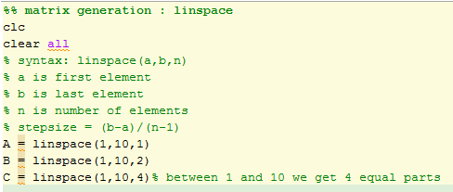
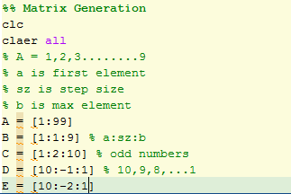
MATLAB Basics
%%Random matrix generator
clc
clear all
a=ones(3,2)
b=zeros(2,4)
c=rand(2,2)
d=magic(3)% create n->rows,n->column values from 1 upto n^2 , (add from any row column,diagonal will be same).
—-------------------------------------------------------------------------------------------------------------------------------------------------------------------------------------------------------------------------------------------------------------------------------------------------------------------------------------------------------------------------------------------------
%% type casting
clc
clear all
A = 8
B = class (A)
C = uint8(A)
D = class (C)
—-------------------------------------------------------------------------------------------------------------------------------------------------------------------------------------------------------------------------------------------------------------------------------------------------------------------------------------------------------------------------------------------------
%% Getting help in matlab
help class %help in command window
doc class %in home tab , on help in menu also can access

Slide 10
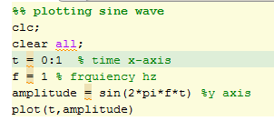
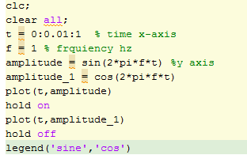
MATLAB Basics
As in fig,’ t ’ is set to 0 and 1 hence at time 0 and 1 the graph is plotted to get sine wave we need to specify’ stepsize’ as well, therefore ‘ t=0:0.01:1 ’
0.01 is like taking 100 samples where as 0.1 is 10 samples
xlabel(‘time’),ylabel(‘amplitude’),title(‘sinewave’)
Try for cosine!!
For multiple plot in script need to add ‘ figure ’ before another plot is called.
To merge two plots ’ plot(t,amplitude,t,amplitude_1) ’
‘ctrl+enter’

Slide 11
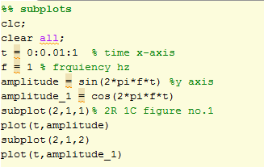
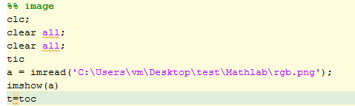
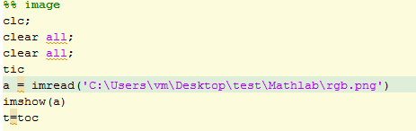
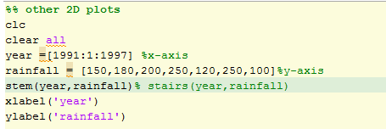
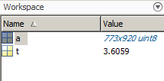
MATLAB Basics
→Double clicking on ‘a’
→ time taken with semicolon/without

Slide 12
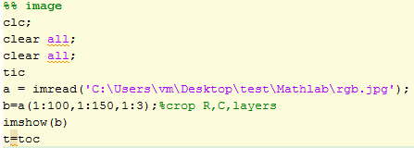
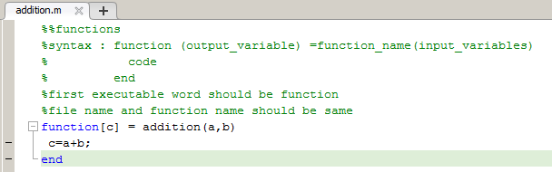

MATLAB Basics
Imtool can be used to crop via mouse

Slide 13
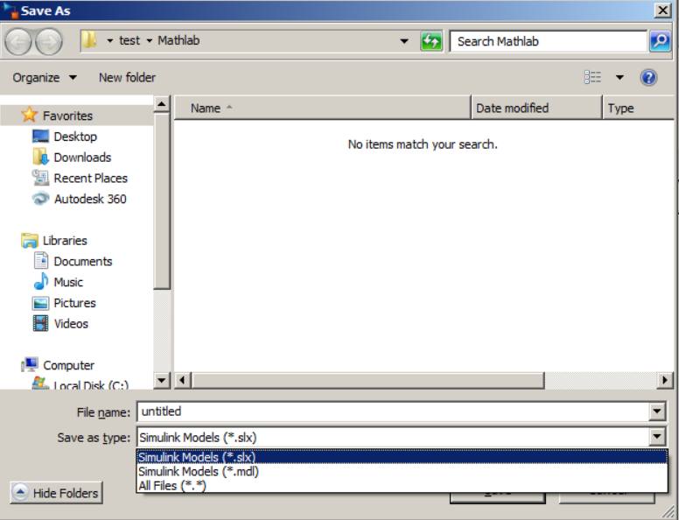
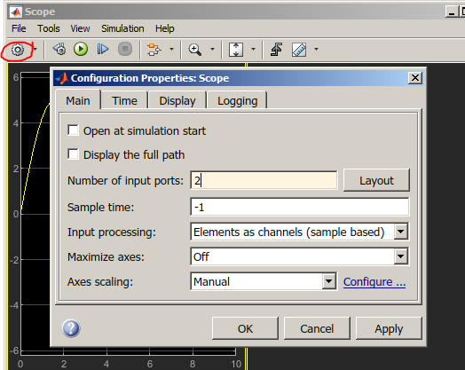
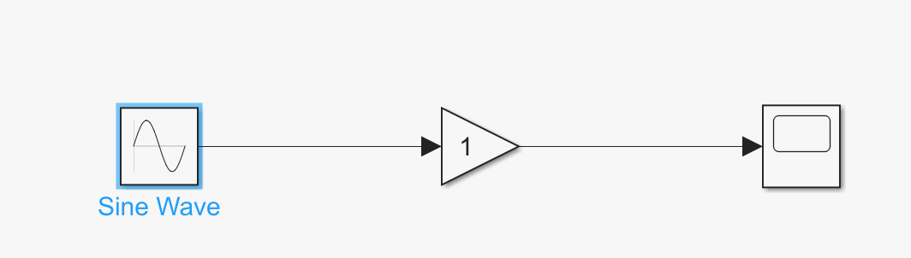
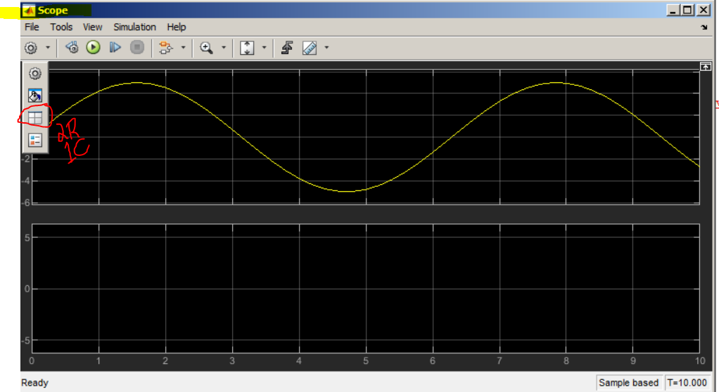
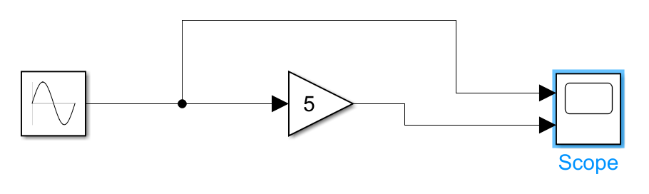
Simulink Basics
→.Slx is latest version (encrypted)
→ simulink is used for modelling
→ in simulink library we have sinks(destination/display point) and source(signal input),commonly used blocks
→ ‘space bar’ used for full screen
→ sine wave generation using simulink,early we did in matlab,double click on sine wave keep all default values,and run after compilation double click on scope to view.

Slide 14
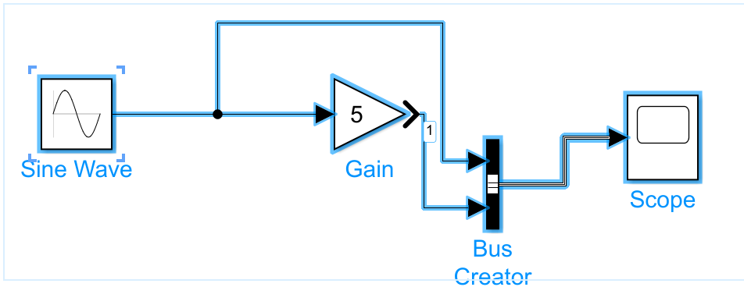
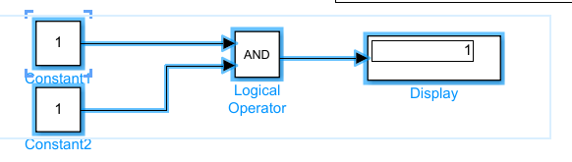
Simulink Basics
Single port in scope 2waves in one figure

Slide 15
Simulink

Slide 16
Model,software,Hardware In Loop

Slide 17
Model,software,Hardware In Loop
Q&A

Slide 18
Electric vehicle(EV)
Classification of Electric vehicles
Type | Driving components | Features | Energy Resource | Problems
BEV | Electric motor | No emission Not dependent on oil Range depends on battery | Battery Ultra capacitor | Battery price and capacity Charging time Infrastructure availability
HEV | Electric motor(ICE) | Very little emission Long range Get power from both electric and fuel | Battery Ultra capacitor ICE | Management of energy source Battery and engine size Optimization Complex structure(can have mechanical and electrical drive train)
FCEV | Electric motor | Very little or no emission High efficiency Not dependent on external supply | Fuel cells | High price Availability of fueiling

Slide 19
Electric vehicle(EV)
EV system important contributors
KERS
E-Motors
Aero dynamics
Battery thermal MGMT
Vehicle control unit(VCU)
Transmission system
eAxle
DC-DC converter
EV
Suspension Geo
Motor control algorithm
ESS Battery pack
Vehicle dynamics
Chassis orientation
Powertrain controller
(PCM)
Auxillary systems
Tyre dynamics
Drive cycles
Power controller

Slide 20
Electric vehicle(EV)
Classification of Electric vehicles

Slide 21
Battery management systems(BMS)

Slide 22
ADAS

