Slide 1

Linux device driver
¬Embeddeds World 🌍

Slide 2
Inline_Assembly _x86
-> Adding asm code in c source file.
-> most performance sensitive part in program can be written in inline_asm code
-> you can access process specific instructions for example: compare, swap test and set instructions which may be used to construct semaphore or other synchronization and locking primitives.
-> system calls: user space to access kernel services we need system calls, it’s architecture specific each and every architecture has its own way of switching to kernel space.
-> we can do system calls using asm.
-> inline_asm code can be use any C variable or function name that is in scope, so it is easy to integrate it with C code.

Slide 3
Inline_Assembly _x86
examples of speed with inline assembly
e1: The x86 architecture includes instructions that determine the positions of the least significant set bit and the most significant set bit in a word.
Implementing the same operation in C require a loop and a bit shift. But in asm we have direct instruction ‘bsrl’ which calculates the position of most significant bit set in first operand ,places the bit position into second operand.
: speed_c.c speed_asm.c
>> time ./speed_c
>> time ./speed_asm
-> henceforth , we can see difference in speed of execution of both the programs mentioned above.

Slide 4
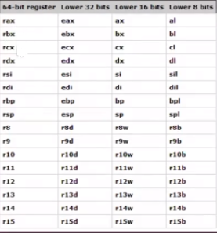
Inline_Assembly _x86
X86 64 registers
-> x64 asm code uses sixteen 64bit registers.
-> the lower bytes of some of these registers may be accessed independently as 32,16 or 8bit registers.
-> in 16bit mode ,the register is identified by its two- letter abbreviation
-> in 32bit mode ,this two-letter abbreviation is prefixed with an ‘E’ (extended). (example EAX)
-> in 64bit version, the ‘E’ is replaced with an ‘R’ (register),so the 64bit version of ‘EAX’ is called ‘RAX’ .

Slide 5
Inline_Assembly _x86
-> GCC supports two kinds of assembly statements:
Basic
the basic form consists of only two things ‘asm keyword’ and ‘string with valid instructions’
Ex: asm(‘”hlt”);
asm(“nop”);
Extended
Advance version of basic
Ex: asm volatile(assembler template
: output operands (optional)
: input operands (optional)
: clobbered registers list (optional)
);
Volatile informs the compiler specifies that the asm statement may produce side effects, so optimisation shall not be performed.

Slide 6
Inline_Assembly _x86
-> GCC by default uses AT&T assembly syntax.
Summary of syntax
Instruction source, destination
the source register is always specified before the destination register.
E.g.: mov %eax,%ebx // transfer the contents of eax to ebx
%register
Register names are prefixed with a percent sign(%) ,Two percent sign must be specified in C source code
in order to generate one percent symbol in output that is forwarded to the assembler program.
$literal
Literal values are prefixed with dollar sign
E.g.: $10 is decimal 10,$0x10 is hexadecimal and value is 16
Movl $0xffff, %eax
Operand size
Specified by a suffix after the assembler statement
B stands for byte, l for long and w for word, q for quad
To move long value from register eax to register ebx, it is therefore necessary to specify movl %eax, %ebx
Indirect memory reference
De-referencing of pointers are possible by including a register in parentheses.
Movl (%eax), %ebx moves the long value at the address in memory pointed to by the value of register eax to the register ebx
Offset(register)
Specifies that the register value is to be used together with an offset that is added to its
actual value 8(%eax) specifies that eax + 8 is to be used as an operand
This notation is used primarily for memory access -- for example, to specify offsets from the stack or frame pointer in order
to access certain local variables

Slide 7
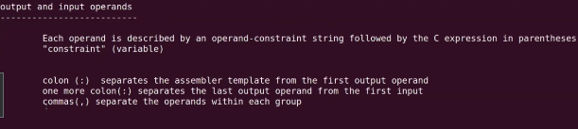
Inline_Assembly _x86
-> Extended Format
asm volatile(assembler template
:output operands (optional)
:input operands (optional)
:clobbered register list (optional)
);
Assembler template
Specifies the instructions to execute
Each instruction should be separated by \n character
E.g.:
Asm(“nop\n”
“nop\n”
“nop”);
In the assembler template, each operand is referenced by numbers. Numbering is done as follows. If there are a total of n operands(both input and output inclusive) , then the first output operand is numbered 0, continueing in increasing order,and the last input operand is numbered n-1
Where %0 is the first operand ,%1 is the second , and so on. And %N-1 is last operand

Slide 8
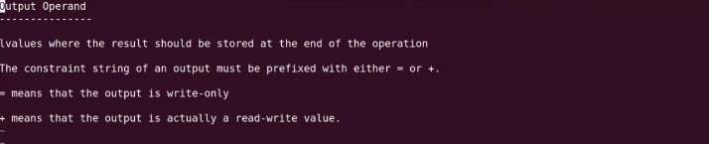
Inline_Assembly _x86
: hello_1.c
>> time ./speed_c
>> time ./speed_asm

Slide 9
Inline_Assembly _x86
->

Slide 10
Inline_Assembly _x86
->

