Slide 1
Veterans Experience Integration Solution
PI 5 System Demo
INSPECT & ADAPT

Slide 2
Team Alpha

Slide 3
Demo Title
Problem/Challenge
Solution/Resolution
One
Two
Three
One
Two
Three

Slide 4
Demo Title
Problem/Challenge
Solution/Resolution
One
Two
Three
One
Two
Three

Slide 5
Team Bravo

Slide 6
Demo Title
Problem/Challenge
Solution/Resolution
One
Two
Three
One
Two
Three

Slide 7
Demo Title
Problem/Challenge
Solution/Resolution
One
Two
Three
One
Two
Three

Slide 8
Team Charlie

Slide 9
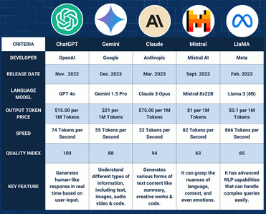
Secure Enterprise Deployment of Azure OpenAI
Large Language Model Deployment
AI's fast progress demands experimentation for companies to compete and innovate.
AI services rely on APIs, so strong API management is crucial for control and regulation. Azure OpenAI Service offers a powerful platform for enterprise GenAI implementation with Microsoft's enterprise-grade security, compliance, and integration capabilities.
Easy API integration of AI services creates a need for end-to-end solutions, enabling faster testing and safer app deployment via AI Gateways.
We'll focus on Azure OpenAI, but the principles apply to all LLMs.

Slide 10
Demo Title
Problem/Challenge
Solution/Resolution
One
Two
Three
One
Two
Three

Slide 11
Team Delta

Slide 12
Demo Title
Problem/Challenge
Solution/Resolution
One
Two
Three
One
Two
Three

Slide 13
Demo Title
Problem/Challenge
Solution/Resolution
One
Two
Three
One
Two
Three

Slide 14
Questions or Comments?

