Slide 1
Veterans Experience Integration Solution
PI 5 System Demo
INSPECT & ADAPT

Slide 2
Team Alpha

Slide 3
Demo Title
Problem/Challenge
Solution/Resolution
One
Two
Three
One
Two
Three

Slide 4
Demo Title
Problem/Challenge
Solution/Resolution
One
Two
Three
One
Two
Three

Slide 5
Team Bravo

Slide 6
Demo Title
Problem/Challenge
Solution/Resolution
One
Two
Three
One
Two
Three

Slide 7
Demo Title
Problem/Challenge
Solution/Resolution
One
Two
Three
One
Two
Three

Slide 8
Team Charlie

Slide 9
GenAI Integration – Enterprise Deployment - Challenges in Scaling AI Adoption - POC
As teams across the organization adopt Azure OpenAI and other AI services, we face a few critical challenges:
Resource Contention & Cost Visibility:
Difficulty tracking which teams are using what capacity (tokens/minute), leading to potential resource starvation for critical applications and unpredictable billing. How do we ensure fair usage and accurately allocate costs?
Security & Compliance Risks:
Spreading model API keys directly to applications increases the attack surface. How do we ensure secure access and meet our governance requirements?
Operational Complexity:
Managing multiple AI service instances and different pricing models (Pay-as-you-go vs. Provisioned) becomes cumbersome, hindering agility and optimizing cost/performance.
Lack of Central Control & Observability:
Without a unified view, it's hard to monitor overall AI consumption, identify issues, or enforce organizational policies effectively. How do we provision such a solution?

Slide 10
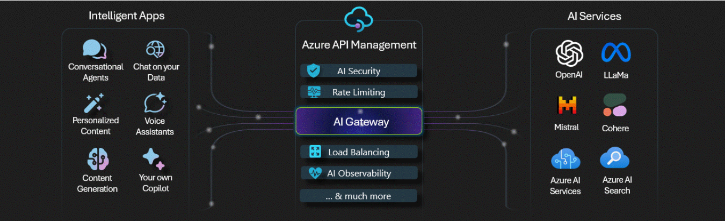
AI Gateway Platform - A Strategic Platform for Governed AI Access
Implement a central AI Gateway, leveraging Azure APIM/Databricks-AI Management as the core platform:
AI Gateway: A well-architected AI Gateway is not just a technical component; it's a foundational platform essential for responsible, scalable, and valuable AI adoption across our enterprise.
The single, secure "front door" for all internal applications needing access to Azure OpenAI and potentially other AI models.
It acts as an intelligent intermediary, managing requests between applications and the AI services.

Slide 11
Key Considerations for Successful GenAI Implementation
Any successful deployment requires clear business objectives, quality data, and a deep understanding of LLM capabilities.
To effectively manage Azure OpenAI models across multiple applications, it is crucial to track token usage, distribute the TPM quota efficiently, secure the API key, and implement load distribution across multiple endpoints, while ensuring that Provisioned Throughput Units (PTUs) are utilized before falling back to Pay-as-you-go instances, all while leveraging advanced GPT models.
The implementation of AI gateways, such as Azure API Management APIM, Portkey, Kong AI Gateway, and Mosaic AI, provides a comprehensive set of capabilities, including token limit policy, load balancing, semantic caching, rate limiting, quota management, content moderation, prompt leakage error handling, and security authentication, to manage and optimize the deployment of Generative AI models like OpenAI, ensuring efficient, reliable, and secure integration into applications.
Additionally, integration with existing tools, security, governance, compliance, scalability, performance, and explainability are crucial factors that must be considered and planned for to ensure the effective deployment and use of LLMs.

Slide 12
AI Gateway Deployment: Solution enterprise-grade governance, compliance, security, cost
Cost Control & Predictability: Implement policies for rate limiting and quotas per application or team.
Gain detailed usage analytics for consumption and cost optimization (e.g., helping in Pay-As-You-Go v/s Provisioned Throughput Units).
Benefit: Reduced unexpected costs, fair resource allocation, clearer ROI on AI investments.
Enhanced Security & Governance: Centralize authentication and authorization. Securely manage and rotate API keys behind the gateway. Enforce organizational security policies consistently.
Benefit: Reduced security risk, improved compliance posture.
Robust Content Filtering: Hate Speech, Sexual Content, Violence, and Self-Harm. Each category often has configurable severity levels (e.g., low, medium, high) to determine the strictness of the filter.
Benefit: Mitigates risks by automatically blocking harmful or inappropriate AI-generated content.
AI Gateway PII Guardrails: Identify and prevent prompt “PII leakage”
Benefit: proactively sanitize data before it reaches the AI model or is returned to the user, ensuring compliance and data protection.
Unified Observability: AI Gateway Inference tables providing centralize logging and monitoring of all AI requests and responses.
Benefit: Faster issue resolution, better understanding of AI usage patterns.

Slide 13
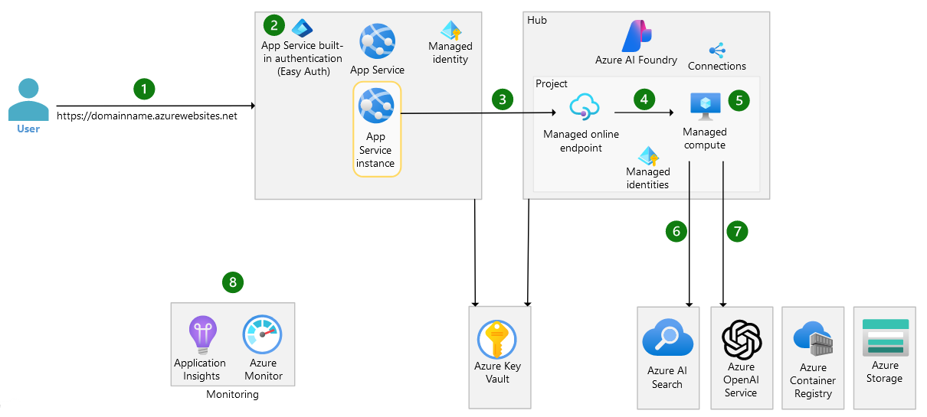
Architechture

Slide 14
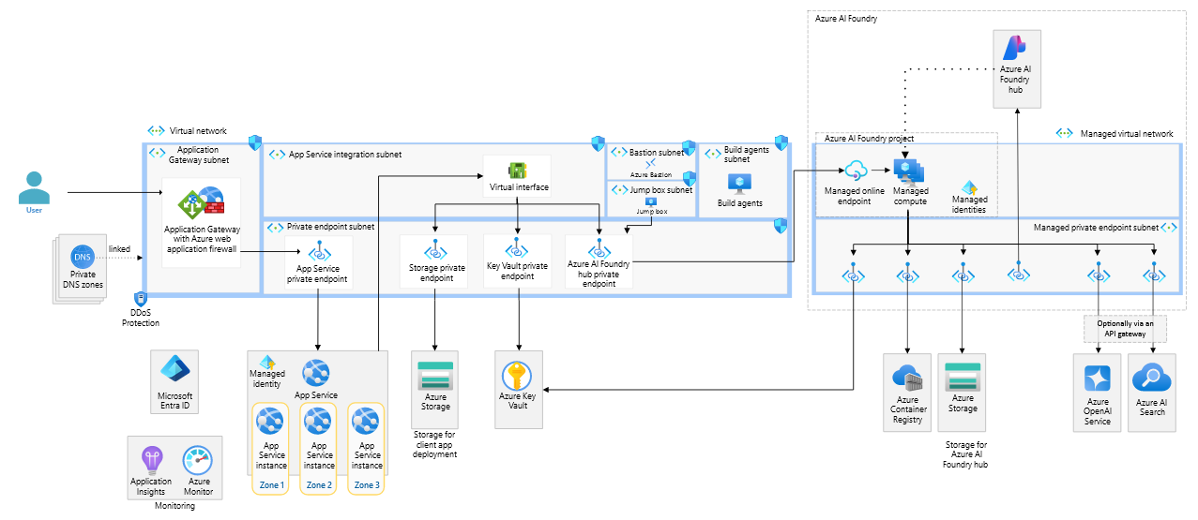
First step toward production:

Slide 15
Terraform Deployment: enterprise-grade governance, compliance, and security
To deploy OpenAI models, such as GPT-3.5 Turbo and text-embedding-ada-002, on Microsoft Azure, Infrastructure-as-Code (Terraform) is utilized, focusing on enterprise-grade governance, compliance, and security.
Deploying OpenAI in an enterprise environment requires a balance between innovation and governance, which can be achieved through the use of Terraform code that provides secure access, compliance, and auditability features, including private endpoints, Network Security Groups (NSGs), and managed identities.
Terraform code will be used to set up an OpenAI module:
Private endpoints for secure access.
Network Security Groups (NSGs) restricting inbound/outbound traffic.
Azure Container Registry (ACR) as a private artifact repository.
Compliance with standards (FedRAMP, HIPAA in Gov environment).
Role-based access control with managed identities.
Monitoring and auditing practices.
Secure and compliant deployment:
Final recommendations include automating deployments via Terraform pipelines, enforcing zero-trust principles, conducting regular audits, and utilizing Azure Policy to enforce resource tagging and retention, ultimately prioritizing private endpoints, least-privilege access, and network segmentation to meet federal and industry governance standards.

Slide 16
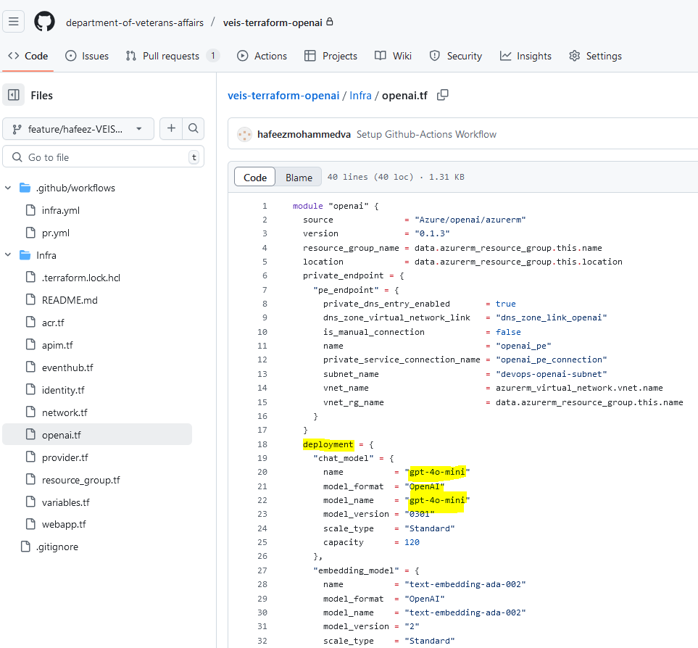
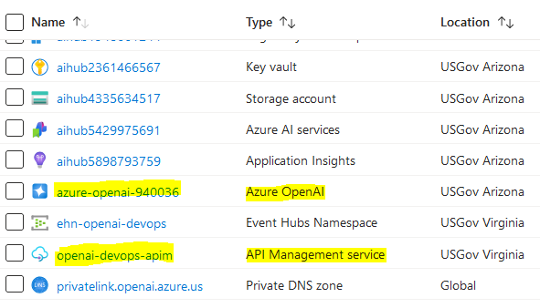
Terraform Deploys OpenAI Services GPT-4 model

Slide 17
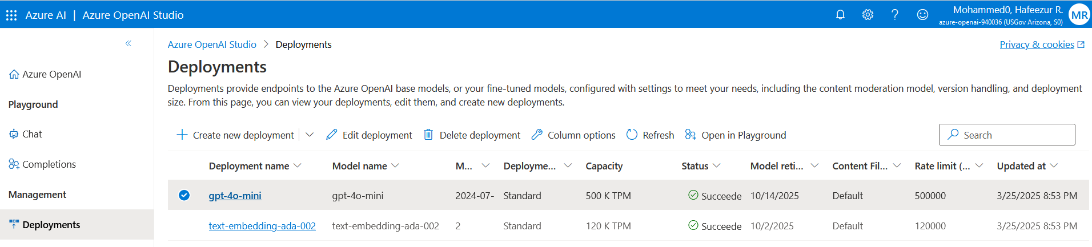
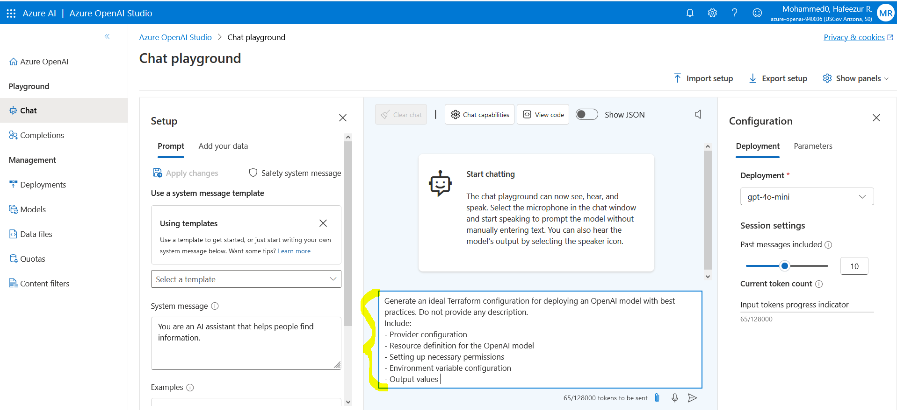

Slide 18
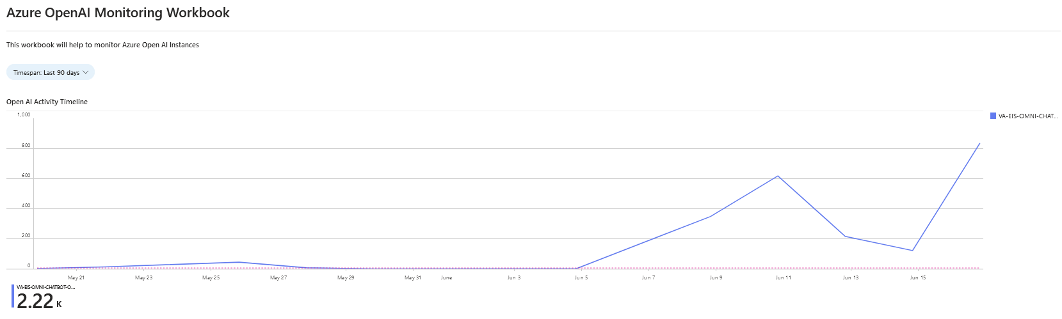
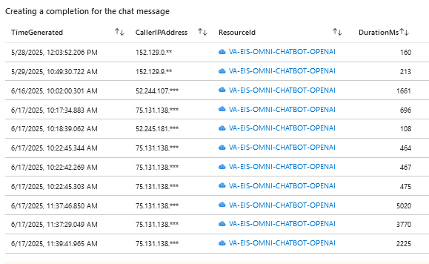
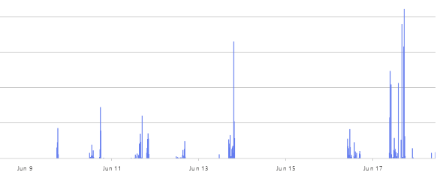

Slide 19
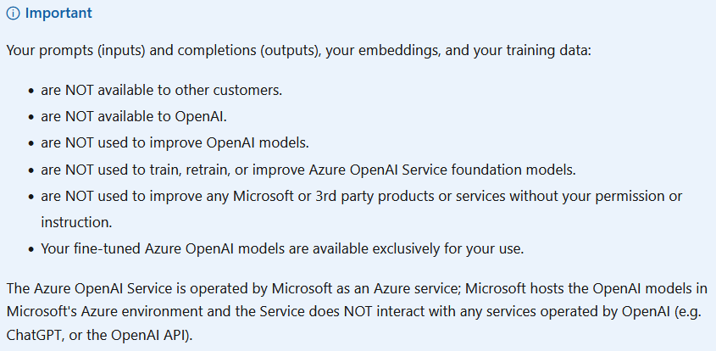
Microsoft - legal claim about cognitive-services/openai/data-privacy regarding prompts-with-data-retrieved-from-your-data-sources-to-the-generated-results

Slide 20
Delivering Enhanced Value to Veterans with AI
Accelerated Innovation: Provide a secure, managed platform that empowers teams to quickly build and deploy AI-powered applications, keeping us competitive.:
Financial Stewardship: Gain critical visibility and control over AI consumption, enabling cost optimization and predictable budgeting.
Risk Mitigation: Significantly enhance security and compliance posture by centralizing access and enforcing policies consistently across all AI usage.
Operational Excellence: Streamline the management, monitoring, and scaling of AI services, freeing up engineering resources.
Future-Proofing: Establish a flexible platform that can easily incorporate future AI models and services as our needs evolve.

Slide 21
Team Delta

Slide 22
Demo Title
Problem/Challenge
Solution/Resolution
One
Two
Three
One
Two
Three

Slide 23
Demo Title
Problem/Challenge
Solution/Resolution
One
Two
Three
One
Two
Three

Slide 24
Questions or Comments?

