Slide 1
Background
Time to boil water under different factors and levels
Tea in lesser time

Slide 2
Parameters
Factors: Material, Type of Stove, Pan Cover
Response Variable: Boiling Time (sec)
Control Variable: Room Temperature
Held-Constant Factor: Stove Knob, Water Amount
Nuisance Factor: Different boiling rates

Slide 3
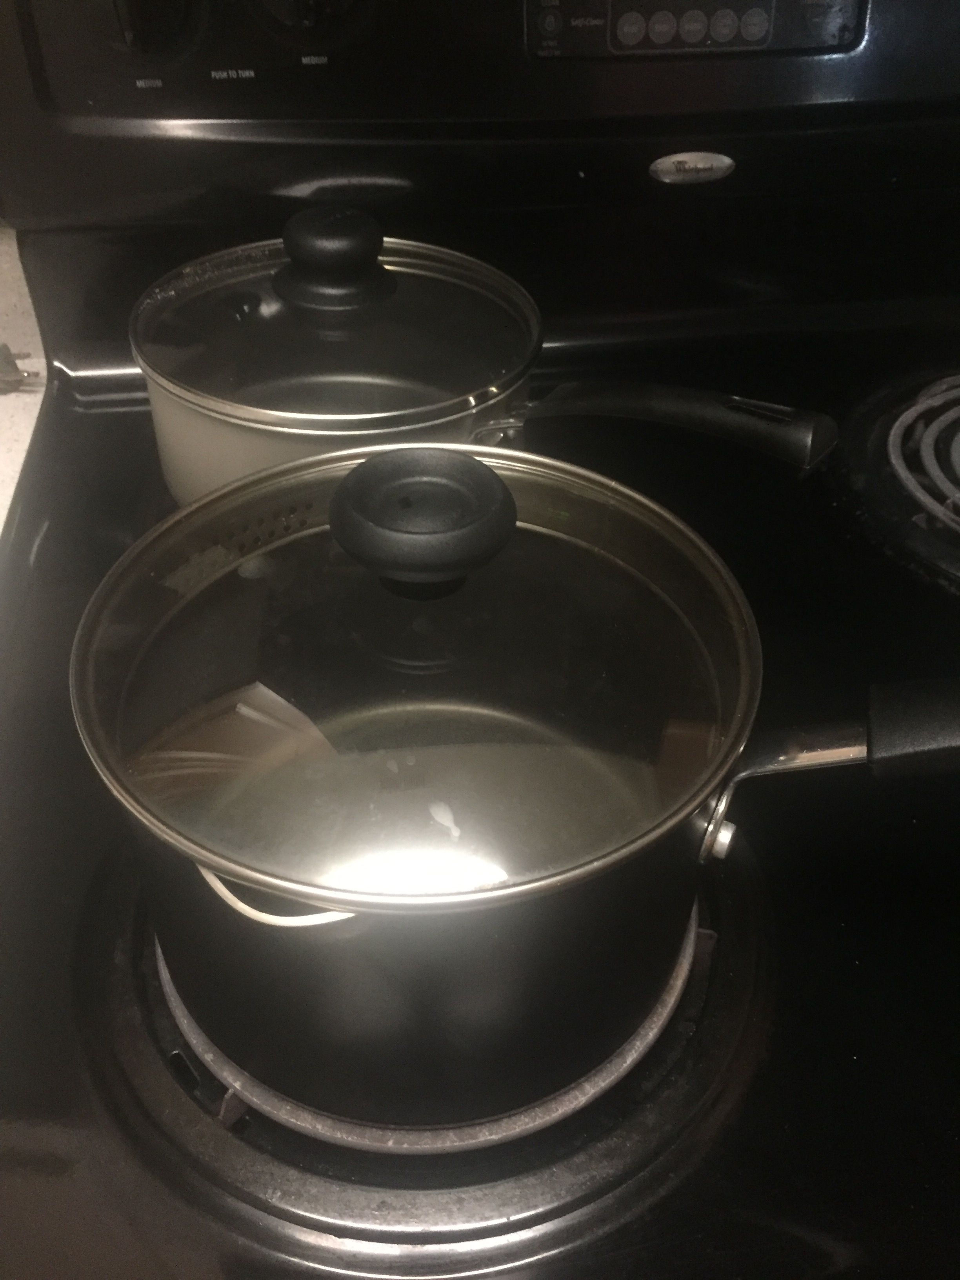
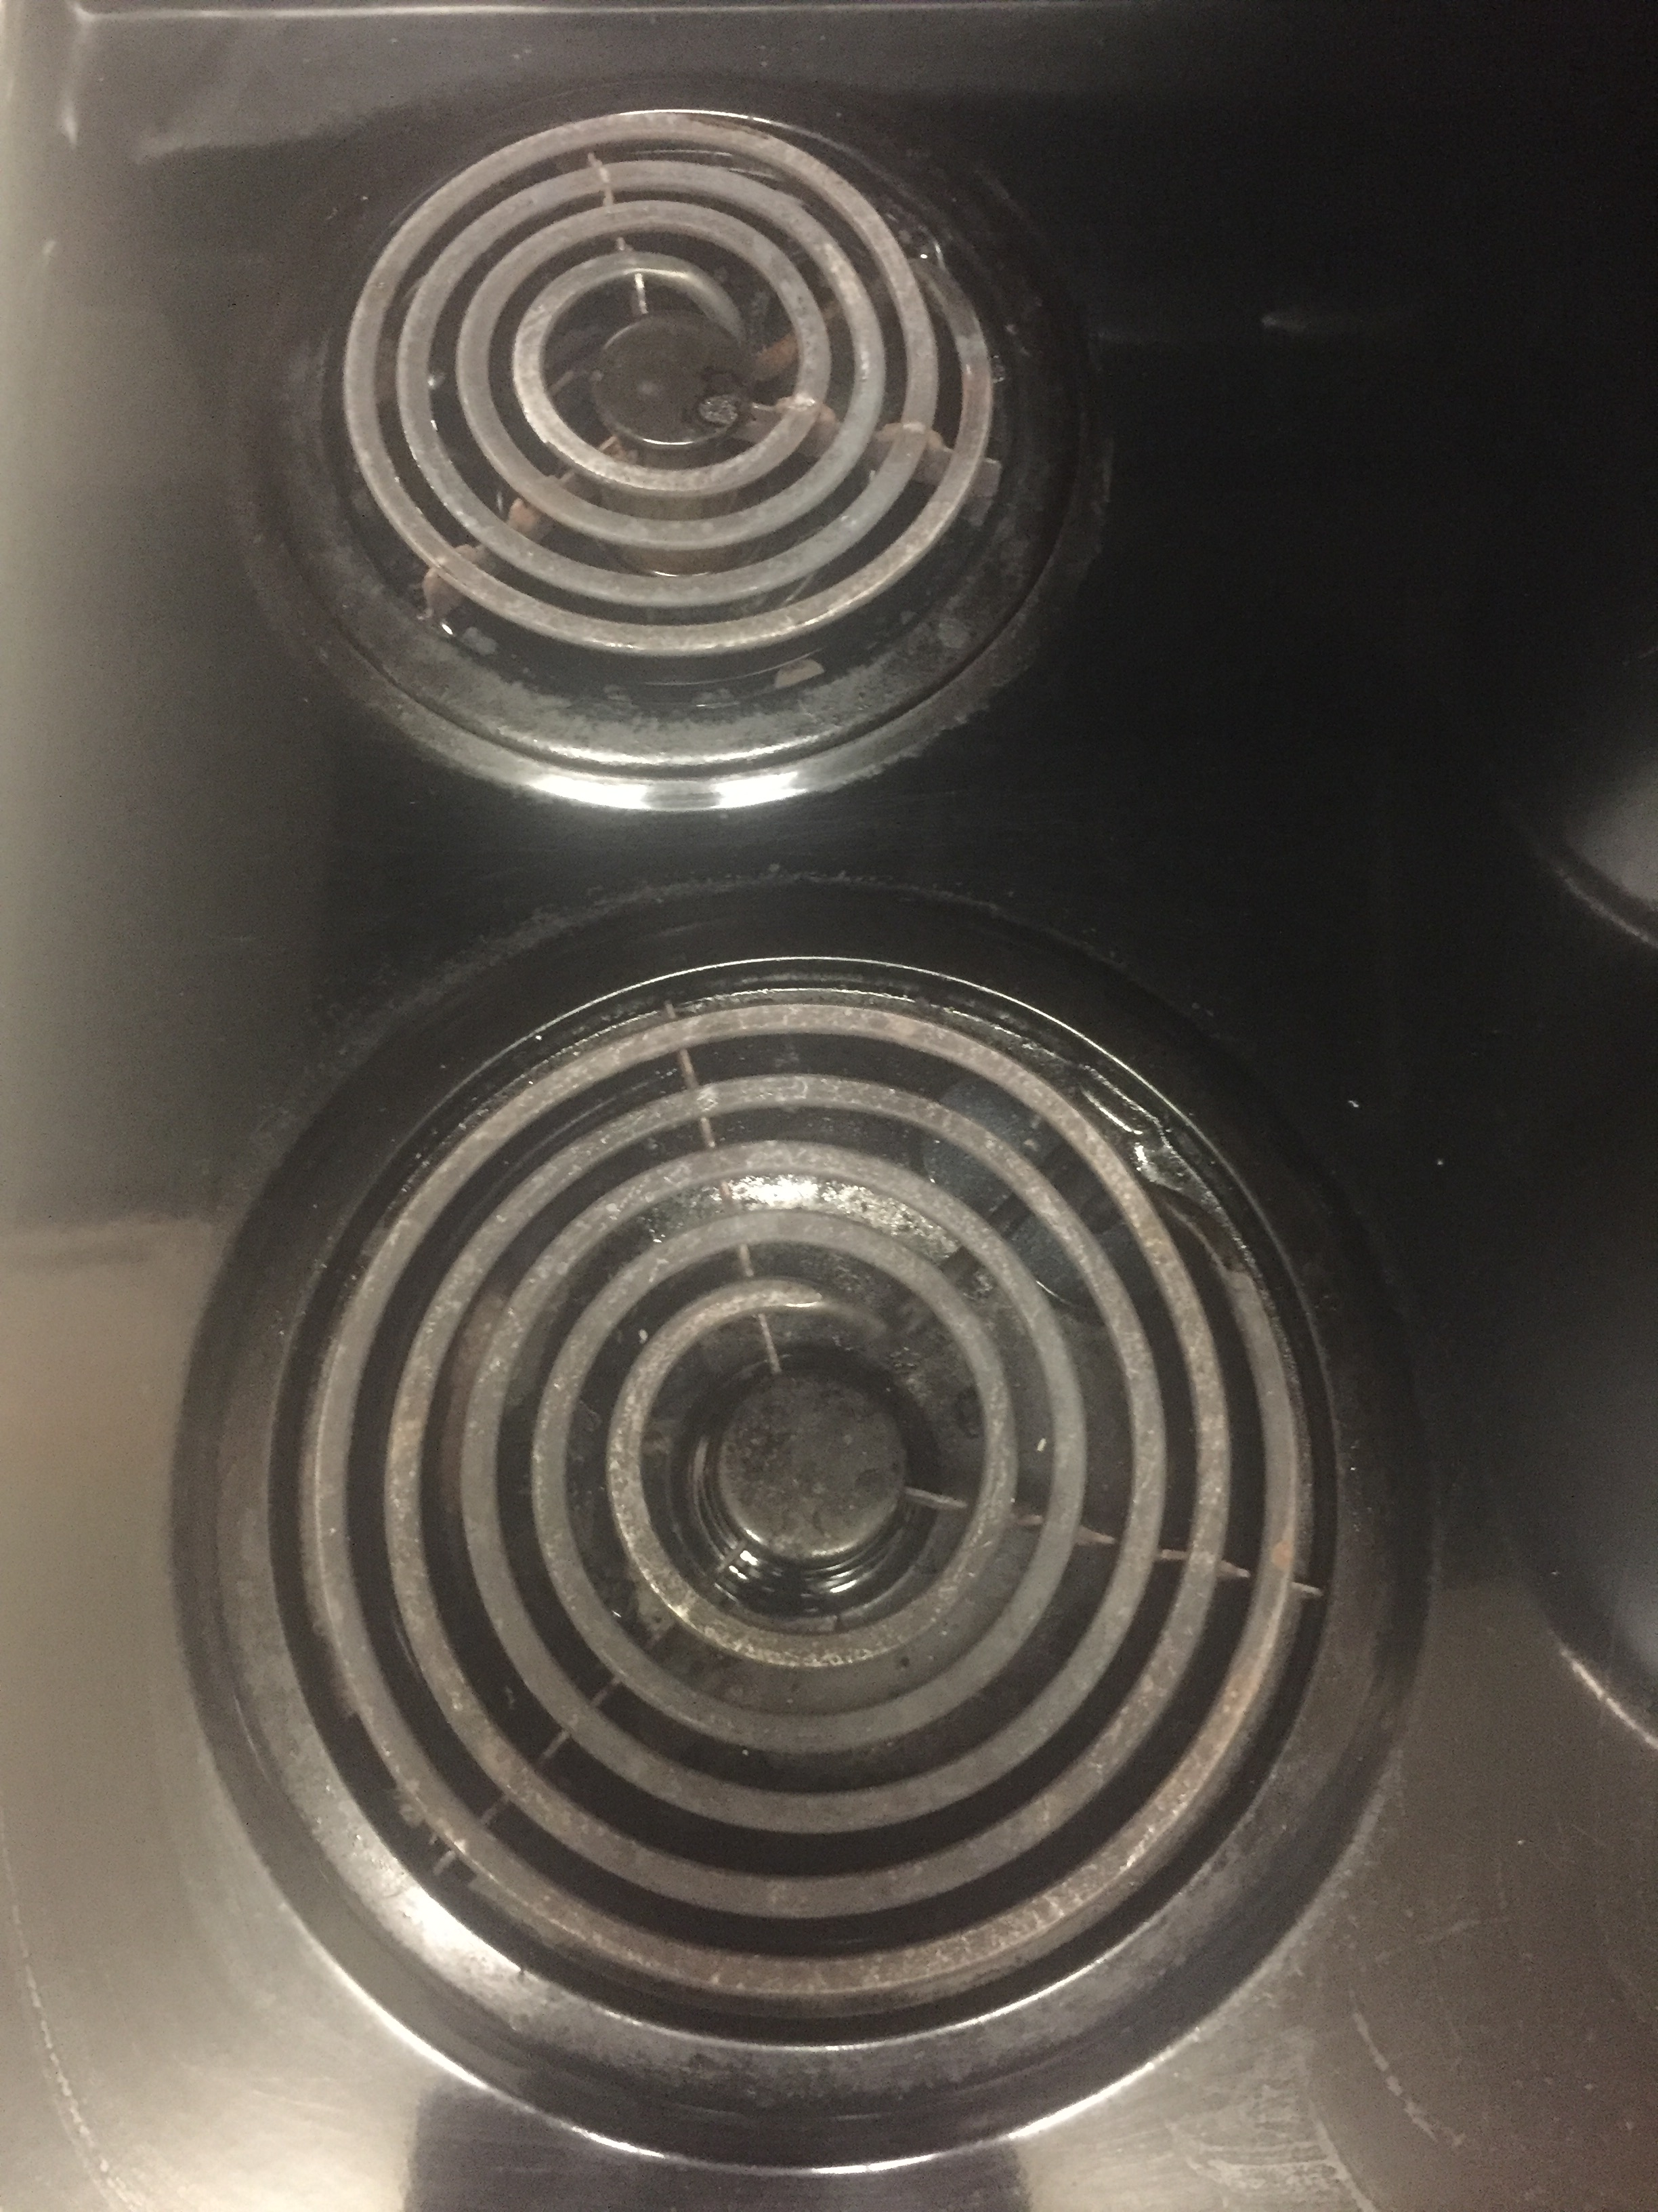
Apparatus

Slide 4

Variability and Error
Different boiling time error
Two readings

Slide 5
Data
Run | Material | Type of Stove | Pan Cover | Time(sec)
1 | Iron | type_1 | No | 330
2 | Stainless Steel | type_1 | No | 383
3 | Iron | type_2 | No | 227
4 | Stainless Steel | type_2 | No | 220
5 | Iron | type_1 | Yes | 315
6 | Stainless Steel | type_1 | Yes | 343
7 | Iron | type_2 | Yes | 210
8 | Stainless Steel | type_2 | Yes | 211
9 | Iron | type_1 | No | 339
10 | Stainless Steel | type_1 | No | 379
11 | Iron | type_2 | No | 213
12 | Stainless Steel | type_2 | No | 224
13 | Iron | type_1 | Yes | 322
14 | Stainless Steel | type_1 | Yes | 348
15 | Iron | type_2 | Yes | 212
16 | Stainless Steel | type_2 | Yes | 204

Slide 6
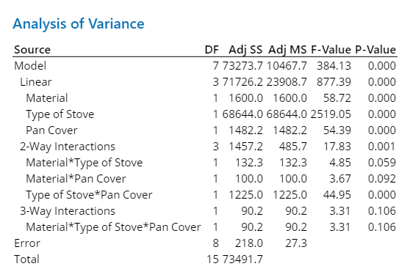
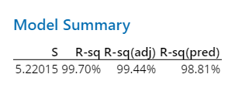
ANOVA

Slide 7
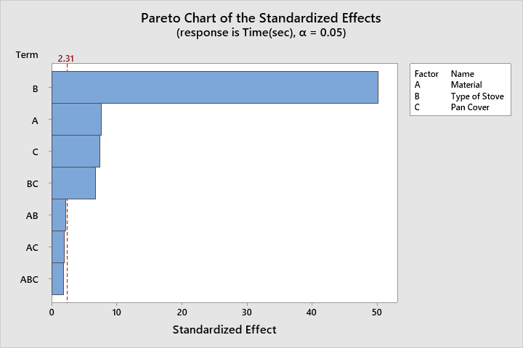
Another Confirmation

Slide 8
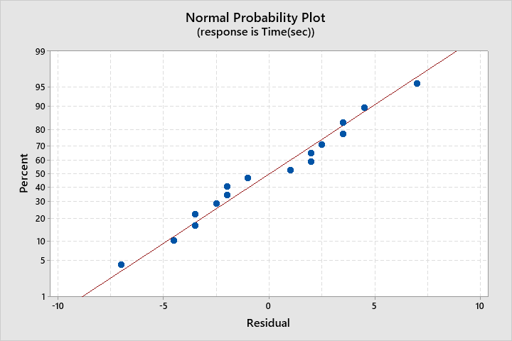
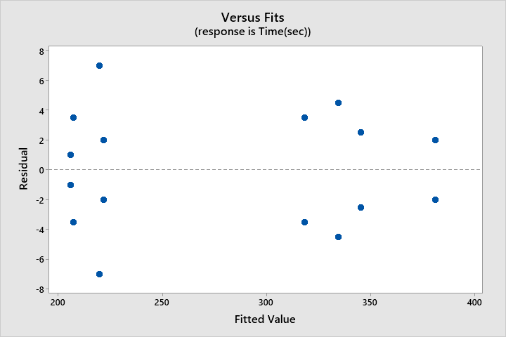
Re-confirming Assumptions

Slide 9
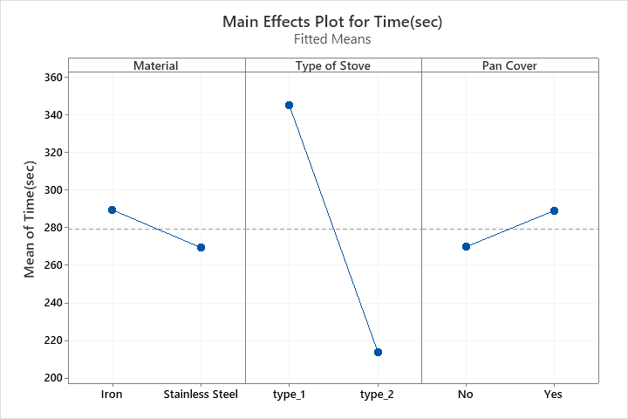
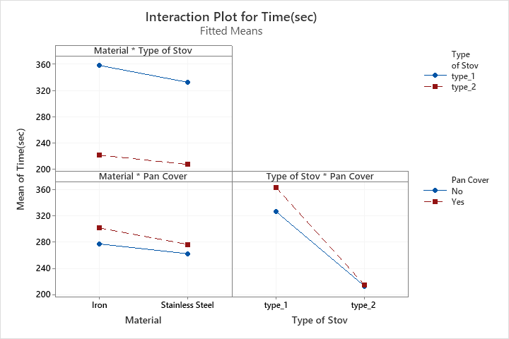
Factorial Plots

Slide 10
Conclusion and Recommendation
Definitely type_2 that is bigger Stove !

