Slide 1
AML Transaction Monitoring
Ranking transactions by laundering risk, within investigators' daily capacity
Hafeez Ullah
Enfuce · Machine Learning Engineer technical case
Notes:
Thanks for the time. I will walk through a transaction-monitoring solution: the model and how I evaluated it, how I would operate it, the architecture, and a delivery plan. Parts 1 and 2 are built end to end, Parts 3 and 4 are design. Throughout, the focus is production readiness and the reasoning behind each choice, which the brief asked for over model score.

Slide 2
1
THE PROBLEM
The problem, and why the framing matters
Given a stream of transactions where about 0.1% are laundering, rank them by risk well enough that investigators, reviewing only the top slice each day, catch as much laundering as possible for as little wasted effort as possible.
It is a ranking problem, not a yes/no classifier. The model ranks and humans decide.
The hard constraint is investigator capacity, not model capacity.
You cannot alert on everything suspicious, so the objective is recall within a fixed daily alert budget.
This is the tension the brief names: detecting suspicious activity vs generating unnecessary alerts.
Every choice in this deck is judged against it.
2 / 25
Notes:
State the problem precisely, because everything follows from it. Not a classifier, a ranker. Laundering is about 1 in 1000, investigators have fixed capacity. The question: within the alerts a team can review in a day, how much laundering do we catch for how much wasted effort. And I built it production-shaped from the start, which is what makes Part 2 possible.

Slide 3
1
THE DATA
SAML-D: synthetic transaction data over time
9.5M
0.10%
11
transactions, Oct 2022 to Aug 2023
laundering, about 1 in 960
monthly files, ready-made batches
Prevalence 0.1%, drifting up (0.10% to 0.13%). A monitoring signal in itself
Labels are per-transaction. score transactions, not accounts (an account looks normal 99% of the time)
Clean data: 293k senders, 90% recurring
28 named typologies, for error analysis only, never a feature
3 / 25
Notes:
9.5M transactions, laundering is about 1 in 1000. Two design drivers: the label is per-transaction, not per-account, so I score transactions; and the data already arrives in monthly files, which is my split unit and later my batch unit in Part 2.

Slide 4
1
EDA
EDA: look before build
Every feature decision here traces to a number, not a hunch.
What I checked | What I found | Decision
Prevalence and stability | 0.10%, drifts 0.10% to 0.13% | ranking problem, PR-AUC, Part 2 watches it
Missing values | none | no imputation step
Do accounts recur? | 90% of senders recur | account-history features are viable
Cross-border and currency-mismatch | 25% vs 10%, and 34% vs 11% (laundering vs normal) | keep both
Large amount (over GBP 100k) | 3.2% vs 0.3% | keep the flag
Night and weekend flags | no separation | dropped
Laundering_type by class | value sets are disjoint | target leakage, excluded
4 / 25
Notes:
EDA is the look-before-you-build step. Point at two or three rows: cross-border is a 2.5x lift, night and weekend flags were dropped for no signal, Laundering_type has disjoint value sets by class so it is a post-hoc label and using it would be leakage. The message: every feature choice traces to a number on this table.

Slide 5
1
PART 1 PIPELINE
The Part 1 pipeline, and how it answers the brief
load
+ time sort
transaction
features
entity
features
temporal
split
handle
imbalance
train
LightGBM
evaluate
at budget
Every step is a reasoned decision with a rejected alternative; not a default.
The brief asked for | Pipeline step that answers it
Preprocessing and feature engineering | transaction features, entity features, leakage prevention
Handling class imbalance | handle imbalance
Train, validation and test split | temporal split
Evaluation metric and the reasoning | evaluate at budget, then the metric-choice slide
Detection versus unnecessary alerts | the recall-versus-workload slide
5 / 25
Notes:
This slide is a map, not an argument. Seven steps, left to right, and everything after this is a zoom into one of them. The table maps the brief's five asks onto the steps so you can see nothing was skipped. Keep this to fifteen seconds.

Slide 6
1
HOW I WORK
The decisions, written down
Every decision that matters is a one-page ADR. Choices, rejected alternatives, trade-off
ADR | Decision | Alternative rejected
0002 | Score in daily batches, not real time | streaming / per-transaction scoring
0003 | Exclude Laundering_type from features | use it (it is a post-hoc label: leakage)
0004 | Split train / val / test by calendar month | random split, or account-grouped k-fold
0005 | Handle imbalance at the threshold, weight = 1 | cost-weight by the ratio, or SMOTE
0006 | Gated promotion: challenger, then human sign-off | auto-promote on a metric win
0001 | Keep an ADR log at all | decisions live only in commit messages
6 / 25
Notes:
Fifteen seconds on this. Every decision the brief cares about is a one-page record in the repo, with the rejected alternative and the trade-off. I'm not going to read them; the next slides walk the important ones in detail. The point of the slide is that the reasoning is written down, which is what a regulator and a model validator both ask for.

Slide 7
1
PREPROCESSING
Preprocessing: deliberately minimal
Done on load
Differs by model
LightGBM: native category dtype (no one-hot), no scaling, log1p on amount for readable importance
Baseline (LogReg): median-impute, standardise, one-hot — linear models require it
Explicit dtypes: half the memory, schema intent in code
One timestamp from Date + Time, then a global sort by time
No missing values in raw data, so no imputation
Only NaN: an entity feature on an account's first transaction, meaning "no history", not "missing"
No target encoding, no PCA. They add leakage surface and opacity for no measurable gain here.
The result: the tree does the work. That is exactly why the linear baseline is so much weaker.
7 / 25
Notes:
Preprocessing is minimal for the tree by design. The heavy prep, scaling and one-hot, is only for the linear baseline. The NaN in the entity features is meaningful: it means the account has no history, not that a value is missing.

Slide 8
1
FEATURE ENGINEERING
Feature engineering: behaviour is the signal
Transaction-level · single row, no leakage risk
Entity-level · causal, per sender and receiver
log-amount, amount bands, cross-border, currency-mismatch, hour, weekday
prior txn count, time since last txn, trailing 1d / 7d / 30d counts, 7d sum and mean, amount vs. the account's recent norm
Corridor flags: each border or currency hop breaks the trail. Cheap, a clean split, keeps the per-alert reason readable.
Windows by meaning: 1d catches a burst, 7d the account's rhythm, 30d its baseline. All strictly backward-looking (next slide).
Excluded on purpose: account IDs (identifiers, not behaviour), Laundering_type (post-hoc label, so leakage).
8 / 25
Notes:
Two groups. Transaction-level features come from one row, so no leakage risk. Entity-level features describe how the account was behaving before this transaction. The corridor flags are cheap and interpretable but not load-bearing. The real signal is behavioural: a transaction many times the account's own recent norm. Windows are chosen for meaning, not tuned. And I deliberately exclude account IDs and Laundering_type.

Slide 9
1
FEATURE ENGINEERING
Leakage prevention: the features cannot see the future
# frame is globally time-sorted on load
g = df.set_index("timestamp").groupby("Sender_account")["Amount"]
df["sender_cnt_7d"] = g.rolling("7D", closed="left").count()
# closed="left" keeps the window [t-7d, t), so the current transaction is excluded
closed="left" makes the window [t-7d, t). It stops the instant before the current transaction, so nothing at time t or after can enter it.
Expanding counts use cumcount(), so only rows already seen. An account's first-ever transaction gets count 0, not 1.
Locked by a test: a 3-row toy account asserts the first transaction sees count 0, an empty window, and a null time-since-last. Break causality and the test fails in CI.
Why it matters: train on future information and the model looks excellent in testing, then collapses in production. It is the most common silent ML failure.
9 / 25
Notes:
This is the one place I would expect a deep dive. Every history feature answers a question about what happened before this transaction, enforced three ways: a global sort on load, closed-left on the rolling window, and cumcount for expanding counts. A unit test on a toy account locks it, so a future change cannot quietly reintroduce leakage.

Slide 10
1
SPLITTING THE DATA
Splitting train, validation and test, strictly by time
Oct
Nov
Dec
Jan
Feb
Mar
Apr
May
Jun
Jul
Aug
TRAINING
8 months · Oct 2022 to May 2023
VALIDATION
June · threshold only
TEST
Jul + Aug · touched once
No shuffling. A random split lets August behaviour inform an October prediction, which inflates the score and hides model decay.
Rejected alternative: account-grouped k-fold. It removes account leakage but still mixes time periods.
Entity features are computed over the full timeline before splitting, so validation and test rows carry real history, exactly as at inference. Encoders are fit on train only.
10 / 25
Notes:
Strictly by time. A random split is leakage and it hides decay. Account-grouped k-fold, the sensible-sounding alternative, still mixes time periods. Train is the first eight months, validation is June and is used only to pick the threshold, and test is July and August and is touched exactly once.

Slide 11
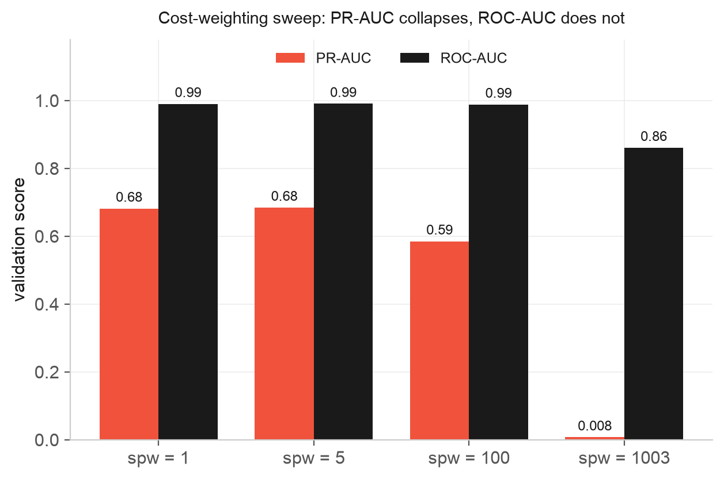
1
CLASS IMBALANCE
Handling class imbalance: a threshold problem
Three options: resample, cost-weight the loss, or move the threshold
Chosen: leave the loss alone, handle it at the threshold
Cost-weight by the ~1000x ratio → PR-AUC collapses to 0.008
That's below the 0.012 linear baseline
Why: it floods the queue with borderline negatives
ROC-AUC barely moves (0.86 → 0.99) — wrong metric to steer by
SMOTE rejected: invents impossible categorical / count rows
SMOTE also has no place in a time-ordered split
chart data pulled live from MLflow: mlflow.search_runs(experiment_names=["aml-part1"])
11 / 25
Notes:
The slide I most want to discuss, because the obvious answer is wrong. This chart is not hand-made: it is read straight out of MLflow with mlflow.search_runs on the aml-part1 experiment, the five runs from one command. Weighting the positive class by the imbalance ratio makes PR-AUC about eighty times worse, below the linear baseline. The model already ranks well, so all the weighting does is push borderline negatives up the queue. Notice ROC-AUC barely moves, which previews why it is the wrong metric. I ship weight one and handle the real trade-off at the threshold.

Slide 12
1
THE MODEL
The model: LightGBM, gradient-boosted trees
INPUT · 26 features / transaction
LightGBM
OUTPUT · one score / transaction
7 transaction-level
amount, corridor flags, time
14 account-behaviour
counts, velocity, amount vs. norm; sender and
receiver
5 categorical
payment type, currencies, bank locations
a risk score from 0 to 1
used to rank the day's transactions
never a yes/no on one transaction by itself
~1,900 shallow trees, depth 4
each tree corrects the last; model is their sum
native categoricals, handles NaN
Why trees: tabular data, categoricals and skewed counts handled natively, fast, explainable per alert via SHAP
Rejected: a neural net (overkill for 26 features and 7k positives, harder to govern); XGBoost (equivalent, slower on categoricals)
Baseline: Logistic Regression scores PR-AUC 0.012. LightGBM's 0.68 is the non-linearity and feature interactions earning their keep.
12 / 25
Notes:
What the model is, in one slide. Input is 26 features per transaction. The model is a few thousand tiny shallow trees, each a small correction to the last, summed. Output is one risk score, used to rank, never a standalone yes/no. Trees because the data is tabular with categoricals and skewed counts, it retrains fast, and it is explainable per alert. The logistic regression baseline at 0.012 proves the model is doing real work.

Slide 13
1
MLOPS
Experiment tracking and the model registry: MLflow
The imbalance sweep is 5 tracked runs from one command. Every run captures params, metrics, the model artifact, the git commit and the environment.
run | val PR-AUC | val ROC-AUC | trees used
logreg baseline | 0.012 | 0.883 | n/a
lightgbm spw = 1 (shipped) | 0.682 | 0.990 | 1993
lightgbm spw = 5 | 0.685 | 0.991 | 2000
lightgbm spw = 100 | 0.585 | 0.989 | 2000
lightgbm spw = 1003 (naive) | 0.008 | 0.861 | 2 (loss collapses)
Model registry
aml-transaction-monitoring
v1 as @champion
in production
v2 as @challenger
from MLOps, not yet promoted
ROC-AUC barely moves across the sweep (0.86 to 0.99). PR-AUC swings 80x.
That is the evidence that ROC-AUC is the wrong metric.
Scoring loads models:/aml-transaction-monitoring@champion, never a version number.
Promotion and rollback are one alias move, not a redeploy.
Training is an offline job. The notebook loads the registered model and never retrains, so experiment and analysis stay separated.
13 / 25
Notes:
The job description names MLflow first, so I show it working. The table is five real runs. Point at the trees-used column: weight one learns over 1993 rounds, the naive weight collapses at two. Point at ROC-AUC barely moving while PR-AUC swings eighty times. On the right, one model is promoted; scoring asks for the champion alias, never a version, so promotion and rollback are one move. I can open the live UI in the discussion.

Slide 14
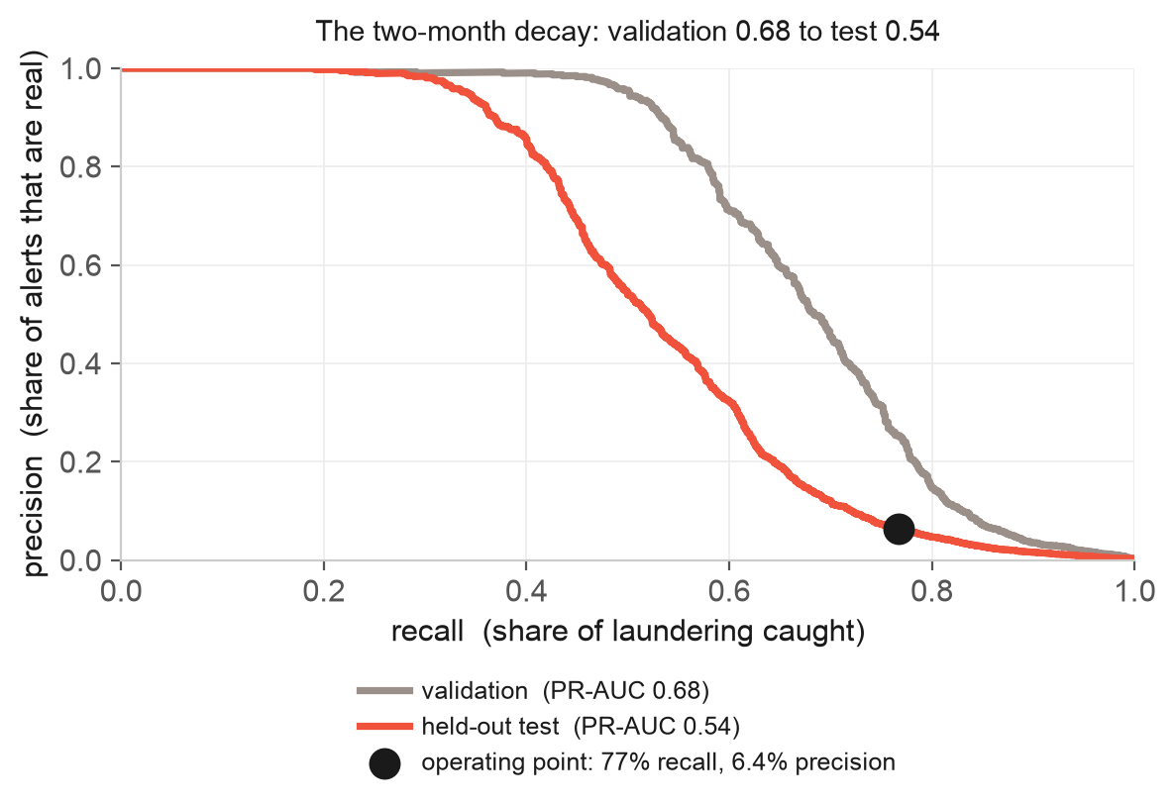
1
EVALUATION METRIC
Choosing the metric, and the result
Accuracy and F1 rejected — they need a fixed 0.5 cut; we alert on the top 1%
ROC-AUC rejected as headline — millions of easy negatives drown it (~0.98 even when weak)
PR-AUC is the headline: threshold-free
It rewards precision on the positives only — what an alert list lives on
Result: 0.68 validation, 0.54 held-out test
The two-month drop is real decay → MLOps addressess
14 / 25
Notes:
ROC-AUC sits at 0.98 and is meaningless at a thousand-to-one. Accuracy and F1 need a 0.5 cut we never use. PR-AUC is the honest summary. On the chart, the grey curve is validation, the coral curve is held-out test, and the dot is the operating point: the validation threshold carried over to test. The gap between the curves is the two-month decay, and that is the bridge to Part 2.

Slide 15
1
DETECTION VS. ALERTS
Detecting suspicious activity versus unnecessary alerts
Threshold fixed on validation at the 1% budget
Applied unchanged to test, no peeking
~405 alerts/day
Precision 6.4%, recall 77%
1390 caught, 423 missed
Operating point
Where you sit on this curve is a capacity and risk-appetite decision for the investigations team, not a modelling choice
Cost framing: the regulator sets a minimum recall, capacity sets the budget, and model quality decides whether both can be met
The realised alert rate drifted from 1.0% to 1.4% as scores rose.
Fixed threshold, moving target.
15 / 25
Notes:
The threshold is fixed on validation and applied blind to test. That comes out to about 405 alerts a day, roughly 26 of them real, catching just over three-quarters of laundering. The curve is the recall-versus-workload trade-off at other budgets. My job is to hand the team the curve, not to pick the point. And the realised rate drifted to 1.4 percent, which is a Part 2 hook.

Slide 16
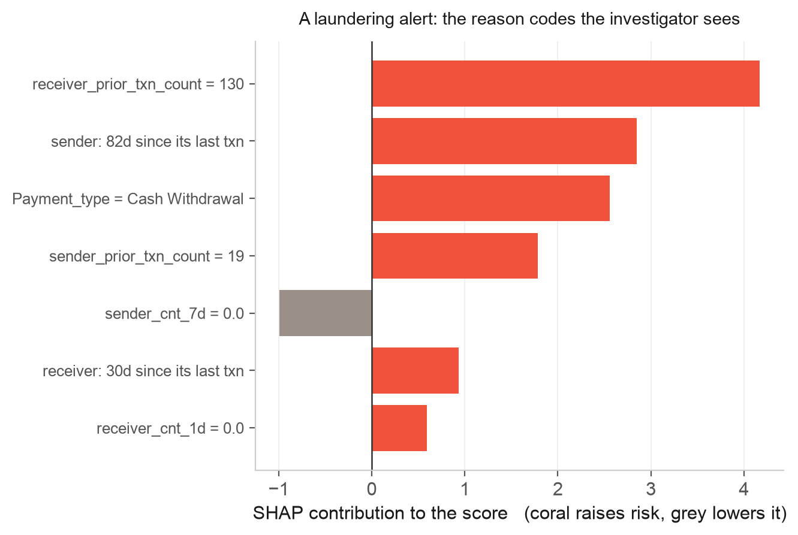
1
EXPLAINABILITY
Every alert carries its own reason
SHAP splits a score into a base rate + a signed push per feature; they sum to the score
Coral raises risk, grey lowers it
Not optional for AML: every alert needs a reason, every SAR a documented basis
Model-risk validation asks for the driver of one decision, not global importance
This alert: a payment ~6.5x the sender's 7-day average, into a thin-history receiver
Every driver points the same way — up
Aggregated, the same method gives honest global importance: account behaviour carries the model
Tree-path SHAP is exact for GBDTs, cheap enough for every alert in the batch
16 / 25
Notes:
This slide answers 'can you explain a single decision'. SHAP decomposes one score into a base rate plus a signed push from each feature, and they sum exactly to the score. Walk the example: a cash withdrawal, the sending account dormant for nearly three months and only nineteen transactions old, moving money to an account with a hundred and thirty prior transactions. Those push the score up. One feature, the sender's zero transactions in the last week, pushes it down, and the grey bar shows it. The investigator sees this, not just a number. Same method aggregated gives the honest global picture. It is a regulatory requirement, not a nicety.

Slide 17
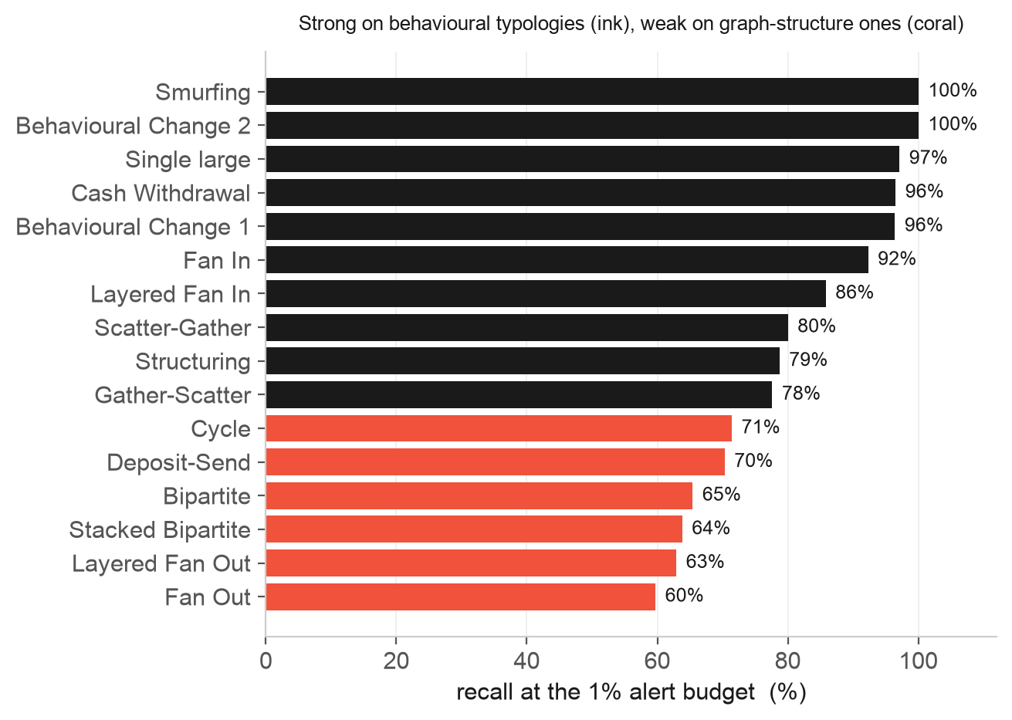
1
ERROR ANALYSIS
Where recall comes from, and honest limits
Strong where behaviour is the signal (ink). Weak on graph-structure patterns (coral), because there are no graph features yet.
No graph features, so weak on fan-out and bipartite. Top of the backlog.
The model decays measurably over about 2 months.
Synthetic, instant labels. Real SAR outcomes lag by months.
A single global threshold. A per-corridor threshold would likely lift recall.
17 / 25
Notes:
Per-typology recall tells the investigations team what to trust. The colour split is the point: ink where the model is strong, coral where it is weak. It is strong on the behavioural typologies, structuring and smurfing and cash withdrawal, and weak on the graph-structure ones, fan-out and bipartite, because I have no graph features yet. That is the top item on the backlog. Three other honest limits are on the right.

Slide 18
2
ML LIFECYCLE AND MLOPS
Operating the model: the lifecycle loop
daily
batch
validate
features
score
alerts
MONITOR
retrain
(rolling)
challenger
+ shadow
approve +
promote
Dark = the daily pipeline. Coral = monitoring, the focus of the next slide. Outlined = the governed retrain-and-promote loop.
The model gets worse over two months, so someone has to keep it healthy. The loop also feeds itself: each alert an investigator acts on becomes a training label for the next version.
Demonstrated · built, run on Jul + Aug
Conceptual
monitoring on every batch, a codified retraining trigger, and a rolling-window retrain with a challenger and gated promotion
registry mechanics, shadow deployment, delayed and biased labels with reservoir sampling, feature-store parity, governance and audit, incident response
18 / 25
Notes:
The model decays, the Part 1 evaluation proved it, so it has to be operated. The three box colours are three tiers: the daily pipeline, the monitoring step which is the focus, and the governed retrain-and-promote loop. The lifecycle runs on proxy signals because true labels lag months, and the feedback loop matters: investigator decisions on alerts are where tomorrow's labels come from. I built and ran the monitoring, the trigger, and challenger promotion on the July and August batches.

Slide 19
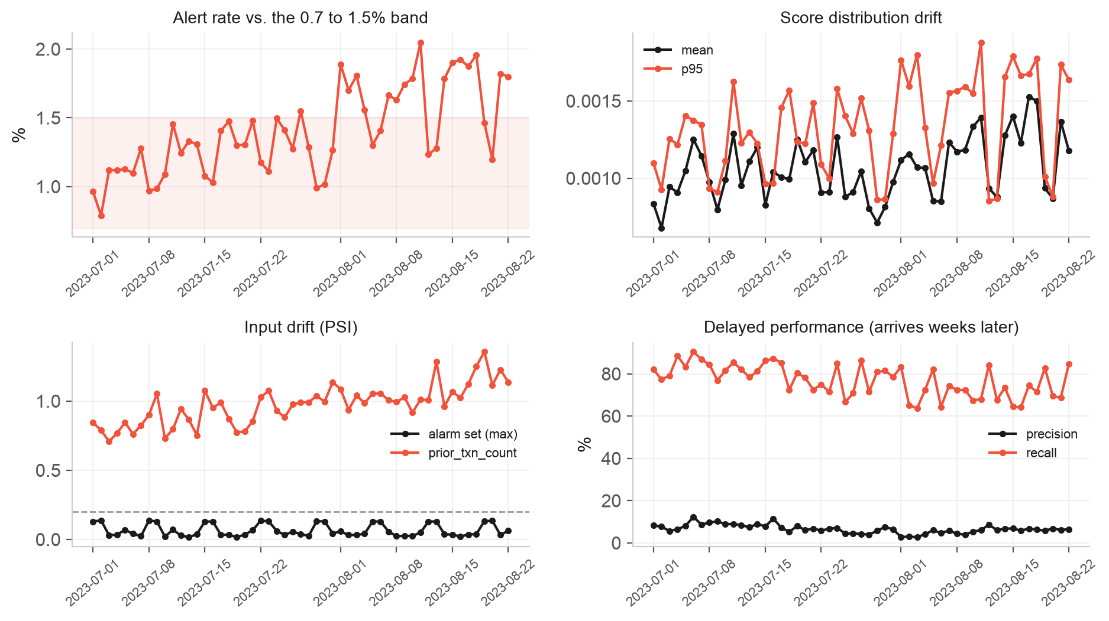
2
ML LIFECYCLE AND MLOPS
Monitoring every batch, and what it caught
Four layers, cheapest first: data quality → input drift (PSI) → prediction drift → delayed performance
Real prediction drift: alert rate crossed the 1.5% band from 1 August
Delayed performance confirms it: precision 7.4% → 5.5%, recall 80% → 72%
Final partial batch (8k vs 30k rows) caught by the data-quality gate, metrics suppressed
Input-drift alarm also caught a feature bug: two prior-txn counters drift with calendar time alone (PSI 1.4)
Tagged as known drift, excluded from the alarm, backlogged
Monitoring doing its job
19 / 25
Notes:
Four layers, cheapest first, each compared to a reference snapshot versioned with the model. The four panels are the real replay output. Top-left, the alert rate climbs out of the band in August. Two findings: real prediction drift, the alert-rate breach; and a feature bug, the unbounded counters whose drift is pure calendar time. The second is exactly what you deploy monitoring to catch.

Slide 20
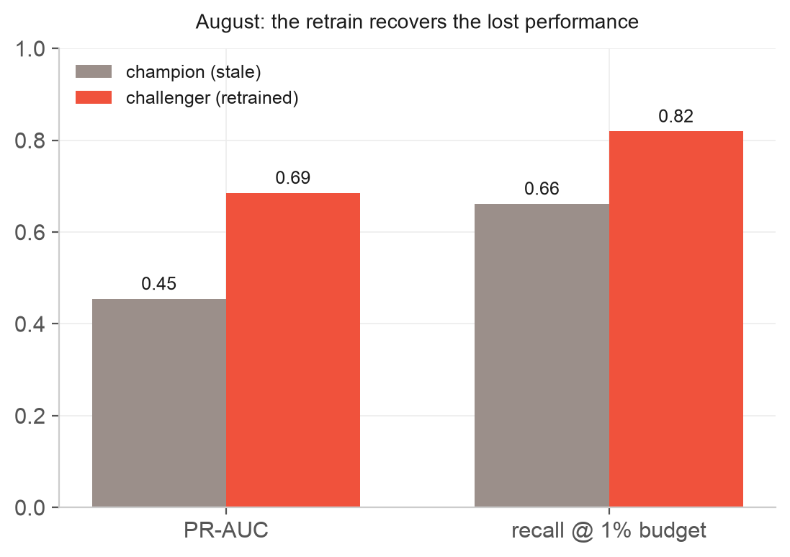
2
ML LIFECYCLE AND MLOPS
Trigger, retrain, challenger, gated promotion
The trigger fired on 3 August. Reasons: the scheduled monthly floor, and alert-rate drift for 3 consecutive days.
Retrained on a rolling 8-month window (December 2022 to July 2023), to track current behaviour rather than all history
The new model is a challenger, judged on the most recent labelled slice (August), and never promoted automatically
Promotion is a registry operation, not a deploy
The challenger beats the champion, so it is registered and the @challenger alias is set. It then awaits model-owner and compliance sign-off before it takes @champion. Scoring only ever asks for @champion, so promotion and rollback are one alias move, and the previous version stays loadable.
20 / 25
Notes:
The trigger fired on 3 August for two reasons: the scheduled monthly floor and three days of alert-rate drift. I retrained on a rolling eight-month window, not all history, so the model tracks current behaviour. The chart: grey is the stale champion, coral the retrained challenger, judged on August. It clearly wins, PR-AUC 0.69 against 0.45. But it is not promoted automatically. A model owner and compliance sign off, then the alias moves. Rollback is the same move in reverse.

Slide 21
3
PRODUCTION ARCHITECTURE
A daily batch pipeline on AWS
S3 raw
immutable
Validate
GE / Deequ
Features
Glue / EMR
Score
SageMaker
Rank + alert
DynamoDB / SQS
Monitor
Evidently
Orchestration: Step Functions daily, plus a second state machine for retrain, shadow and promote. MLflow registry on Fargate. Terraform.
Batch, not streaming.
The label and the workflow are both post-event, so there is no real-time decision.
Add streaming only for a specific high-risk corridor if the business needs faster interdiction.
The MLflow registry is the single control point.
Scoring loads the @champion alias, never a path.
Rollback is an alias move, then re-score.
The raw zone is immutable and date-partitioned.
Any past batch can be re-scored with any model version.
21 / 25
Notes:
Talk to the flow left to right. Raw is immutable storage. Validation sits upstream of scoring because a broken feed is the number one cause of what looks like model failure. Scoring is the one coral box, the model step. The registry is the single control point, and immutable raw plus versioned models is reproducibility: any past batch, any model version.

Slide 22
3
PRODUCTION ARCHITECTURE
Technology choices: the trade-offs
Decision | Choice | Alternative | Why this way
Serving | Daily batch | Streaming | Post-event problem, so batch is simpler with no train/serve skew
Compute | SageMaker | EKS with Kubeflow | Managed, minimal ops for a small team
Registry | MLflow, self-hosted | SageMaker Model Registry | One tool for tracking and registry, portable, team standard
Feature compute | Glue / EMR Serverless | Pandas on a big box | Scales past 10x volume, serverless
Feature storage | S3 table plus shared code | SageMaker Feature Store | Batch-only, so parity without the infrastructure
Case management | Buy | Build a UI | Not the differentiation, and it fits the investigator workflow
22 / 25
Notes:
Every choice is biased toward less operational burden for a small team. For each row I can name the alternative and the condition under which I would switch: EKS if the organisation already runs Kubernetes, a feature store if a real-time path appears, build the case-management UI only if an off-the-shelf one does not fit the investigator workflow.

Slide 23
4
DELIVERY
From proof of concept to production over 3, 6 and 9 months
The model never replaces the rules outright: shadow, then parallel, then staged retirement.
0 to 3 months: make it trustworthy
3 to 6 months: make it self-sustaining
Graph features and typology models
Per-corridor thresholds
Full model cards, annual validation
Staged rules retirement
The lowest-risk work, and only after the foundations hold.
Reliable pipeline and data validation
One model, fully monitored
Shadow mode, action nothing
Baselines agreed with compliance
You cannot operate, or get sign-off for, a control you cannot see.
Automated retraining with challengers
Investigator feedback loop for labels
Reservoir sampling for unbiased recall
Run in parallel with rules
Label lag is months, so the feedback loop must start early.
6 to 9 months: make it better and auditable
23 / 25
Notes:
Reliability first, sophistication last, which is the opposite of the instinct. Shadow before parallel before retirement. Each stage has an exit criterion: the pipeline SLA met for four weeks, then two clean automated retrains, and so on. The feedback loop starts in phase two because label lag is months and it has to be running before the labels are needed.

Slide 24
What I would want you to take away
Framed as alerting, not classification: recall at a fixed workload
Causal features, a temporal split, and imbalance treated as a threshold problem.
Each choice was tested against an alternative, not asserted.
Every alert is explained with SHAP, which a regulated control needs
The model decays measurably in 2 months, and MLOps makes that operable
The production seams are already in place: package, ADRs, MLflow, registry
77%
of laundering caught
at about 400 alerts per day
recall at the 1% validation budget, applied to held-out test (1390 of 1813)
24 / 25
Notes:
To close: I treated it as alerting, not classification, and made every choice with investigator workload in mind, testing each against an alternative rather than asserting it. Every alert is explained. The headline is 77 percent of laundering caught at about 400 alerts a day, and it decays in two months, which is exactly what Part 2 is built for.

Slide 25
Thank you
Questions and discussion
Hafeez Ullah
AML Transaction Monitoring · Enfuce technical case
Notes:
Thank you. Happy to go as deep as you like on any part of it: the imbalance sweep, the leakage handling, the monitoring, the architecture trade-offs, or the delivery plan.

