Slide 1

NIST Immunization Test Suite
Focus on ONC 2015 Health IT Certification
Robert Snelick
National Institute of Standards and Technology (NIST)
Rob Savage, Craig Newman
Center for Disease Control (CDC)
January 21st, 2016
Contact: robert.snelick@nist.gov

Slide 2
Objectives
ATL Training for the NIST Immunization Test Suite to support ONC 2015 Health IT Certification
Test Criterion and Test Procedure
Understand and link relevant parts of the Immunization Implementation Guide
Review Test Cases
Administration Test Case Group
Query/Response Test Case Group
Review Documentation
Notes:
Limited: by the (availability/testability/in-scope for this) of functional requirements; time/resources

Slide 3
Immunization Test Suite: Overview and Capabilities
1
Transport
SOAP Envelope Testing
Validate message to SOAP schema and to CDC WSDL
[EHR-S and IIS]
2
SOAP Connectivity Testing
Echo back; Fault generation (Authentication; Message Size, etc.)
[EHR-S and IIS]
3
Content
HL7
Context-free Testing
Cut-n-paste; validate message structure and most vocabulary
[EHR-S and IIS]
4
Cut-n-paste; validate message against test cases and test data
[EHR-S and IIS]
HL7
Context-based Testing
ONC 2015 Certification
5a
Functional
Phase-by-phase testing
Start simple and progress
Independent—can enter at any stage
Phase 4 (ONC 2015 Certification Test Plan)
Multiple levels within a phase
Detailed test cases and associated data
EHR-S Functional Testing
5
Interactive round-trip; scenario and functional testing
[End-to-end Testing]
5b
IIS Functional Testing

Slide 4
Immunization Validation Tool Overview
Tool Key Capabilities
SOAP Envelope Testing | The SOAP Envelop Testing ensures SOAP envelopes are correctly formed, validating the conformance of the messages to the requirements in the SOAP and Transport specifications.
SOAP Connectivity Testing | The SOAP Connectivity Testing evaluates valid SOAP connectivity, the ability to send and receive SOAP messages, validating the conformance of the messages to the requirements in the SOAP and Transport specifications.
Context-Free Testing | Provides a simple and convenient method for testing immunization messages structure and most vocabulary. Validation is perform on messages with or without a SOAP wrapper.
Context-Based Testing | Context-based testing provides, in addition to HL7 Context-free validation, message validation associated with a given test script that includes data for a specific test scenario where the context is known by the validation tool. It also validate messages with a SOAP wrapper.
Isolated Testing | Isolated testing provides a simulated operational environment that allows validation at the functional level in addition to content and context-free testing, where Test Agents simulates the functions of IZ EHR-S or IIS.
Environment: NIST Immunization Test Suite is accessible as a web application.
Supported Browsers: Firefox, Chrome, Safari, and Internet Explorer (Version 10 and 11)
URL: http://hl7v2-iz-r1.5-testing.nist.gov
NOTE: The Test Tool (.war file) can also be downloaded and installed locally. See Documentation tab in Test Tool

Slide 5
ONC 2015 Health IT Certification

Slide 6
ONC Final Rule Criterion - Immunizations
§170.315(f)(1) Transmission to immunization registries
Evaluates the capability for a Health IT Module to electronically create immunization information for electronic transmission using the Immunization Messaging Guide and associated Addendum, with CVX codes for historical vaccines and National Drug Code Directory codes for administered vaccines
Evaluates the capability for a Health IT Module to enable a user to request, access, and display a patient’s evaluated immunization history and forecast from an immunization registry with information from the Health IT Module, if applicable, using the Immunization Messaging Guide and associated Addendum
Referenced Standards
§170.205 Content exchange and implementation specifications for exchanging electronic health information
(e)(4) Standard. HL7 2.5.1 Implementation specifications.
HL7 2.5.1 Implementation Guide for Immunization Messaging, Release 1.5
HL7 Version 2.5.1 Implementation Guide for Immunization Messaging (Release 1.5)—Addendum, July 2015
§170.207 Vocabulary standards for representing electronic health information
(e)(2) Standard. HL7 Standard Code Set CVX -- Vaccines Administered, updates through August 17, 2015
(e)(4) Standard. National Drug Code Directory– Vaccine Codes, updates through August 17, 2015
Note: The ONC certification criterion does not specify use of a transport standard; therefore, testing for this criterion does not require Health IT Modules to be certified to any transport standards

Slide 7
Messaging Standard – Supported Profiles
HL7 2.5.1 Immunization Implementation Guide Release 1.5
HL7 2.5.1 Immunization Implementation Guide Release 1.5, Addendum
All 8 Profiles Supported
VXU^V04
Z22 - SEND UNSOLICITED IMMUNIZATION UPDATE USING A VXU
ACK
Z23 - RETURN AN ACKNOWLEDGEMENT
QBP^Q11
Z34 - REQUEST A COMPLETE IMMUNIZATION HISTORY
Z44 - REQUEST EVALUATED IMMUNIZATION HISTORY AND FORECAST QUERY PROFILE
RSP^K11
Z31 - RETURN A LIST OF CANDIDATES PROFILE
Z32 - RESPONSE PROFILE – RETURN COMPLETE IMMUNIZATION HISTORY
Z33 - RETURN AN ACKNOWLEDGEMENT WITH NO PERSON RECORDS
Z42 - RETURN EVALUATED HISTORY AND FORECAST

Slide 8
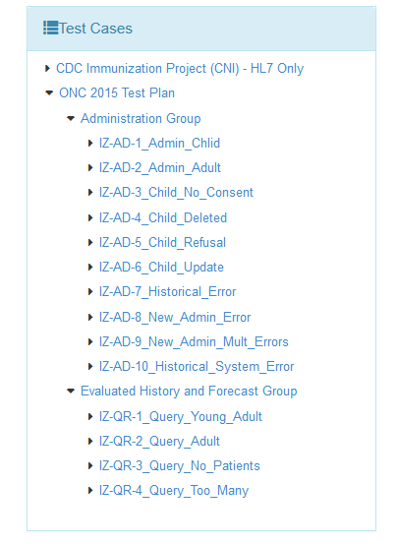
Test Plans and Associated Test Cases and Test Steps
ONC 2015 Certification Test Plan
Designed for ONC 2015 Edition certification testing
Consists of two Groups of Test Cases
10 Administration Test Case
4 Evaluated History and Forecast Test Cases
Provides Test Steps containing the test data
Includes five of the profiles defined in the Immunization Messaging Guide Release 1.5, which are paired for the certification testing
Profile Pair | Message Pair | Description
Z22/Z23 | VXU^V04/ACK | Send Immunization/ACK
Z44/Z42 | QBP^Q11/RSP^K11 | Evaluated History & Forecast—Query/Respond OK (Found)
Z44/Z33 | QBP^Q11/RSP^K11 | Evaluated History & Forecast—Query/Respond NF (Not Found)
Z44/Z33 | QBP^Q11/RSP^K11 | Evaluated History & Forecast—Query/Respond TM (Too Many)

Slide 9
ONC 2015 Certification Test Plan
Test Cases | Message Created – Step 1 | Message Returned – Step 2
Administration Group | Send Administration Message | Consume ACK Message
IZ-AD-1_Admin_Child | IZ-AD-1.1_Send_V04_Z22 | IZ-AD-1.2_Receive_ACK_Z23
IZ-AD-2_Admin_Adult | IZ-AD-2.1_Send_V04_Z22 | IZ-AD-2.2_Receive_ACK_Z23
IZ-AD-3_No_Consent | IZ-AD-3.1_Send_V04_Z22 | IZ-AD-3.2_Receive_ACK_Z23
IZ-AD-4_Delete_Record | IZ-AD-4.1_Send_V04_Z22 | IZ-AD-4.2_Receive_ACK_Z23
IZ-AD-5_Refusal | IZ-AD-5.1_Send_V04_Z22 | IZ-AD-5.2_Recieve_ACK_Z23
IZ-AD-6_Update_Record | IZ-AD-6.1_Send_V04_Z22 | IZ-AD-6.2_Receive_ACK_Z23
IZ-AD-7_Historical_IIS-Error | IZ-AD-7.1_Send_V04_Z22 | IZ-AD-7.2_Receive_ACK_Z23
IZ-AD-8_Admin_IIS-Warning | IZ-AD-8.1_Send_V04_Z22 | IZ-AD-8.2_Receive_ACK_Z23
IZ-AD-9_Admin_IIS-2Warnings | IZ-AD-9.1_Send_V04_Z22 | IZ-AD-9.2_Receive_ACK_Z23
IZ-AD-10_Historical_IIS-SysError | IZ-AD-10.1_Send_V04_Z22 | IZ-AD-10.2_Receive_ACK_Z23
Evaluated History & Forecast Group | Send Query Message | Receive Response Message
IZ-QR-1_Query_Child | IZ-QR-1.1_Query_Q11_Z44 | IZ-QR-1.2_Response_K11_Z42
IZ-QR-2_Query_Adult | IZ-QR-2.1_Query_Q11_Z44 | IZ-QR-2.2_Response_K11_Z42
IZ-QR-3_Query_No_Patients | IZ-QR-3.1_Query_Q11_Z44 | IZ-QR-3.2_Response_NF_K11_Z33
IZ-QR-4_Query_Too_Many | IZ-QR-4.1_Query_Q11_Z44 | IZ-QR-4.2_Response_TM_K11_Z33

Slide 10
Administrative Test Group Overview
Administrative Test Group
Tests the EHR-S capability of: (1) Creating immunization messages based on Immunization Messaging Standard (Z22 Profile) and specific Test Data, and (2) Receiving acknowledgment messages based on the Immunization Messaging Standard (Z23 Profile).
All 10 test cases consists of 2 test steps: (1) Create Immunization Message (2) Receive Acknowledgment
Create Immunization Message | Create immunization message test steps are designed to test a broad scope of the immunization messages including new and historical administrations, refusals, combination vaccines, patient consent and various observations including VIS, VFC.
(2) Receive ACK | Receive acknowledgement test steps are designed to test the EHR-S capability to correctly handle application accept, application error, and application warning acknowledgements. A juror document is provided for inspection.

Slide 11
Immunizations Administration Testing Process
Immunization IG, Release 1.5, and Addendum
Immunization Data Entry
VXU Message & Direct Data Entry
HIT Module
(System under Test)
NIST Validation Tool (acting as IIS)
VXU Message
ACK Message Imported
ACK Message
VXU Message
Imported
ONC Certification Testing Scope
Test Step 1
Test Step 2
The HIT Module is the system being tested. The HIT Module is required to create VXU messages and consume ACK messages that conform to the referenced standards (see previous slides).
Test data can be entered into the HIT Module directly via the Module’s user interface or can be imported via an incoming message.
The HIT Module is expected to process the test data to create a VXU message. This message is imported into the testing tool for validation (Test Step 1 – Z22 VXU). The HIT Module is expected to consume an ACK message. This message is imported from the testing tool into the HIT Module (Test Step 2 – Z23 ACK).
Test data are available through the Test Tool via the Test Steps in the Test Cases. Each Test Step includes a Test Story that provides the context, a Test Data Specification that lists the test data, a Message Content Data Sheet that shows the conformant message (in a table format), and a Juror Document (for ACK Test Steps).

Slide 12
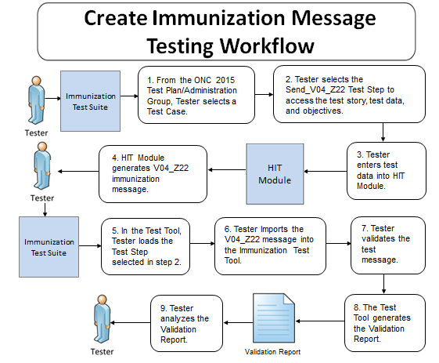
Testing Workflow Diagram (Test Step 1 – Z22 VXU)
This diagram shows
How the major steps of the create VXU message test are sequenced
When the Test Tool is to be used

Slide 13
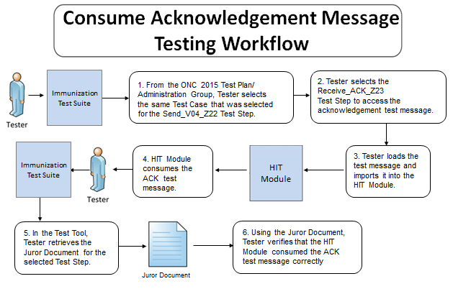
Testing Workflow Diagram (Test Step 2 – Z23 ACK)
This diagram shows
How the major steps of the consume ACK message test are sequenced
When the Test Tool is to be used

Slide 14
Test Case 1: Immunization for Child
IZ-AD-1_Admin_Child
Purpose | Create administration message containing historical and new administrations for a child. Receive an application accept acknowledgement
Steps | High-level Test Objectives
Step 1: IZ-AD-1.1_Send_V04_Z22 Create Administration Message | Create record for a Child (Infant) 3 New Administration Immunizations (use NDC) 2 Historical Immunizations (use CVX) Next of Kin (multiple instances) Combination Vaccine Observations including: Patient Consent VIS – Vaccination Information Statement Funding Source VFC Eligible – Vaccine Funding for Children
Step 2: IZ-AD-1.2_Receive_ACK_Z23 Receive ACK | Receive valid application accept acknowledgement without error and transparent to end user

Slide 15
Vaccine Codes Required for Immunization Messages
2015 ONC Certification Testing Only
Codes from the NDC Directory are required for vaccines in new vaccine administered records in
Z22 VXU (send unsolicited immunization update message)
CVX codes are required for vaccines in vaccine historical records in
Z22 VXU (send unsolicited immunization update message)
Z42 RSP (return evaluated history and forecast message)
Example Scenario
A Z22 VXU message is transmitted from an EHR to an IIS with an NDC for a new vaccine administered
A query for an Evaluated Immunization History and Forecast (Z44 QBP message) is performed via the EHR the next day
The response for the Evaluated Immunization History and Forecast (Z42 RSP message) is transmitted from the IIS with a CVX code for the vaccine sent with an NDC in the Z22 VXU the day before, as this vaccine now exists as a historical record in the IIS

Slide 16
NDC Format
NDC has various formats for representing a concept
Published NDC codes are 10 digits with dashes (can be groups of 4-5, 3-4, 1-2, digits but always 10 total)
CMS created 11 digit unformatted (padded without dashes, always with 5-4-2, groups of digits with one of the 1st, 2nd, or 3rd component padded with a 0)
The problem of the 10 digit format is that they don’t often have the dashes and so can’t reliably be determined to match a given vaccine. This motivated the “normalization” to 11 characters.
11 digit format with dashes and padded. E.g., “CDC Vaccine Price List”
much of the vaccine used in the US is federally funded and ordering uses the 11 character with dash—this format was determine to be the most appropriate choice
The link in the ONC rule points to files that contain the 11 digit format with dashes and padded.
Bar codes are created that map to the NDC codes (Today’s NDC bar codes are unique). Bar codes contain a prefix, 10 digit NDC (no dashes), and a check digit
There are crosswalk tables to keep all of this straight and to be able to go from one format to another (Implementers may need to do this to meet their implementation choices)
Certification Requirements are to use the 11 digit format with dashes and padded
RXA-5.1 Example: 00006-4047-20^RotaTeq^NDC
Note 10 digit NDC code is 0006-4047-20 with the leading 0 added to the first component.
No other formats are acceptable for certification
If vendors wish to send an alternative code they may do so in the 2nd triplet of RXA-5
e.g., 00006-4047-20^RotaTeq^NDC^00006404720^RotaTeq^NDC
In this case the 11 digit padded without dashes format is used
First triplet must be NDC 11 padded with dashes
Vendors can represent the NDC codes internally in their HIT system in any manner they choose

Slide 17
Testing Acknowledgements
Test Cases 1-6 contain no Errors or Warnings
Nothing needs to be displayed or indicated by the EHR
It is invalid if an Error/Warning is indicated
ATLs should only be concerned if an error is raised
It is sufficient (at the discretion of the ATL) to only require 1 import of an acknowledgement containing no errors to warnings and confirm no that no Error or Warning is issued.
The EHR may indicate a valid incorporation but this is bad practice and highly unlikely.
Test Cases 7-10 Contain an Errors and/or Warnings
Meaning the ACK message structure is valid but the content of the ACK message reports that the responding system (e.g., IIS) had trouble processing the incoming message (whether it is valid or not)
Each ACK message needs to be imported into the EHR
The ATLs are to confirm that the EHR displays some indication that the responding system had an issue with the incoming message

Slide 18
Test Case 2: Immunization for Adult
IZ-AD-2_Admin_Adult
Purpose | Create administration message containing historical and new administrations for an adult Receive an application accept acknowledgement
Steps | High-level Test Objectives
Step 1: IZ-AD-2.1_Send_V04_Z22 Create Administration Message | Create record for an Adult 1 New Administration Immunization (use NDC) 2 Historical Immunizations (use CVX) Patient E-mail Address Observations including: Patient Consent VIS – Vaccination Information Statement Funding Source Not VFC Eligible – Vaccine Funding for Children
Step 2: IZ-AD-2.2_Receive_ACK_Z23 Receive ACK | Receive valid application accept acknowledgement without error and transparent to end user

Slide 19
Test Case 3: Immunization for Child but No Consent
IZ-AD-3_No_Consent
Purpose | Create administration message containing a new vaccine but consent is not given. Receive an application accept acknowledgement
Steps | High-level Test Objectives
Step 1: IZ-AD-3.1_Send_V04_Z22 Create Administration Message | Create record for a child 1 New Administration Immunization (use NDC) Patient Consent is not given (PD1-12 = Y) Test support for full first and middle name (Length >= 9) Observations including: VIS – Vaccination Information Statement Funding Source VFC Eligible – Vaccine Funding for Children
Step 2: IZ-AD-3.2_Receive_ACK_Z23 Receive ACK | Receive valid application accept acknowledgement without error and transparent to end user

Slide 20
Test Case 4: Previous Vaccination Deleted
IZ-AD-4_Delete_Record
Purpose | Create administration message intended to delete a previously documented vaccination due to user error. Receive an application accept acknowledgement
Steps | High-level Test Objectives
Step 1: IZ-AD-4.1_Send_V04_Z22 Create Administration Message | Complete information about a previously documented vaccination is requested Action Code is set to deleted (RXA-21 = D)
Step 2: IZ-AD-4.2_Receive_ACK_Z23 Receive ACK | Receive valid application accept acknowledgement without error and transparent to end user

Slide 21
Test Case 5: Refusal and Multiple Birth Indicator
IZ-AD-5_Refusal
Purpose | Create administration message that indicates a vaccine refusal for a twin. Receive an application accept acknowledgement
Steps | High-level Test Objectives
Step 1: IZ-AD-5.1_Send_V04_Z22 Create Administration Message | Create record for a child 3 New Administration Immunizations (use NDC) 1 Refused Immunization (use CVX, RXA-20 = RE, value RXA-18) Child is a twin, set multiple birth indicator and order Multiple Birth Indicator (PID-24 = Y) Birth Order (PID-25 = 2)
Step 2: IZ-AD-5.2_Receive_ACK_Z23 Receive ACK | Receive valid application accept acknowledgement without error and transparent to end user

Slide 22
Test Case 6: Previous Vaccination Updated
IZ-AD-4_Update_Record
Purpose | Create administration message intended to update a previously documented vaccination due to user error. Receive an application accept acknowledgement
Steps | High-level Test Objectives
Step 1: IZ-AD-6.1_Send_V04_Z22 Create Administration Message | Complete information about a previously documented vaccination is requested Action Code is set to updated (RXA-21 = U) Lot Number (RXA-15) is changed
Step 2: IZ-AD-6.2_Receive_ACK_Z23 Receive ACK | Receive valid application accept acknowledgement without error and transparent to end user

Slide 23
Test Case 7: Historical Record with Error from IIS
IZ-AD-7-Historical_IIS-Error
Purpose | Create administration message containing a simple historical immunization Receive an application accept acknowledgement with a error. The IIS rejected the message due to an internal error even though the message is valid.
Steps | High-level Test Objectives
Step 1: IZ-AD-7.1_Send_V04_Z22 Create Administration Message | Create record for an adult 1 Historical Immunization (use CVX) Organization ID used in MSH-22/23 using the Assigning Authority Namespace
Step 2: IZ-AD-7.2_Receive_ACK_Z23 Receive ACK | Receive application accept acknowledgement with error Make the error notification visible in the system

Slide 24
Test Case 8: New Vaccine with Warning from IIS
IZ-AD-8_Admin_IIS-Warning
Purpose | Create administration message containing a simple new administered immunization Receive an application accept acknowledgement with a warning. The IIS issued a warning due to an internal warning even though the message is valid.
Steps | High-level Test Objectives
Step 1: IZ-AD-8.1_Send_V04_Z22 Create Administration Message | Record for infant 1 New Administration Immunization (use NDC) Test the use of OIDs throughout the message (e.g., MSH-3, assigning authority, etc.)
Step 2: IZ-AD-8.2_Receive_ACK_Z23 Receive ACK | Receive application accept acknowledgement with warning Make the warning notification visible in the system

Slide 25
Test Case 9: New Vaccine with Multiple Warnings
IZ-AD-9_Admin_IIS-2Warnings
Purpose | Create administration message containing 2 new administered immunizations Receive an application accept acknowledgement with multiple warnings. The IIS issued warnings due to internal warnings even though the message is valid.
Steps | High-level Test Objectives
Step 1: IZ-AD-9.1_Send_V04_Z22 Create Administration Message | Create record for a child 2 New Administration Immunizations (use NDC) Guardian (as next of kin)
Step 2: IZ-AD-9.2_Receive_ACK_Z23 Receive ACK | Receive application accept acknowledgement with warnings Make the warning notifications visible in the system

Slide 26
Test Case 10: Historical Record with System Error
IZ-AD-10-Historical_IIS-SysError
Purpose | Create administration message containing a simple historical immunization Receive an application accept acknowledgement with a system error. The IIS rejected the message due to an internal error even though the message is valid (unrecognized version – MSH-12).
Steps | High-level Test Objectives
Step 1: IZ-AD-10.1_Send_V04_Z22 Create Administration Message | Create record for an adult 1 Historical Immunization (use CVX)
Step 2: IZ-AD-10.2_Receive_ACK_Z23 Receive ACK | Receive application accept acknowledgement with error Make the error notification visible in the system

Slide 27
Evaluated History and Forecast Test Group Overview
Evaluated History and Forecast Test Group
Test the EHR-S capability to: (1) create query messages based on Immunization Messaging Standard (Z44 Profile) and specific Test Data, and (2) receive (Z42 Profile) messages and display evaluated history and forecast OR receive (Z33 Profile) and display too many patients found or no patients found.
All 4 test cases consists of 2 test steps: (1) Create Query Message (2) Receive Response Message
Create Query Message | Create query message test steps are design to test typical query messages that include patient demographic information required by the implementation guide. Specific test data is provided.
(2) Receive Response Message | Receive response message based on query and display (1) evaluated history and forecast (2) too many patients found, or (3) no patients found. A juror document (inspection check list) is provided that indicates the content that is expected to be displayed.

Slide 28
Evaluated Immunization History & Immunization Forecast Testing Process
Immunization IG, Release 1.5, and Addendum
Patient Data Entry
ADT Message & Direct Data Entry
HIT Module
(System under Test)
NIST Validation Tool (acting as IIS)
QBP Message
QBP Message Imported
RSP Message
RSP Message
Imported
ONC Certification Testing Scope
Test Step 1
Test Step 2
The HIT Module is the system being tested. The HIT Module is required to create QBP messages and consume RSP messages that conform to the referenced standards (see previous slides).
Test data can be entered into HIT Module directly via the Module’s user interface or can be imported via an incoming message.
The HIT Module is expected to process the test data to create a QBP message. This message is imported into the testing tool for validation (Test Step 1 – Z44 QBP). The HIT Module is expected to process an RSP message and display the Evaluated Immunization History & Forecast if received. The RSP message is imported from the testing tool into the HIT Module (Tests Step 2 – Z42 or Z33 RSP).
Test data are available through the Test Tool via the Test Steps in the Test Cases. Each Test Step includes a Test Story that provides the context, a Test Data Specification that lists the test data, a Message Content Data Sheet that shows the conformant message (in a table format), and a Juror Document (for RSP Test Steps).

Slide 29
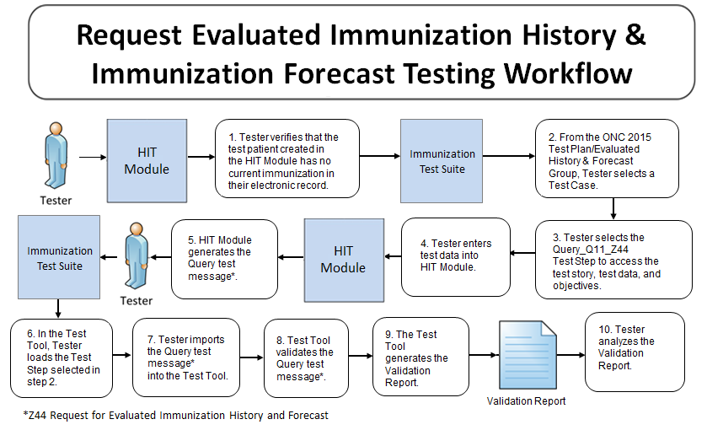
Testing Workflow Diagram (Test Step 1 – Z44 QBP)
This diagram shows
How the major steps of the create QBP message test are sequenced
When the Test Tool is to be used

Slide 30
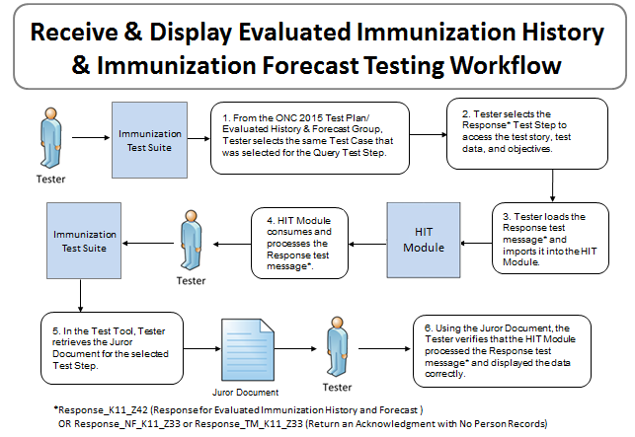
Testing Workflow Diagram (Test Step 2 – Z42 or Z33 RSP)
This diagram shows
How the major steps of the process RSP message test are sequenced
When the Test Tool is to be used

Slide 31
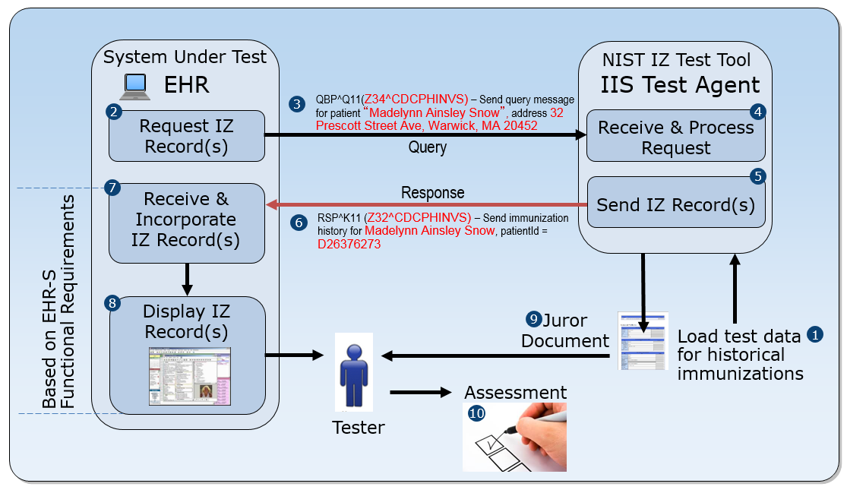
Query/Response Test Cases Work Flow
Test the ability of an EHR-S to create a valid immunization history query message
Receive and incorporate immunization history record(s) in the response message
Display the immunization history record(s) according to the Juror Document provided
Note: It is important that the EHR system and hence the query message contains the data prescribed in the test case because the response message is tied to that data.

Slide 32
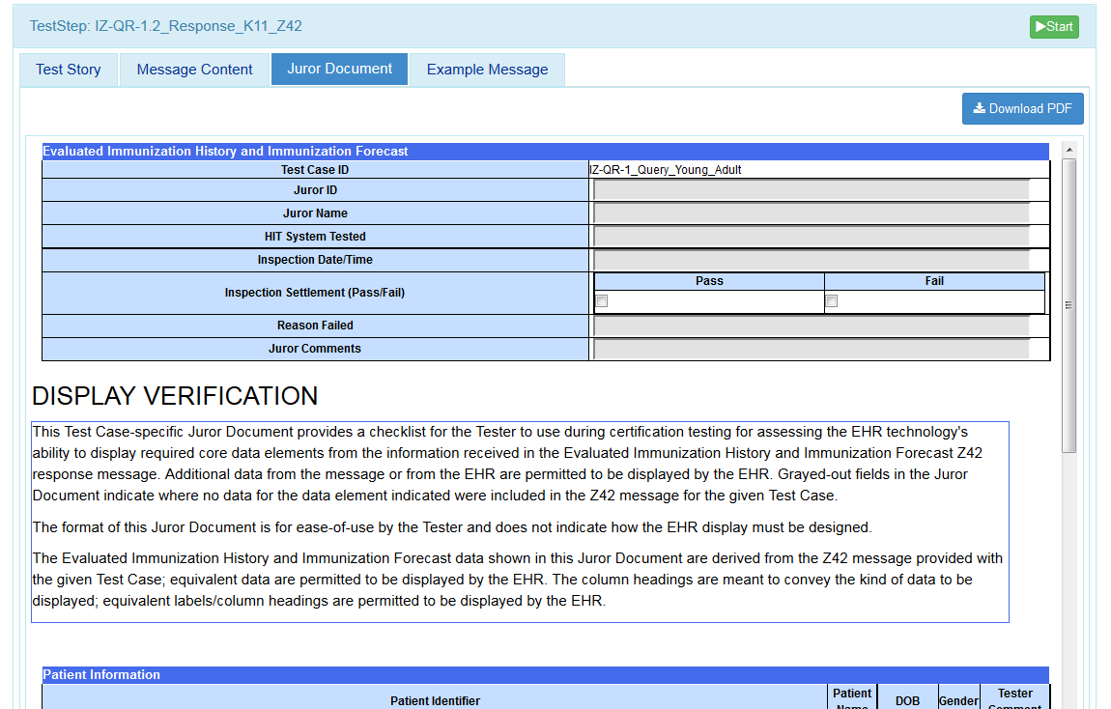
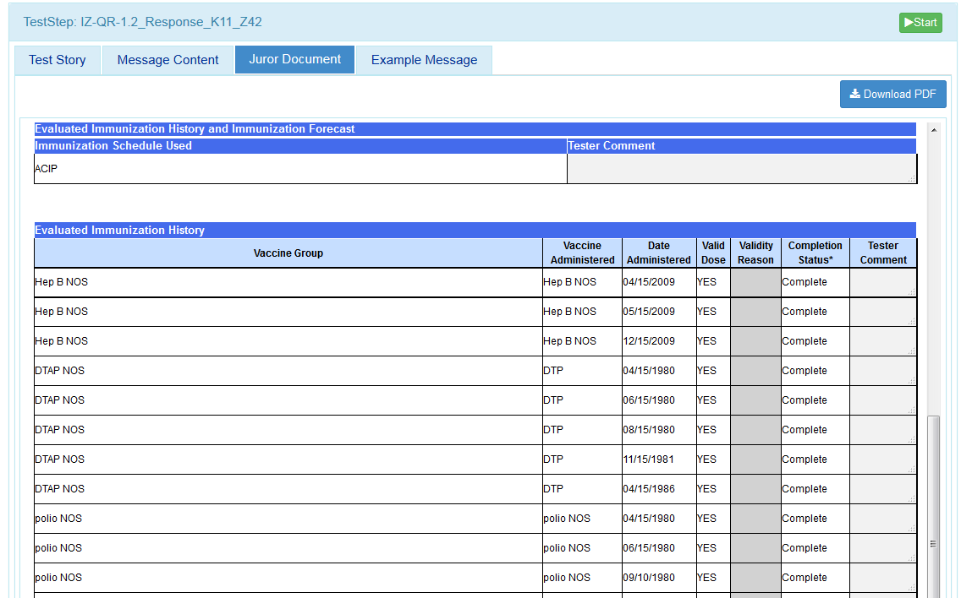
Display Evaluated History and Forecast
Juror Document (Inspection Check List)

Slide 33
Display of IIS Evaluated History and Forecast
Work Flow and Pre-conditions
HIT Module has a test patient for the Test Case
Tester verifies that this patient has no current immunization administration information in their electronic record
Tester causes Module to create a Query for Evaluated History and Forecast
Module must display the Evaluated History and Forecast Response information returned by the IIS (IIS simulated by NIST Test Tool)
Scope
ONC requirement is for the HIT Module to receive and display Evaluated History and Forecast from IIS
Test environment is set up so this information sent in the RSP message from the Test Tool is the only available immunization administration information in the patient’s electronic record
This information must be displayed, and only display of this information for the Evaluated History and Forecast is valid for ONC certification testing—see next bullet (Exception: PID data can be from EHR)
HIT Modules can be designed to display the immunization Forecast based on data stored in the Module, but this capability is out-of-scope for ONC certification testing
Scope of ONC certification testing is focused on verifying that the HIT Module is able to display the Evaluated History and Forecast from the IIS
Substitution of a Forecast produced from patient immunization data stored in the HIT Module is not acceptable for the ONC certification testing; the Testers will check to make sure the electronic record for the test patient has no immunization information prior creation of the Evaluated History and Forecast Query (Some vendors may request a substitution—this is not acceptable)
The Juror Document used for assessing the Evaluated History and Forecast Response step indicates what information from the RSP message must be displayed, not how this information is to be displayed (Meaning that the entirely of the content must be displayed but the formatting is up to the vendor—e.g., e.g, the vendors may group certain data for screen efficiency if the data is the same and can be grouped—e.g., the date is the same for 5 immunizations, they could be group under the same date; the information is the same).

Slide 34
Test Case 1: Query for Child
IZ-QR-1_Query_Child
Purpose | Query for a child in which the patient record is found Receive a response message containing the evaluated history and forecast; display history and forecast.
Steps | High-level Test Objectives
Step 1: IZ-QR-1.1_Query_Q11_Z44 Create Query Message | Create a query message for Young Adult Contains typical demographics data including: Patient Name Patient Identifier DOB Gender Address Phone
Step 2: IZ-QR-1.2_Response_K11_Z42 Receive RSP | Query was successful and returns an evaluated history and forecast for the patient EHR-S is to process and display the response message containing multiple immunization events and recommendations

Slide 35
Test Case 2: Query for Adult
IZ-QR-2_Query_Adult
Purpose | Query for an adult in which the patient record is found Receive a response message containing the evaluated history and forecast; display history and forecast.
Steps | High-level Test Objectives
Step 1: IZ-QR-2.1_Query_Q11_Z44 Create Query Message | Create a query message for older Adult Contains typical demographics data including: Patient Name Patient Identifier DOB Gender Address Phone
Step 2: IZ-QR-2.2_Response_K11_Z42 Receive RSP | Query was successful and returns an evaluated history and forecast for the patient EHR-S is to process and display the response message containing a single immunization event and multiple recommendations

Slide 36
Test Case 3: Query where No Patients are Found
IZ-QR-3_Query_No Patients
Purpose | Query for a toddler in which the patient record is not found Receive a response message indicating no person found
Steps | High-level Test Objectives
Step 1: IZ-QR-3.1_Query_Q11_Z44 Create Query Message | Create a query message Contains typical demographics data and additionally: Multiple Birth Indicator Birth Order Mother’s Maiden Name Fully valued address Support of OIDs in the query message
Step 2: IZ-QR-3.2_Response_K11_Z33 Receive RSP | Query was successful but returned no high confidence matches EHR-S is to process the response message and display some indication to the end user that no matches were found

Slide 37
Test Case 4: Query where Too Many Patients Found
IZ-QR-4_Query_Too_Many
Purpose | Query for a child in which no patient record is returned because too many patients are found Receive a response message and inform the end user
Steps | High-level Test Objectives
Step 1: IZ-QR-4.1_Query_Q11_Z44 Create Query Message | Create a query message Contains typical demographics data including: Patient Name Patient Identifier DOB Gender Address Phone
Step 2: IZ-QR-4.2_Response_K11_Z33 Receive RSP | Query was successful but returns an indication that too many matching patients were found EHR-S is to process the response message and display some indication to the end user that too many matches were found

Slide 38
Documentation

Slide 39
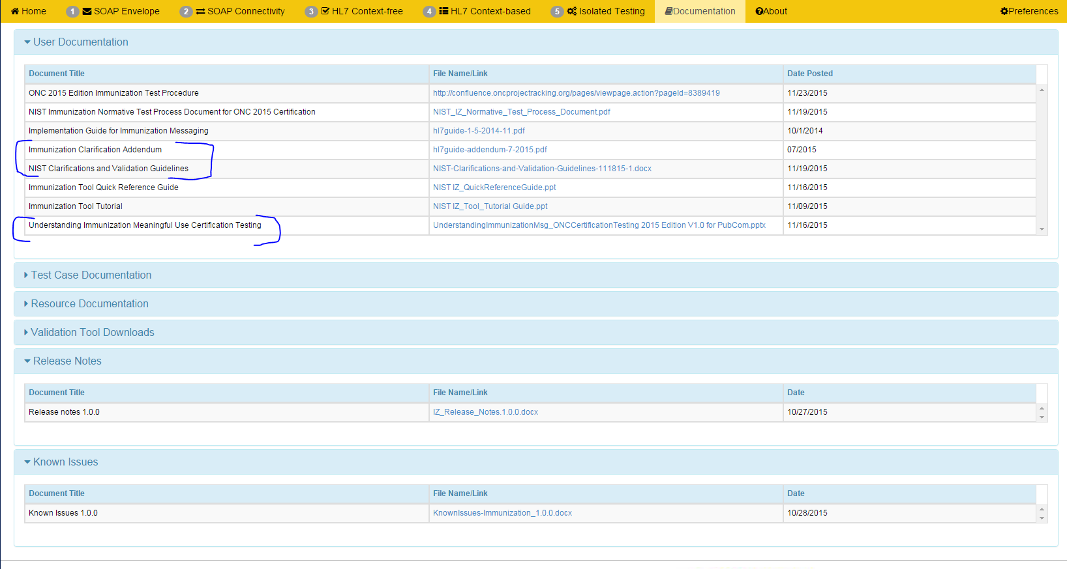
Documentation

