Slide 1
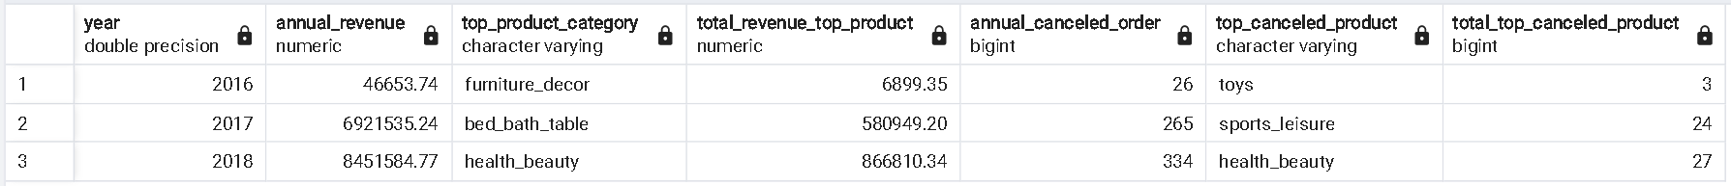
Annual Product Category Quality Analysis
The performance of an e-Commerce business is closely tied to the available products. Analyzing product quality in e-commerce provides valuable insights for making informed business decisions. Key metrics for assessing product quality on an annual basis are as follows:
Total annual revenue.
Number of orders canceled per year.
Product category generating the highest annual revenue.
Product category with the highest number of canceled orders per year.
here is the query results table for each the metrics above:
The complete query can be seen here

Slide 2
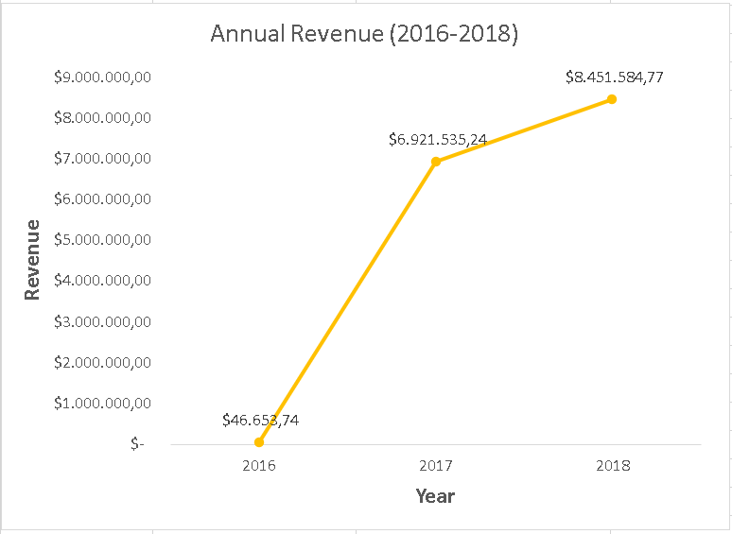
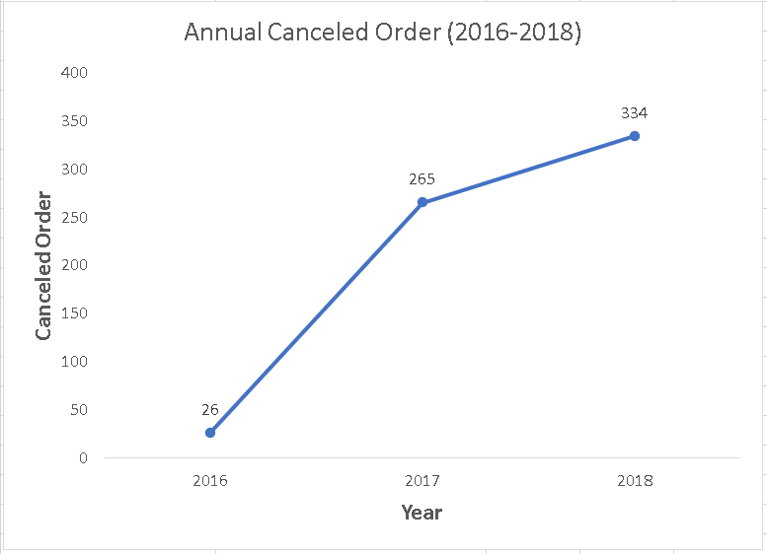
Annual Product Category Quality Analysis
Annual revenue increased by 17994.61% from 2016 to 2018, where in 2017 there was a significant increase.
Orders canceled annually have also increased. This can be caused by various factors such as delivery errors, out of stock, or changes in customer preferences.

Slide 3




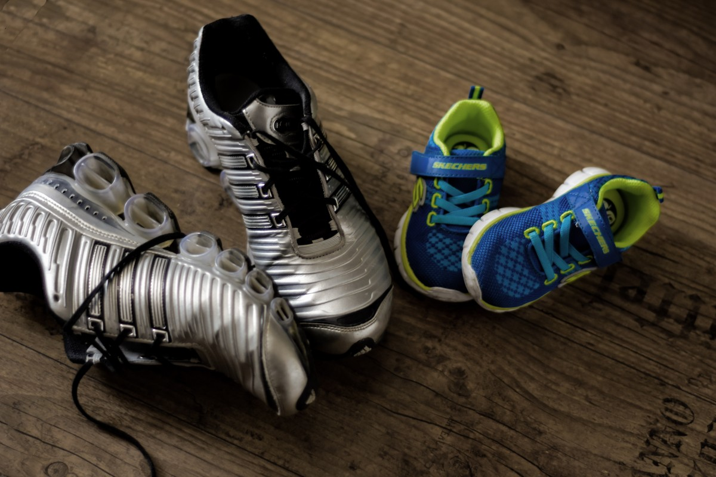
Annual Product Category Quality Analysis
Best Selling Product Category
2016 | 2017 | 2018
Furniture_decor | Bed_bath_table | Health_beauty
$ 6899.35 | $ 580949.2 | $ 866810.34
Best-Selling Product Categories always change every year, as well as the revenue generated increases every year.
Revenue
Most Canceled product Category
2016 | 2017 | 2018
Toys | Sport_leisure | Health_beauty
3 Items | 24 Items | 27 Items
Product categories with the most cancellations also change every year. However, in 2018 the products that were canceled the most and became best sellers were in the same category, namely health & beauty.

