Slide 1
AJAX-JSON

Slide 2
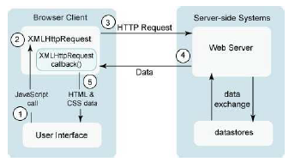

AJAX

Slide 3
AJAX
user clicks, invoking an event handler
handler's code creates an XMLHttpRequest object
XMLHttpRequest object requests page from server
server retrieves appropriate data, sends it back
XMLHttpRequest fires an event when data arrives
  this is often called a callback
  you can attach a handler function to this event
your callback event handler processes the data and displays it

Slide 4
What is JSON?
“JSON” stands for “JavaScript Object Notation”
  Lightweight data-interchange format
  Despite the name, JSON is a (mostly) language-independent way of specifying objects as name-value pairs
  Structured representation of data object
  Can be parsed with most modern languages
JSON Schema can be used to validated a JSON file

Slide 5
JSON syntax
An object is an unordered set of name/value pairs
  The pairs are enclosed within braces, { }
  There is a colon between the name and the value
  Pairs are separated by commas
  Example: { "name": "html", "years": 5 }
An array is an ordered collection of values
  The values are enclosed within brackets, [ ]
  Values are separated by commas
  Example: [ "html", ”xml", "css" ]

Slide 6
JSON syntax
A value can be: A string, a number, true, false, null, an object, or an array
  Values can be nested
Strings are enclosed in double quotes, and can contain the usual assortment of escaped characters
Whitespace can be used between any pair of tokens
File type is “.json”

Slide 7
JSON Example
{
"name": "John Smith",
"age": 35,
"address": {
"street": "5 main St.",
"city": "Austin"
},
"children": ["Mary", "Abel"]
}
Notes:
This is a single JSON object for a person. It’s wrapped in curly braces and uses the key/value pairs.
The first pair, which is the name, uses a string as the value, John Smith, must be wrapped in double quotes.
The second one is the number, and note that the number is not wrapped in double quotes.
The next is address which is actually an embedded object with a street and a city.
The last one is an array is an array of strings.

Slide 8
JSON Schema
A JSON Schema allows you to specify what type of data can go into your JSON files.
It allows you to restrict the type of data entered.

Slide 9
JSON Schema
{
"type": "object",
"properties": {
"name": {
"type": "string"
},
"age": {
"type": "integer"
},
"address": {
"type": "object",
"properties": {
"street": {
"type": "string"
},
"city": {
"type": "string"
}
}
},
"children": {
"type": "array",
"items": {
"type": "string"
}
}
}
}

Slide 10
Validating JSON file
The following website can be used to validate a JSON file against a schema
  https://www.jsonschemavalidator.net/
Paste both the schema and the corresponding JSON file

Slide 11
Using JSON with Python
To work with JSON (string, or file containing JSON object), you can use Python's json module.
  import json
Notes:
In Python, JSON exists as a string.
p = '{"name": "Bob", "languages": ["Python", "Java"]}‘
It's also common to store a JSON object in a file.
Opening a file using with is as simple as: with open(filename) as file: # it automatically closes the file when done.

Slide 12
Loading JSON data from a file
Example:
  def load_json(filename):
  with open(filename) as file:
  jsn = json.load(file)
  #file.close()
  return jsn
  person = load_json('person.json')
This command parse the above person.json using json.load() method from the json module. The result is a Python dictionary.
Notes:
(1) In Python, JSON exists as a string.
p = '{"name": "Bob", "languages": ["Python", "Java"]}‘
It's also common to store a JSON object in a file.
(2) json.loads(s): load JSON data from a string.
(3) json.load(f): load JSON from a file.
Opening a file using with is as simple as: with open(filename) as file: # it automatically closes the file when done.

Slide 13
Writing JSON object to a file
Example:
  person = { "name": "John Smith", "age": 35, "address": {"street": "5 main St.", "city": "Austin"}, "children": ["Mary", "Abel"]}
  with open('person_to_json.json', 'w') as fp:
  json.dump(person, fp, indent=4)
Using json.dump(), we can convert Python Objects to JSON file.
Notes:
(1) In Python, JSON exists as a string.
p = '{"name": "Bob", "languages": ["Python", "Java"]}‘
It's also common to store a JSON object in a file.
(2) json.dumps(s): output JSON object as a string.
(3) with open('person_to_json.json', 'w') as fp:
json.dump(person, fp, indent=4)
In the first line of code, the file person_to_json.json gets created and opened as the variable fp.
In the second line, your dict person gets written into the person_to_json.json.

Slide 14
Accessing JSON Properties in Python
  Example:
  Assume that you already loaded your person.json as follows.
  person = load_json('person.json')
  To access the property "name"
Print(person["name"])
John Smith

Slide 15
Accessing JSON Properties in Python
  Example:
  Assume that you already loaded your person.json as follows.
  person = load_json('person.json')
  To access the property “age"
person["age"]
35

Slide 16
Accessing JSON Properties in Python
  Example:
  Assume that you already loaded your person.json as follows.
  person = load_json('person.json')
  To access the property “street"
print(person["address"]["street"])
5 main St.

Slide 17
Accessing JSON Properties in Python
  Example:
  Assume that you already loaded your person.json as follows.
  person = load_json('person.json')
  To access the property “street"
print(person["address"]["city"])
Austin

Slide 18
Accessing JSON Properties in Python
  Example:
  Assume that you already loaded your person.json as follows.
  person = load_json('person.json')
  To access the property “street"
print(person["children"][0])
Mary

Slide 19
Accessing JSON Properties in Python
  Example:
  Assume that you already loaded your person.json as follows.
  person = load_json('person.json')
  To access the property “street"
print(person["children"][1])
Abel

Slide 20
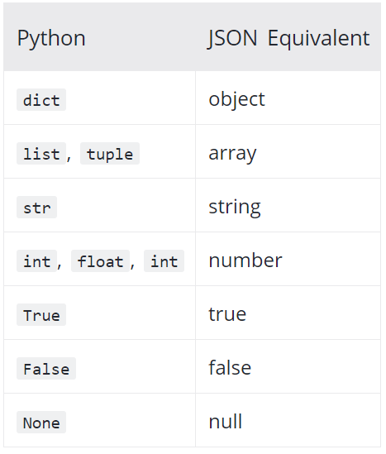
Python – JSON Objects
Notes:
array: Ordered list of 0 or more values. Wrap in square brackets
object: Unordered collection of key/value pairs
number: No difference between integers and floats
integer
string: Use double quote
boolean: true or false
null: Empty value

Slide 21
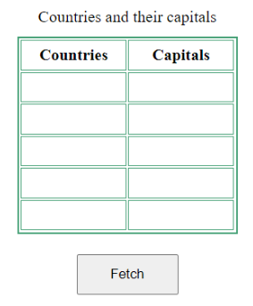
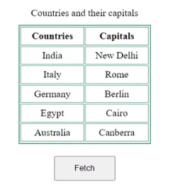
AJAX-JSON

Slide 23
Credit:
https://www.youtube.com/watch?v=wI1CWzNtE-M
https://www.programiz.com/python-programming/json
https://www.geeksforgeeks.org/how-to-get-json-response-in-ajax/

