Slide 1

WELCOME TO PRESENTATION SESSION
05 JUL, 2019

Slide 2

PRESENTATION
ON
SCHOOL MANAGEMENT SYSTEM
Course Title : System Analysis and Design Lab
Course Code : CSE 326

Slide 3
Senior Lecturer Department of CSE City university
Directed by :
Supta Richard Philip

Slide 4
Presented by :
Md. Robin
(171442640)
Sharful Islam
(171442641)
Nitu Akter
(171442639)
Hafijur Rahman
(171442648)
CSE Department, 44th Batch (Eve)
City University, Dhaka.

Slide 5
What is school management?
School management is concerned with the planning and formulation of educational policies of programmes with a view to achieving educational goals.

Slide 6
Some problems of old school management system
Old admission system
Teacher student communication problem
Time based classes
Time based classes
Problem to do group based jobs/assignments
Manual attendance system
Student suffer for old payment system

Slide 7




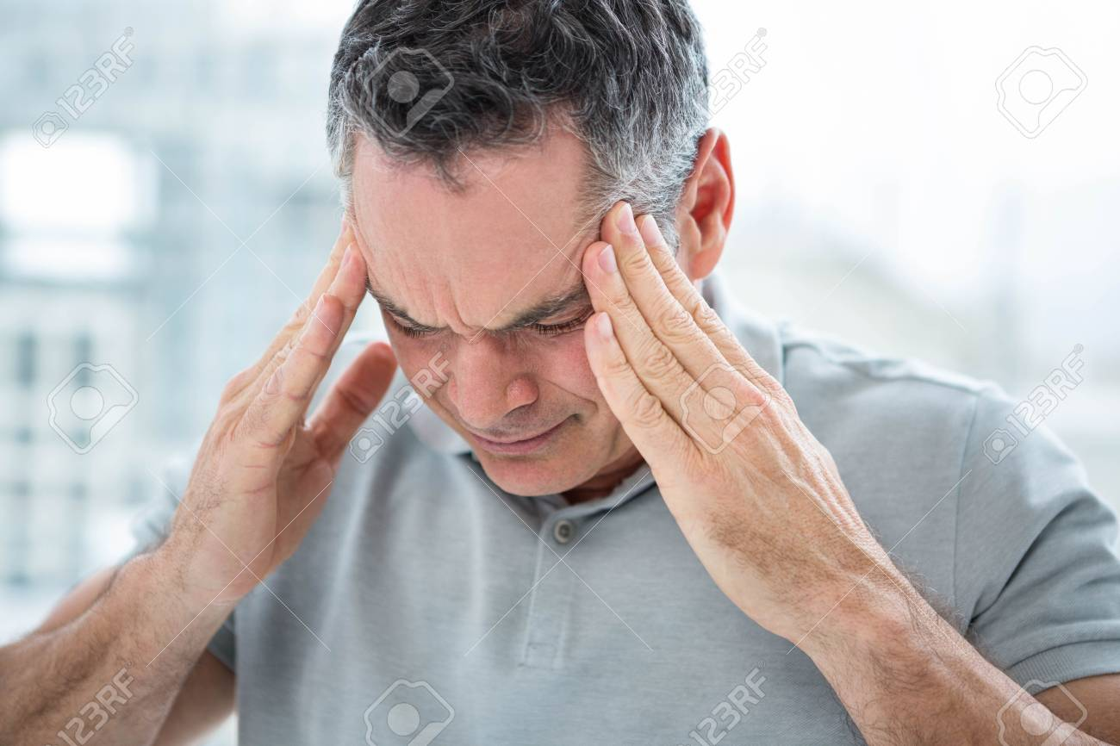

Slide 8
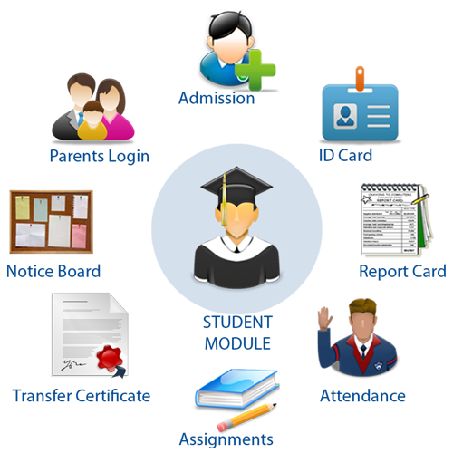
Solution of this problem
Online/Digital School Management System

Slide 9
What is School Management System?
School Management System is a is a complete school management software designed to automate a school's diverse operations from classes, exams to school events calendar.
This school software has a powerful online community to bring parents, teachers and students on a common interactive platform. It is a paperless office automation solution for today's modern schools. The School Management System provides the facility to carry out all day to day activities of the school, making them fast, easy, efficient and accurate.

Slide 10


Slide 11
Requirement gathering
Functional Requirements
Non-Functional Requirements
Admin shall add new student, teacher, and class and modify them
Usability
Student shall login by his/her id.
Efficiency
Performance
Teacher shall login by his/her id
Parents shall login through his child id
Space
Declare result online
Portability

Slide 12
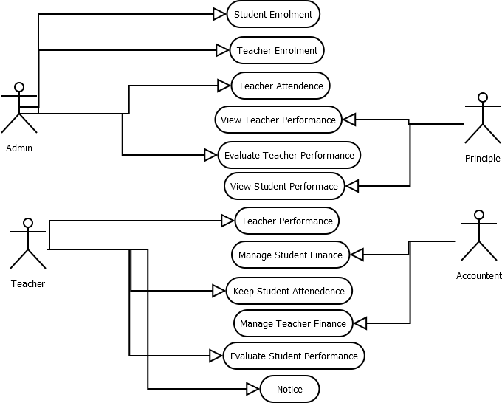
Use Case Diagram for
School Management System

Slide 13
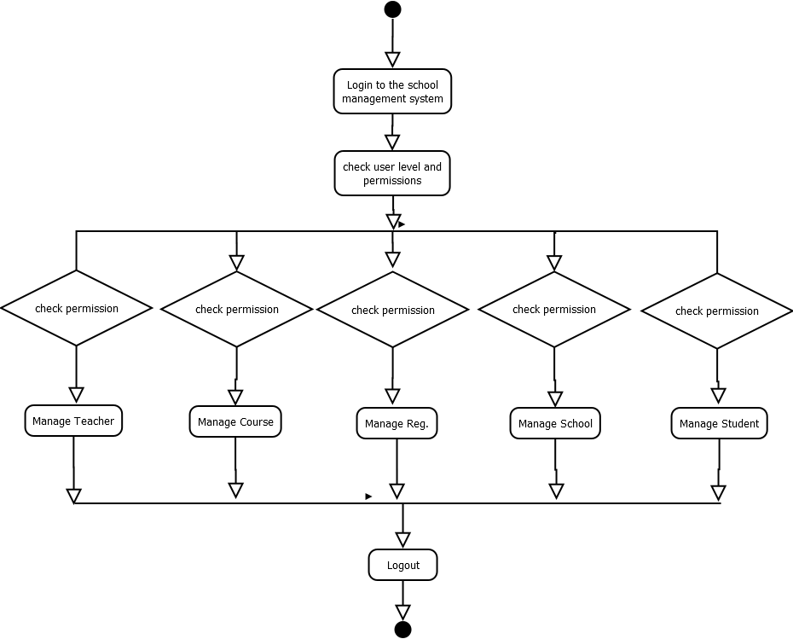
Activity Diagram for
School Management System

Slide 14
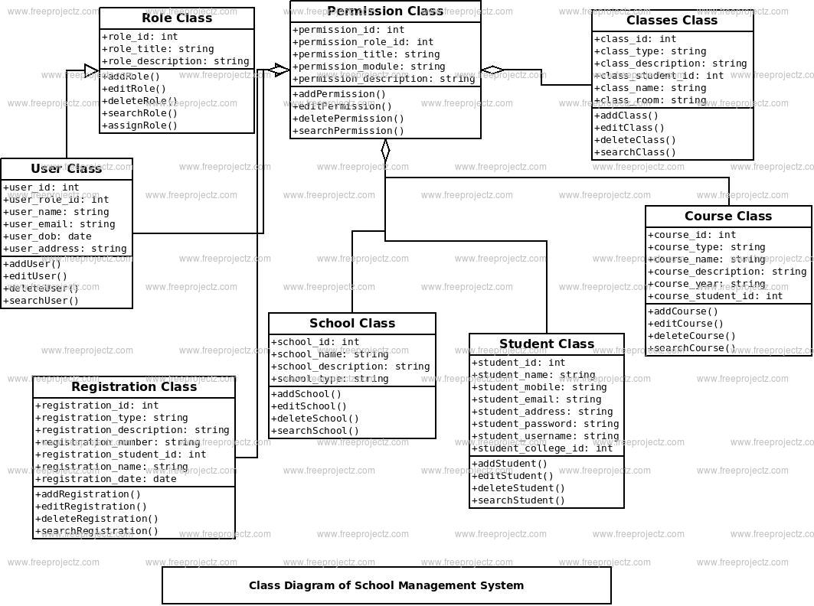
Class Diagram

Slide 15

After complete this project I think teacher, parents, student, administrator all will not suffer from those various problems. And we will make a beautiful education system

Slide 16
Conclusion
At the end of this project not only will you have more inside knowledge about our career but also know how complex project we have to handle. We are thankful to our teacher SUPTA RICHARD PHILIP. We find so much fun as well as interesting with this project.

Slide 17


Thank You

