Slide 1
MILESTONE 1 : https://youtu.be/2YkK7AqTRjw
WATCH ME ON YOURTUBE
MILESTONE 2 : https://youtu.be/a04JOjj_Ggg
MILESTONE 3 : https://youtu.be/eUmpLTMV-gA
MILESTONE 4 : https://youtu.be/rnEdM-jBobA
MILESTONE 5 :

Slide 2

data mining for stocks prediction
Yong Keh Soon
WQD180065
Shien Long
WQD180027
Vee Kin
WQD180064
Vikas Mann
WQD180051

Slide 3

Agenda
Data Acquisition (Milestone 1)
Data Management (Milestone 2)
Data Processing (Milestone 3)
Data Interpretation (Milestone 4)
Communication of Insights (Milestone 5)
Objective

Slide 4
objectives
Predict next day closing price is higher or lower than previous day
Analysis scope in KLSE Stocks
Form short term investment strategy (day trading) to beat the market using machine learning
Exploit data mining techniques to acquire various data sources for model refining
Saleable big data warehousing technology

Slide 5
Agenda
Data Acquisition
Data Cleaning
Data Warehouse
Data Analysis (sentiment, co-variance)
Data Preprocessing
Modeling (python)
Recommendation
Publication

Slide 6
THE
system
Twitter
RSS Sources
Web Indicators
Web News
Web Forum
Extract : Docker Python Scheduler Script
Staging Storage (Google BigQuery)
Data cleaning,
Transformation
Enterprise Data Warehouse (Hadoop/Hive)
Data Preprocessing: Cleaning, Feature Engineering, Transformation (Python)
Visualization (co-variance, sentiment)
Tableau, PowerBI, R
Result
ML Modeling
(Python)
Production (Out of Scope)

Slide 7
ML Process
Filter
Feature Engineering
Join
Clean
Machine Learning
Wide Data
StocksPrice
SMA3
Transpose Long to Wide
Joining
Index by Date (Time Series)
Fill Missing Data
Backfill
Forward Fill
Interpolate
Scale
Split
Model
AirAsia
Weekday
Long Data
Commodities
Gold, Oil
Indices
2Mar – 10 May 2019
DJI, Nasdaq
Forex
USD, SGD, MYR
Google Translate, Qualitative Measure
Text Data
BusinessNews
AirAsia

Slide 8
JOINING
Wide Data
Long Data
Transpose to Wide
Join
Final Dataset

Slide 9
MISSING DATA TREATMENT
Backward Fill
Interpolate to nearest neighbor
Forward Fill

Slide 10
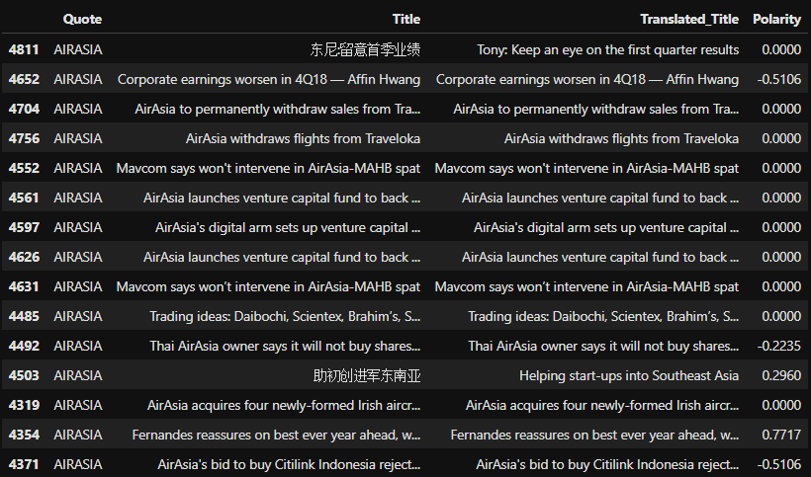
Feature engineering and transformation
Backward Fill
2
Dummies For Categorical Feature
SMA3 = average of last 3 days
1
(+) (-) represents direction
(0.xxxx) represent strength
Sentiment Analysis
4
Min Max Scaling on all numeric features
3

Slide 11
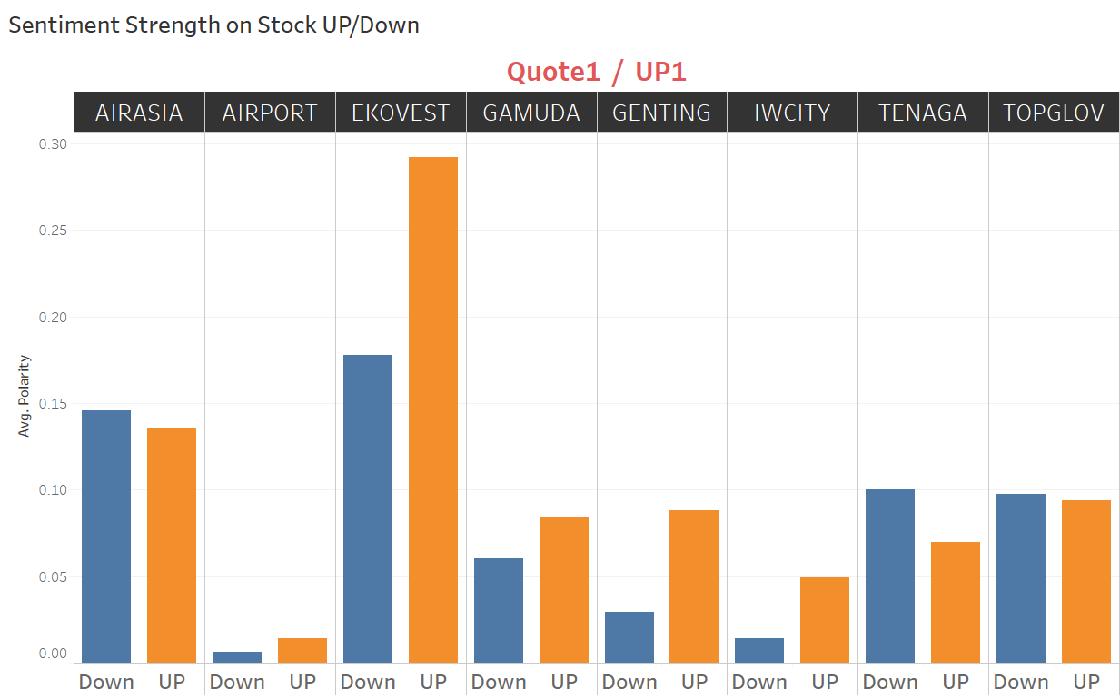
Sentiment analysis
Average Polarity for Different Stocks
Significant only for EKOVEST and Genting

Slide 12
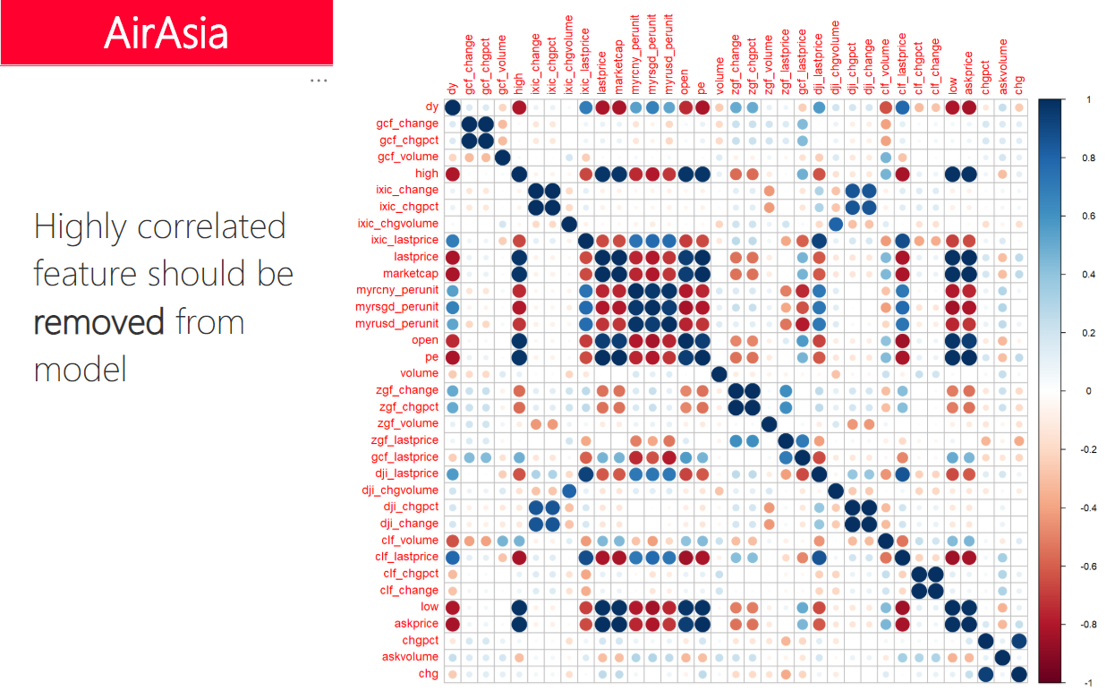

Slide 13
Model metric
Predicted
Predict Price goes UP tomorrow
Make Money = TP
Lost Money = FP
FN, TN = No transaction
Maximize Precision:
 | Positive | Negative
Positive | TP (Benefit) | FN
Negative | FP (Cost) | TN
Actual
TP
Buy when model predict Positive
TP + FP

Slide 14
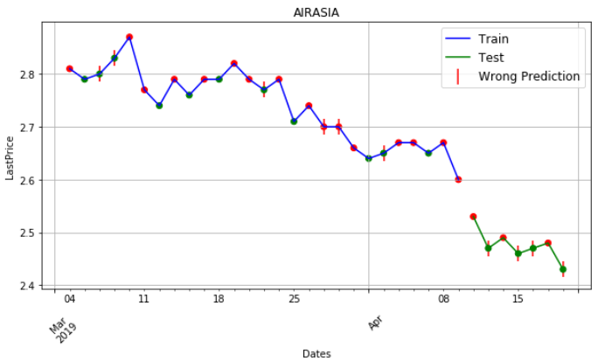
Standard train/test split modeling
AIR
To make this useful, we need to predict price going up tomorrow.
Does it really work ?
Maybe not yet, at least we are not making a lost
Test
?
Training

Slide 15
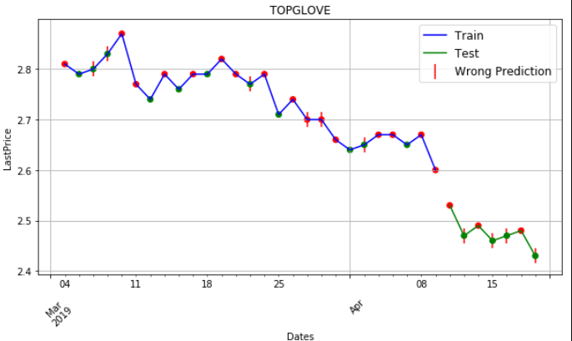
Progressive modeling
For short term data, Progressive modelling should be explored…
Fixed training windows size timeframe, predict next time up/down
Final evaluation of approach through average prediction accuracy

Slide 16
Progressive modeling
Train
Predict

Slide 17
Progressive modeling
Train
Predict

Slide 18
Machine learning
Clean Data
Scale Data
Build and Fine Tune Model
Train & Test
Air Asia | CV (all data) | Test Data 70/30
XGBoost | 0.51 | 0.50
Logistic Regression |  | 0.33
Logistic Regression (Progressive) |  | 0.66 (37d window)
Air Asia + GENTING + GAMUDA + AIRORT | CV (all data) | Test Data 70/30
XGBoost | 0.49 | 0.43
Logistic Regression |  | 0.00
Logistic Regression (Progressive) |  | 0.71 (29d window)

Slide 19
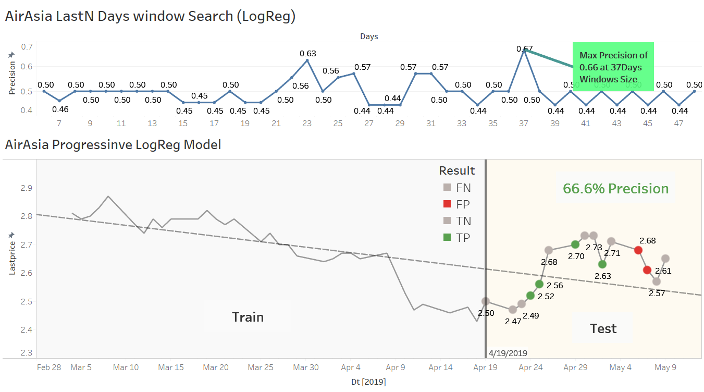
AIRASIA progressive logreg modeling

Slide 20
Strategy recommendation
Total trading days in a year = 261
Machine will predict price to go up next following day, 40% of the time. Making 261 x 40% = 104 buy day, expect to make 1% each successful trade
Precision is 66%. After contract with loses (wrong prediction of 34%), we make 32% nett (66-34)%.
Over a year, we would make 104 days * 32% = 33% (each win/lost is caped at 1%).
Key Assumptions
Data are small
40% machine predicted positive
You can catch buy/sell gap at 1% on each transaction
You can sustain consecutive losses

Slide 21


https://github.com/yongks/stocks118 What you get ?
Python source code:
Data extractions
Data cleaning and machine learning
Power BI workbook
Tableau workbook
This Powerpoint
Feel free to return the script (ensure all files and directory are in same working location)

