Slide 1
MILESTONE 1 : https://youtu.be/2YkK7AqTRjw
WATCH ME ON YOURTUBE
MILESTONE 2 : https://youtu.be/a04JOjj_Ggg
MILESTONE 3 : https://youtu.be/eUmpLTMV-gA
MILESTONE 4 : https://youtu.be/rnEdM-jBobA
MILESTONE 5 : https://youtu.be/owAwgPs4nv4

Slide 2


Um Data scientist never dies
https://www.youtube.com/watch?v=UKTNWI0eYJ4

Slide 3

data mining for stocks prediction
Yong Keh Soon
WQD180065
Shien Long
WQD180027
Vee Kin
WQD180064
Vikas Mann
WQD180051

Slide 4

Agenda
Data Acquisition (Milestone 1)
Data Management (Milestone 2)
Data Processing (Milestone 3)
Data Interpretation (Milestone 4)
Communication of Insights (Milestone 5)
Objective

Slide 5
objectives
Predict next day closing price is higher or lower than previous day
Analysis scope in KLSE Stocks
Form short term investment strategy (day trading) to beat the market using machine learning
Exploit data mining techniques to acquire various data sources for model refining
Saleable big data warehousing technology

Slide 6
Model metric
Predicted
Predict Price goes UP tomorrow
Make Money = TP
Lost Money = FP
FN, TN = No transaction
Maximize Precision:
 | Positive | Negative
Positive | TP (Benefit) | FN
Negative | FP (Cost) | TN
Actual
TP
Buy when model predict Positive
TP + FP

Slide 7
Agenda
Data Acquisition
Data Cleaning
Data Warehouse (Hive)
Data Analysis (sentiment, co-variance)
Data Preprocessing
Modeling (python)
Recommendation
Github

Slide 8
THE
system
Twitter
RSS Sources
Web Indicators
Web News
Web Forum
Extract : Docker Python Scheduler Script
Staging Storage (Google BigQuery)
Data cleaning,
Transformation
Enterprise Data Warehouse (Hadoop/Hive)
Data Preprocessing: Cleaning, Feature Engineering, Transformation (Python)
Visualization (co-variance, sentiment)
Tableau, PowerBI, R
Result
ML Modeling
(Python)
Production (Out of Scope)

Slide 9
ML Process
Filter
Feature Engineering
Join
Clean
Machine Learning
Wide Data
StocksPrice
SMA3
Transpose Long to Wide
Joining
Index by Date (Time Series)
Fill Missing Data
Backfill
Forward Fill
Interpolate
Scale
Split
Model
AirAsia
Weekday
Long Data
Commodities
Gold, Oil
Indices
2Mar – 10 May 2019
DJI, Nasdaq
Forex
USD, SGD, MYR
Google Translate, Qualitative Measure
Text Data
BusinessNews
AirAsia

Slide 10
JOINING
Wide Data
Long Data
Transpose to Wide
Join
Final Dataset

Slide 11
MISSING DATA TREATMENT
Backward Fill
Interpolate to nearest neighbor
Forward Fill

Slide 12
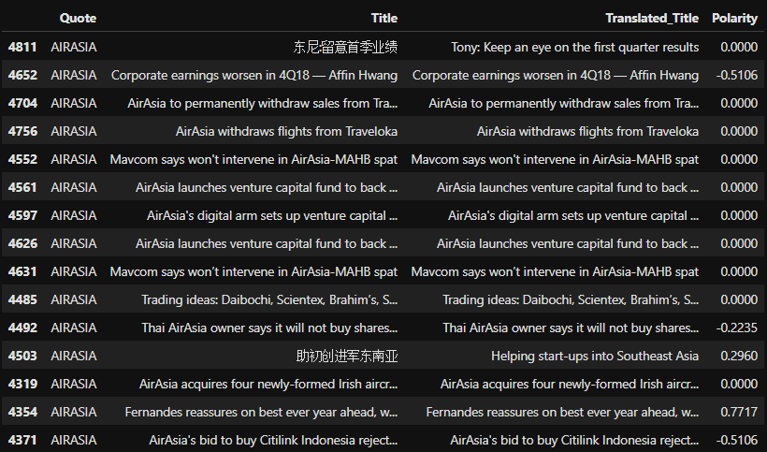
Feature engineering and transformation
Backward Fill
2
Dummies For Categorical Feature
SMA3 = average of last 3 days
1
(+) (-) represents direction
(0.xxxx) represent strength
Sentiment Analysis
4
Min Max Scaling on all numeric features
3

Slide 13
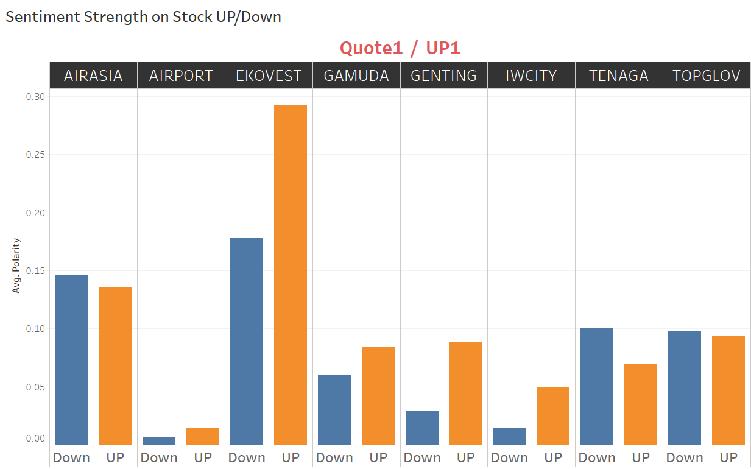
Sentiment analysis
Average Polarity for Different Stocks
Significant only for EKOVEST and Genting

Slide 14
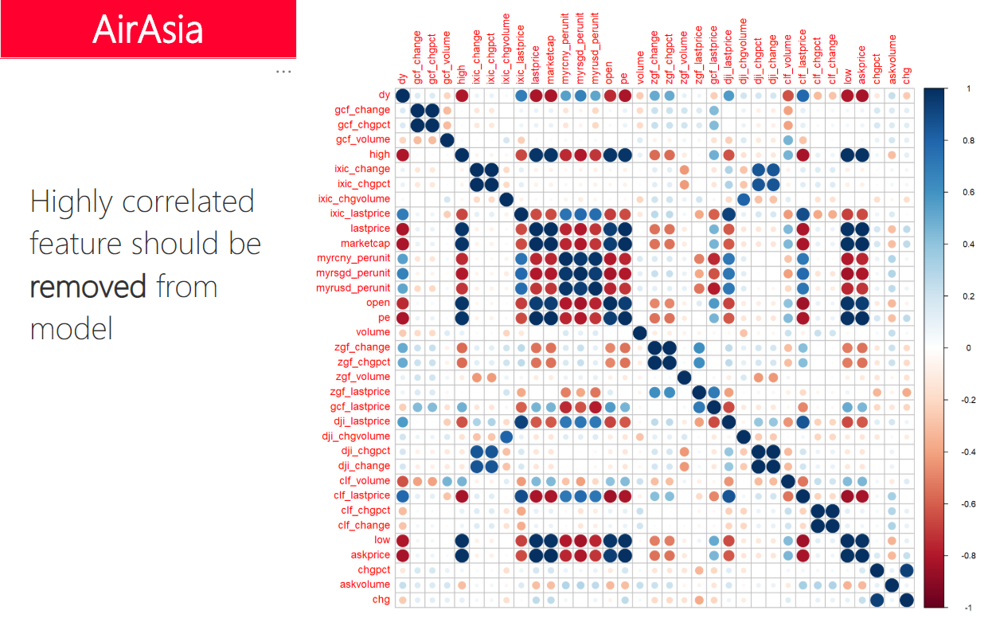

Slide 15
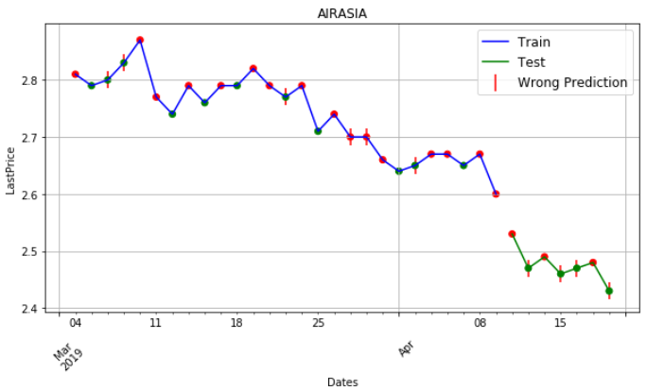
Standard train/test split modeling
Long Term Questions :
Q1:
When you buy a stock, do you look at its price 10 years ago ?
Q2:
How do we know the company had consolidated their stock (5:1). Old data may skew our model.
Test
?
Training

Slide 16
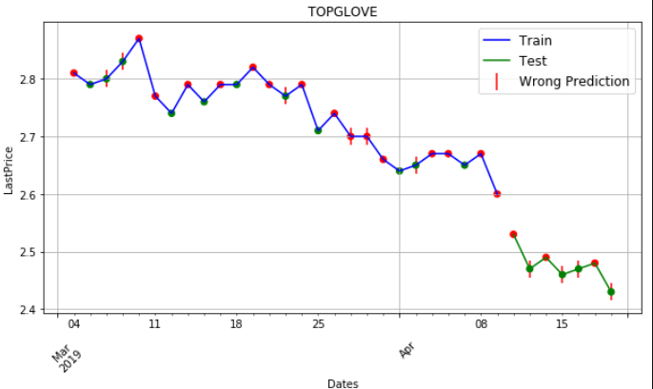
Progressive modeling
For short term data, Progressive modelling should be explored…
Fixed training windows size timeframe, predict next time up/down
Final evaluation of approach through average prediction accuracy
Predict
Train

Slide 17
Progressive modeling
Train
Predict
Predict
Train

Slide 18
Progressive modeling
Train
Predict
Predict
Train
Window Size: Last ?? Days

Slide 19
Machine learning
Clean Data
Scale Data
Build and Fine Tune Model
Train & Test
Air Asia | CV (all data) Precision | Test Data 70/30 Precision Score
Model 1: XGBoost | 0.51 | 0.50
Model 2: Logistic Regression |  | 0.33
Model 3: Logistic Regression (Progressive) |  | 0.66 (37d window)
Air Asia + GENTING + GAMUDA + AIRORT | CV (all data) | Test Data 70/30
Model 1: XGBoost | 0.49 | 0.43
Model 2: Logistic Regression |  | 0.00
Model 3: Logistic Regression (Progressive) |  | 0.71 (29d window)

Slide 20
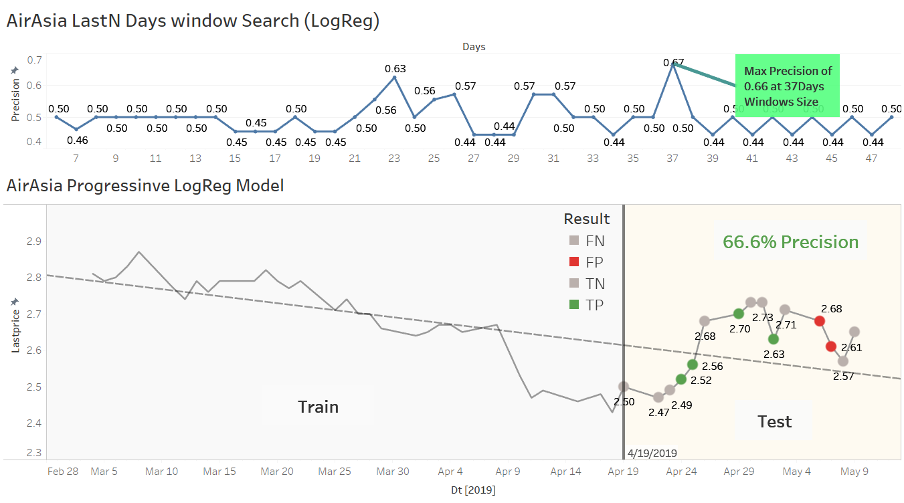
AIRASIA progressive logreg modeling

Slide 21
Strategy recommendation
Total trading days in a year = 261
Machine will make positive prediction, 40% of the time. Making 261 x 40% = 104 buy opportunity, expect to make 1% each successful trade
Precision is 66%. After contra with loses (wrong prediction of 34%), we make 32% nett (66-34)%.
Over a year, we would make 104 days * 32% = 33% (each win/lost is caped at 1%).
Key Assumptions
Data are small
40% machine predicted positive
You can catch buy/sell gap at 1% on each transaction. Sometimes opening price is already more than 1%
You can sustain consecutive losses
Take your own risk

Slide 22
½ Strategy
Total 261 Trading Days
Need Exit Strategy
40%
(down trend)
60%
Target Improvement: Precision 80%
Model Predict UP
104
Model Predict DOWN
157
66%
34%
No Trade
Caveats:
When model predict UP, you don’t always able to catch yesterday closing price
We had not considered EXIT strategy (when to sell, and target sell price)
DON’T Invest Using This Incomplete Strategy
Correct, TP
69
Wrong, FP
35
Net 34%

Slide 23


https://github.com/yongks/stocks118 What you get ?
Python source code:
Data extractions
Data cleaning and machine learning
Power BI workbook
Tableau workbook
This Powerpoint
Feel free to return the script (ensure all files and directory are in same working location)

Slide 24
Future work
Improvement Target:
Improve to 80% precision – For Entry Strategy
Develop Model – For Exit Strategy
Model Improvement
Get more Data:
Recommendation from other analyst
Scrap more text sentiment data (many research had reported up to 80% accuracy using Text Analysis with SVM and NN)
Include quarterly financial report, refine tweets, facebook and company website
Include feature interaction to measure Volatility (volume and gap), what else ?
Adjust target threshold (e.g. price difference>1%) Actual Nett based for various Profit Target
Incorporate 3 Phase Clustering method by Dr. Teh to identify co-movement stocks. How ?

Slide 25
Multi layer modeling
Features Engineering
Cluster1
Model A
Merging
Model A1
3 Phase Clustering
Stock1
Cluster2
Model B
Model A2
:
:
Stock2
Model B3
ClusterN
Model Z
:
:
:
:
:
Model B4
:
:
Model1s
Model 1
Model 2
Model Z
StockN
Model N

Slide 26
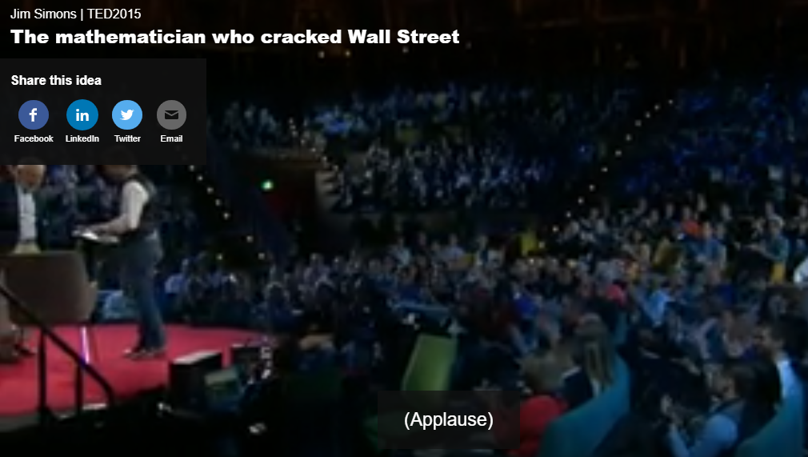
James Simons – billionaire mathematicians who cracked wall street
Renaissance Technology (Hedge Fund)
Managing hedge fund with bunch of scientist.
US No.1 Hedge Fund, better performance than Soros Quantum Fund
Year 2015, $65b fund size, own majority by employees
1994-2014, average 78% annual return
17months loses over 49 quarters
300 staffs
90 PhD
All background: statistician, mathematicians, astronomers (45), physicist, computer scientist etc.
9TB of data daily
Model changes, keep up with the game

