Slide 1
Title: Heart Disease Risk Prediction Using Machine Learning
Name: Hafiz Abdul Razzaq
Student Id: 23086394
Gith Hub Link: https://github.com/hafiz2343243/Master-Thesis-Heart-Disease-Risk-Prediction-By-using-Machine-learning.git

Slide 2
Project Overview
This initiative forecasts the risk of heart disease via clinical patient data. The information includes health attributes such as age, blood pressure, cholesterol levels, kind of chest discomfort, maximal heart rate, and exercise-induced angina. Patients are categorized into two groups: Low Risk and High Risk. Three machine learning models are evaluated: Decision Tree, Support Vector Machine (SVM), and XGBoost. The evaluation of model performance is conducted using accuracy, F1-score, confusion matrix, and ROC-AUC. The primary objective is to ascertain the most effective model for predicting heart disease risk.

Slide 3
Research Question and Objectives
Research Question: How accurately can machine learning models predict heart disease risk using clinical health features? Objectives: Clean and prepare the heart disease dataset.
Classify the original risk score into Low Risk and High Risk categories.
Conduct fundamental exploratory data analysis to comprehend patterns in patient characteristics.
Train and evaluate Decision Tree, Support Vector Machine, and XGBoost models.
Enhance model efficacy by the application of RandomizedSearchCV. Assess models utilizing Accuracy, F1-score, Confusion Matrix, and ROC-AUC.

Slide 4
Literature Review
Prior research indicates that machine learning is effective at predicting cardiac disease.
Rachapalli et al. employed Random Forest, XGBoost, SVM, and MLP, concluding that XGBoost exhibited superior performance following data augmentation.
Anurag et al. employed an optimized ensemble model, with 96% accuracy.These studies endorse the project's utilization of Decision Tree, SVM, XGBoost, and ROC-AUC for evaluation purposes.

Slide 5
Data Preprocessing
Column names were standardized for consistency and enhanced use in Python.
The dataset was examined for absent values, and none were identified.
The dataset contained 55 duplicate rows, which were eliminated before to modeling.Subsequent to the elimination of duplicates, the dataset comprised 970 rows and 14 columns.
The initial decimal target column was transformed into a binary classification.Patients with a goal of 0.5 or above were classified as High Risk.
Patients having a goal less than 0.5 were classified as Low Risk.
The ultimate target column employed for prediction was target_class.

Slide 6
Dataset Description
Summary of the Dataset The dataset comprises clinical information pertaining to the risk of heart disease in patients.
The original dataset had 1025 rows and 14 columns.
The dataset has attributes including age, sex, kind of chest pain, blood pressure, cholesterol levels, fasting blood sugar, maximum heart rate, exercise-induced angina, oldpeak, slope, calcium, and thalassemia status.
The initial goal column comprised decimal risk values ranging from 0.1 to 0.9.
This project reclassified the initial objective into two categories: Low Risk and High Risk.
The dataset was appropriate for a classification challenge as it comprises clinical variables that can indicate the risk of heart disease.

Slide 7
Exploratory Data Analysis (EDA)
Exploratory Data Analysis (EDA) was used to comprehend patient patterns prior to modeling.
The age distribution indicated that the majority of patients were aged between 50 and 65 years.
The age comparison graph revealed a disparity between the Low Risk and High Risk groups.
The correlation heatmap indicated that variables including chest pain type, maximum heart rate, exercise-induced angina, oldpeak, slope, ca, and thal were associated with heart disease risk. Exploratory Data Analysis facilitated the identification of significant clinical trends and aided in the model selection process.

Slide 8
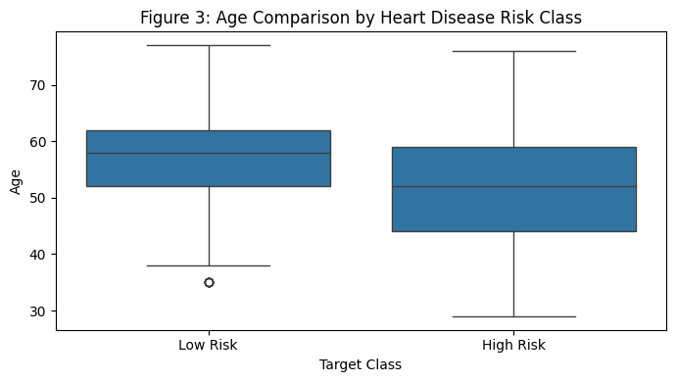
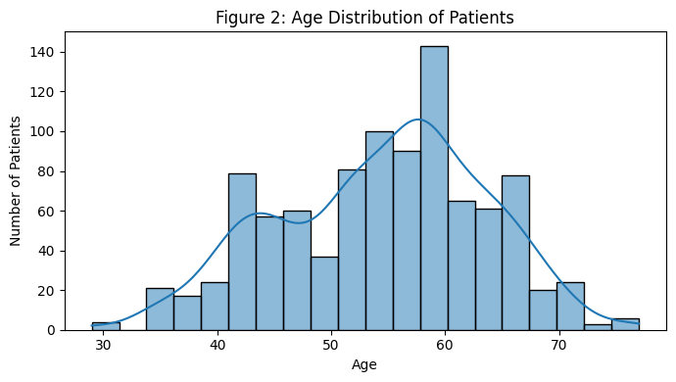
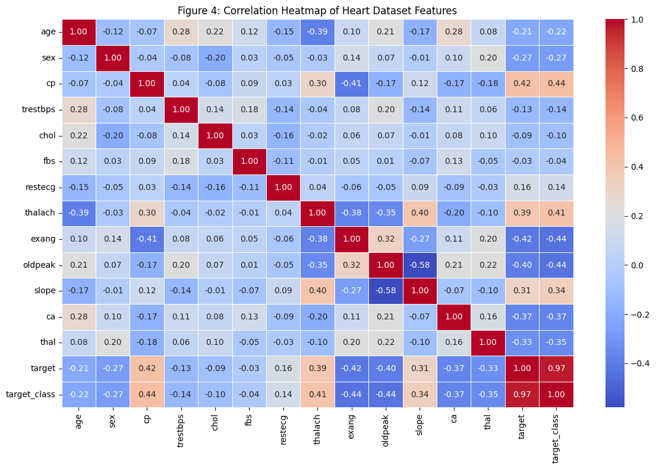
EDA PLOTS

Slide 9
Methodology
The dataset was imported and examined for structure, absent values, and redundancies.
Fundamental preparation was conducted by sanitizing column names and eliminating duplicate entries.
The initial decimal risk score was transformed into a binary target variable designated as target_class.
Exploratory data analysis was conducted utilizing class distribution, age distribution, age comparison, and a correlation heatmap.
The dataset was divided into training and testing sets using an 80:20 ratio.
The StandardScaler was utilized to normalize the feature values prior to model training.
Three models were developed: Decision Tree, Support Vector Machine (SVM), and XGBoost.
The model's performance was assessed by Accuracy, F1-score, Confusion Matrix, and ROC-AUC.
Hyperparameter optimization was conducted with RandomizedSearchCV.

Slide 10
Model Training and Initial Results
Three models were developed with the normalized training data. The employed models were Decision Tree, Support Vector Machine (SVM), and XGBoost. The Decision Tree attained an accuracy of 83.51% and an AUC of 0.9321. The SVM attained an accuracy of 94.33% and an AUC of 0.9860. XGBoost attained the highest preliminary outcome with 96.91% accuracy and 0.9957 AUC. Prior to optimization, XGBoost outperformed both Decision Tree and SVM.

Slide 11
Analysis of Initial Results
XGBoost exhibited the highest initial performance, achieving 96.91% accuracy and an AUC of 0.9957. The SVM achieved an accuracy of 94.33% and an AUC of 0.9860. The Decision Tree exhibited the least performance, achieving an accuracy of 83.51% and an AUC of 0.9321. The ROC-AUC results indicate that all three models efficiently distinguish between Low Risk and High Risk patients. XGBoost excelled due to its integration of numerous decision trees, enabling it to discern complex patterns with more efficacy. The preliminary findings indicated that model optimization was necessary to enhance performance further.

Slide 12
References
Anurag, S. Kalta, J. Thakur, H. Bhardwaj and Y. Banyal, "Optimized Ensemble model for Heart Disease Prediction using Machine Learning," 2023 3rd Asian Conference on Innovation in Technology (ASIANCON), Ravet IN, India, 2023, pp. 1-5, doi: 10.1109/ASIANCON58793.2023.10270436.
URL: https://ieeexplore.ieee.org/stamp/stamp.jsp?tp=&arnumber=10270436&isnumber=10269805
V. K. Rachapalli, C. Meenavalli, S. P. Nunna, P. Yarramaneni, S. K. Mishra and S. K. Mishra, "Enhancing Heart Disease Prediction with Data Augmentation and ML Classifiers," 2025 International Conference on Artificial Intelligence and Machine Vision (AIMV), Gandhinagar, India, 2025, pp. 1-6, doi: 10.1109/AIMV66517.2025.11203752.
URL: https://ieeexplore.ieee.org/stamp/stamp.jsp?tp=&arnumber=11203752&isnumber=11203297

