Slide 1
KP URBAN • PSLM • WORKING AGES 15–64
Earnings rise with age —
but most stay near the middle.
A clear age pattern, a wide spread, and one design lesson: the scale you choose changes the story you see.
Who counts?
What rises?
What misleads?
THE SAMPLE
THE PATTERN
THE DESIGN
Urban workers in KP, aged 15–64, with positive annual earnings. Each person counts by household weight — not one vote each.
Average earnings climb from the late teens into the late fifties, then the oldest band falls back — on a very small sample.
On a plain linear scale, a few high earners squash everyone else to the bottom. A log scale lets the whole distribution breathe.
No raw data tables on the main slides — the numbers are gathered, at a glance, on the final infographic slide.
Notes:
Opening message: this is not a story of everyone getting richer at the same rate. It is a rising average with a wide spread around it. The deck uses only the KP Urban filter from the R and Python scripts: prov_code=1, urban_rural=2, ages 15-64, positive earnings, positive household weight.

Slide 2
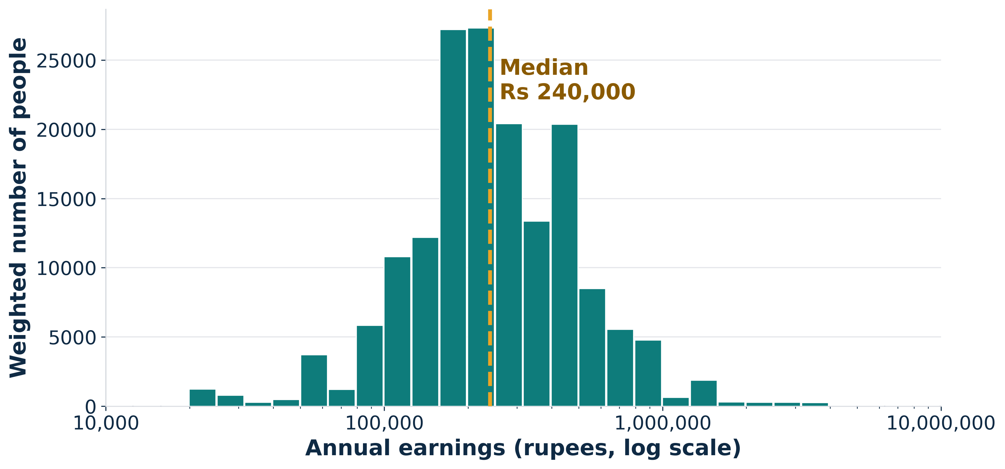
1 • THE DISTRIBUTION
Most workers cluster in the middle
Weighted histogram • A long tail to the right • Log scale: Rs 10,000 to Rs 10,000,000 in one picture
READ IT LIKE THIS
▸ The hump is the story. Tallest bars: a few hundred thousand rupees.
▸ The tail matters. A thinner stretch passes Rs 1 million.
▸ Log scale, plainly: Each big step multiplies earnings.
2
PSLM • KP Urban • Ages 15–64 • Positive annual earnings, weighted by household weight
Notes:
Q2 histogram: log10 bins from 4 to 7 in steps of 0.1, weighted by hhweight. One observation falls outside the Rs 10,000–10,000,000 display range. The weighted median is Rs 240,000; the weighted mean is higher, Rs 323,302, because the right tail pulls the mean up.

Slide 3
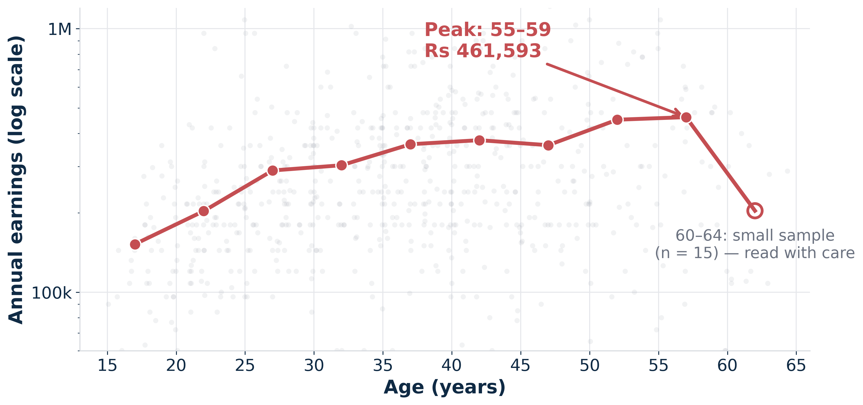
2 • EARNINGS BY AGE
The average climbs — then the last band drops
Red line: weighted mean in each five-year age band • Grey dots: individual earners
THREE MOVES
▸ Up early. Rises steadily from the teens into the thirties.
▸ Flat, then up again. A plateau in the forties, then a jump in the fifties.
▸ Do not over-read the end. The 60–64 drop rests on only 15 people.
3
PSLM • KP Urban • Ages 15–64 • Positive annual earnings, weighted by household weight
Notes:
Q3: weighted means by five-year band. Peak is 55-59 at Rs 461,593. For the required comparison, 25-29 is Rs 289,679 and 45-49 is Rs 361,264. The 60-64 mean is Rs 203,724 on n=15 and is flagged low_count in the R code, so treat the drop as uncertain, not as a proven fall.

Slide 4
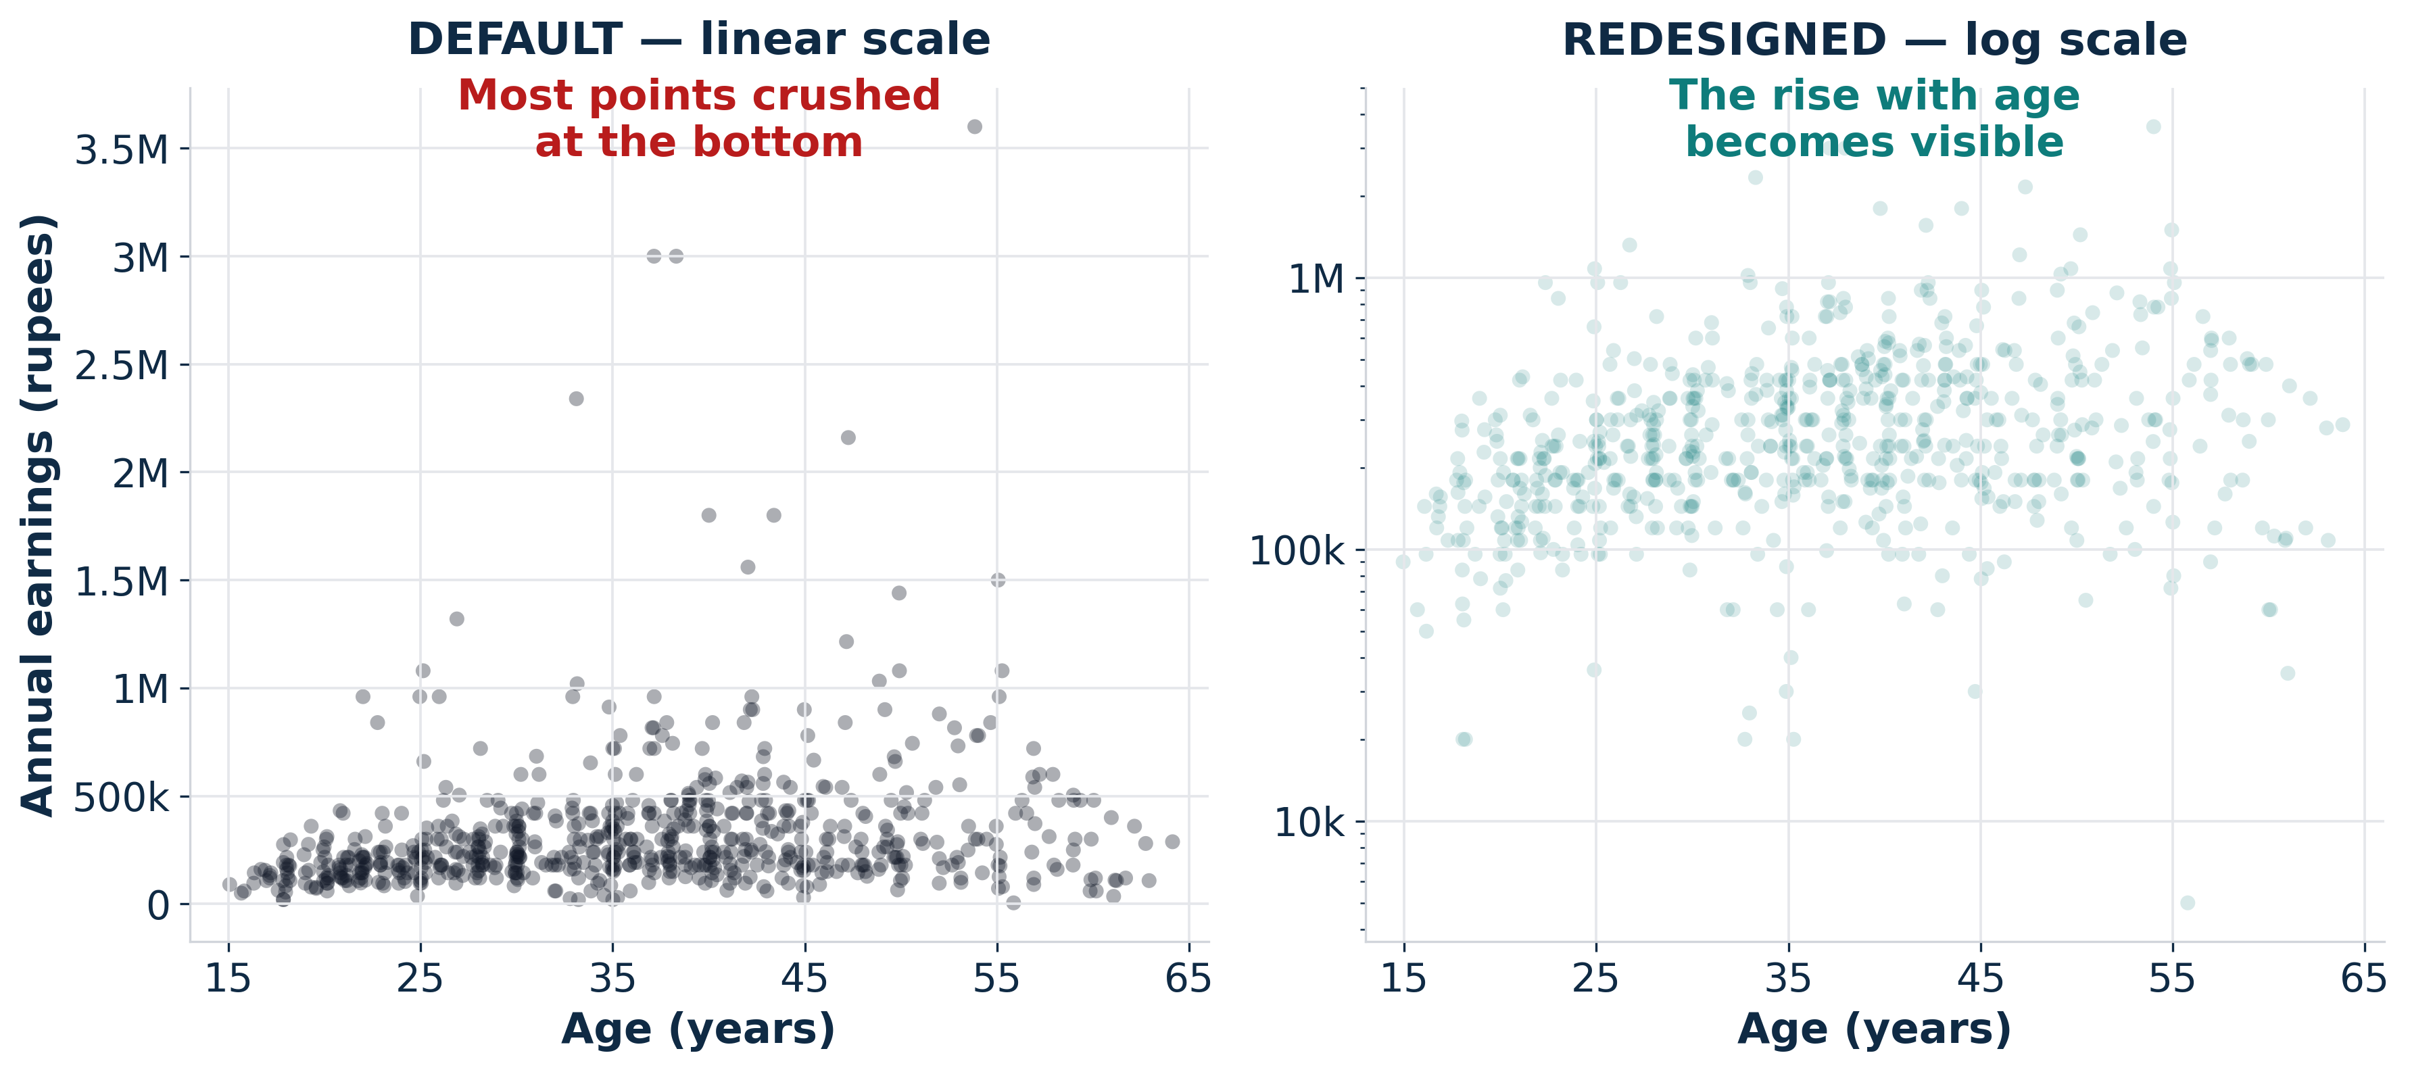
3 • DEFAULT VS. REDESIGNED
Same data, a different story
Q4: what a default scatter hides, and what three small fixes reveal — the design changed the story
1 • LOG SCALE — low earners get room to be seen
2 • FAINT POINTS — overlap stops hiding the crowd
2 • FAINT POINTS — overlap stops hiding the crowd
3 • DIRECT LABELS — the eye lands on the point
3 • DIRECT LABELS — the eye lands on the point
4
PSLM • KP Urban • Ages 15–64 • Positive annual earnings, weighted by household weight
Notes:
Q4A is the default ggplot geom_point with no scale, colour or transparency choices. Q4B redesigns it with a log10 y-axis, alpha transparency, jitter and a minimal theme. The lesson is general: a default is a choice too, and for skewed earnings it is usually the wrong one.

Slide 5
4 • READ IT HONESTLY
What this evidence can — and cannot — say
Four cautions that keep a good chart honest
WEIGHTED,
NOT COUNTED
LOG, NOT
LINEAR
SMALL BANDS,
FRAGILE
CHECKED
TWICE
Each surveyed earner stands in for many similar workers. Unweighted counts describe the sample, not KP Urban.
On a log axis, equal gaps mean equal multiples. A move from Rs 100k to 200k looks like 200k to 400k — by design.
Bands with few people swing easily. The 60–64 band (n = 15) is flagged, not hidden.
The same age-band means come out of the R script and the Python reproduction — a useful cross-check, not a new result.
Bottom line: age is associated with higher average earnings — but age alone does not explain the wide spread at every age.
5
PSLM • KP Urban • Ages 15–64 • Positive annual earnings, weighted by household weight
Notes:
This slide is the guardrail before the numbers. The chart shows association across age bands in a cross-section, not the lifetime path of one person, and it does not control for education, occupation or hours. The R and Python age-band tables match exactly, including 15-19 Rs 152,102 and 55-59 Rs 461,593.

Slide 6
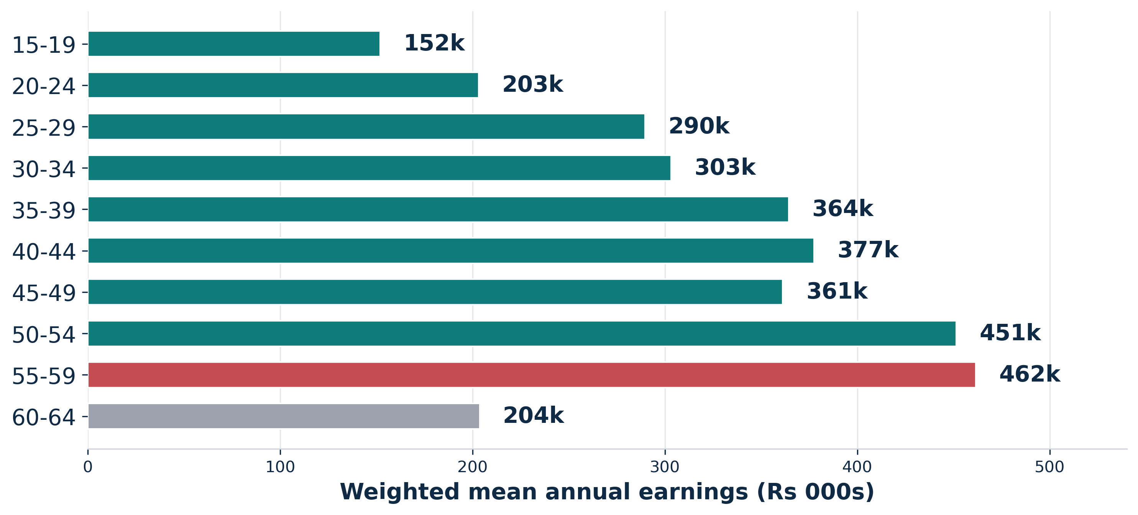
INFOGRAPHIC • ALL THE NUMBERS, IN ONE PLACE
KP Urban earnings at a glance
Ages 15–64 • Positive annual earnings • Weighted by household weight
678
167,869
Rs 240,000
Rs 323,302
Rs 108,000
Rs 588,000
surveyed earners
in the filter
weighted people
represented
weighted median
(typical earner)
weighted mean
above the median
P10 → P90
2.45× the median
Weighted mean by age band (rupees)
TWO AGES, SIDE BY SIDE
25–29: Rs 289,679
45–49: Rs 361,264
Peak band: 55–59 • Rs 461,593
About 38% of weighted earners are below Rs 200,000.
About 13% are at or above Rs 500,000.
Caution: 60–64 mean is only 15 people.
ECO346 Assignment 1 • Variant 5 — KP Urban • Methods: R (01_analysis.R) and Python (q5_reproduction.py) give the same age-band means.
Notes:
Infographic data, all verified by re-running the filter on the supplied CSVs: n=678; weighted population 167,869; weighted median Rs 240,000 (unweighted median also Rs 240,000); weighted mean Rs 323,302; P10 Rs 108,000; P90 Rs 588,000; P90/median 2.45. Age-band means are in the bar chart; 60-64 is Rs 203,724 on n=15. Shares below Rs 200,000 (38.1%) and at/above Rs 500,000 (13.4%) are weighted shares.

