Slide 1
Intro to HTML & CSS
Accenture

Slide 2
HTML – An Overview
Hyper Text Markup Language
HTML is the language we use for creating web pages
It’s broken down into elements
We can identify elements by <> e.g. <body>
HTML has syntax in the same way that English has grammar
The elements in HTML are like instructions – they tell the web browser how to display the content provide
HTML is not case-sensitive; however, it is best practice to stick to lowercase

Slide 3
HTML – An Example
<!DOCTYPE html>
<html lang="en">
<head>
<title>Page Title – what you see in the tab</title>
</head>
<body>
<h1>Heading 1 – the biggest, boldest heading</h1>
<p>My first paragraph. – normal text content</p>
</body>
</html>

Slide 4
HTML – An Example
<!DOCTYPE html>
<html>
<head>
<title>Page Title – what you see in the tab</title>
</head>
<body>
<h1>Heading 1 – the biggest, boldest heading</h1>
<p>My first paragraph. – normal text content</p>
</body>
</html>

Slide 5
HTML – Some Key Elements
<example> Content goes here... </example>
title (this is what you see in the tab)
h1, h2, h3, h4, h5, h6 (these get progressively smaller)
p (these are paragraph tags, for normal written content)
a (this is usually what you see followed by href for hyperlinks)
img (this is an image, usually followed by src for source)
br (this is for line break, and it creates a new line in content)
div (this is to help divide content into blocks)
button (this is for clickable buttons)
form (this is for forms for users to submit input)
ul / ol (followed by li – this is for unordered (bullet) and ordered (numbered) lists)

Slide 6
HTML – Intro to Attributes
There are a lot of other elements that we can use, but these were the most common and useful.
More tags can be found at:
<a href=“https://www.w3schools.com/tags/default.asp”> this link </a>
HTML <elements> can have attributes – these help to describe the element in more detail or provide context for the web browser to understand
For an image, these attributes might include:
    Source
    Height
    Width
    Alt text

Slide 7
CSS – Intro to Styling
So far, we can build an entire website with everything we know about HTML, but it would look really boring.
By default, the background is #FFFFFF and text is #000000
Everything is left aligned and the default font is Times New Roman, and 16pt for paragraph text.
When we want colours, fonts and emphasis, we need to implement styling, which is where CSS comes in.

Slide 8
CSS – Intro to Styling
Cascading Style Sheets
Cascading refers to how styles applied to parent elements automatically cascade and apply to child elements
There are 3 key parts to CSS – elements, classes and id’s
There is a hierarchy of the order in which instructions must be followed, rules for what style overwrites the other if both are relevant
We can use 3 types of styling:
Inline, internal and external – we will mostly be using external

Slide 9
CSS – Intro to Styling
Inline - by using the style attribute inside HTML elements
Internal - by using a <style> element in the <head> section
External - by using a <link> element to link to an external CSS file
This is how we link a CSS stylesheet to our webpage:
<!DOCTYPE html>
<html>
<head>
<link rel="stylesheet" href="styles.css">
</head>
<body>
<>…
</body>
</html>

Slide 10
CSS – Intro to Styling
We use external styling so that we can change how lots of things look quickly and easily
Style sheets provide a space for instructions on how each element should appear
body {
background-color: green;
}
h1 {
color: blue;
}
p {
color: red;
}

Slide 11
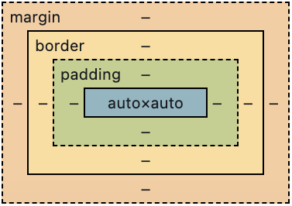
CSS – Intro to Styling
We can apply lots of different styles to one single element
p {
color: red;
font-family: Arial;
font-size: 20px;
border: 2px solid pink;
padding: 30px;
margin: 50px;
}

Slide 12
CSS – Intro to Styling
We can also split elements up for styling by using the class attribute
<p class=“important”>My first paragraph. – important text content</p>
<p class=“normal”>My first paragraph. – normal text content</p>
.important {
color: red;
font-size: 20px;
}
.normal {
color: black;
font-size: 16px;
}

Slide 13
CSS – Intro to Styling
We can also split elements up for styling by using the id attribute
<p id=“important”>My first paragraph. – important text content</p>
<p id=“normal”>My first paragraph. – normal text content</p>
#important {
color: red;
font-size: 20px;
}
#normal {
color: black;
font-size: 16px;
}

Slide 14
HTML & CSS – Images
Images are an important part of a website – how can we add them properly?
<img src=“url” alt=“alternatetext”>
The src attribute describes to the web page where to get that photo from, it needs to be saved in a location that can be accessed by the web page
One idea is to have a folder, usually one level up from the web pages, in your file structure, that contains all the photos you need, and then you reference them relative to your webpage
<img src=“./photos/picture1.jpg” alt=“important text that describes the photo”>

Slide 15
HTML & CSS – Navigation
If you want to move between pages, you can use the <a> element to point one thing to another
<a href="url">link text</a>
This can be done relatively, so you can point one piece of text from one page to another
<a href=“/about-us.html”>About Us</a>
Or it can be done absolutely, which points to another website entirely
<a href="https://www.google.com/">Search something on Google!</a>

Slide 16
HTML & CSS – Searching
An important skill to learn as a technical person is how to search
It sounds simple, but being able to know what and how to search specific things helps you figure out how to fix a problem – most issues have already been encountered by someone else
Styling divs is something you can do to make the page look more professional – but how can we do this if we don’t know the CSS by heart?
We can Google it!
Some good websites to use for HTML are:
    W3Schools
    mdn Web Docs (HTML, CSS)

Slide 17
Intro to JavaScript
Accenture

Slide 18
JavaScript – An Overview
JavaScript helps to make our HTML pages interactive – we want something to happen when we click or hover or type
So far, we can only create static websites, this means that the information on the website stays exactly as it is all the time – it’s the same for everyone
When we introduce JavaScript, we can start thinking about customising the experience for the user and creating something new - like outcomes from doing something like clicking a button
JavaScript is a programming language that we can put into our HTML that executes like a set of instructions

Slide 19
JavaScript – An Overview
We use the <script> tag to insert our JavaScript into our HTML
We can use it for events like a click of a button
In our context, we want to take the user input data from an HTML form that we created on the webpage, and export it to a file that can be read by a program like Microsoft Excel
How can we think like a computer to make this happen?

Slide 20
JavaScript – An Overview
When we’re programming, we have to think very logically and literally – the program will do exactly what you have asked it to do, with no assumptions beyond what you have explicitly stated
We know where we want to start – an empty form, and we know where we want to end – a populated spreadsheet – what are the steps we need to take to get there?
    Allow a user to type in their responses
    Save the responses from the user somewhere when they click submit
    Collate all the user responses as they keep submitting
    Write the stored information to an external file when you export
How can we tell the computer to do this?

Slide 21
JavaScript – Variables
We need somewhere to store the data – this is where variables come in
Variables are like little memory boxes – they can store information and manipulate it when we want, and we can reference variables when we want to retrieve or change something stored inside one
We define variables using keywords:
let userData;
const userData;
We use let if the variable is something we want to change - we might want to do something do it
We use const is the variable is a constant – something that will never change

Slide 22
JavaScript – Data Types
When we use variables, we are storing data, and there’s different types of data that we need to learn to store
String: we use this for any type of alphanumeric data
Int: we use this for integers
Boolean: we use this for true or false
Object: we use this when we want to store key-value pairs
Array: we use this when we want to store things in a list

Slide 23
JavaScript – Logic
We use logic in order to make our code perform tasks
This can be mathematical operations like:
+ Addition
- Subtraction
* Multiplication
/ Division
It can also be to compare things and figure out whether they’re true or false
a == b a != b a <= b a > b a >= b

Slide 24
JavaScript – Conditional Statements
We can take logic and base certain operations on it, for example:
if ( a == b ) {
then do something…
} else if ( a > b ) {
do something else…
} else {
do this instead…
}

Slide 25
JavaScript – Loops
Alternatively, we can loop through arrays, and make things happen based on certain pieces of information, for example:
let numbers_list = [0, 1, 3, 6, 10];
for (let number of numbers_list) {
number = number * 2;
}
console.log( numbers_list );

Slide 26
JavaScript – Functions
We can put variables and logic and loops together and create small pieces of code called functions that serve specific purposes and that we can call in our code to do specific things, for example:
function double_numbers(array) {
let doubled_array = [] ;
for (let number of array) {
doubled_array.push(number * 2) ;
}
return doubled_array ;
}
let numbers_list = [0, 1, 3, 6, 10];
let doubled_list = doubleNumbers(numbers_list);
console.log(doubled_list);

Slide 27
JavaScript – Arrays
An array is another way of saying a list
Arrays can contain different data types, but they should be consistent e.g.
const numbers = [ 1 , 4 , 72 , 2 , 0 , 35 ]
const names = [ “Sam” , “Paula” , “Cherie” ]

Slide 28
JavaScript – Objects
Objects help us to organise and store key-value pairs
This means that they contain 2 pieces of information for each thing
let student1 = { name: “Sandy” , age: 17, pass: true }
let student2 = { name: “Andrea” , age: 16, pass: false }
let student3 = { name: “Cass” , age: 16, pass: true }
We can access properties within objects by using “.” like this:
Console.log(student3.name) ➔ Cass
Console.log(student2.pass) ➔ false
Console.log(student1.age) ➔ 17

Slide 29
JavaScript – Ordering instructions
Back to the scenario – we have a form that accepts different types of data and we need to store it, what were the steps?
We need a variable to store the information
We want to make sure we know what information is associated with what submission, so we might need a bit of both – objects are good at storing key-value pairs, and arrays are good at storing records
We want the end result to be an array of objects containing ints, and strings
[ { name: alice, age: 23, house_cost: 250000 } , { name: bob, age: 31, house_cost: 30000 } , { name: carla, age: 19, house_cost: 100000 } , { name: damian, age: 27, house_cost: 185000 } ]

Slide 30
JavaScript – Ordering instructions
Back to the scenario – we have a form that accepts different types of data and we need to store it, what were the steps?
We need to know when to store the information
This is where it will be handy to use some of JavaScript's built-in functions like getElementById() or addEventListener()
This is starting to get a bit more complicated, and it’s still not very tangible, let’s go through a demo and see what we want the end result to be, and figure out how we can get there

Slide 31
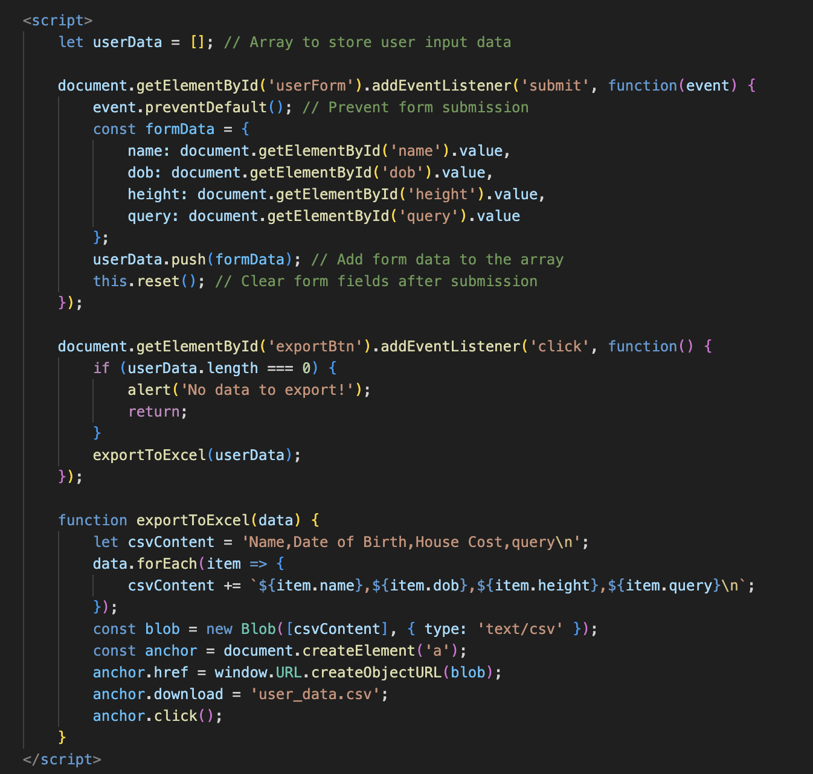
JavaScript – A Worked Demo

Slide 32
Intro to Python GenAI
Accenture

Slide 33
Python – An Overview
Python helps to automate tasks, run logic on the server, and process data. It makes things happen behind the scenes (not just in the browser).
So far, with only HTML/CSS we build static pages, Python lets the output change based on input, files, or external services.
With Python you can write scripts, build web backends (e.g., Flask), or call APIs to create personalised, data-driven experiences.
Python is a readable, general-purpose programming language with a large library ecosystem that executes clear instructions to perform real work (automation, web, data, AI).

Slide 34
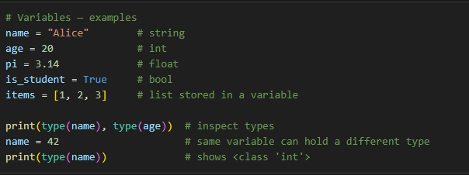
Python – An Overview
What is a variable in Python? 🧾
A variable is a name that stores a value; Python figures out the value’s type automatically (dynamic typing).

Slide 35
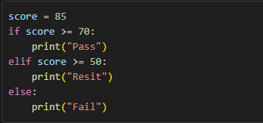
Python – Control flow: If
If condition ✅
If runs a block of code only when a Boolean expression is True (use elif and else for alternatives)

Slide 36
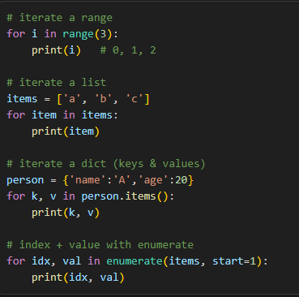
Python – Control flow : For
For loop 🔁
Repeats a block of code once for each item in an iterable (list, range, string, dict, etc.).

Slide 37
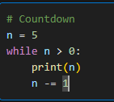
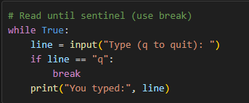
Python – Control flow : While
What is a while loop in Python? 🔁
One-liner: Repeats a block of code as long as a condition remains true.

Slide 38
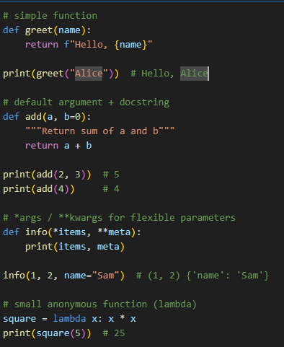
Python – Functions 🧠
Functions 🧩
A function is a named, reusable block of code that accepts inputs (arguments), performs work, and can return a result.

Slide 39
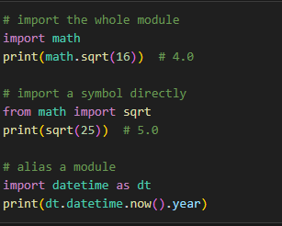
Python – Imports 🧠
What is import in Python? 🔧
import brings code (functions, classes, variables) from another module into your current file so you can reuse it.

Slide 40
Python – Code Walkthrough: Quick Guide 📄
Where to look
File: app_simple.py the simple Flask backend
File: config.py environment and API key checks
High-level flow
Load environment variables (API key)
Configure the Google Generative AI client
Start a Flask app and enable CORS
Expose /generate-prompt (POST): read JSON → build prompt → call model → return JSON
Expose /health (GET) for a simple status check

Slide 41
Python – Code Walkthrough:
Read the Files Quick Guide 📄
Key constructs and examples (map to lines in app_simple.py)
Imports: bring packages into the file: import os, from flask import Flask, request, jsonify
Load env: load_dotenv() and API_KEY = os.getenv('GOOGLE_API_KEY') (safe secret handling)
Condition / Guard: if not API_KEY: raise RuntimeError(...) (fail fast with clear message)
Flask app & decorator: @app.route('/generate-prompt', methods=['POST']) defines a request handler function
Reading JSON: data = request.get_json() or {} (safe extraction with defaults)
String & list handling: studies_text = ', '.join(studies) (list → readable string)
Calling external APIs: model.generate_content(prompt) (use the client library to call an LLM)
Safe attribute access: getattr(response, 'text', str(response)) (avoid attribute errors)
Return JSON response: return jsonify({'success': True, 'response': ai_text}), 200
Main guard: if __name__ == '__main__': app.run(...) (run app only when executed directly)

Slide 42
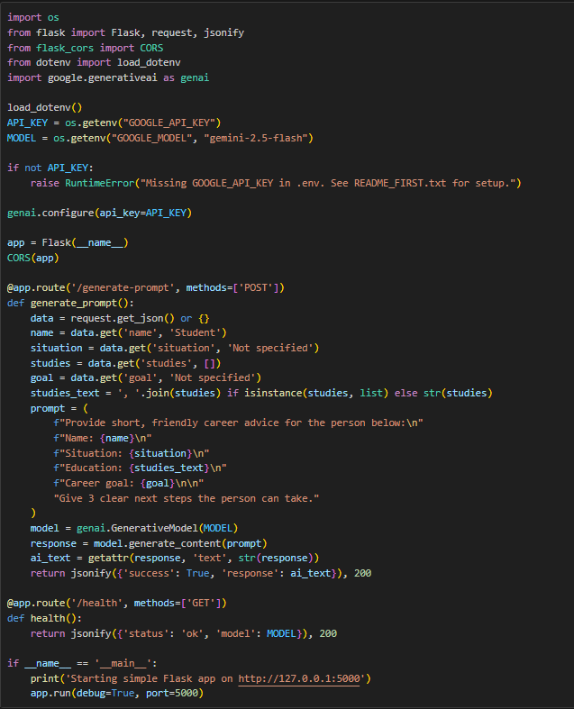
Python – Code Walkthrough:
Read the Files Quick Guide 📄

