Slide 1
Startup Fail Analysis:
Unveiling the Patterns Behind Startup Failure
Hafizh Maulana • DS 27

Slide 2
Summary
Objectives
Find the biggest cause of failing startups
Datasets
Startup Success Prediction
Why Startups fail?
Can’t make a good and lot connection!
Lack of Financing/ Investors

Slide 3
Business Understanding
As a tech consultant company. Our stakeholders find that most of our client is the new startup that worried that they will fail so fast.
Get some information about what is the biggest cause of startup failure.
What recommendation we can give to the most of our client, so we have the same foundation for the same problem?
What is the key of the success startups? So we can give some suggestion to our client.

Slide 4
What Happened?
According to the Bureau of Labor Statistics BLS, ⅕ of startups fail within their first year. and up to 65% of startups will fail within 10 years of opening for businesses.
source : https://www.forbes.com/advisor/business/software/startups-failure-rate/

Slide 5
Why did it happen?
Source 1
38% of startup failures occur due to financial issues
35% of businesses fail due to lack of market need
20% of businesses fail due to industry competition
19% of businesses fail due to unsuccessful business model
18% of businesses fail due to legal challenges
source : https://www.forbes.com/advisor/business/software/startups-failure-rate/
Source 2
Reason 1: Lack of financing or investors 47%
Reason 2: Running out of cash 44%
Reason 3: Lack of market demand or poor timing
Reason 4: People problems—Clashing between leadership, teams, and investors
source : https://www.capchase.com/blog/the-top-4-reasons-why-startups-fail-and-how-to-avoid-them

Slide 6
Objectives
From this Dataset, we’re gonna explore every features that have impact to the success or fail condition. We will validate 1 of top 10 google search about “the reason behind startups failure” then finding the biggest cause of startup failing.
It would help us and our client’s common issues.

Slide 7
Data Understanding

Slide 8
What Data do we have?
923 Rows and 49 Columns
unnamed: 0
state_code
latitude
longitude
zip_code
id
state_code.1
unnamed: 6
name
founded_at
closed_at
first_funding_at
closed_funding_at
milestones
avg_participants
is_top500
labels
status
age_first_funding_year
age_last_funding_year
age_first_milestone_year
age_last_milestone_year
relationship
funding_rounds
has_VC
has_angel
has_roundA
has_roundB
has_roundC
has_roundD
funding_total_usd
object_id
city
is_CA
is_NY
is_MA
is_TX
is_otherstate
category_code
is_software
is_web
is_mobile
is_enterprise
is_advertising
is_gamesvideo
is_ecommerce
is_biotech
is_consulting
is_othercategory
Data Source : https://www.kaggle.com/datasets/manishkc06/startup-success-prediction

Slide 9
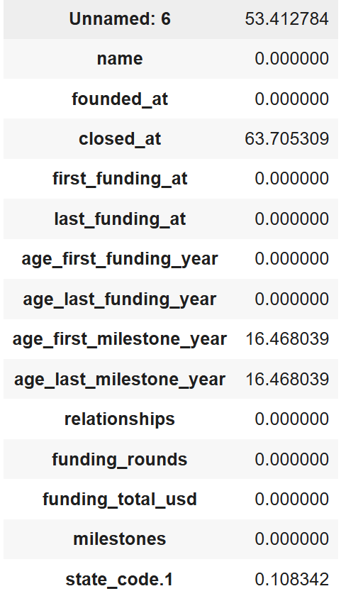
Data Cleaning
Handling Missing Values :
drop unnamed 6 columns
drop closed_at column after add lifespan columns.
age_last_milestone_year and first_milestone probably because they don't have any milestone. If true, we gonna fill it with 0
Drop state code columns
There is No Duplicate in the data

Slide 10
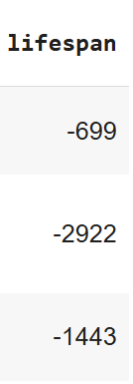
Data Manipulation
Anomaly Data
Drop Some Columns :
Labels is the same as Status
Drop Irrelevant columns
Drop anomaly in Data
Drop minus row in age first and last funding
Creating New Features :
Lifespan for EDA
Funding_age
Irrelevant Columns : ['Unnamed:6', 'state_code.1', 'zip_code', 'id', 'Unnamed: 0','object_id', 'state_code', 'name', 'latitude', 'longitude', 'first_funding_at', 'last_funding_at', 'founded_at', 'closed_at', 'category_code', 'city']

Slide 11
EDA

Slide 12
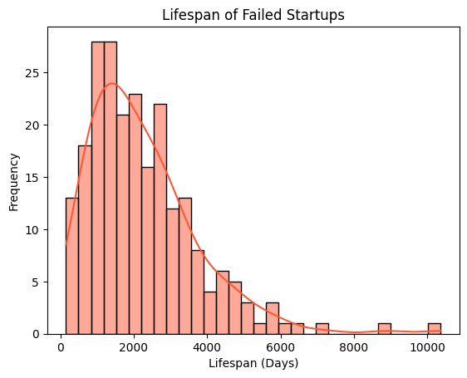
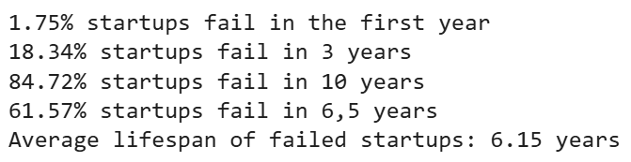
Startup Lifespan
The data is Left-skewed, with a peak at around 1000–2500 days (about 3–6.5 years). The frequency gradually decreases as the lifespan increases.
1-3 years (Adapt Phase)
3-6,5 years (Critical Phase)
> 6,5 years (Maturity Phase)

Slide 13
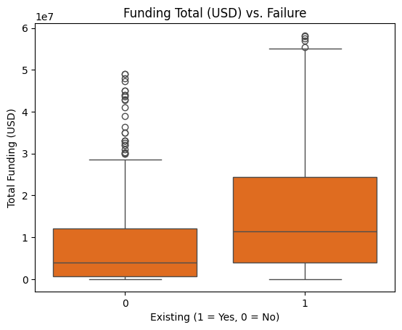
Funding Analysis
The median funding for existing startups is higher than failed startups, This suggests that startups with higher funding tend to survive more often.
The existing have wider range of funding total, it means some successful startup gain more funding that most failed startups.
Existing have more extreme funding outliers. The farthest outlier for fail startup just reach the beginning of existing outliers.

Slide 14
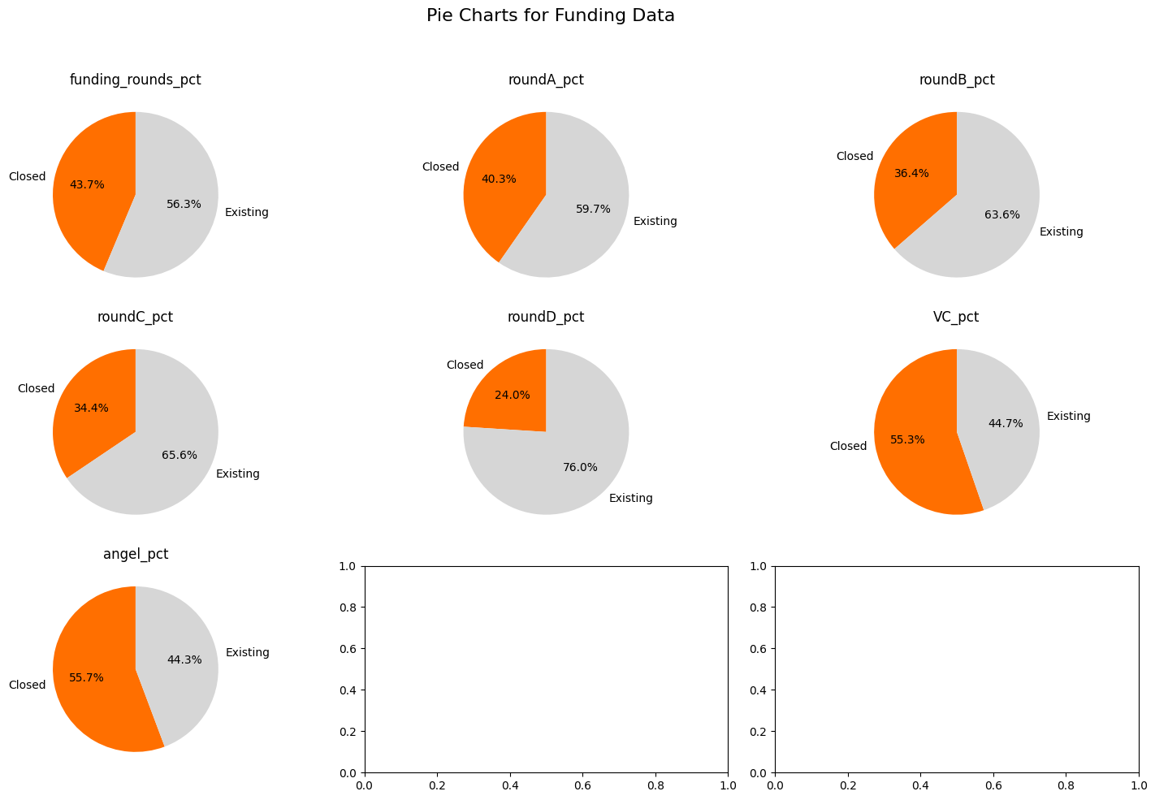
Funding Analysis
43.7% of startups that received funding have closed, This suggests that while funding can help, analyzing other factors like market fit or execution being critical for survival.
VC and Angel funding may not always correlate with long-term survival, possibly due to high-risk investments.
To improve survivability, startups should aim to advance to later funding stages while balancing growth with operational stability.

Slide 15
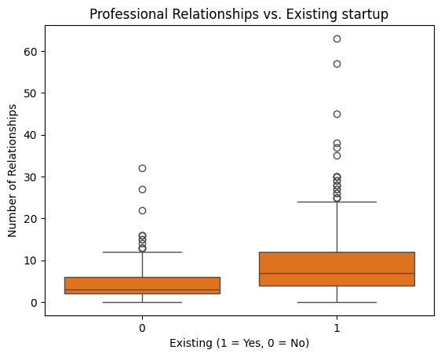
RelationsAnalysis
we found that startup that have more relations tend to survive. If a startups have more than 20 Professional Relationship, they will strongly survive!

Slide 16
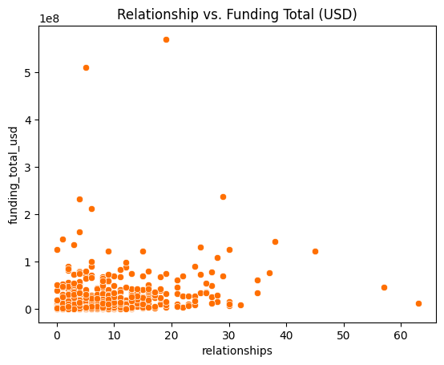
RelationsAnalysis
Surprisingly, Relations and total funding is not highly correlated.

Slide 17
Feature Engineering

Slide 18
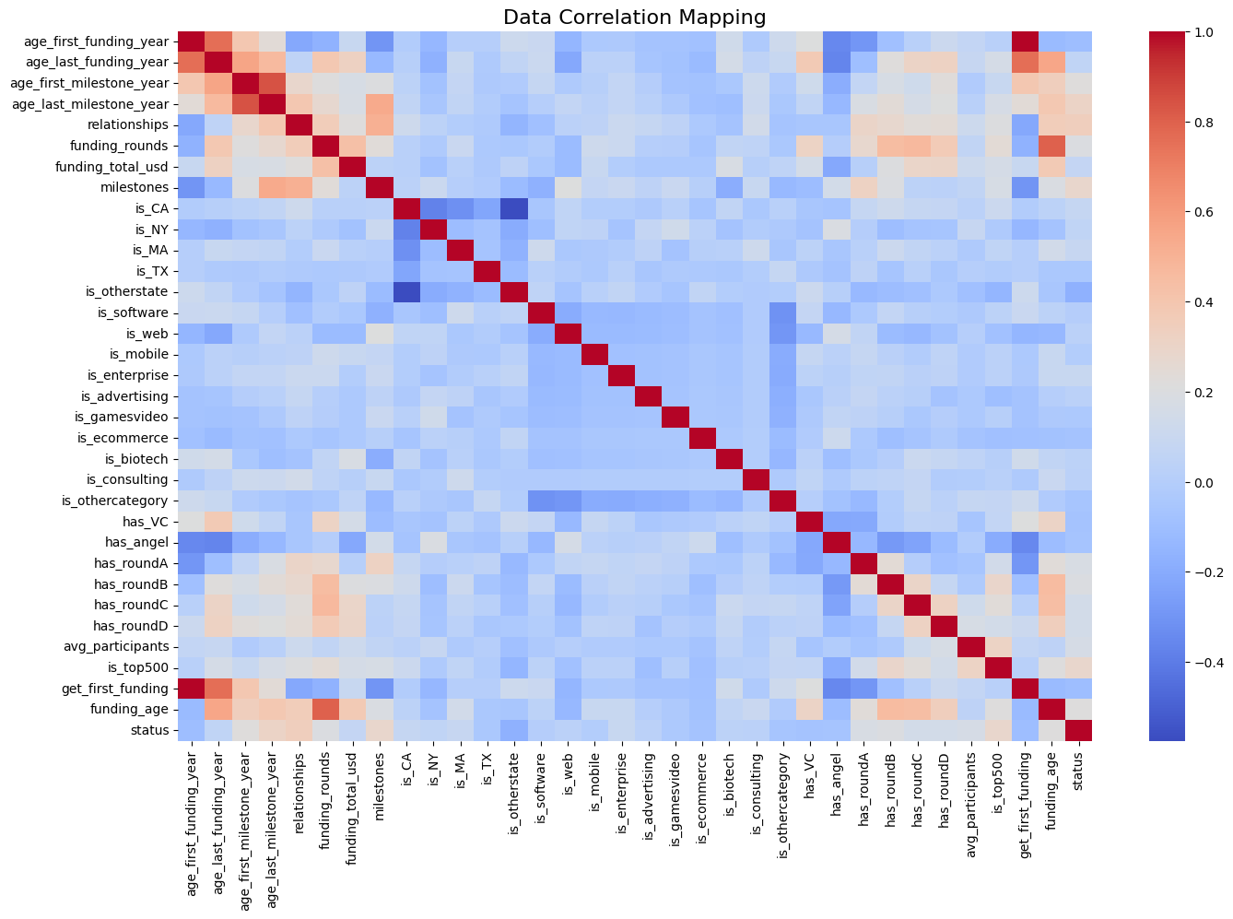
Encoding
Multicol
This dataset has already encoded well as we saw on Data Understanding
We don’t need to handle it because we use a model that strong against it. And there is no features that have strong correlation with status

Slide 19
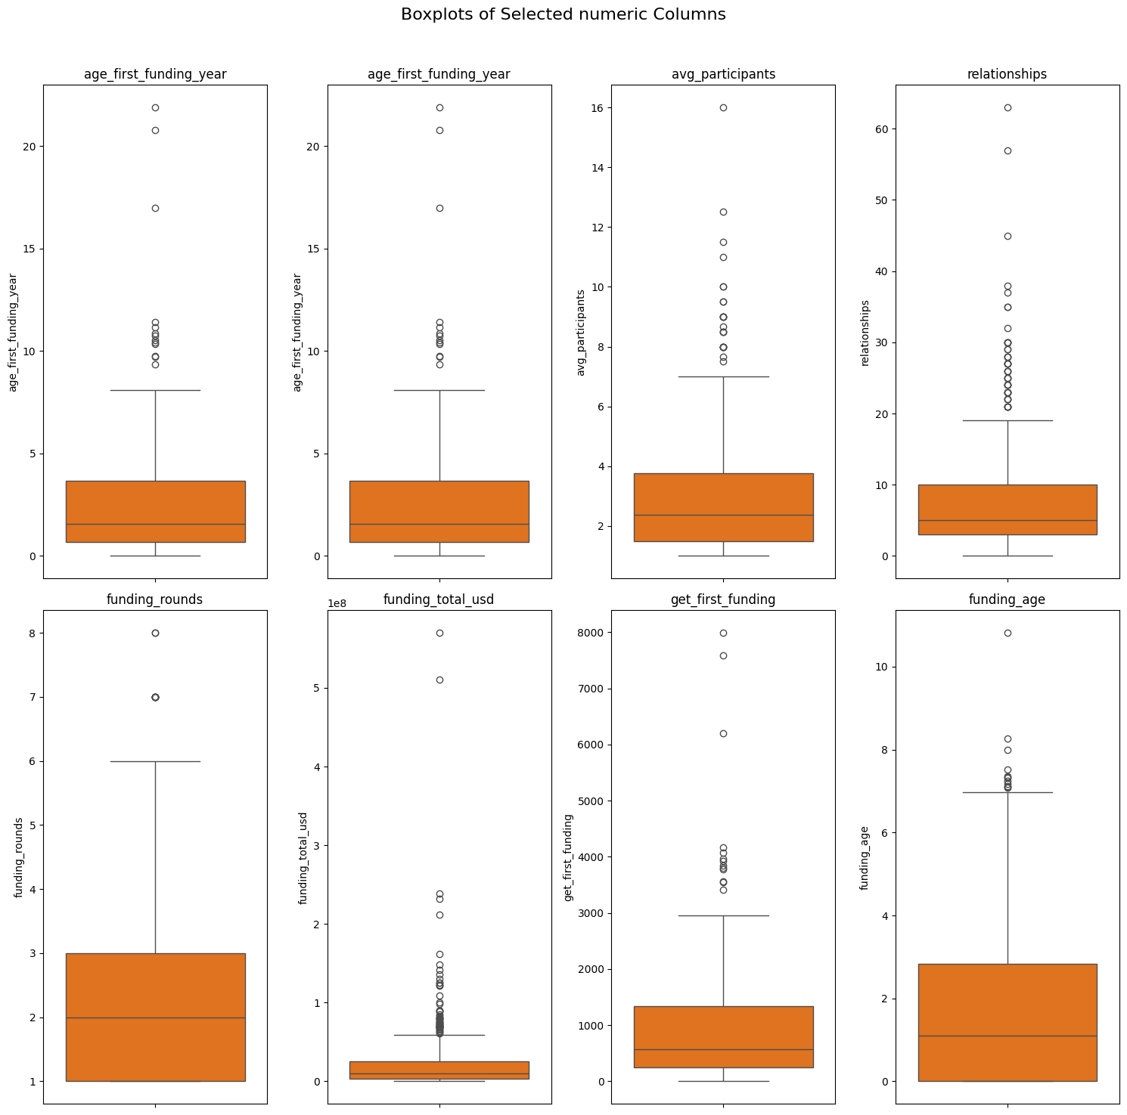
Outliers
Scaling
We don’t handling any outliers because we see that the outliers is important and we use tree-based model
We use standard scaler for scaling the data.

Slide 20
Modeling

Slide 21
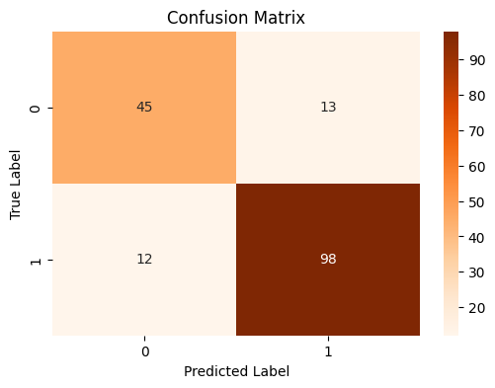
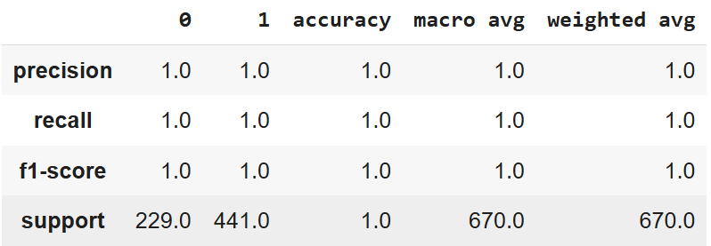
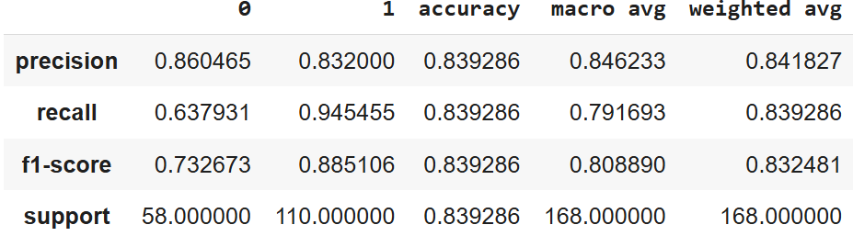
Random Forest Evaluation
Train Data
Test Data

Slide 22
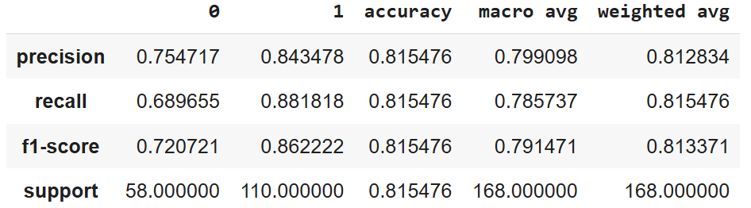
XGBoost Eval
Train Data
Test Data

Slide 23
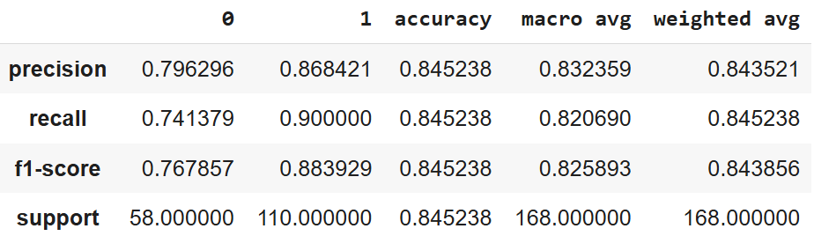
LGBM Evaluation
Train Data
Test Data

Slide 24
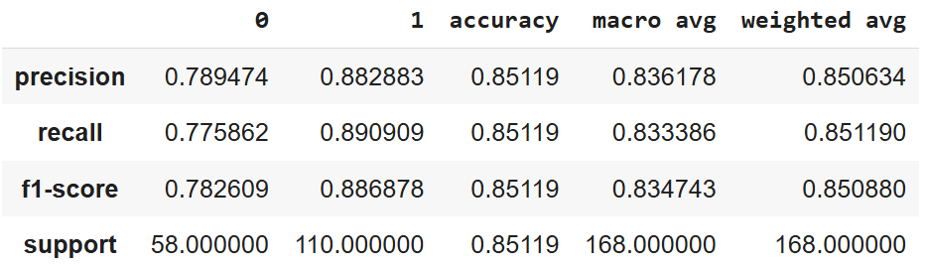
LGBM w SMOTE Evaluation
Train Data
Test Data

Slide 25

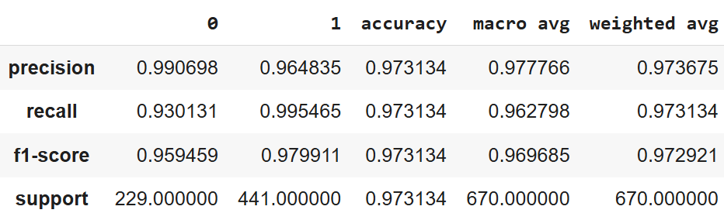
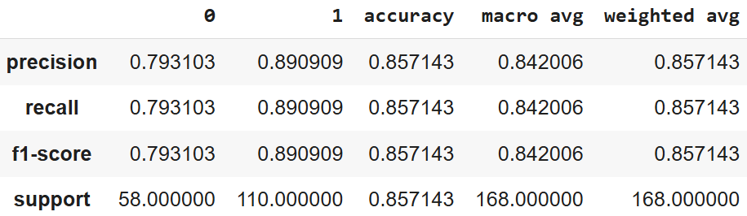
LGBM w SMOTE & Tuning Evaluation
Train Data
Test Data

Slide 26
Feature Importance

Slide 27
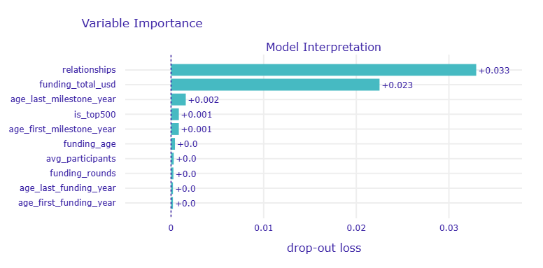
Variable Importance
relationship
Relation have the biggest impact to the success or the close of a startup.
funding_total_usd
Surprisingly, funding is the next after relationship. And from EDA we don’t see any correlations between them.
Age last milestone
is_top500
age first milestone

Slide 28
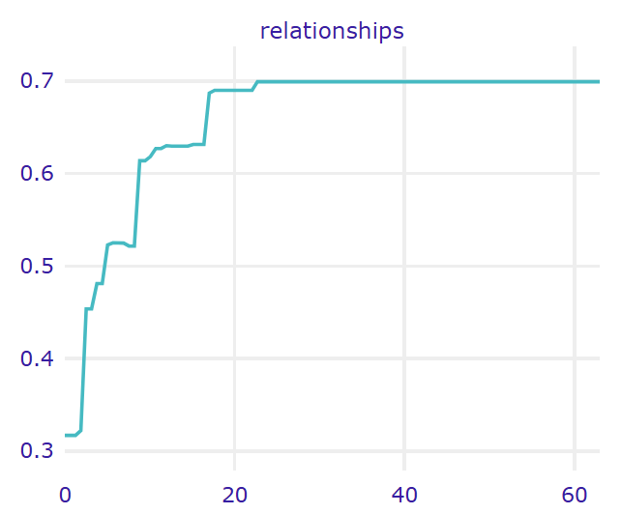
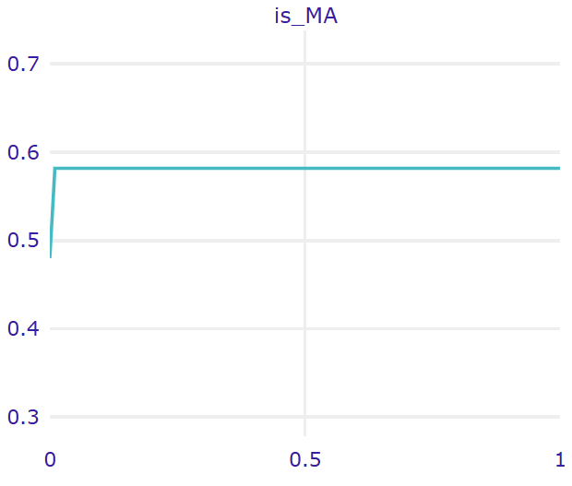
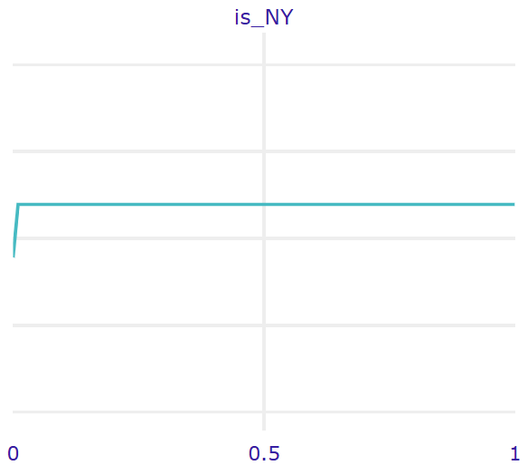
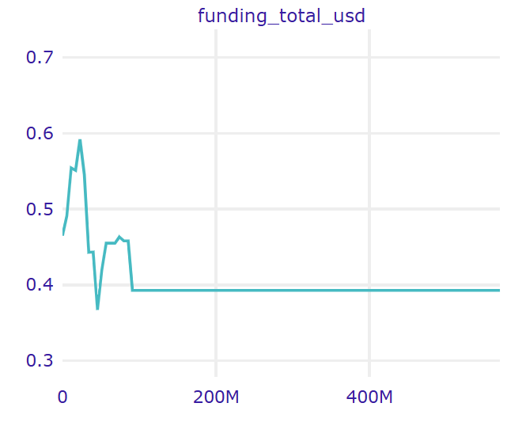
Relationship is the KEY!
-The more relationships are established, the more a startup will survive.
- After reach 20 relations, it will strongly survive
- Startups that located in Massachusets and New York exist more.
-Startups with a large total funding amount have a higher chance of success, but there is a point where the effect plateaus.

Slide 29
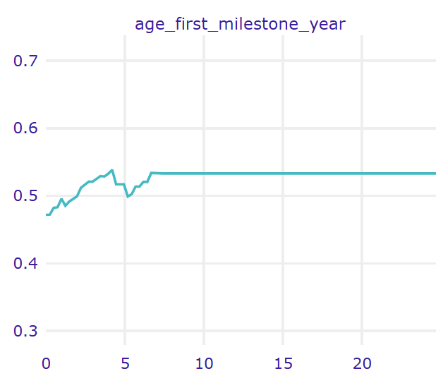
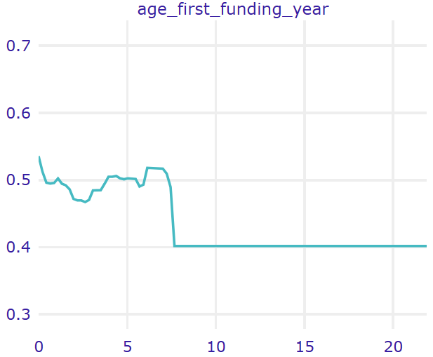
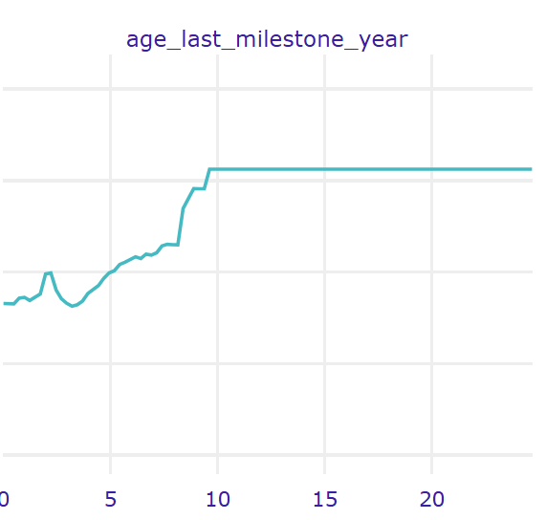
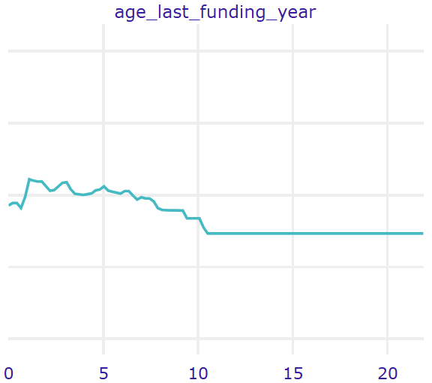
Funding & Milestones vs Failure
-Reaching the first milestone early seems to have a positive impact on startup success. Profitability increases up to a certain period.
- Startups with older first or last funding years tend to have a better chance of success.
-If the last milestone year is too long ago, there is a potential that the startup is losing its competitive edge, but they may survive because they have built a solid base of operations.

Slide 30
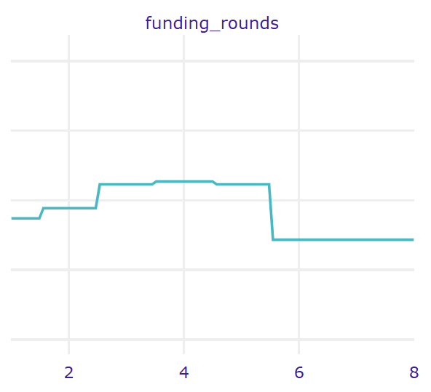
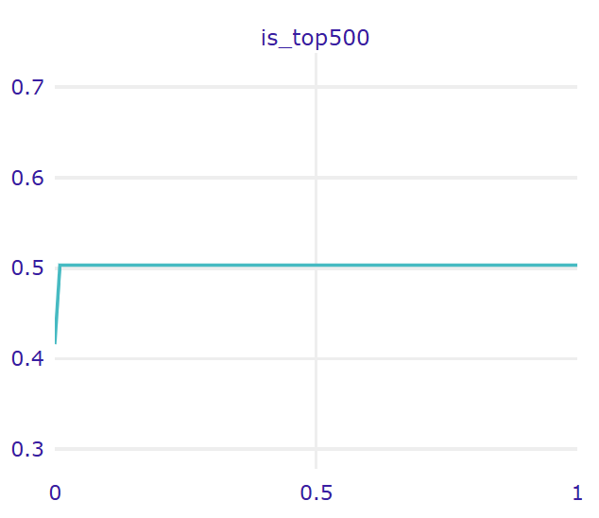
Join top 500 clubs!
- Startups with multiple rounds of seed funding show higher profitability, but after a certain number of rounds, the impact levels off.
- Startups that join top 500 clubs will be existing more that than the others that not joining

Slide 31
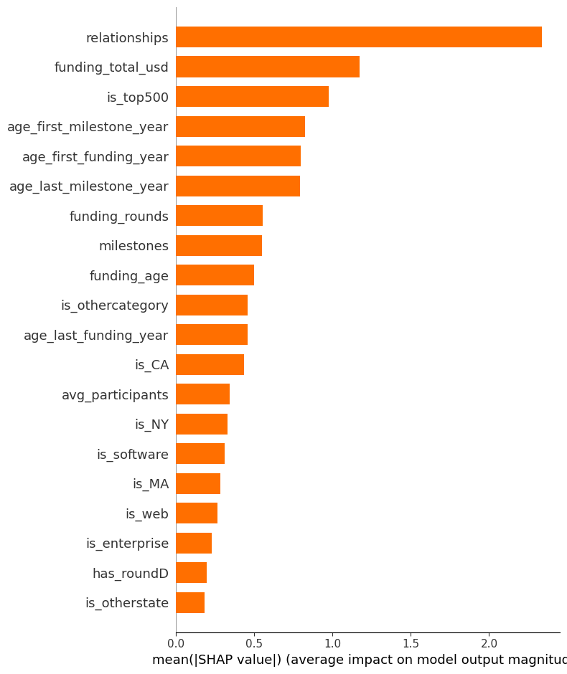
Relationship still the no.1
Top 5 success/fail features:
Relationship : almost twice the funding total.
Funding total
top 500
age first milestone
age first funding

Slide 32
Why Relationship?
Access to Resources
Strong relationships enable startups to obtain funding, mentorship, and relevant technology. Investors not only provide money but also open access to partner or customer networks.
Reputation and Credibility
Relationships with influential figures (political figures/influencers or artist) can increase market trust and accelerate startup growth.
Growth Acceleration
Partnering with large companies or institutions can expand market access and facilitate product penetration. Example: Fintech startups that start with large banks gain credibility and customers faster.

Slide 33
Suggestion
Make a great connections with the total of 20 including :
The Right Mentor (Airbnb)
Public Figure
Industry (Spotify)
Investors
Government (Mining company)
Gain More Funding, Optimize spending, focus on focus on stable and sustainable funding not just big at the beginning

