Slide 1
ANALYSIS TIME SERIES
Airline Passenger Data 1949–1960
Data Understanding, Processing, Pattern Analysis, and Forecasting-Based Strategic Recomendation
Prepared By: Muhammad Hafizh Rifandi
Dataset : Airline Passenger Dataset Colab

Slide 2
PRESENTATION MAP
Agenda
01
Data Understanding
Dataset overview, time range, and core variables
02
Data Processing Methods
Date parsing, missing values, and transformations
03
Analysis & Visualization
Decomposition, smoothing, stationarity testing, forecasting
04
Insight & Recommendation
Key findings and data-driven strategic recommendations
05
Reference & Documentation
Colab links, dashboards, and analytical proof
2

Slide 3
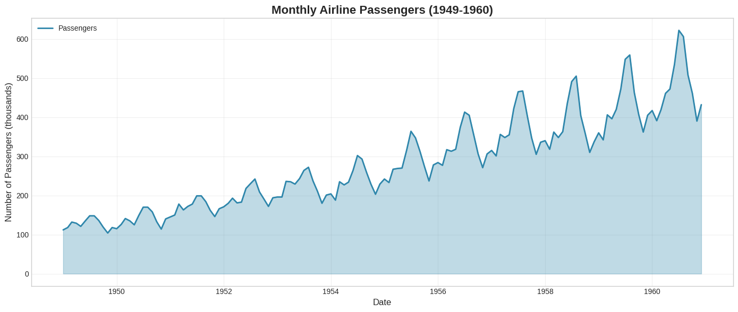
01 — DATA UNDERSTANDING
Data Understanding
Dataset Name
AirPassengers (Monthly Airline Passengers)
Time Range
January 1949 – December 1960 (12 years)
Number of Obs.
144 monthly data rows
Main Variables
Date (month-year) & Passengers (in thousands)
Characteristics
Long-term upward trend + clear annual seasonal pattern
Raw data from 1949–1960 shows a consistent upward trend with recurring spikes every year.
3

Slide 4
02 — DATA PREPROCESSING METHOD
Data Preprocessing Steps
1
2
3
4
Date Parsing
Handling Missing Values
Data Transformation
Decomposition & Smoothing
The month-year column is converted into datetime format and set as a time series index to ensure a consistent chronological sequence.
The dataset was checked and no missing values were found (144/144 complete), so no imputation was required.
Log transformation and differencing (first difference, seasonal difference lag 12) were performed to reduce the trend and achieve stationarity.
Data is decomposed into trend, seasonal, and residual components (multiplicative method), and smoothed using moving average & exponential smoothing.
4

Slide 5
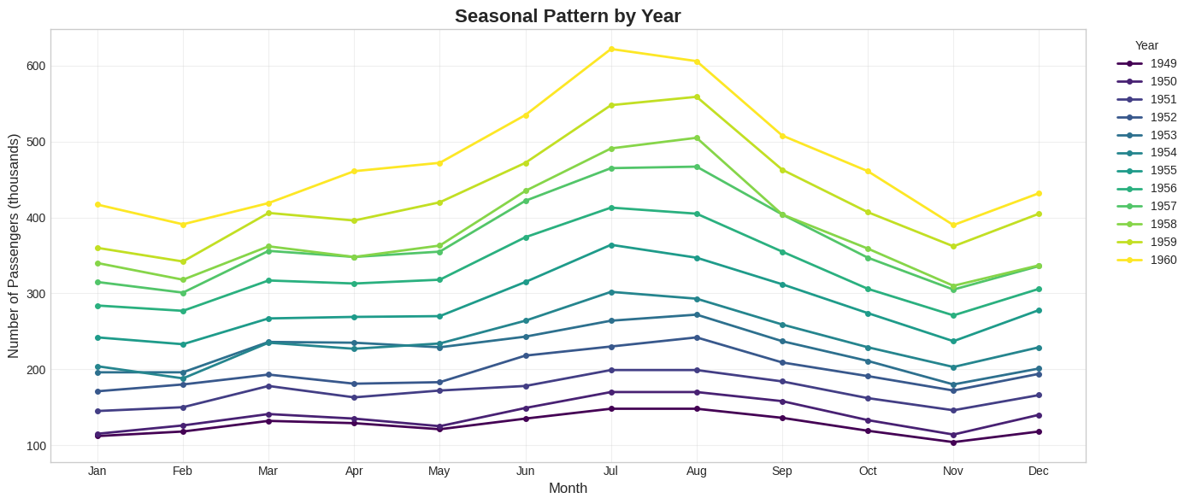
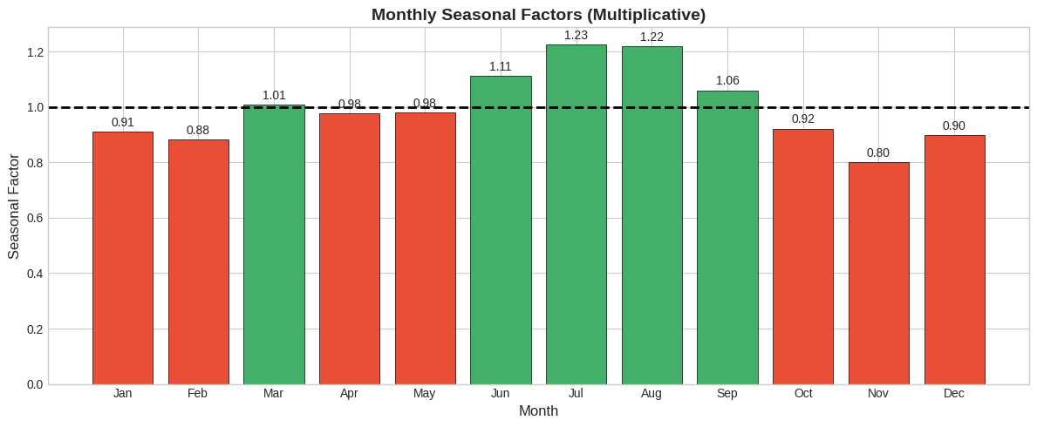
03 — ANALYSIS & VISUALIZATION
Annual Seasonal Pattern
Graph Reading:
Every year (1949–1960) exhibits an identical seasonal pattern shape rising towards the middle of the year.
Peak demand consistently occurs in July -August (seasonal factor 1.22–1.23).
The lowest point occurs in November (seasonal factor 0.80), followed by December–February.
Each yearly line shifts progressively higher - confirming the long-term growth trend overlaying the seasonal pattern.
5

Slide 6
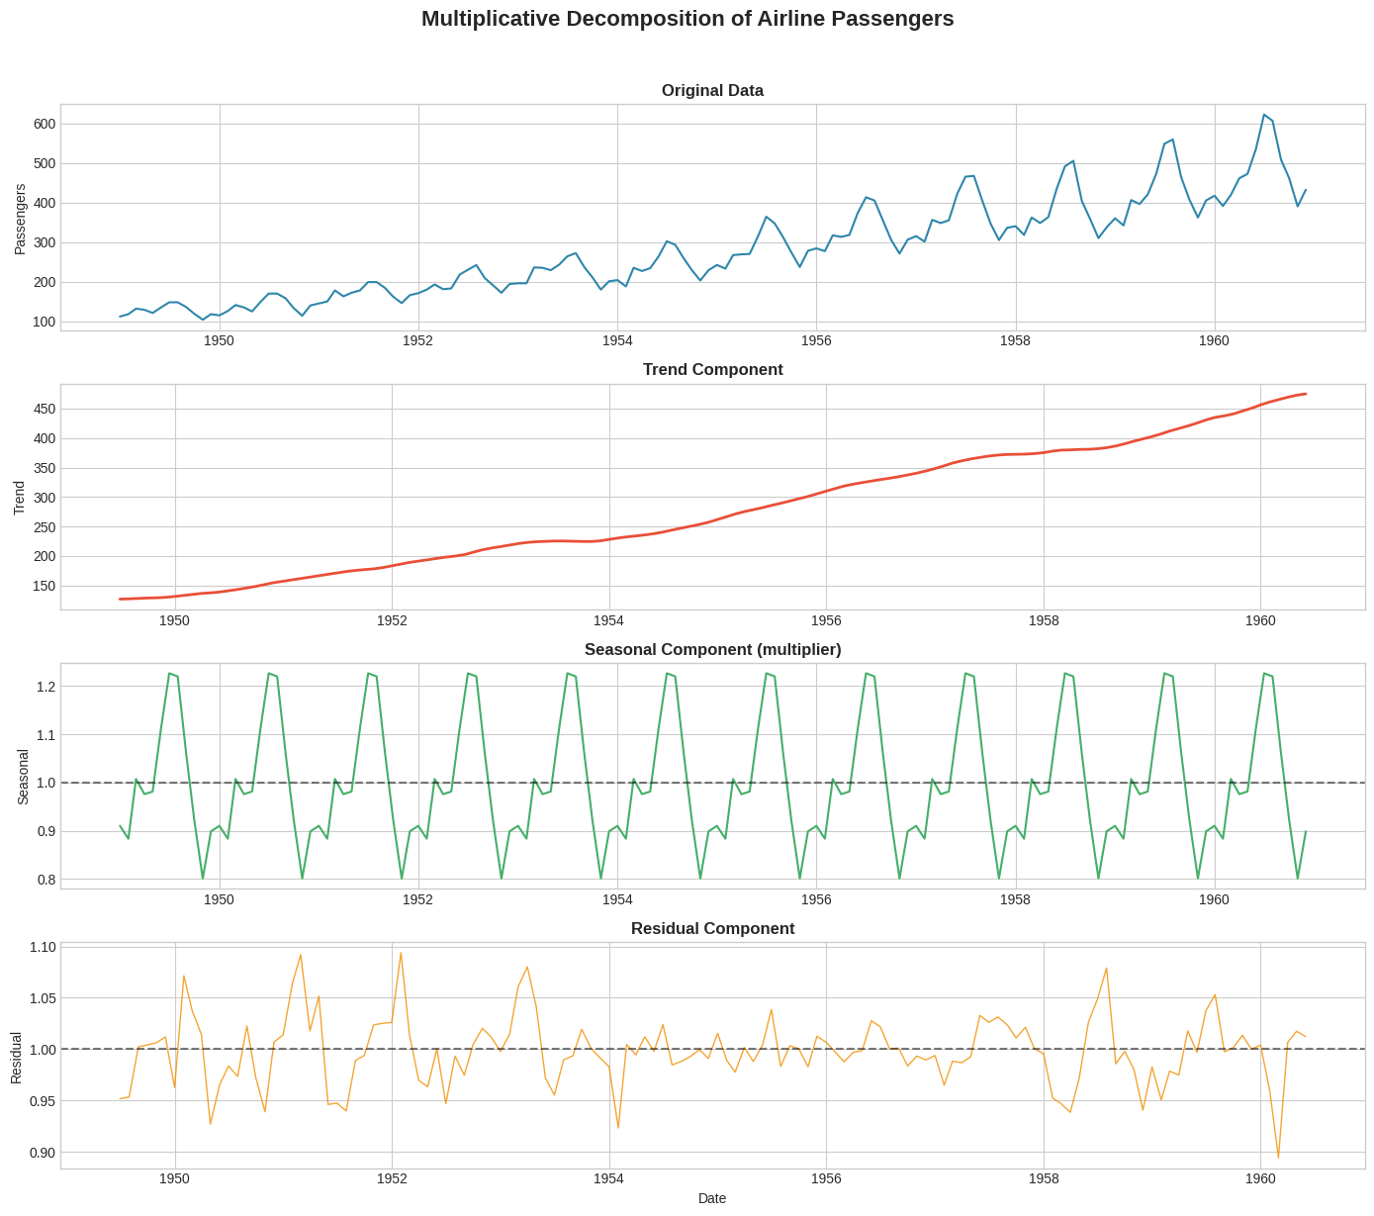
03 — ANALYSIS & VISUALIZATION
Decomposition Time Series (Multiplicative)
Trend
Rises nearly linearly from ~130 (1949) to ~470 (1960).
Seasonal
Stable repeating pattern every 12 months, factor range 0.80–1.23.
Residual
Fluctuates randomly around 1.0, with no systematic pattern remaining.
6

Slide 7
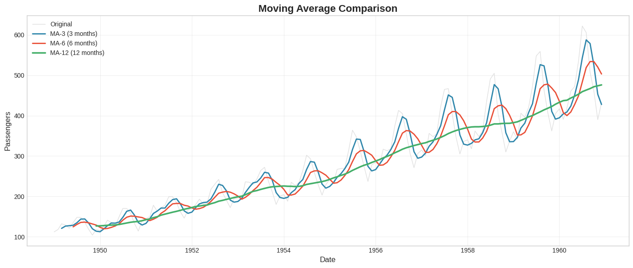
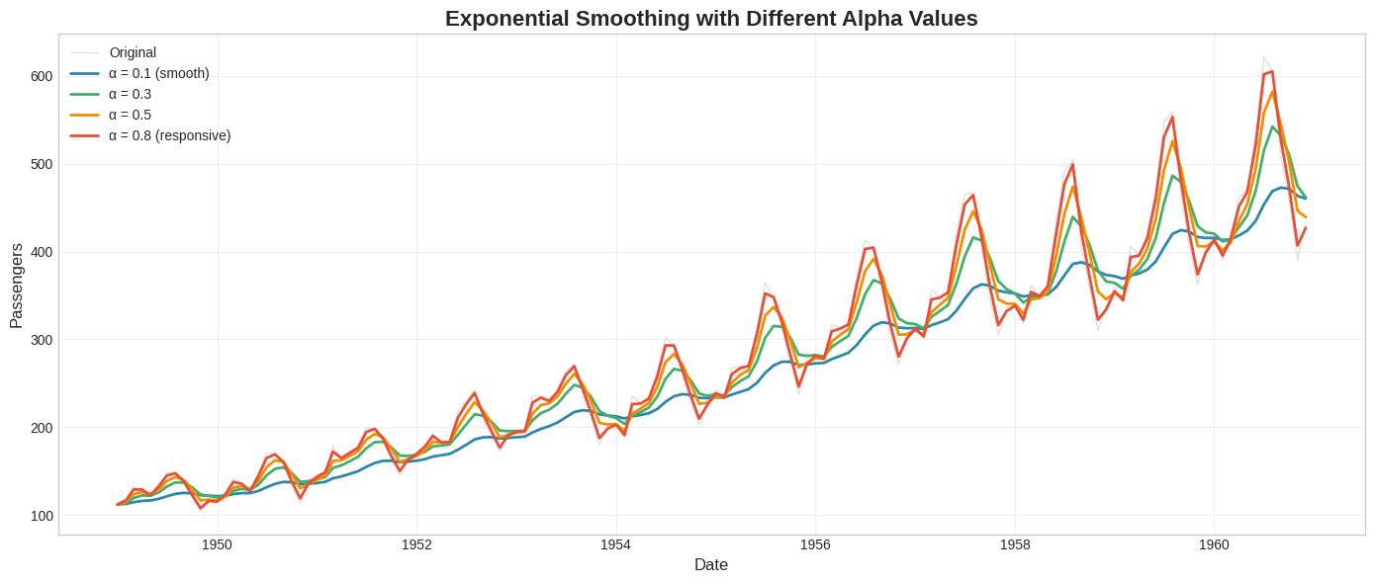
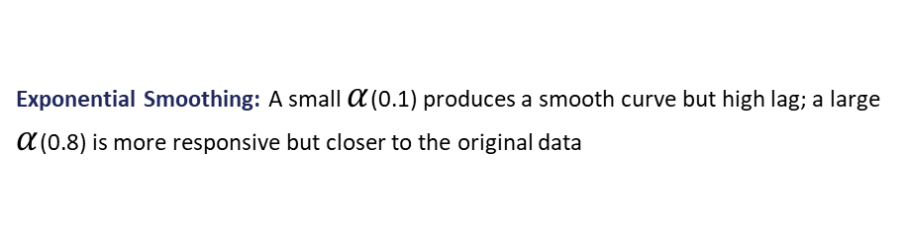
03 — ANALYSIS & VISUALIZATION
Smoothing: Moving Average & Exponential Smoothing
Moving Average (MA-3/6/12): Moving Average (MA-3/6/12): The larger the window, the smoother the curve but the higher the lag slower to respond to changes with MA-12 best at following the trend line.
Exponential Smoothing: A small $α$(0.1) produces a smooth curve but high lag; a large $α$(0.8) is more responsive but closer to the original data
7

Slide 8
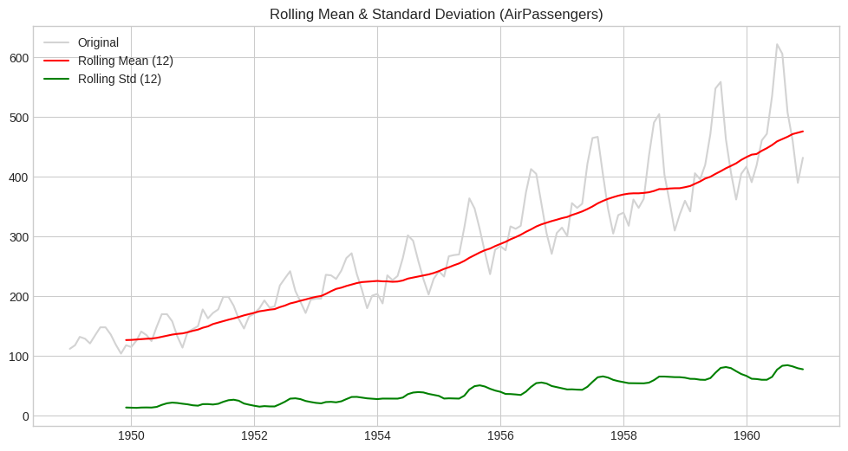
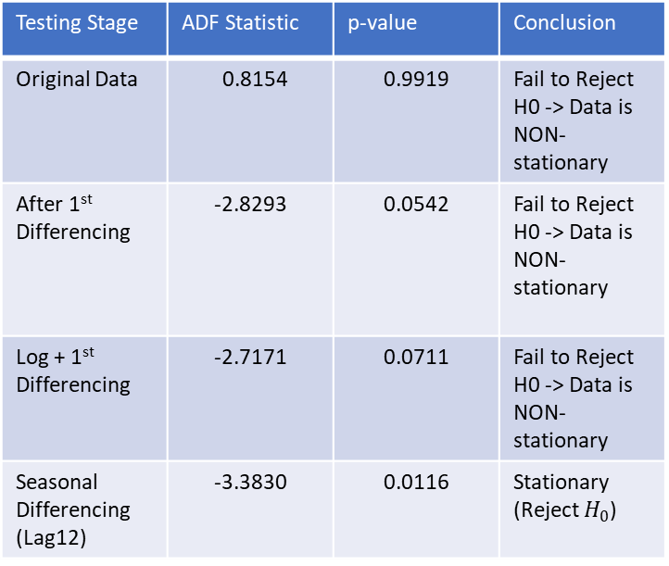
03 — ANALYSIS & VISUALIZATION
Stationarity Test: Rolling Statistics & ADF Test
Testing Stage | ADF Statistic | p-value | Conclusion
Original Data | 0.8154 | 0.9919 | Fail to Reject H0 -> Data is NON-stationary
After 1st Differencing | -2.8293 | 0.0542 | Fail to Reject H0 -> Data is NON-stationary
Log + 1st Differencing | -2.7171 | 0.0711 | Fail to Reject H0 -> Data is NON-stationary
Seasonal Differencing (Lag12) | -3.3830 | 0.0116 | Stationary (Reject $H_{0}$)
Rolling mean keeps increasing and rolling std also grows over time, visual indication that the data is not yet stationary.
Conclusion: Only seasonal differencing (lag 12) successfully makes the data stationary (p-value 0.0116 < 0.05).
8

Slide 9
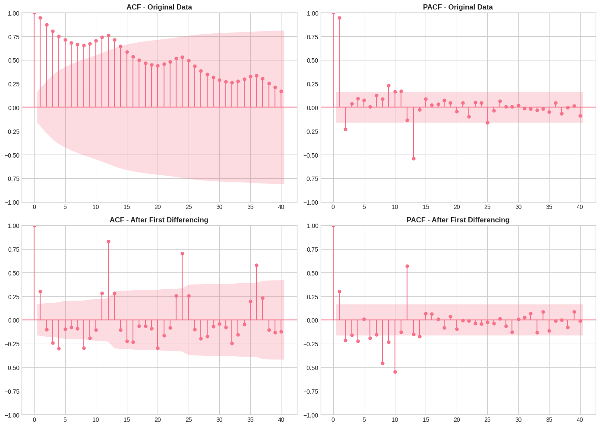
03 — ANALYSIS & VISUALIZATION
Stationarity Test: ACF & PACF
Original Data
After Differencing
ACF decays slowly & repeats every 12 lags -> strong trend + seasonality, non-stationary; therefore, standard transformations like differencing or seasonal adjustment are mandatory before any reliable statistical modelling or forecasting can take place.
Significant spikes still appear at lag 12 & 24 -> seasonal component needs to be handled separately (supporting SARIMA/Holt-Winters models).
9

Slide 10
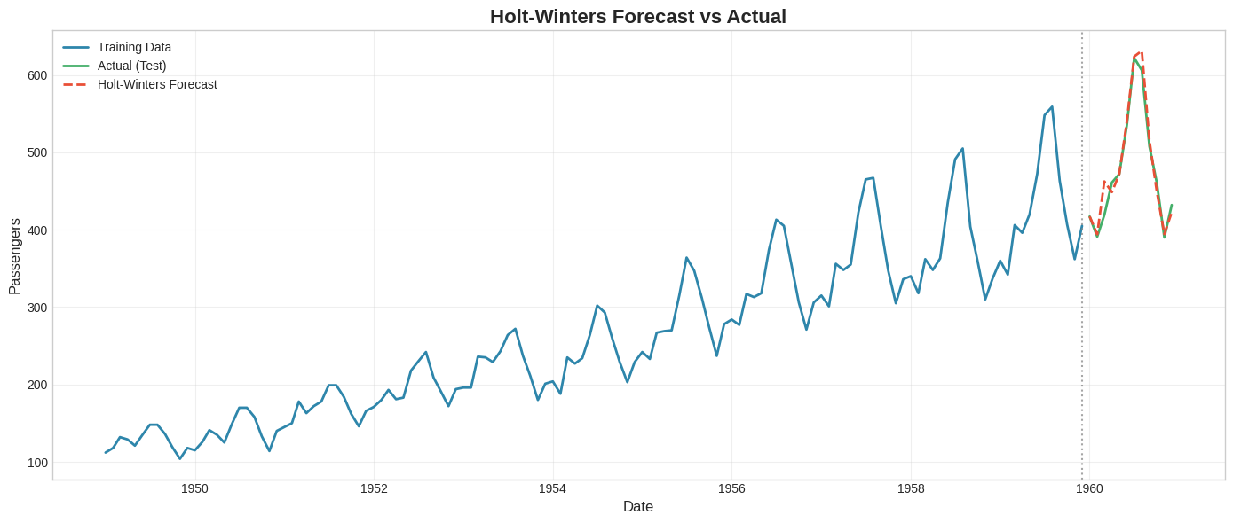
03 — ANALYSIS & VISUALIZATION
Forecasting: Holt-Winters
Why Holt-Winters?
Captures both trend and seasonality simultaneously in a single model.
Forecast (red dashed line) closely matches the actual pattern (green line)..
Well-suited for time series data with stable seasonality, such as airline passenger volume.
Key Findings?
The Holt-Winters model demonstrates strong predictive performance by successfully capturing both the underlying upward trend and the repeating seasonal fluctuations in a single framework.
The forecasted trajectory (red dashed line) aligns closely with the actual test data (green line), proving its effectiveness for out-of-sample prediction on data with stable seasonal patterns.
10

Slide 11
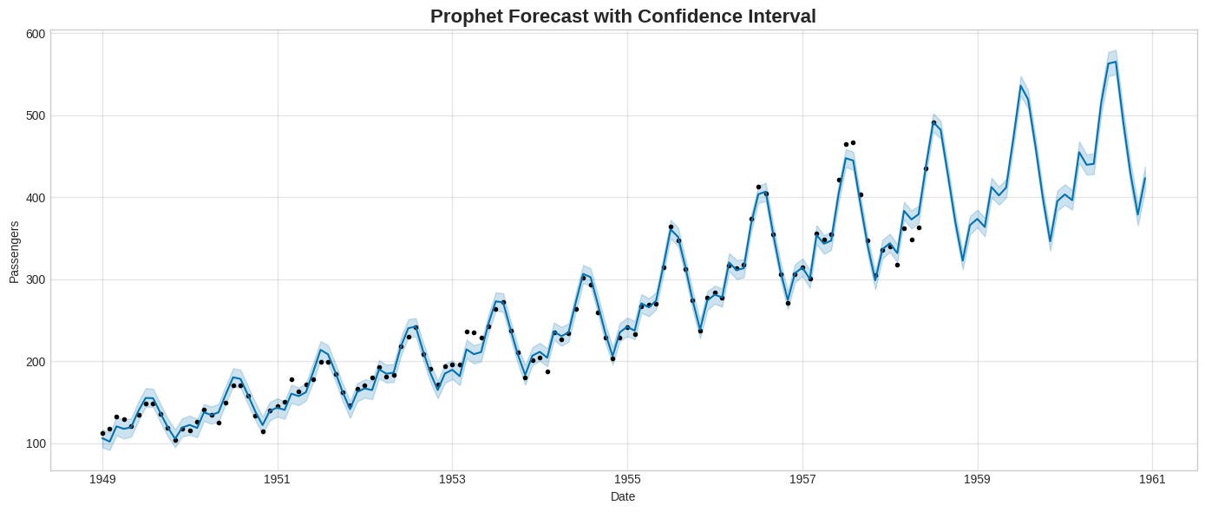
03 — ANALYSIS & VISUALIZATION
Forecasting: Prophet Model
Model Accuracy
The confidence interval (light blue area) remains narrow throughout the period indicating that the model is confident in its predictions.
An MAPE of 4.08% is classified as highly accurate for business time series data.
18.41
22.68
4.08%
MAE
RMSE
MAPE
11

Slide 12
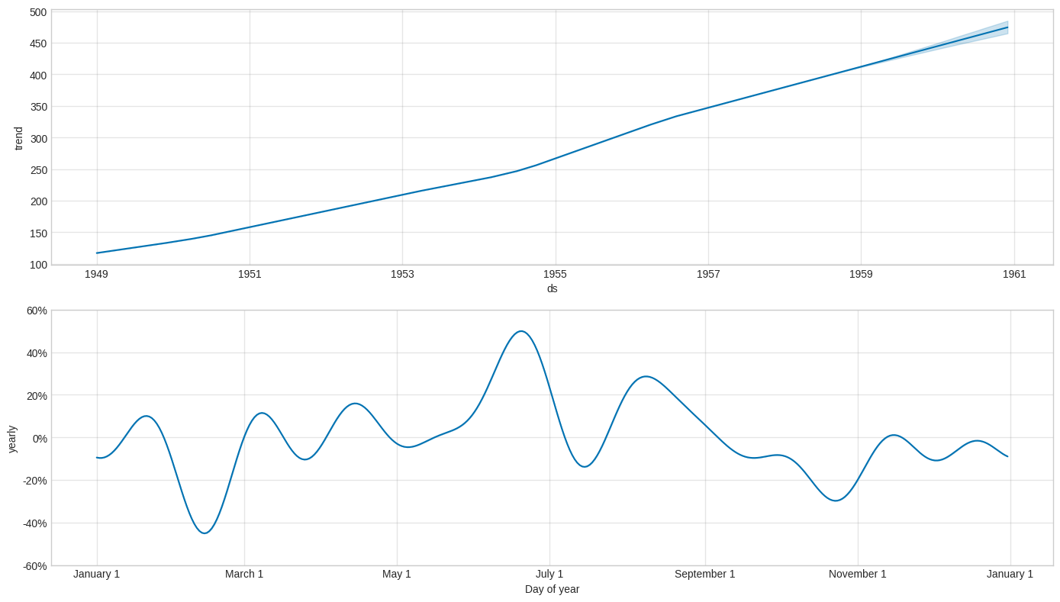
03 — ANALYSIS & VISUALIZATION
Prophet Components: Trend & Yearly Seasonality
Interpretation:
Long-term trend increases consistently with no signs of slowdown through late 1960.
Annual seasonal effect peaks around late June early July (+~50%) and drops sharply in November (~-30%).
Double seasonal shape (minor peaks in March & August) indicates distinct holiday periods.
12

Slide 13
04 — INSIGHT & RECOMMENDATION
Key Findings
1
Seasonal Peak Demand
Highest demand consistently occurs every July–August (seasonal factor 1.22–1.23), aligning with the summer holiday season.
2
Sustainable Growth Trend
Passenger volume grew nearly linearly from ~130 thousand (1949) to ~470 thousand (1960) — with no signs of slowdown.
3
Strong Seasonality, Not a Random Walk
ADF test shows data is only stationary after seasonal differencing (lag 12), confirming the seasonal pattern as a dominant component, not noise.
4
Seasonal-Based Models Are Highly Accurate
Holt-Winters and Prophet yield high-precision forecasts (MAPE 4.08%), making them reliable for short-to-medium-term capacity planning.
13

Slide 14
04 — INSIGHT & RECOMMENDATION
Strategic Recommendations
1
When to Add Capacity
2
When to Add Inventory/Stock
To successfully anticipate seasonal demand surges between June and August, airlines must proactively scale operations by increasing fleet availability through short-term leases, optimizing flight schedules on high-demand leisure routes, and aggressively recruiting, training, and rostering additional staff.
Prior to the high-demand summer peak in June, airlines need to proactively stock up on essential supplies such as fuel, catering provisions, and aircraft spare parts to avoid shortages and pricing spikes. Conversely, during the slower winter months of November and December, operations should lean into a reduction of stock levels to minimize holding costs, eliminate waste, and optimize working capital when flight volumes
3
Dynamic Pricing Strategy
4
Forecast-Based Planning
To level out demand throughout the year, ticket prices should be raised during the peak July–August travel window to maximize revenue from high volume. Conversely, strategic promotions and discounts should be implemented in November to stimulate passenger traffic during lower-demand periods.
Holt-Winters and Prophet forecasting models, which achieve a mean absolute percentage error of approximately 4%, should be utilized as a reliable baseline for monthly capacity and budget planning, accompanied by regular re-evaluations.
14

Slide 15
05 — REFERENCE & DOCUMENTATION
References & Documentation
Google Colab
Complete analysis notebook (preprocessing, decomposition, stationarity test, forecasting).
[Tautan Google Colab — lengkapi sebelum dibagikan]
Dashboard Power BI
Interactive dashboard
[Lampirkan file PDF dashboard — jika digunakan]
Screenshot Dashboard
Visual proof of the dashboard interface as documentation of the analysis results.
[Sisipkan screenshot dashboard di sini]
15

Slide 16
Thank you
Analysis Time Series — Airline Passenger Data 1949–1960
Dataset : Airline Passenger Dataset Colab

