Slide 1


Practical applications of Wazuh in on-premises Environments
HJ
by Hafiz Javid

Slide 2
Introduction
1
Purpose of the Research
2
Background
3
Commissioner
The increasing need for comprehensive cybersecurity solutions that can proactively identify, mitigate, and respond to threats.
This research was commissioned by Hafiz highlighting the academic interest in practical cybersecurity solutions.
To evaluate Wazuh's effectiveness in enhancing cybersecurity in on-premises environments, addressing the growing sophistication of cyber threats.

Slide 3
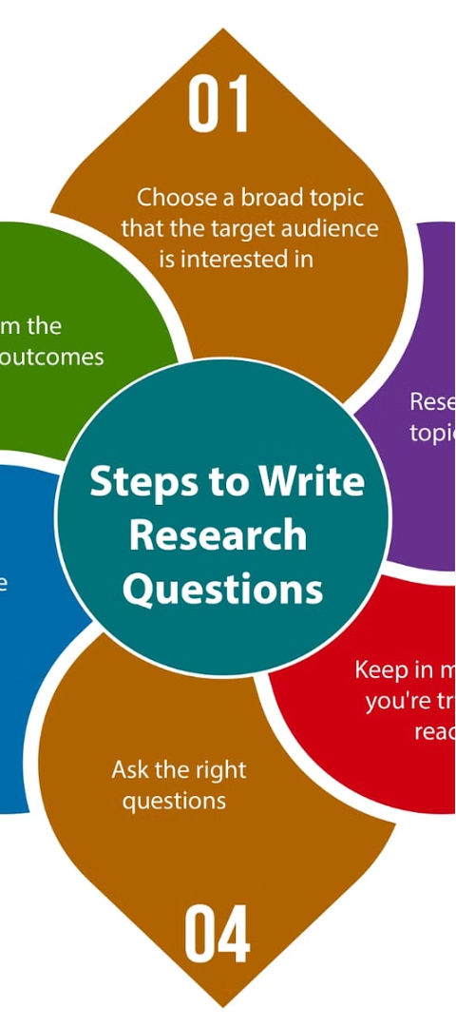
Research Questions
1
Main Questions
1. How effectively can Wazuh identify and mitigate vulnerabilities within an on-premises environment?
2. What are the capabilities of Wazuh as a SIEM and XDR tool in automating the detection and response to cybersecurity threats?

Slide 4
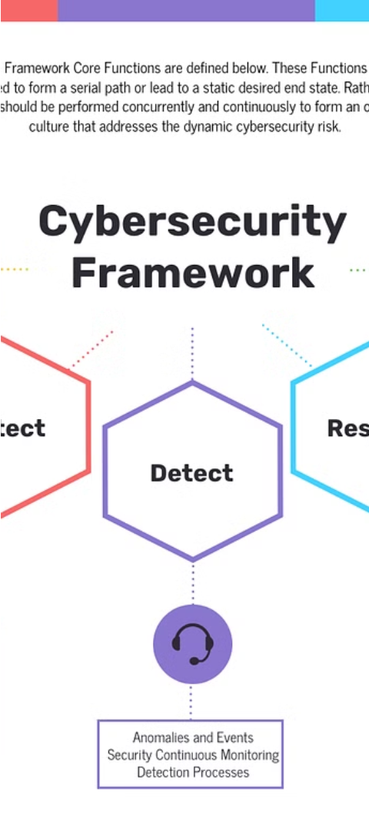
Research Methodology
1
Approach
The research was primarily empirical and practical, supported by a theoretical framework that guided the setup and evaluation.
2
Structure of the Thesis
Overview of key cybersecurity principles, Wazuh's architecture, and a virtual lab environment for testing and data collection.
3
Methods Used
Simulations including FIM, VirusTotal integration, and Atomic Red Team attacks to assess Wazuh's capabilities.

Slide 5
Practical Implementation
Vulnerabilities Detector
VirusTotal & FIM Integration
Attack Simulations
Wazuh setup across Ubuntu and Windows to monitor and manage security in the virtual environment.
Implementation of Wazuh's integration with VirusTotal and FIM for enhanced threat detection.
Simulation of attack scenario based on the MITRE ATT&CK framework to test Wazuh's response capabilities.

Slide 6
Key Findings
Effectiveness of Wazuh
Capabilities as SIEM and XDR
Wazuh effectively detected and responded to various simulated threats, maintaining system integrity and confidentiality.
Wazuh's robust real-time monitoring, incident detection, and management capabilities across the virtual environment.

Slide 7

Conclusions
Research Outcomes
1
Wazuh proved to be an effective tool for enhancing cybersecurity, capable of handling complex threat detection and response scenarios.
2
Operational Effectiveness
Wazuh meets and potentially exceeds typical expectations for SIEM and XDR systems in on-premises settings.

Slide 8



Recommendations and Future Research
Implementation Recommendations
Broader deployment of Wazuh in similar environments with regular updates and configurations to handle evolving threats.
Future Research Directions
Further studies on the application of Wazuh in cloud and containerized environments to explore its adaptability and effectiveness.

Slide 9
Questions and Discussion
How effective was Wazuh in detecting and responding to the simulated attacks based on the MITRE ATT&CK framework?
What were some of the key challenges or limitations encountered during the practical implementation of Wazuh in the virtual environment?
Can you provide more insights into the integration of Wazuh with VirusTotal and how it enhanced the overall threat detection capabilities?

