Slide 1

ETL TEST FACILITIES
Fuel & additive testing, built for BS-VII
Test benches and potential projects for India's next emission stage
Briefing for the Fuels & Additives Department | October 2026
Notes:
Opening. This deck is for the fuel and additive team: what BS-VII means for fuels, which ETL benches matter, and which projects we can propose.

Slide 2
India has moved fast on cleaner fuel, BS-I to BS-VI
BS-V skipped
BS-I
BS-II
BS-III
BS-IV
BS-VI
BS-VII
2000 Nationwide
2005 Nationwide
2010 Nationwide
2017 Nationwide
2020 Nationwide
2029+ Phased
10 ppm
Sulphur cap in petrol and diesel since BS-VI (April 2020)
200×
Diesel sulphur cut from BS-I (2000 ppm) to BS-VI (10 ppm)
2029
BS-VII starts: tighter tailpipe limits and longer durability
Notes:
Reference: Bharat Stage fuel sulphur limits. India skipped BS-V and went from BS-IV to BS-VI on 1 April 2020. BS-VII is the next step.

Slide 3




BS-VII is proposed to roll out in phases from April 2029
PHASE 1
PHASE 2
PHASE 3
PHASE 4
Apr 2029
2030
2031
To be set
Cars & SUVs
Small CVs
Buses & heavy trucks
Two-wheelers
New passenger cars and SUVs go first
Small commercial vehicles: goods delivery and pick-up vans
Heavy-duty phase; some reports extend the window to 2035
Norms to be notified separately; date not yet announced
Not retrospective: BS-VI vehicles on the road are unaffected. Expected gain: about 20-50% lower pollutants, heavy vehicles most.
Source: media reports of the proposed schedule (Team-BHP, Business Standard, CarDekho). Draft notification awaited; dates may change.
Notes:
The schedule is reported, not yet notified. Reports differ on the final heavy-vehicle date (2031 in most, 2035 in one). Two-wheeler norms will be notified separately.

Slide 4





What BS-VII is expected to change, using Euro 7 as the guide
10 nm
Brake & tyre
Particle counting down from 23 nm
Non-exhaust particles regulated for the first time
Longer life
On-board checks
Cars up to 200,000 km; heavy trucks 875,000 km
Live tailpipe monitoring through the vehicle's life
Any market fuel
NH3 & N2O
Compliance across the full spec range of market fuel
New gases limited, mainly for heavy-duty engines
India's BS-VII limits are not yet notified. Reports say they will align with Euro 7, so Euro 7 is our planning benchmark.
Notes:
Euro 7 heavy-duty: NOx 460 to 200 mg/kWh, PM 10 to 8, CO 4000 to 1500, on-road NOx 690 to 260. Car limits for CO, NOx and THC are unchanged in Euro 7; the changes are particles (10 nm, port-injection petrol included), evaporative, brake particles and durability.

Slide 5
What this means for fuels and additives
BS-VII DRIVER
FUEL LEVER
ETL STUDY
Sub-10 nm particles
Aromatics, volatility, ethanol content
Particle number vs fuel composition
Durability to 200,000 km
Injector and intake-valve cleanliness
Keep-clean additive effect on emissions over hours
Any market fuel must comply
E10 to E27, M15, IBA, biodiesel blends
Blend sweeps: emissions and fuel economy
New gases and cold start
CNG, HCNG, ED, DMFA winter diesel
NH3, N2O, CH4 and cold-start emissions
Notes:
Each BS-VII driver maps to a fuel lever and an ETL study. This sets up the project slides that follow.

Slide 6
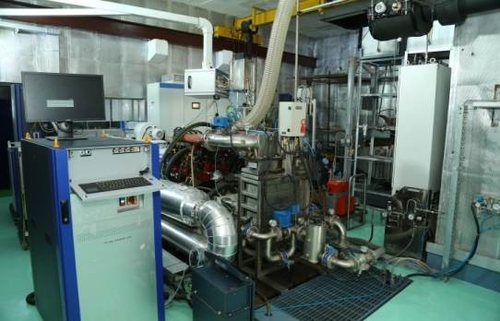
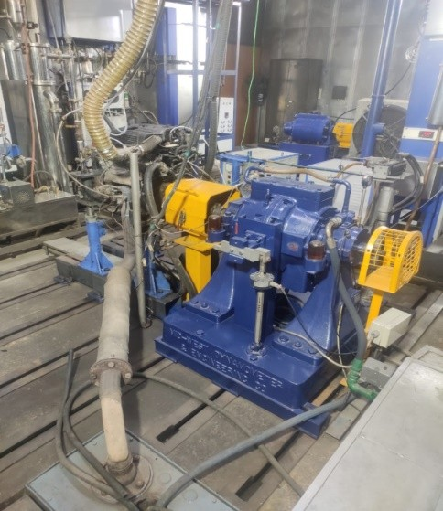
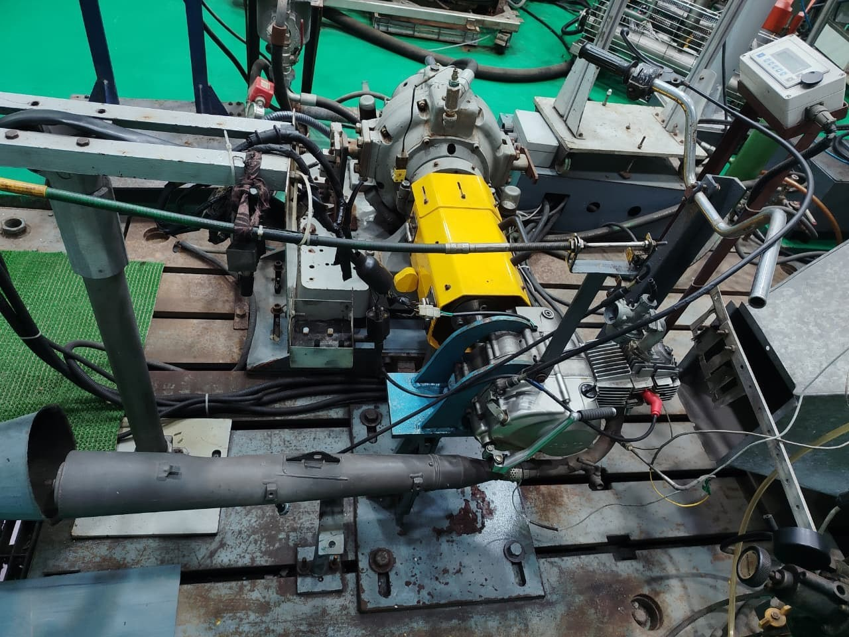
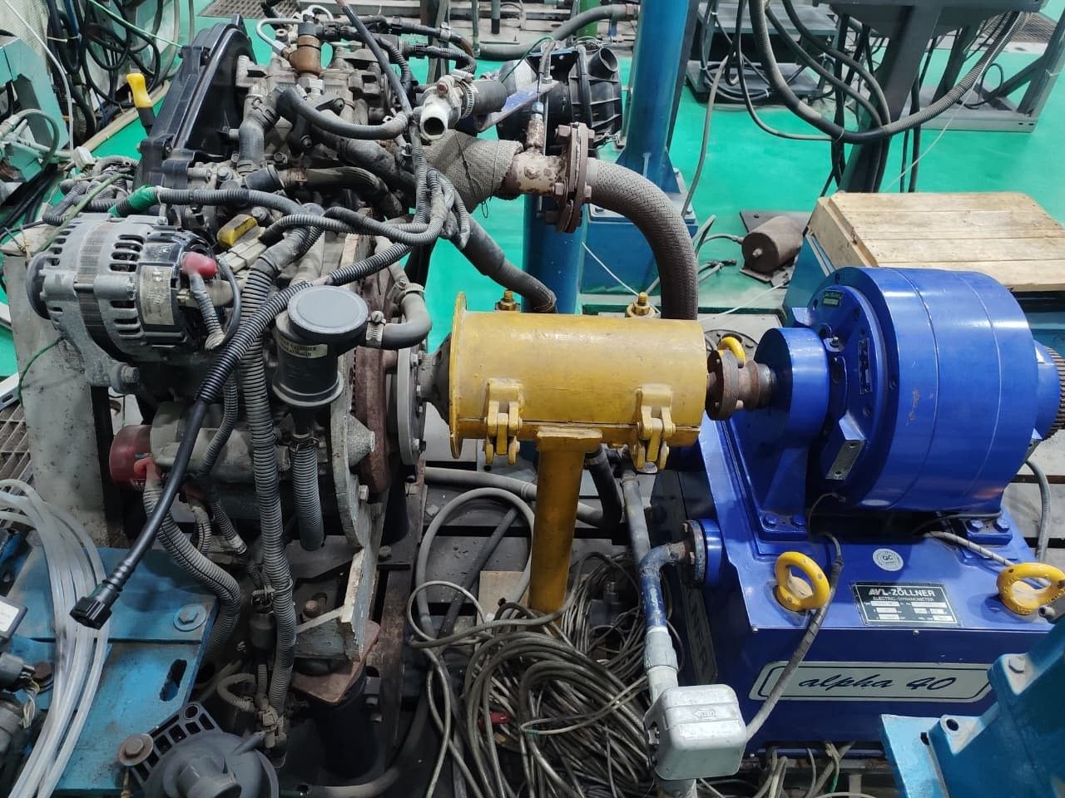
Five ETL benches for fuel work
Horiba transient bench
2W/3W transient bench
Maruti Wagon-R
Hero 2-wheeler
Mahindra Jeeto
BS-VI, 50-220 kW
55 kW dyno
998 cc, 3-cyl gasoline
100 cc, 4-stroke SI
Single-cyl BS-IV diesel
Diesel, CNG, HCNG; WHTC, WHSC, ETC, FTP
Liquid and gaseous fuels, 1500-7500 rpm
XP95, XP100, E10; 11 high-octane fuels run
90/95/100 RON, E0-E20, M15
DMFA, BS-VI winter diesel with MFA
Notes:
Only the benches relevant to fuel and additive work are shown. Wagon-R, Hero and Jeeto are used for fuel evaluation; the two transient benches cover emissions.

Slide 7
Potential BS-VII projects: gasoline and two-wheelers
Maruti Wagon-R
Fuel dilution study
Ethanol-blend emissions
Keep-clean additives
E10 to E27 and high-octane XP95 / XP100
CO, THC, NOx and fuel economy at E20+
Injector and valve deposits vs emissions drift
Hero 2-wheeler
E20 to E30 and M15 runs
RON 90 / 95 / 100 study
Cold start with ethanol
Performance and emissions; 2W norms due separately
Knock margin and power on premium fuels
Starting and drivability on blends
2W/3W transient bench
E20+ transient emissions
CNG and LPG 3W duty
Particle screening
Cycle-based CO, THC, NOx for 2W and 3W
Gaseous-fuel emissions on transient cycles
Particle number on small gasoline engines
Notes:
BS-VII link: durability and any-fuel compliance drive the Wagon-R work (fuel dilution, ethanol blends, keep-clean additives). Two-wheeler norms are still to be notified, so Hero and 2W transient work positions us early.

Slide 8


Potential BS-VII projects: heavy-duty, diesel and gas
Horiba transient emission bench
BS-VI, 50-220 kW: diesel, CNG, HCNG
Mahindra Jeeto
Single-cyl diesel
IBA and ED studies in emissions
P-theta study
DMFA / MFA winter diesel
Cold flow and cold-start emissions
WHTC / WHSC emissions on alternative blends
In-cylinder pressure vs crank angle for combustion quality
Diesel keep-clean additive
Heat release study
CNG / HCNG gases
Injector cleanliness and emission drift
Burn-rate analysis for blends, CNG and HCNG
NH3, N2O and methane slip, the Euro 7-type gases
Biodiesel blends B7 to B20
Emissions and fuel economy
Notes:
Heavy-duty and gas fuels on the Horiba transient bench: IBA and ED studies in emissions, P-theta combustion analysis, heat release study, and the Euro 7-type gases (NH3, N2O, CH4) for CNG and HCNG. Jeeto covers DMFA and winter diesel work.

Slide 9
Projects lined up against the BS-VII phases
2026
2027
2028
2029
2030
2031
Wagon-R
Fuel dilution study
Ethanol + keep-clean
Hero 2W
E20 to E30, M15 runs
2W BS-VII readiness
2W/3W transient
E20+ and CNG cycles
Particle screening
Jeeto
DMFA / winter diesel
Keep-clean, B7 to B20
Horiba transient
IBA, ED emissions
P-theta, heat release
NH3, N2O, CH4 on CNG/HCNG
Cars Apr 2029
Small CVs 2030
Heavy CVs 2031
Indicative plan for discussion; timing to be agreed with partners and OEMs.
Notes:
Indicative sequencing only. Red dashed lines mark the reported BS-VII phase dates. Gasoline and two-wheeler work comes first, gas and heavy-duty work builds toward 2030-31.

Slide 10



Where we go next
Benches ready
Projects defined
Decisions needed
Five fuel-capable benches cover gasoline, diesel, CNG, HCNG and 2W/3W
Fuel dilution, IBA / ED, P-theta, heat release, blends and keep-clean studies
Priorities, OEM and OMC partners, and any analyser upgrades for particles, NH3 and N2O
Thank you
Notes:
Close: ask the department for project priorities and partner introductions.

