Slide 1
Links target Attribute
By default, the linked page will be displayed in the current browser window. To change this, you must specify another target for the link.
_self - Default. Opens the document in the same window/tab as it was clicked
The target attribute specifies where to open the linked document.
_blank - Opens the document in a new window or tab
_parent - Opens the document in the parent frame

Slide 2
Link to an Email Address
Use mailto: inside the href attribute to create a link that opens the user's email program (to let them send a new email)
<a href="mailto:someone@example.com">Send email</a>

Slide 3
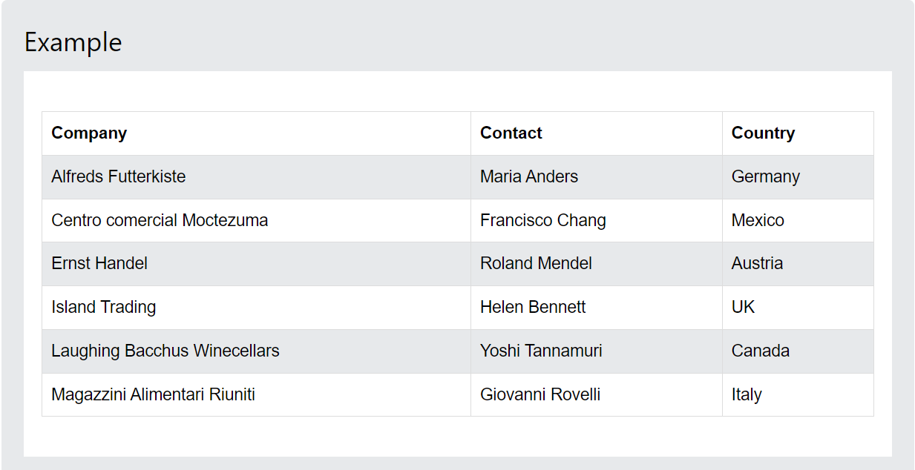
HTML Table
HTML tables allow web developers to arrange data into rows and columns.

Slide 4
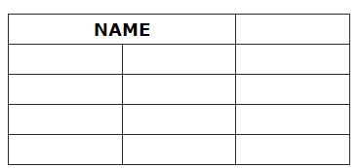
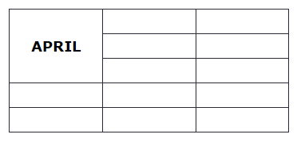
HTML Table Colspan & Rowspan
HTML tables can have cells that span over multiple rows and/or columns.

Slide 5
HTML Entities
Reserved characters in HTML must be replaced with entities:
Some characters are reserved in HTML.
Entity names or entity numbers can be used to display reserved HTML characters.
< (less than) = &lt;
> (greather than) = &gt;

Slide 6
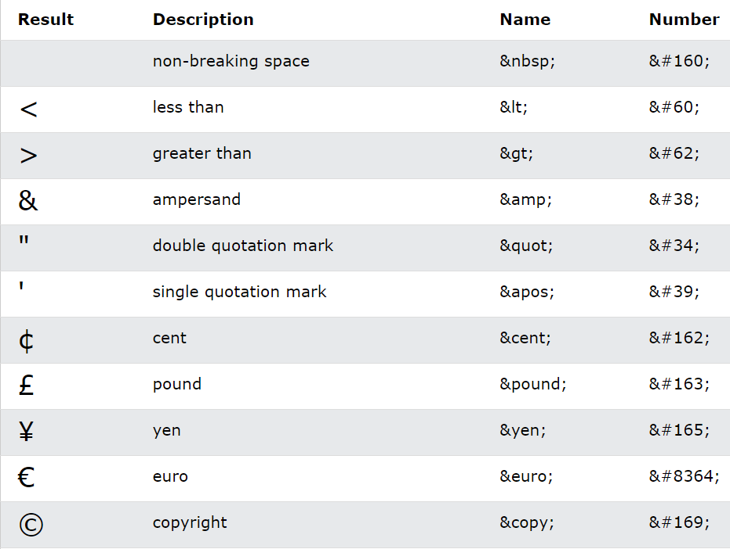
Some Useful HTML Character Entities

