Slide 1
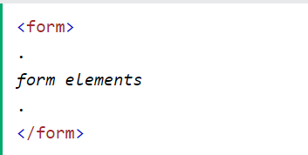
HTML Forms
An HTML form is used to collect user input. The user input is most often sent to a server for processing.
The HTML <form> element is used to create an HTML form for user input

Slide 2
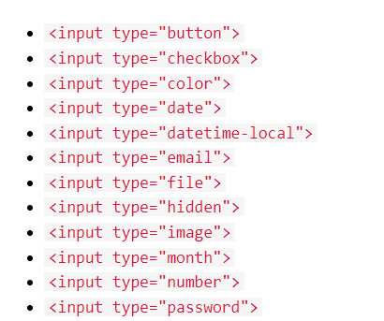
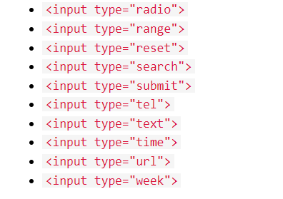
HTML Input Types
Here are the different input types you can use in HTML

Slide 3
HTML Input Attributes
value Attribute
readonly Attribute
disabled Attribute
maxlength Attribute
placeholder Attribute
required Attribute
autofocus Attribute
multiple Attribute
min and max Attributes
step Attribute

Slide 4
HTML Form Attributes
The Action Attribute
The action attribute defines the action to be performed when the form is submitted.
The Method Attribute
The method attribute specifies the HTTP method to be used when submitting the form data.
The form-data can be sent as URL variables (with method="get") or as HTTP post transaction (with method="post").

Slide 5
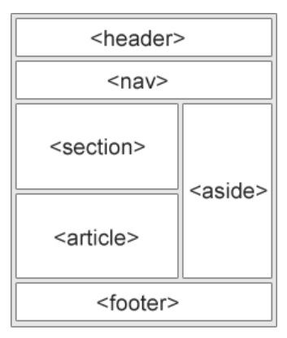
HTML Layout Elements
<header> - Defines a header for a document or a section
<nav> - Defines a set of navigation links
<section> - Defines a section in a document
<article> - Defines an independent, self-contained content
<aside> - Defines content aside from the content (like a sidebar)
<footer> - Defines a footer for a document or a section
<div> - Division tag. The div tag is used in HTML to make divisions
of content in the web page like (text, images, header, footer, navigation bar, etc.

Slide 6
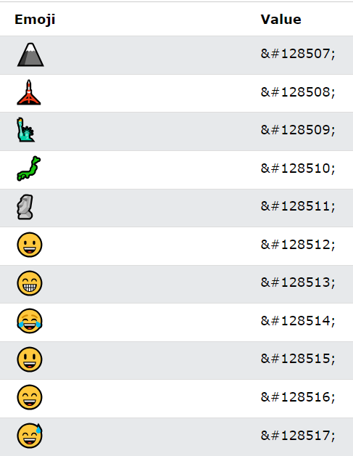
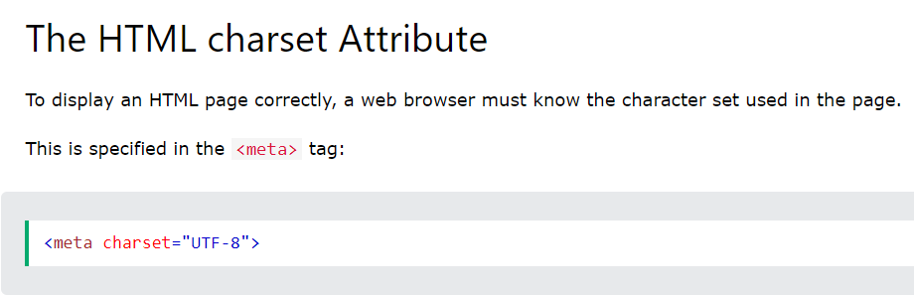
Using Emojis in HTML
Emojis are characters from the UTF-8 character set: 😄 😍 😜
What are Emojis?
Emojis look like images, or icons, but they are not.
They are letters (characters) from the UTF-8 (Unicode) character set.

Slide 7
HTML Favicon
A favicon is a small image displayed next to the page title in the browser tab.
Add a Favicon in HTML
You can use any image you like as your favicon. You can also create your own favicon on sites like https://www.favicon.cc.
<link rel="icon" type="image/x-icon" href="/images/favicon.ico">

