Slide 1
Database (Lec) Semester Project Presentation
Creation of Database with SQL using MySQL Workbench :
Software House Management System

Slide 2
Self Introduction
M.Shaheer (BSE-23F-253)
Ahmed Muhammed (BSE-23F-103)
Hafiz Wildan Ahmed Siddiqui (BSE-23F-081)

Slide 3
Introduction
In this project, we have designed and implemented
a comprehensive database system for managing a
software house's operations. The system includes
entities such as departments, employees, clients, projects,
tasks, invoices, payments, employee-project, leaves, and
meetings. The goal is to facilitate efficient
management and data retrieval processes for the
organization.

Slide 4
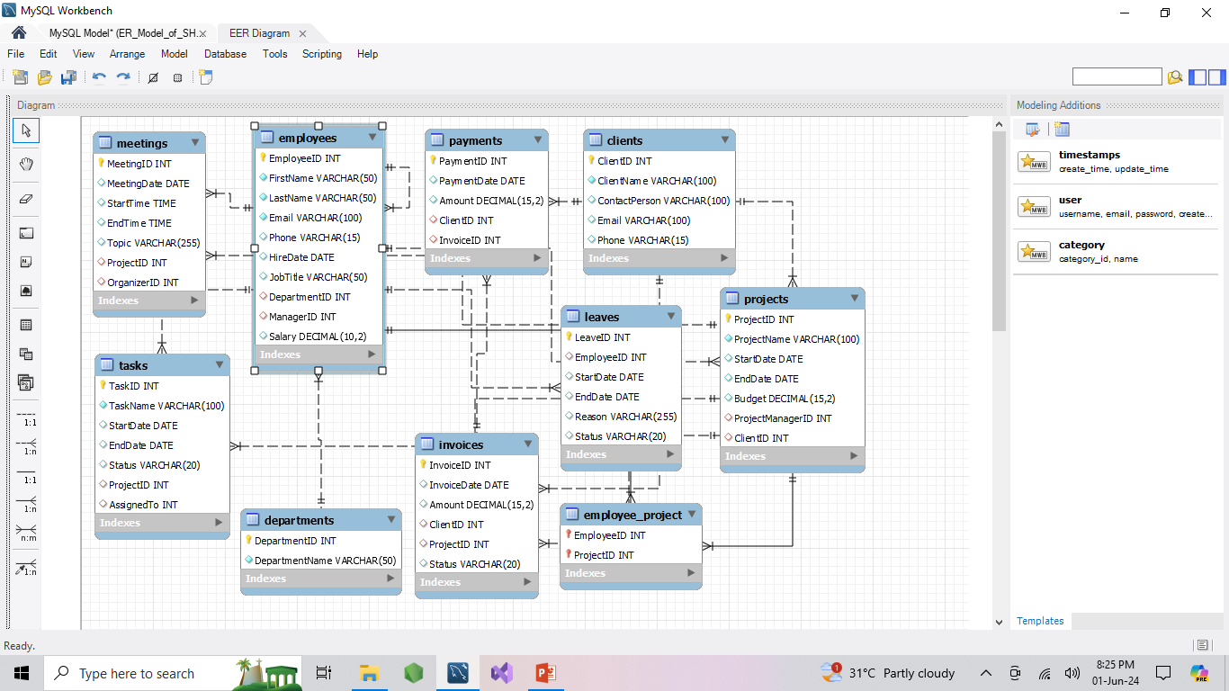
Entity Relationship Model (ERM)

Slide 5
Contribution of Each Partner
This project was a collaborative effort among three team members:
Shaheer, Ahmed, and Wildan. Each member contributed significantly to
different aspects of the project.
Shaheer:
Focused on designing and creating the tables for departments, employees,
and clients. He also inserted sample data into these tables.
Ahmed:
Took responsibility for the projects, tasks, and employee-project associations. He
designed these tables and populated them with sample data.
Wildan:
Worked on the financial aspects, including invoices, payments, leaves, and
meetings. He also created relevant sample data for these tables.

Slide 6
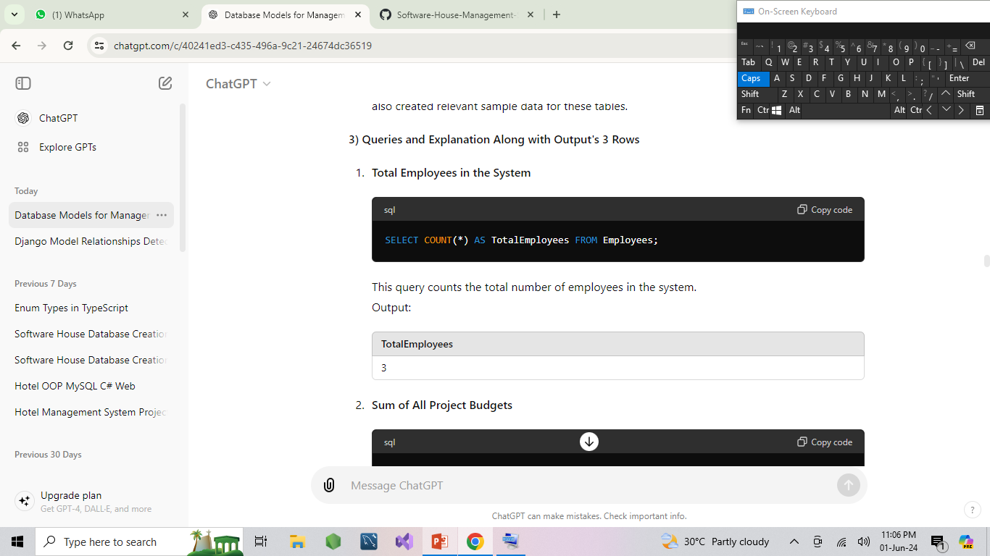
Queries and Explanation Along with Output

Slide 7
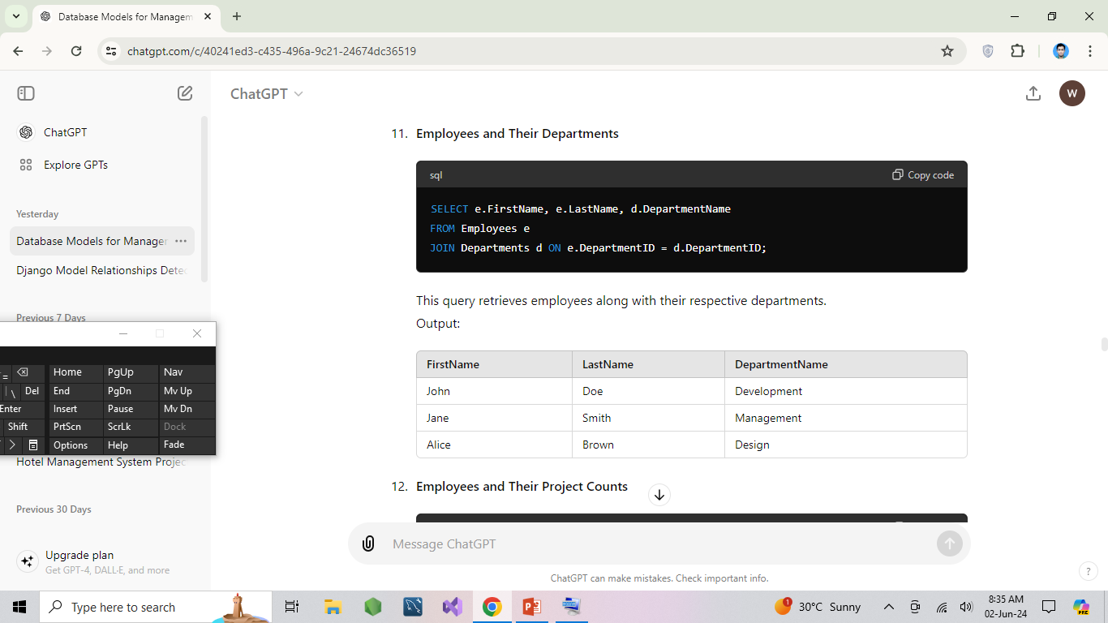

Slide 8
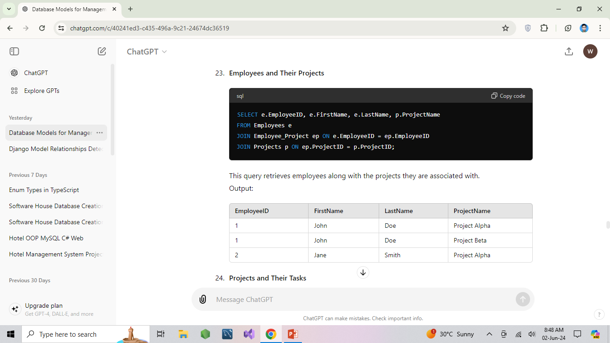

Slide 9
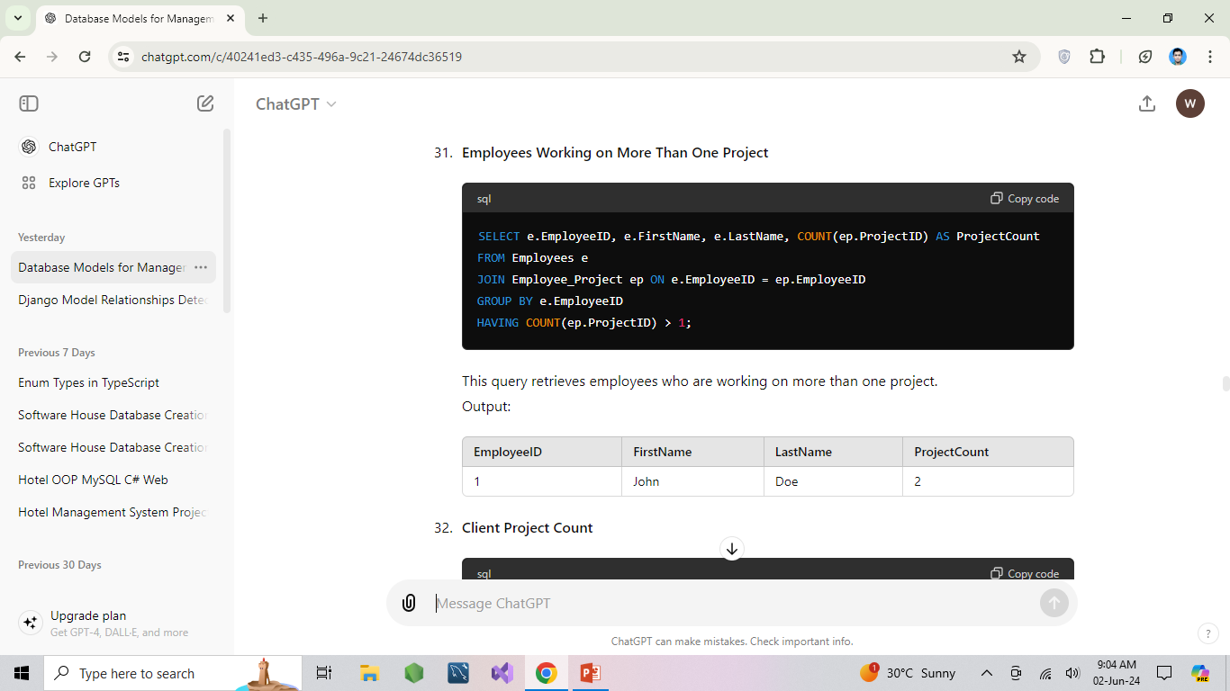

Slide 10
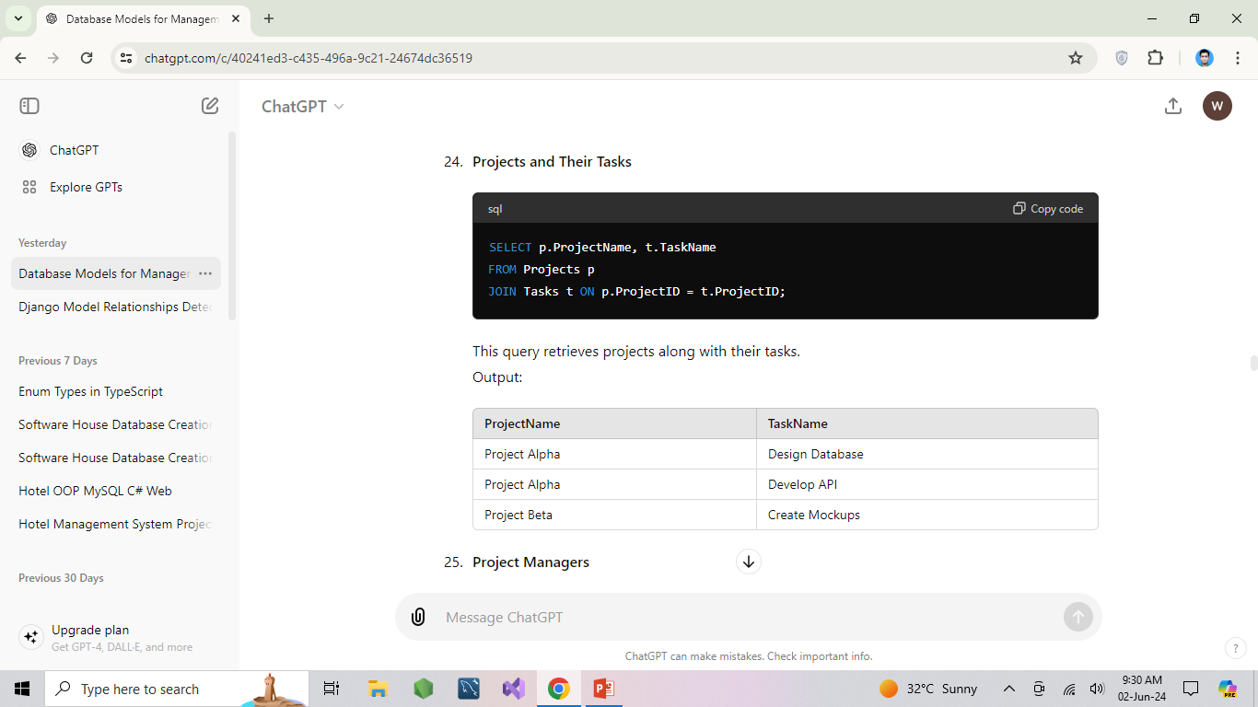

Slide 11
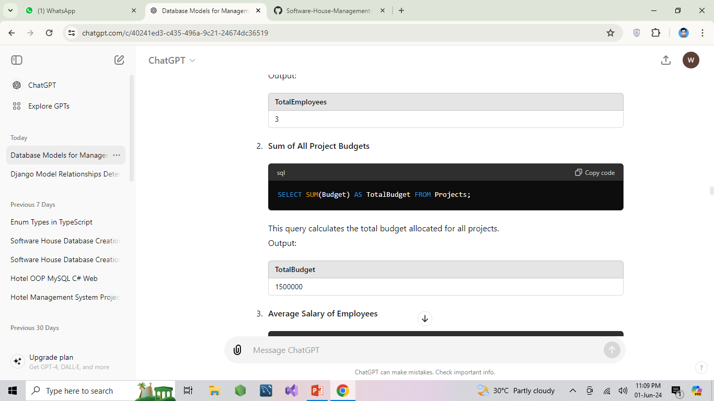

Slide 12
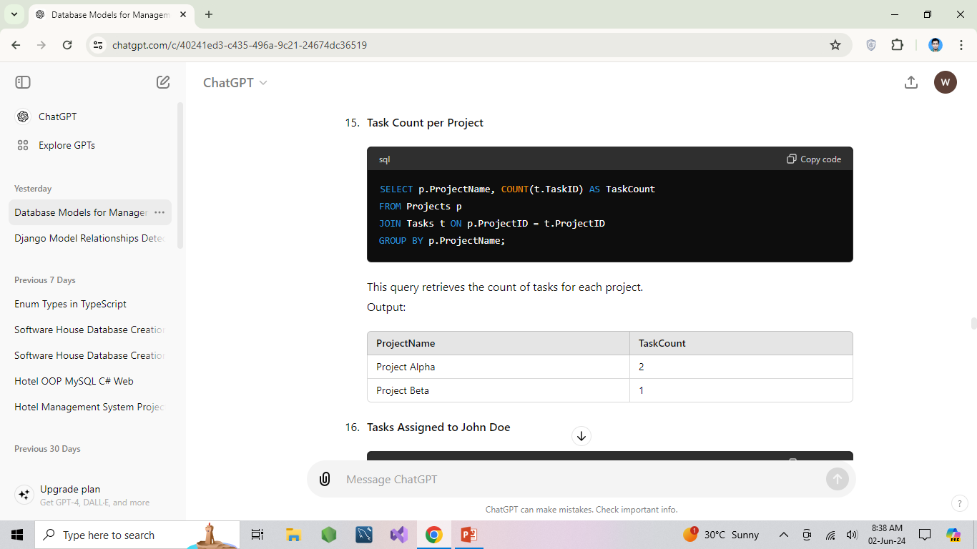

Slide 13
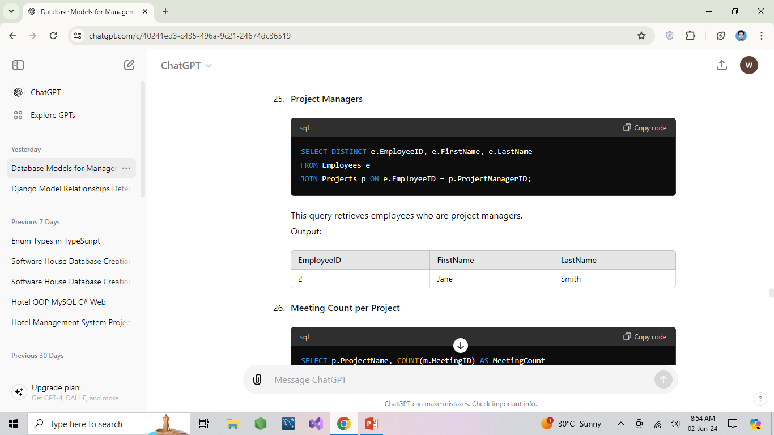

Slide 14
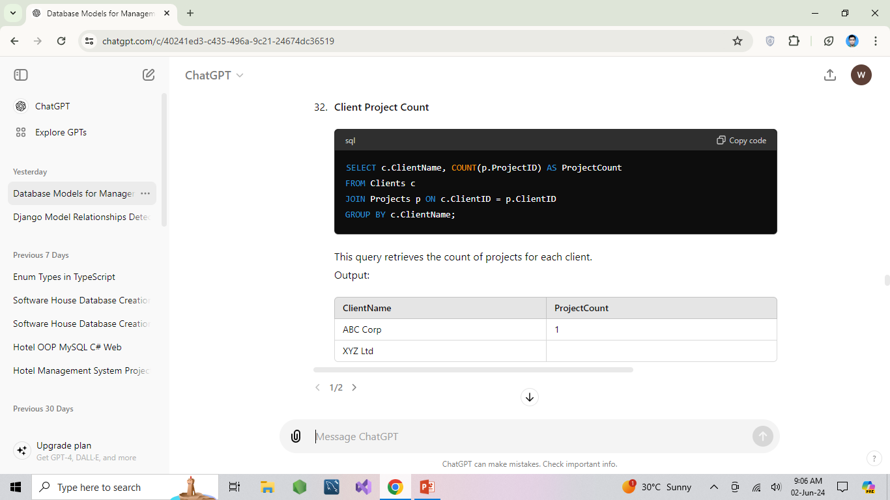

Slide 15
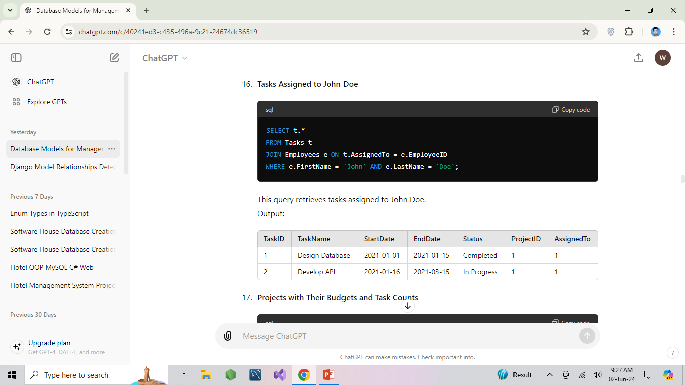

Slide 16
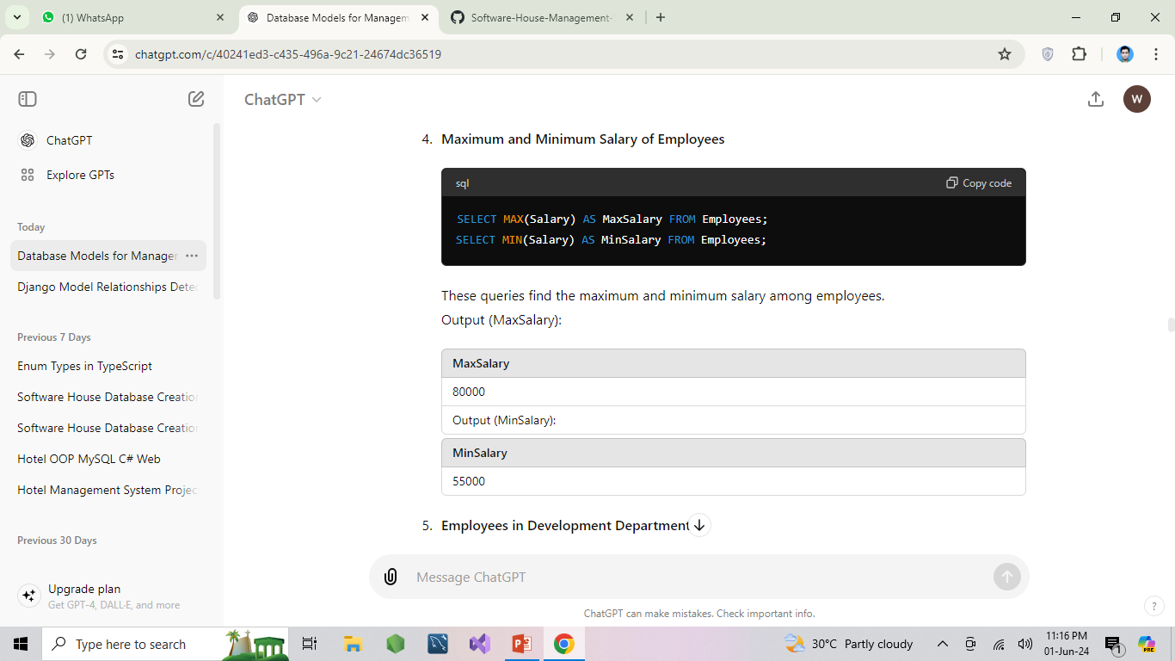

Slide 17
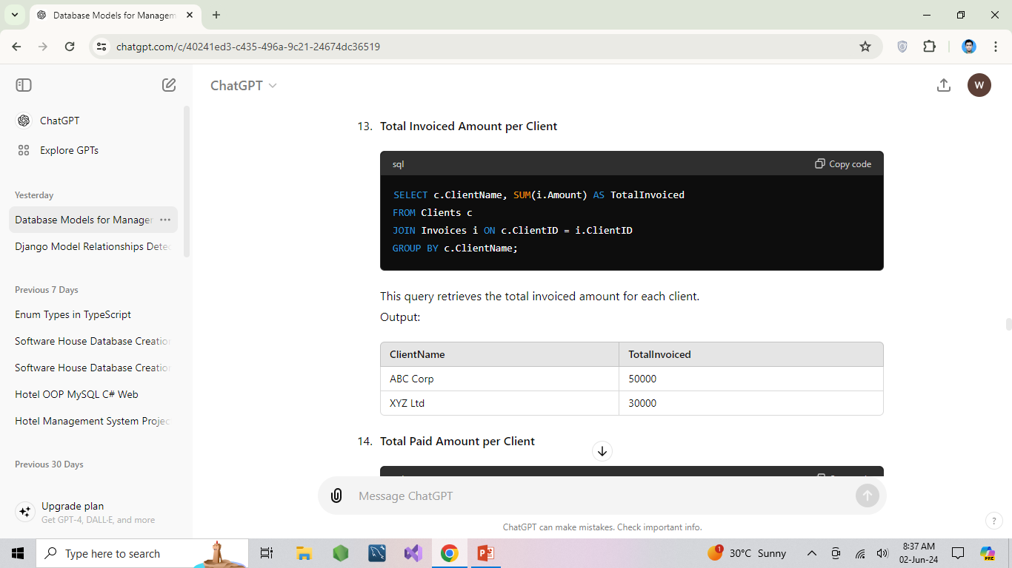

Slide 18
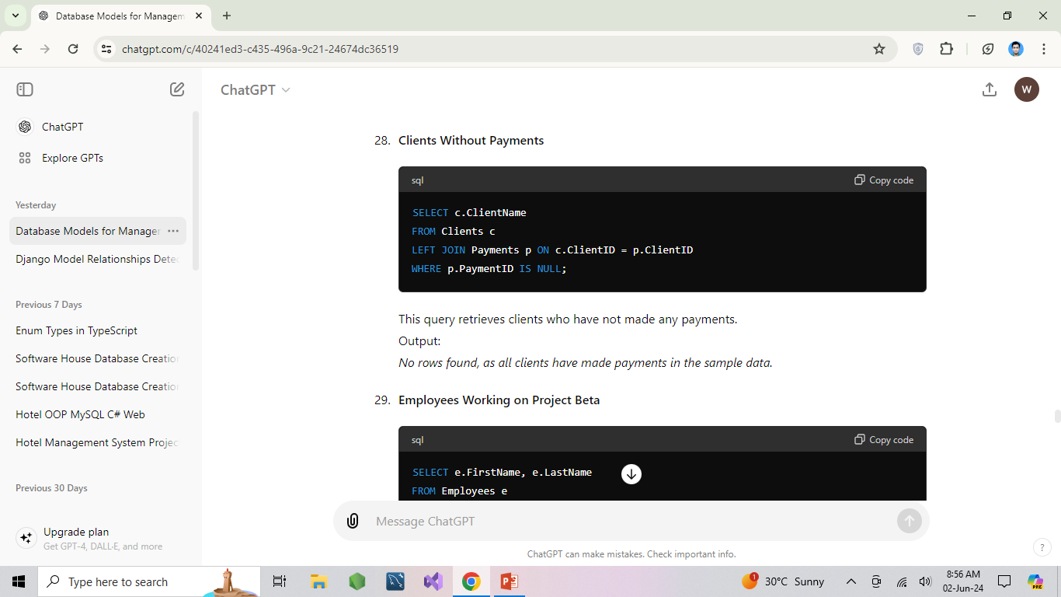

Slide 19
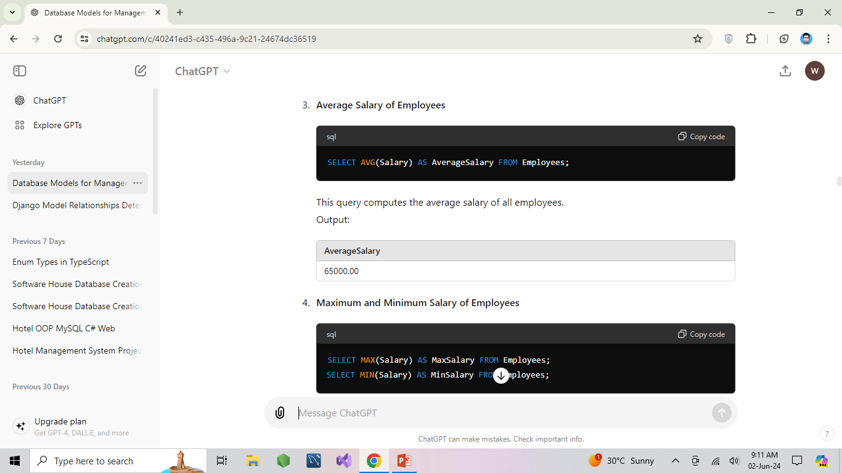

Slide 20


Slide 21

Any Questions ?

Slide 22


