Slide 1

Diabetes Prediction Using Artificial Neural Network
Submitted By Bonnhi Shikha Parna ID:1903610201820 Md Hafizul Islam ID:1903610201822 | Submitted To Mr. Faisal Ahmed Assistant Professor Department of CSE Premier University Chattogram
Notes:
Click to add notes
This template is copyright of Presentation Magazine. www.presentationmagazine.com

Slide 2
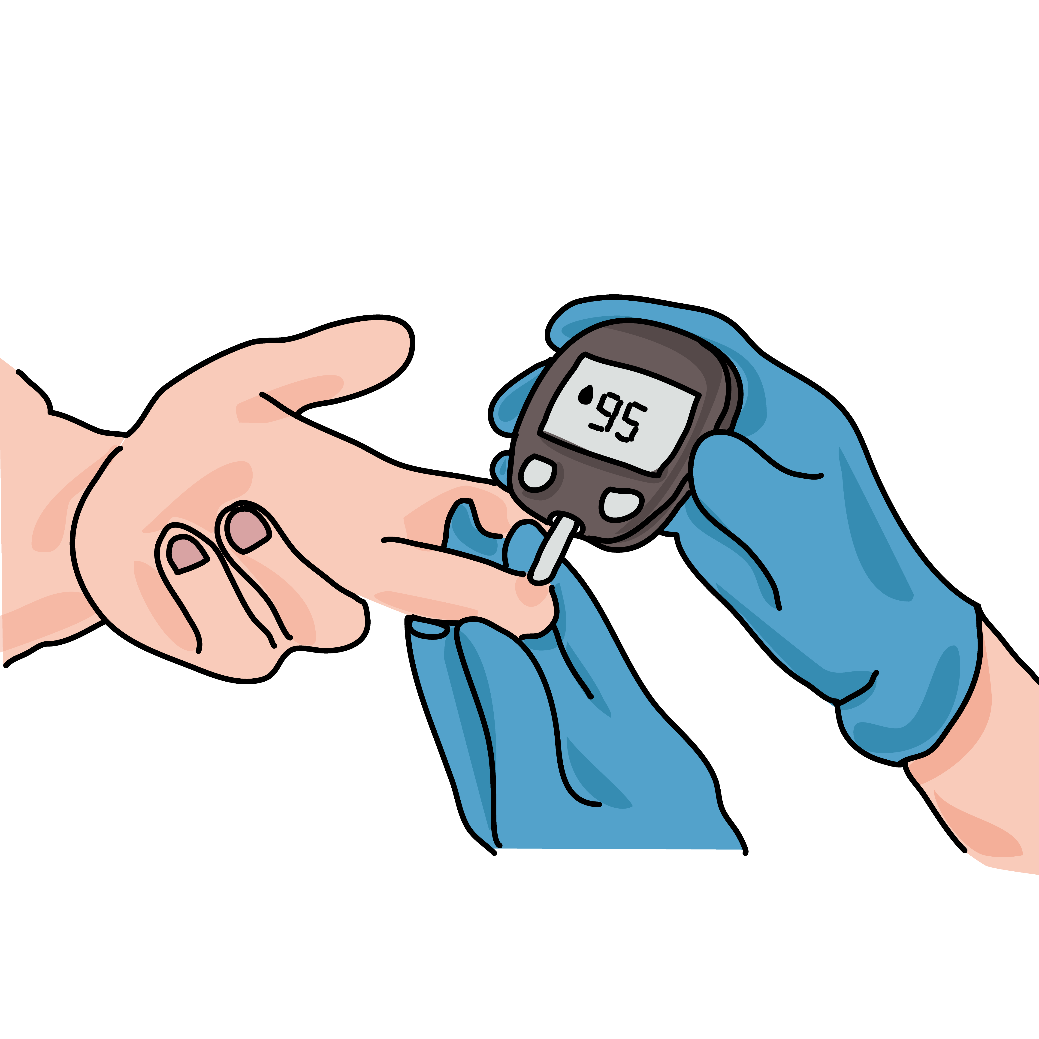
Introduction
Diabetes is one of the biggest health problems that affect millions of people across the world. Uncontrolled diabetes can increase the risk of heart attack, cancer, kidney damage, blindness, and other illnesses.
Our goal is we will be predicting that whether the patient has diabetes or not on the basis of the features.

Slide 3
Objective of Project
The objective of diabetes prediction using Artificial Neural Network (ANN) is to develop a model that can accurately predict the presence or absence of diabetes in a patient based on their input features.
The Goal of our prediction
Positive result = 1, the patient will be diagnosed with diabetes.
Negative result = 0, the patient will not be diagnosed with diabetes.

Slide 4
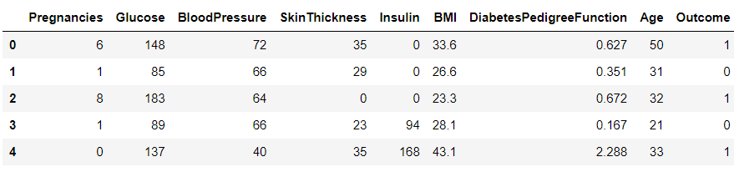
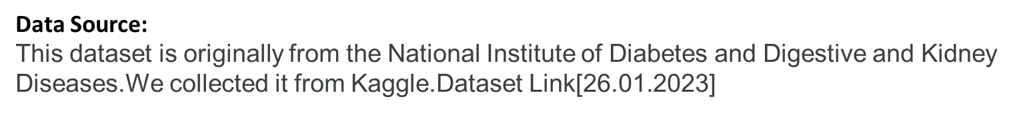
Dataset
Pregnancies: To express the Number of pregnancies.
Glucose: To express the Glucose level in blood.
Blood Pressure: To express the Blood pressure measurement.
Skin Thickness: To express the thickness of the skin.
Insulin: To express the Insulin level in blood.
BMI: To express the Body mass index.
Diabetes Pedigree Function: To express the Diabetes percentage.
Age: To express the age.
Outcome: To express the final result 1 is Yes and 0 is No.

Slide 5
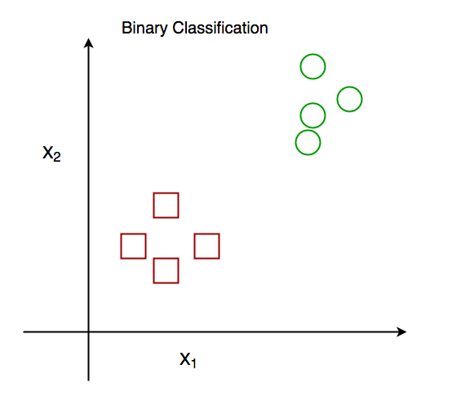
Exploratory data analysis basis of neural network
There are seven features(Pregnancies,Glucose,BloodPressure,SkinThickness,Insulin. DiabetesPedigreeFunction,Age) and one label(Outcome) in our dataset. Therefore, we must use all of those features.
This is binary classification problem.So,there are two classes.

Slide 6
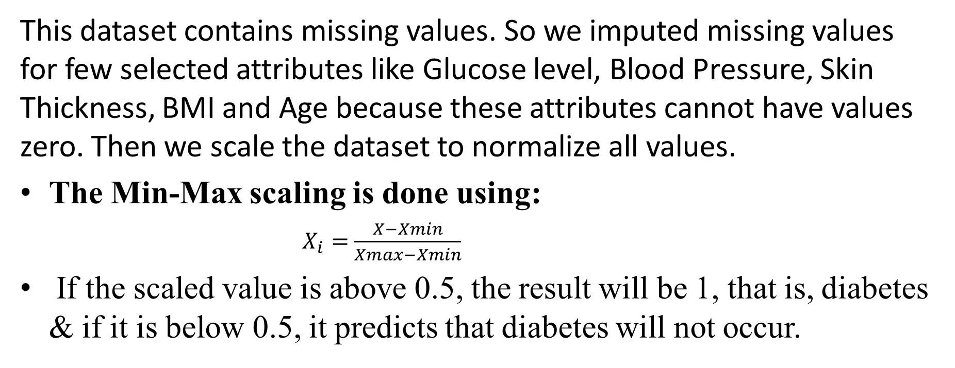
Preprocessing
This dataset contains missing values. So we imputed missing values for few selected attributes like Glucose level, Blood Pressure, Skin Thickness, BMI and Age because these attributes cannot have values zero. Then we scale the dataset to normalize all values.
The Min-Max scaling is done using:
$X_{i}=$ $\frac{X−Xmin}{Xmax−Xmin}$
If the scaled value is above 0.5, the result will be 1, that is, diabetes & if it is below 0.5, it predicts that diabetes will not occur.

Slide 7
Neural Network model
1st
2nd
3rd
.
.
.
.
.
.
.
.
8th
Input Layer
Hidden layer
Output Layer
Fig 1: Neural Network Model

Slide 8
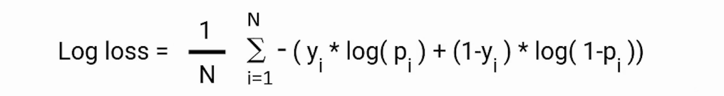
Activation Function
Sigmoid / Logistic Activation Function-
Activation function, A = 1/(1 + e^{-x})
Value Range : 0 to 1
Loss Function :
Binary Cross-Entropy / Log Loss

Slide 9
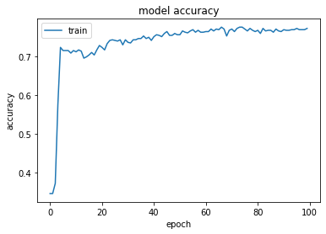
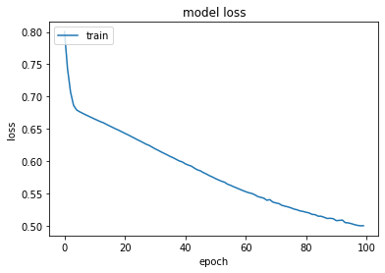
Graphical Representation:
Fig 3: Accuracy of training data
Fig 2: Loss of training data
Evaluation:
loss: 0.5423
accuracy: 0.7597

Slide 10
Results
Classification Report :
Classifier | precision | recall | F1-score | support
0 | 0.81 | 0.96 | 0.94 | 53
1 | 0.67 | 0.90 | 0.92 | 39
accuracy |  |  | 0.76 | 154
macro avg | 0.74 | 0.74 | 0.74 | 154
weighted avg | 0.76 | 0.75 | 0.76 | 154
Table 1. Classification report.

Slide 11
Conclusion
One of the important real-world medical problems is the detection of diabetes at its early
stage.
Experimental results determine the adequacy of the designed system with
an achieved accuracy of 75% using Decision Tree algorithm.
We have used KNN Algorithm and Decision Tree to predict the diabetes where result is classified into Yes or No . We compared the testing data and actual data to get the accuracy of our project.

Slide 12
