Slide 1
Building a Scalable Machine Learning Pipeline
Dan Dixey & Chris Harris

Slide 2
Why?
Based on the discussion at the last meet up group these these themes were discussed:
Machine Learning
Natural Language Processing
“Big Data”
And others of course…

Slide 3
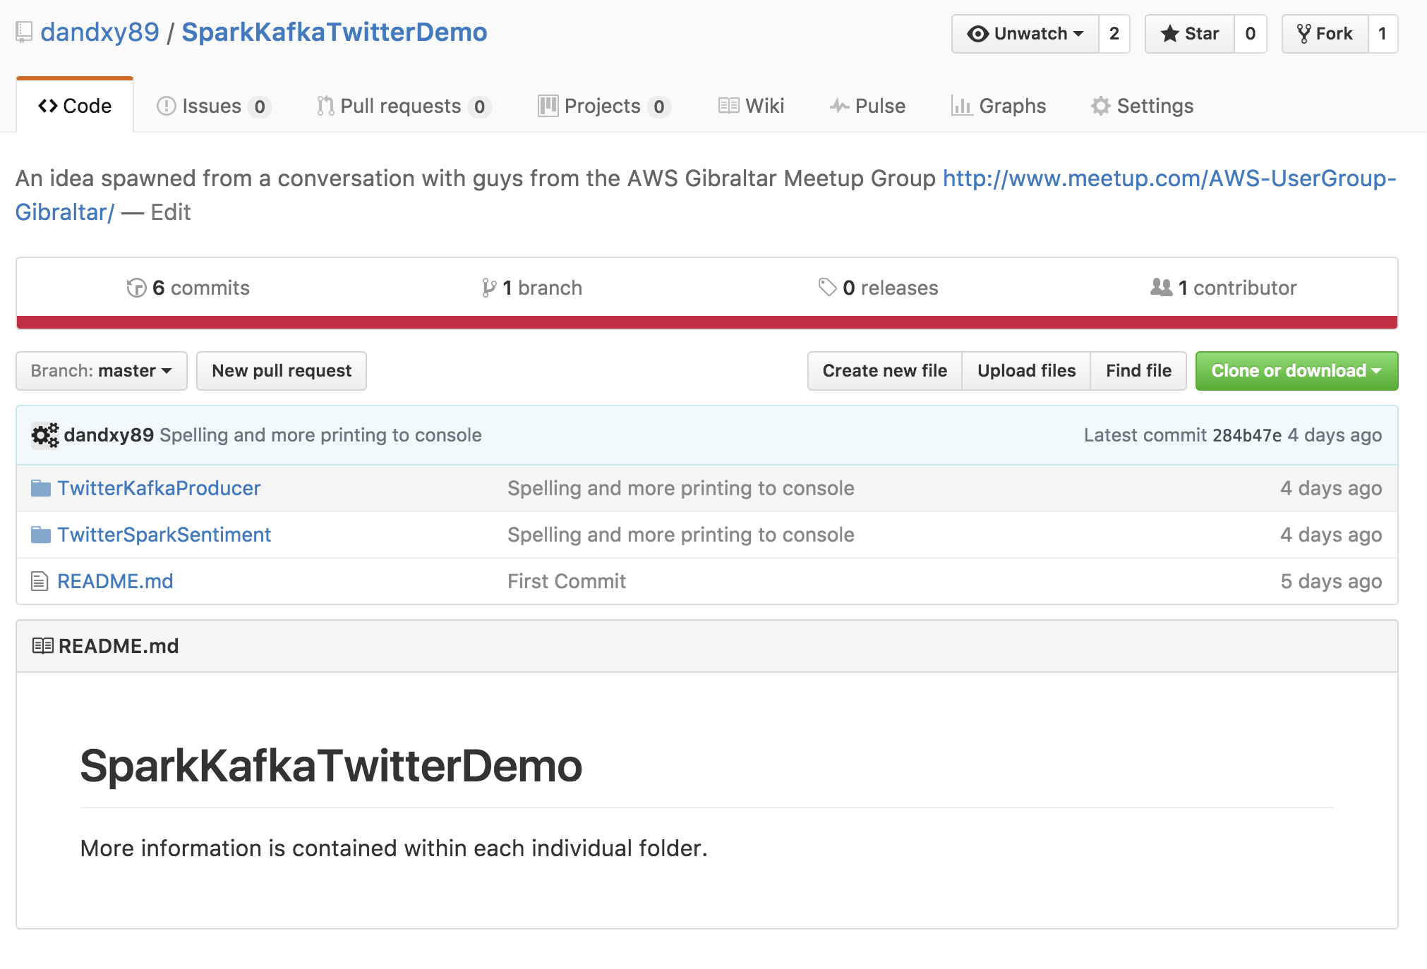
What have you done?
Setup a mini-project that can be used to:
learn and demonstrate the power of the AWS ecosystem
gain some exposure to Machine Learning
play with cool technologies
And most importantly, promote the AWS Gibraltar Meetup group

Slide 4



The master plan.
Twitter API
Akka
Stage 1
Stage 2
All code is written in Scala
Scalable Architectures

Slide 5
Ok, so what does it do?
Stage 1:
Access the *free* twitter API to make use of streaming, high volume data
Apply some simple parsing to extract information for each twitter message
Push the data as a JSON into a Kafka topic

Slide 6
Here is the interesting part…
Stage 2:
Apache Spark listens to the topic
Extracts the tweet message
Applies SENTIMENT ANALYSIS to it using a trained model and a well known JAVA NLP project (CoreNLP)

Slide 7
And…
The custom sentiment model is trained by YOU using freely available sources
actually its a requirement, otherwise it won’t run…
And this is all ready to be run
right now.

Slide 8
To summarise!
So far the ground work as been laid out for an interesting project to explore “Big Data”, ML and often most importantly AWS
A seemingly end-less (almost) project that you can immediately start working on!

Slide 9
Whats left?
Twitter API
Akka
Stage 1
Stage 2
All code is written in Scala
Scalable Architectures
Both stages can be placed into Dockers
EC2 Container Service
Each element can be replaced by an AWS equivalent
Kafka => SQS
Akka => Kinesis
Spark => Elastic Map Reduced
UI => Chris?

Slide 10
“Once I get on a puzzle, I can't get off.”
– Richard P Feynman

Slide 11


Let’s stay in touch
Dan Dixey
Data Scientist @ QbizUK
dan.dixey@qbizuk.com
part of the QGroup

