Slide 1
PROJECT REPORT · HOME-LAB BUILD
SOC AUTOMATION LAB
Building a SIEM-to-SOAR Detection & Response Pipeline
WAZUH
SYSMON
VIRUSTOTAL
N8N
GROQ AI
DISCORD
Prepared from lab build documentation and process screenshots

Slide 2
01 · EXECUTIVE SUMMARY
From Raw Endpoint Telemetry to an
AI-Narrated Analyst Alert
This project builds a fully automated Security Operations Center pipeline in a home lab. A single suspicious event on a monitored Windows endpoint flows through detection, enrichment, AI-assisted triage, and analyst notification — with zero manual steps in between.
PIPELINE AT A GLANCE
2
Wazuh + Sysmon capture endpoint telemetry in real time
A custom Python monitor hashes new processes and queries VirusTotal
n8n scores severity and branches the response automatically
A Groq-hosted LLM drafts a human-readable threat report
The finished alert is posted straight to a Discord SOC channel
Independent notification paths
6
Integrated tools & platforms
0
Manual steps at alert time
End-to-end
webhook → AI → Discord
SOC AUTOMATION LAB
02 / 15

Slide 3
02 · SYSTEM ARCHITECTURE
Two Cooperating Chains, One Verdict
DETECTION & ENRICHMENT CHAIN
Windows
Endpoint
Wazuh Agent
→ SIEM
wazuh_monitor.py
VirusTotal API
Sysmon + Event Logs
Manager / Indexer / Dashboard
Detects new process, hashes file
SHA256 lookup → verdict
ORCHESTRATION & RESPONSE CHAIN
n8n Webhook
Calculate
Severity
IF Branch
AI Agent
(Groq LLM)
Discord
#alerts
Receives VT verdict JSON
Normalizes risk score
Routes on malicious count
Drafts analyst-ready report
Posts final incident report
Two notification paths exist by design: Python posts a fast, minimal Discord alert the moment a verdict lands, while n8n independently produces a richer, AI-narrated report on the same data — immediacy and depth without one path waiting on the other.
SOC AUTOMATION LAB
03 / 15

Slide 4
03 · TOOLING
The Stack Behind the Pipeline
01
02
03
04
Wazuh
Sysmon
Python
VirusTotal
Open-source SIEM — Manager, Indexer, Dashboard, agent-based collection
Extends Windows telemetry: process, network, file & registry activity
Custom scripting layer — log tailing, hashing, REST API integration
Threat-intel API used to verdict every observed file hash
05
06
07
08
n8n
Groq LLM
Discord
VirtualBox
No-code SOAR engine — webhooks, branching logic, orchestration
llama-3.3-70b-versatile drafts the human-readable incident report
Real-time analyst notification channel via webhook bot
Isolated NAT-network lab: Ubuntu SOC host + Windows endpoint
SOC AUTOMATION LAB
04 / 15

Slide 5
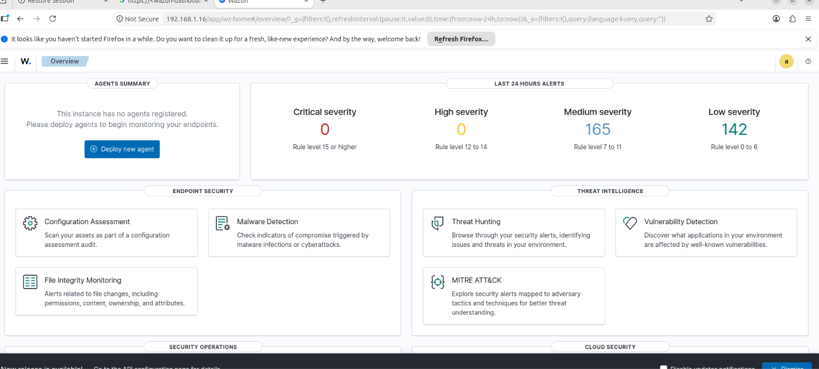
04 · SIEM DEPLOYMENT
Standing Up Wazuh as the Detection Core
Wazuh chosen for its agent-based collection, built-in File Integrity Monitoring, and REST-friendly alert log — all prerequisites for the automation layers built on top
Manager, Indexer, and Dashboard deployed together on the Ubuntu SOC host via the official all-in-one installer
Dashboard reachable over HTTPS, exposing Malware Detection, FIM, Vulnerability Detection, and MITRE ATT&CK modules out of the box
Zero agents registered at first login — the clean starting point before endpoint onboarding
Wazuh dashboard — Agents Summary & Endpoint Security modules on first login
SOC AUTOMATION LAB
05 / 15

Slide 6
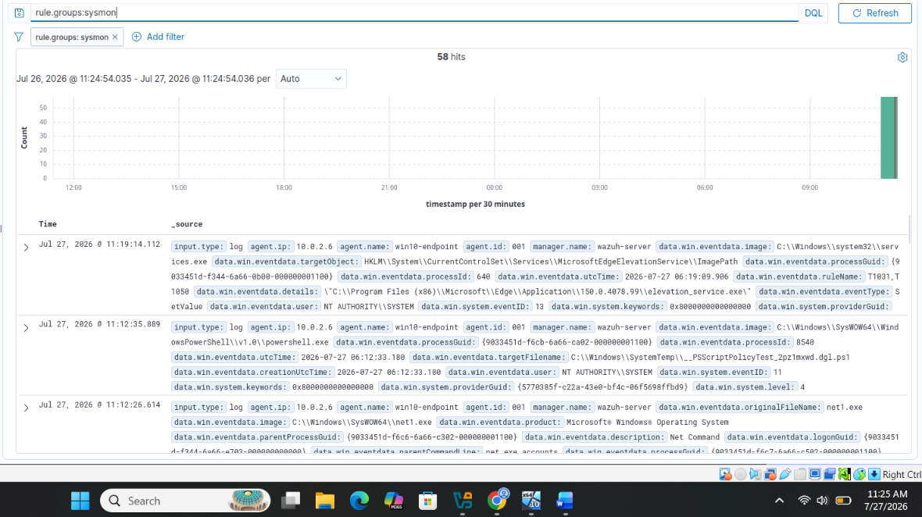
05 · TELEMETRY EXPANSION
Widening Visibility with Sysmon & FIM
Default Windows Event Logs gave limited process/network visibility, so Sysmon was installed on the endpoint and its channel added to the agent's ossec.conf
A Discover query for rule.groups: sysmon confirmed 58 matching events already indexed — validating the full log path from endpoint to dashboard
File Integrity Monitoring was separately validated: create/modify/delete events on the endpoint produced 43 syscheck hits
Discover view — 58 Sysmon events confirmed flowing into Wazuh
SOC AUTOMATION LAB
06 / 15

Slide 7
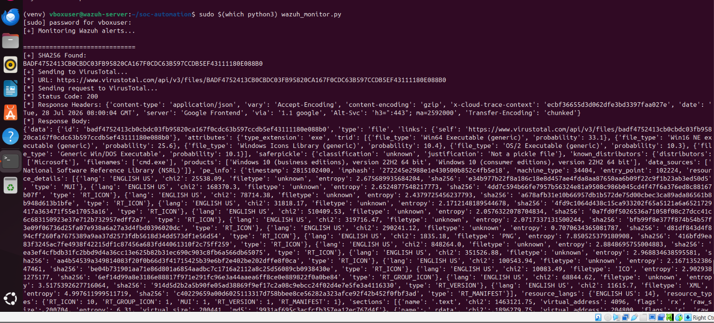
06 · AUTOMATION LAYER
wazuh_monitor.py: The Centerpiece Script
Tails the Wazuh alert log in real time and detects new-process events as they occur
Computes the SHA256 hash of every executed file and submits it to the VirusTotal API
Exercised repeatedly across different processes (Cmd.exe, net1.exe, SecEdit) to confirm consistent detect → hash → lookup behavior
Every result — malicious, suspicious, undetected, harmless — is captured for downstream scoring
wazuh_monitor.py hashing a detected file and querying the VirusTotal API
SOC AUTOMATION LAB
07 / 15

Slide 8
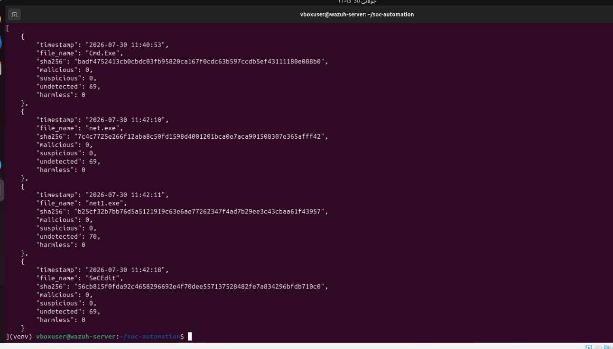
07 · EVIDENCE & LOGGING
Every Verdict Becomes a Structured Record
Each analyzed file is appended to a local incidents.json log with timestamp, filename, SHA256, and VirusTotal detection counts
A derived severity label (e.g. SAFE) is attached automatically based on the VirusTotal verdict
A plain-text incident_report.txt is generated alongside it for quick human review without parsing JSON
incidents.json — structured record per analyzed file
SOC AUTOMATION LAB
08 / 15

Slide 9
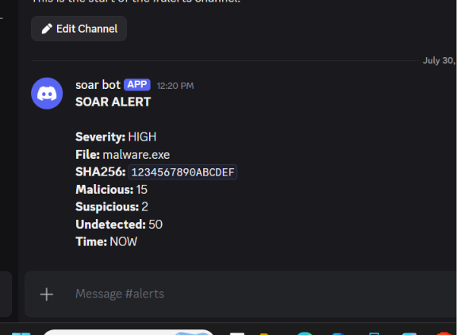
08 · REAL-TIME NOTIFICATION
Getting Alerts in Front of an Analyst
A dedicated Discord server and #alerts channel were stood up as the analyst-facing notification surface
A small notifier module pushes every processed detection to Discord the moment a verdict is available
Removes the need to babysit a terminal or dashboard — the analyst is notified passively, in real time
First automated alert posted by the custom "soar bot"
SOC AUTOMATION LAB
09 / 15

Slide 10
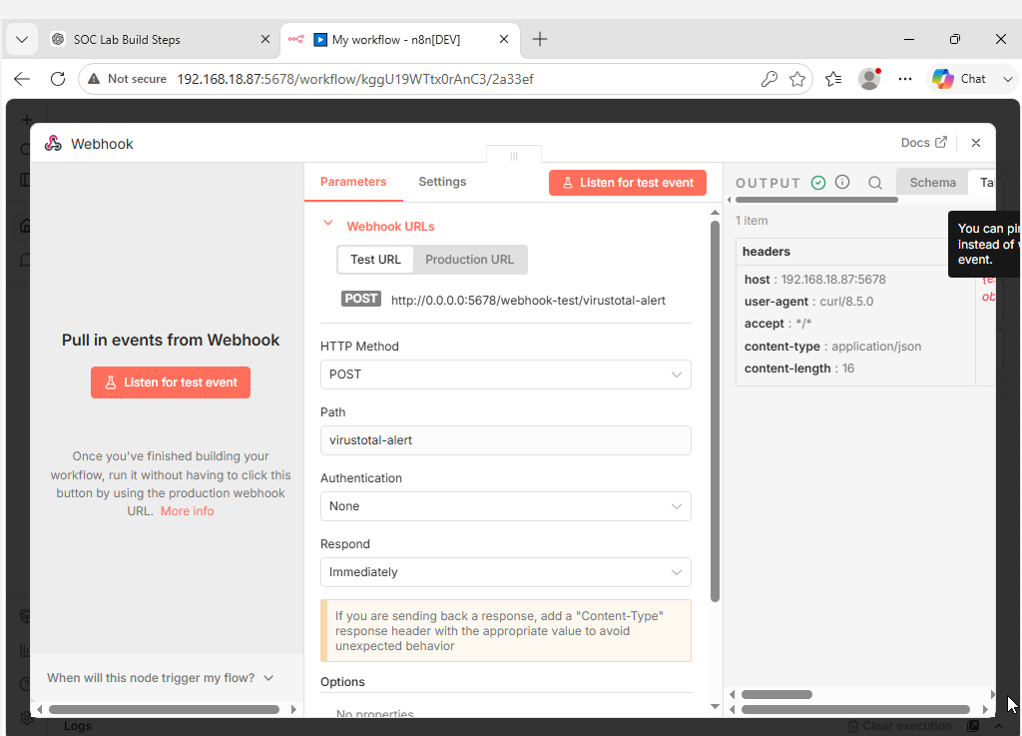
09 · SOAR ORCHESTRATION
n8n: From Direct Alerts to a Real Workflow
n8n installed on the SOC host to move beyond "script posts to Discord" toward a proper Security Orchestration, Automation & Response workflow
A Webhook trigger node (POST /virustotal-alert) was configured as the entry point for results from the Python script
Iteratively tested with realistic payloads — alert_type, url, malicious, suspicious, risk_score — matching the exact shape the script would send
Configuring the n8n Webhook trigger node: POST, path virustotal-alert
SOC AUTOMATION LAB
10 / 15

Slide 11
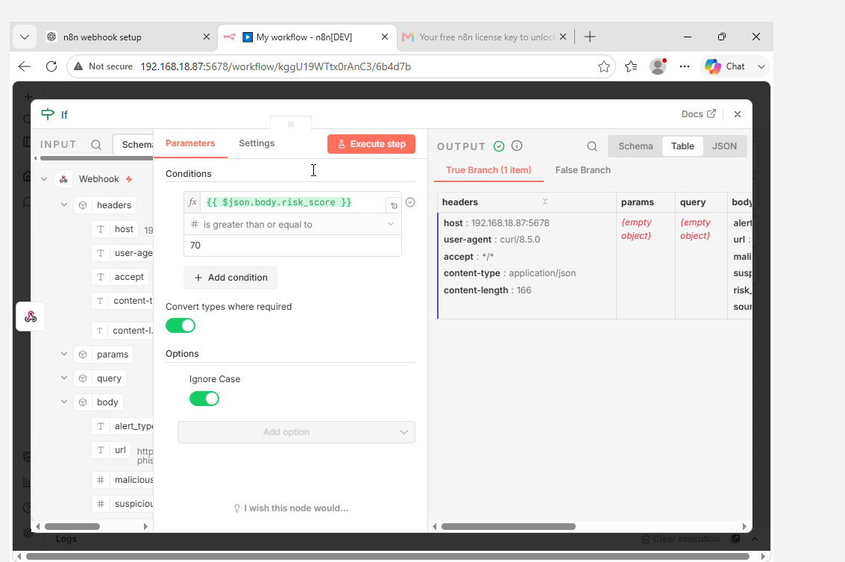
10 · DECISION LOGIC
Severity Scoring & Conditional Branching
An IF node routes each alert down a different branch depending on severity
Condition evolved from a risk_score threshold (≥ 70) to directly checking VirusTotal's malicious detection count — a simpler, more reliable signal
A dedicated "calculate severity" code node was later inserted before the IF node so severity is derived consistently inside the workflow itself
IF node condition: branch on VirusTotal malicious detection count
SOC AUTOMATION LAB
11 / 15

Slide 12
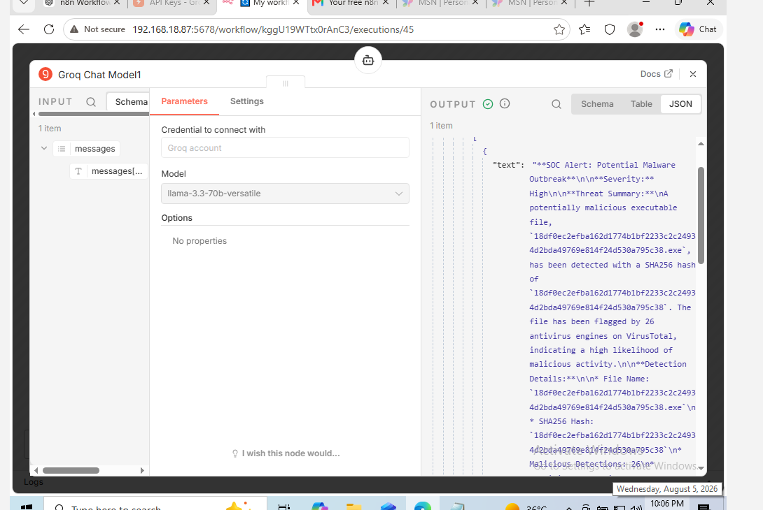
11 · AI-ASSISTED TRIAGE
Groq LLM Drafts the Analyst Report
An AI Agent node is wired to a Groq Chat Model running llama-3.3-70b-versatile
Given the raw detection JSON, it drafts a full narrative: severity, threat summary, detection details, and recommended SOC actions
Turns a structured verdict into the kind of write-up an analyst would otherwise type by hand
Groq Chat Model generating a draft SOC alert narrative in n8n
SOC AUTOMATION LAB
12 / 15

Slide 13
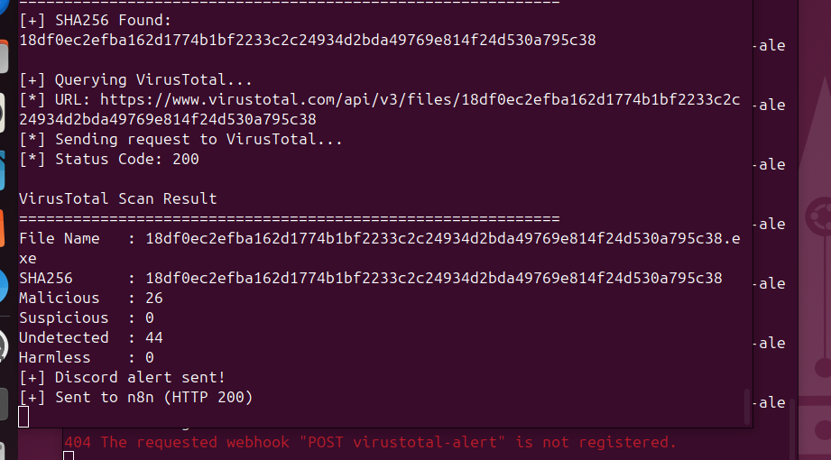
12 · TROUBLESHOOTING
Chasing an Intermittent HTTP 404
VirusTotal lookups and Discord alerts were working, but the n8n webhook call was intermittently returning HTTP 404 — the workflow wasn't actually receiving the event
Root cause: the workflow was only in manual test mode, not published/listening, and severity data was inconsistent across the payload
Fix: published the workflow, added the "calculate severity" node, and simplified the IF condition
Result: every leg of a full wazuh_monitor.py run succeeded — VirusTotal verdict, Discord alert, and a webhook call returning HTTP 200
404 → 200: the fixed pipeline succeeding end to end
SOC AUTOMATION LAB
13 / 15

Slide 14
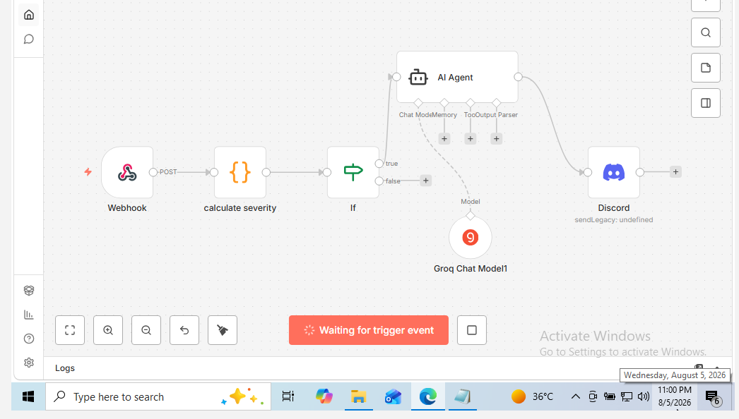
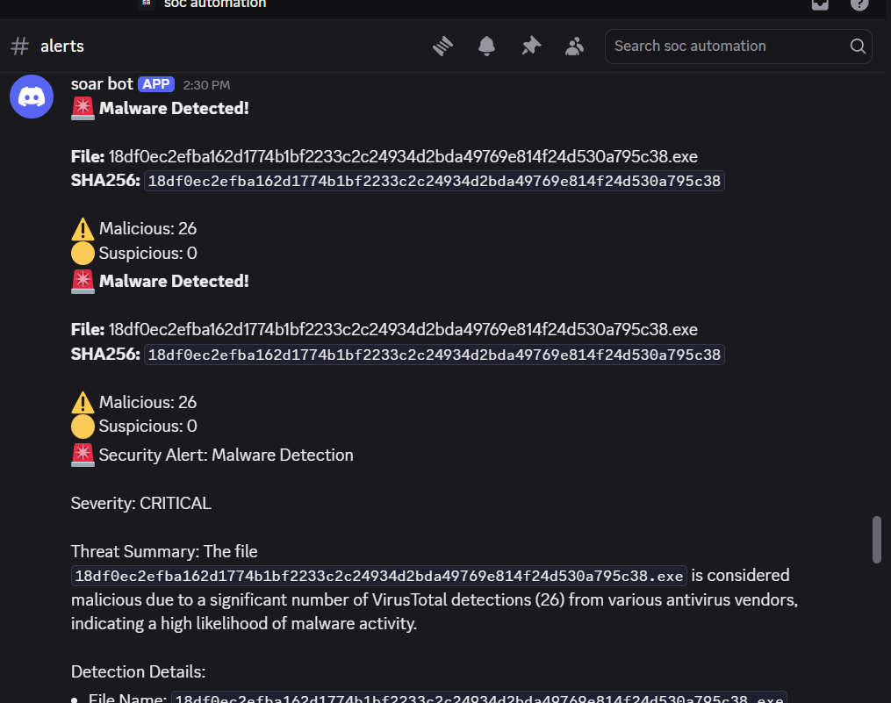
13 · FINAL RESULT
The Completed Automation, End to End
Webhook → calculate severity → IF → AI Agent (Groq) → Discord — running unattended. A single malicious detection now produces a fully formatted, AI-authored incident report with zero manual write-up.
Finished n8n automation graph, wired end to end
Live #alerts channel: AI-generated severity & threat summary
14 / 15

Slide 15
14 · CONCLUSION
Skills Demonstrated
SIEM deployment & administration (Wazuh: Manager, Indexer, Dashboard, agent enrollment)
Endpoint telemetry engineering (Sysmon configuration, File Integrity Monitoring)
Security automation scripting in Python (log tailing, hashing, REST API integration)
SOAR workflow design in n8n (webhooks, conditional branching, AI Agent / LLM integration)
Real-time alerting integration (Discord webhook notifications)
Systematic troubleshooting of a multi-system pipeline (VM networking, agent enrollment, webhook failures)
Full documentation & source code: github.com/your-username/soc-automation-lab
15 / 15

