Slide 1
Car Parking
Rijja Masood 21l-7590
Hafsah Zulqarnain 21l-5315
Shaff Suleiman 21l-5328

Slide 2
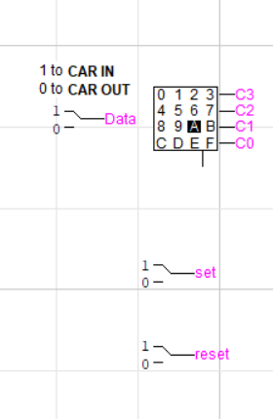
Input devices :
1. Hexadecimal keyboard
2. Data pin
3. Set
4. Reset

Slide 3
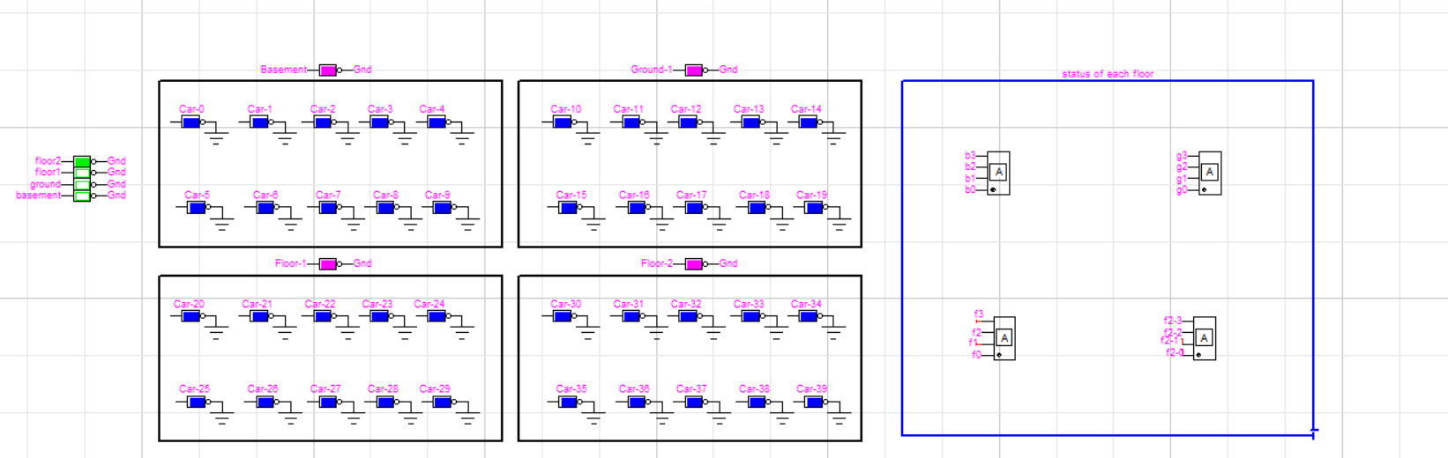
Output Devices:
Led for Floor selected
Led for Cars
Led for check capacity
Hexadecimal display for displaying Status of each floor

Slide 4
Hexadecimal Keyboard And it’s working
Hexadecimal keyboard is used as an input device here
We are using the first 10 pins for car selection at each floor
And the last four pins for floor selection
Now the output from this keyboard are four pins and here C3 is msb and C0 lsb

Slide 5
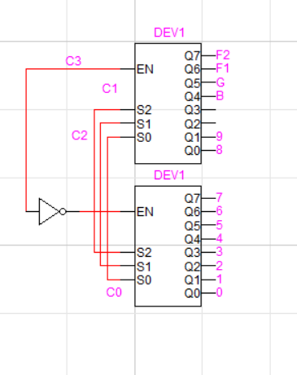
Decoder working:
The output of hexa keyboard is going into a decoder where msb is acting as an enabler
Where as the rest of outputs are acting as selection pins
The output to this decoder will be on the basis of these selection pins
This enabler will turn on the first 3-8 decoder whenever a car enters within range from (0-7)
But the second decoder will be turned on when car(8,9) are needed to selected
The last four pins of second decoder will turn on when (C-F) is chosen from hex keyboard
Now the results of B,G F1,F2 are sent into an encoder where it will be encoded to act as Basement ,Ground,First Floor and Second floor

Slide 6
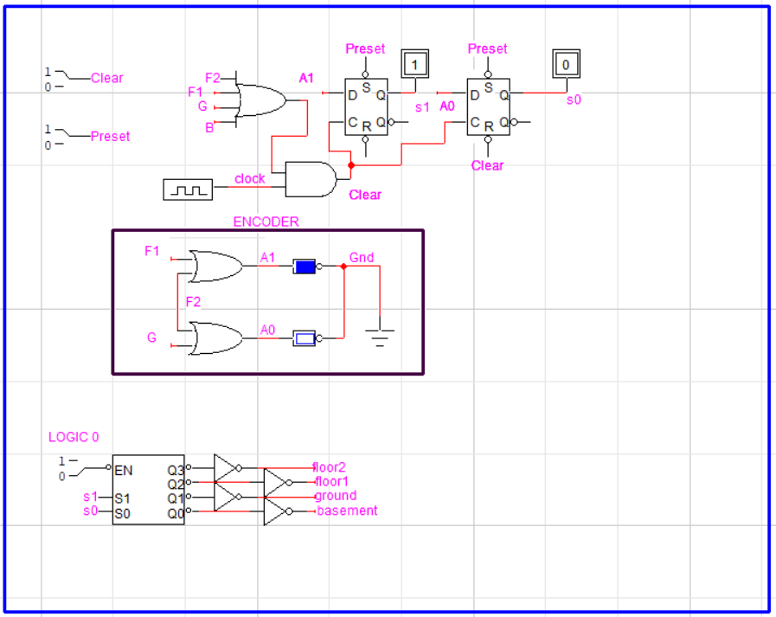
This Diagram is divided into three parts
Encoder
PIPO register
Decoder

Slide 7
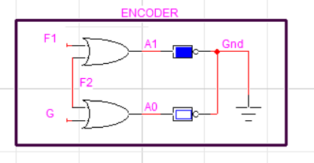
This encoder works in such a way that if B is selected the output to this encoder is 00,if it’s G the output will be 01, if F1 is selected it’ll be 10 and for second floor it’ll be F2
These results are stored in A1 and A0

Slide 8
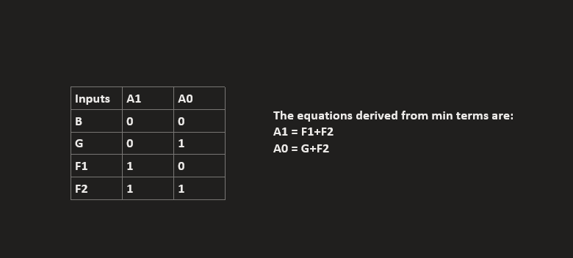
The circuit for encoder is made using these equations

Slide 9
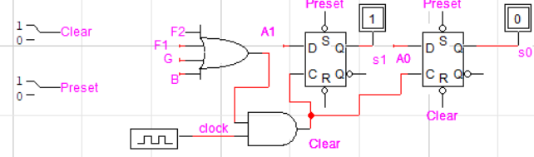
Now the result is stored into registers where the clock works in such a way that if any of the floors is turned on (B,G,F1,F2) and clock are multiplied
The input to these registers is result of encoder and it stores the results until changes are made in floor selection
The results of PIPO are stored in wires s1 and s0

Slide 10
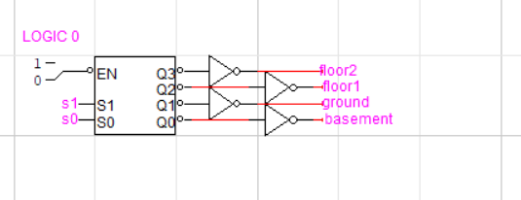
Decoding Back
The enable is always at logic 0 because of the bubble which indicates it’s NOT
The result of s1 and s0 are used as selection pins to choose the floor
NOT is applied at each output because of bubble

Slide 11
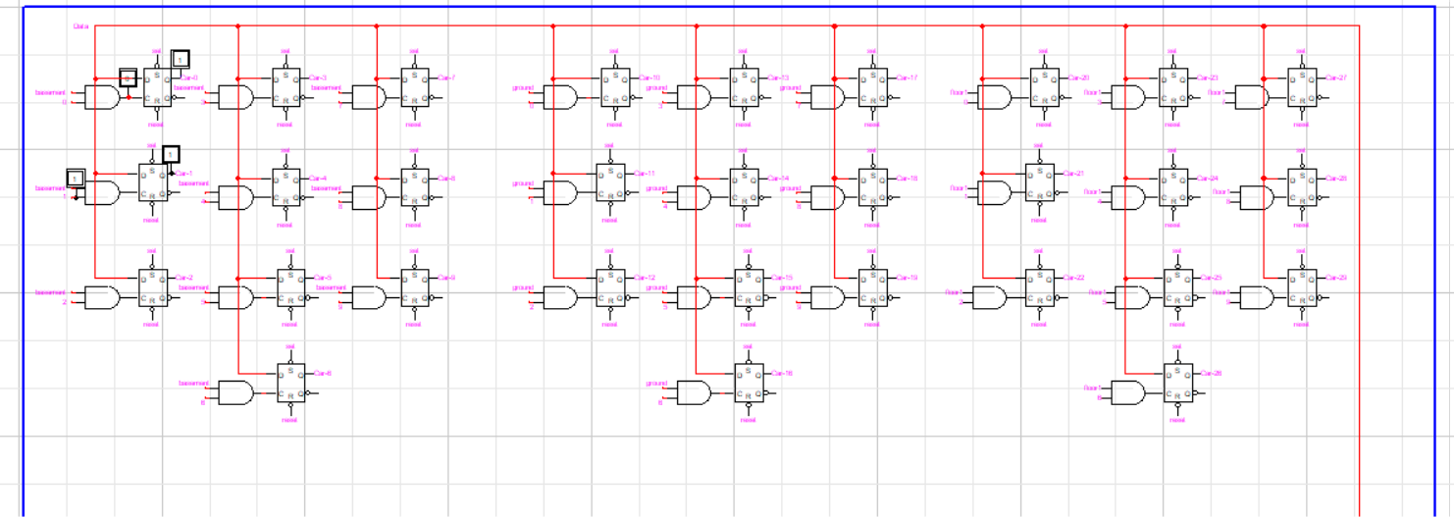
Data pin is used for Car-in and Car-Out
If data pin is on clock is reflected
If data pin off car leaves the parking ie if data pin is zero , it resets the flipflop

Slide 12
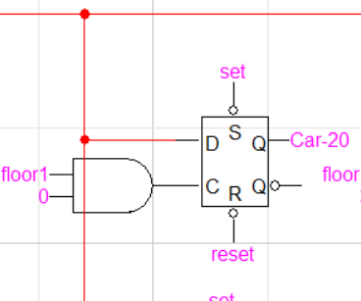
Working of a single d-flipflop:
A single d flip-flop will store car in the parking only for a single floor when a car is selected on that floor
In addition, Data pin needs to be logic 1 for storing car
However , when the Data pin of car is logic 0 the d-flipflop resets back to 0
All d-flipflops are attached to Common Data pin and whenever the data pin

Slide 13
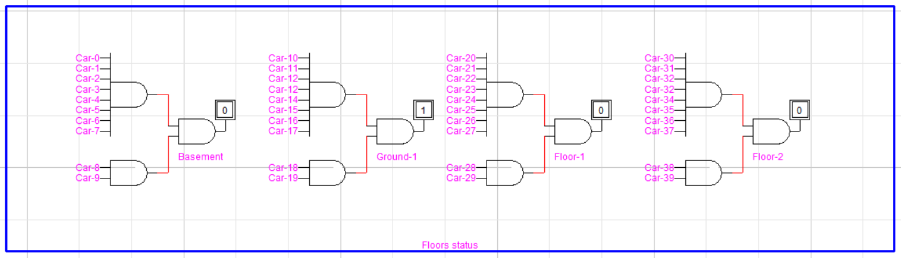
If Capacity on a single floor is filled the led indicating it will turn on

Slide 14
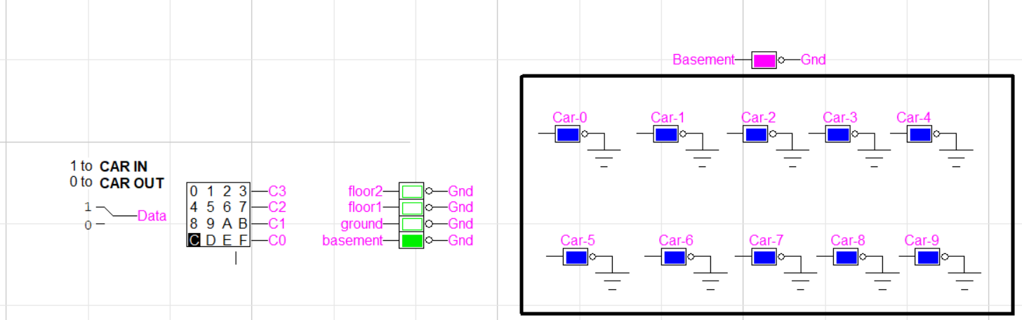
Output

Slide 15
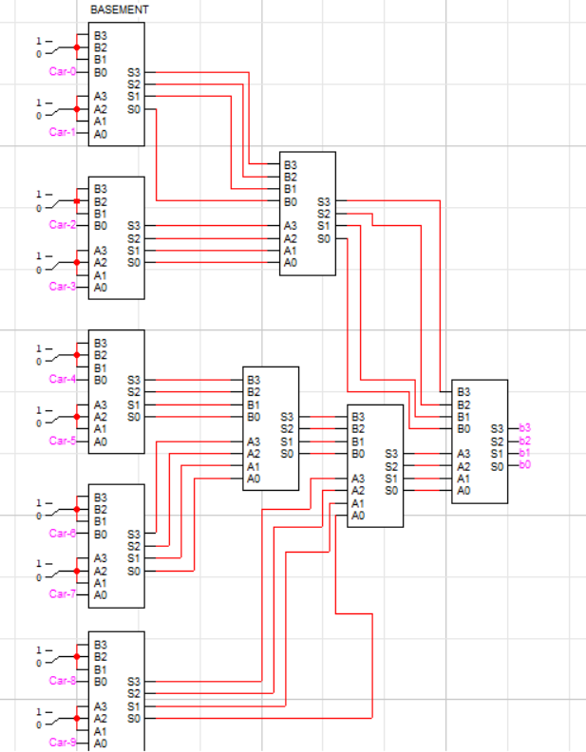
These adders are connected to hexadecimal display
All floors have same mechanism for display status of each floor

Slide 16
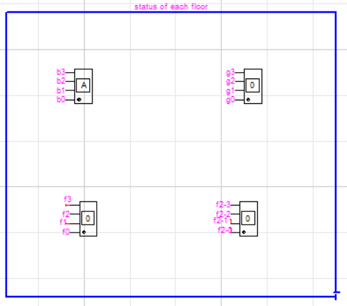
Hexadecimal display is used to display status of each floor

Slide 17
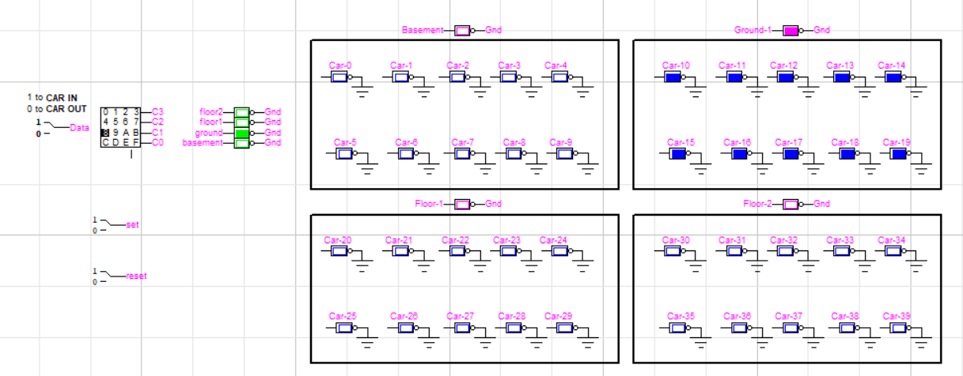

Slide 18
