Slide 1
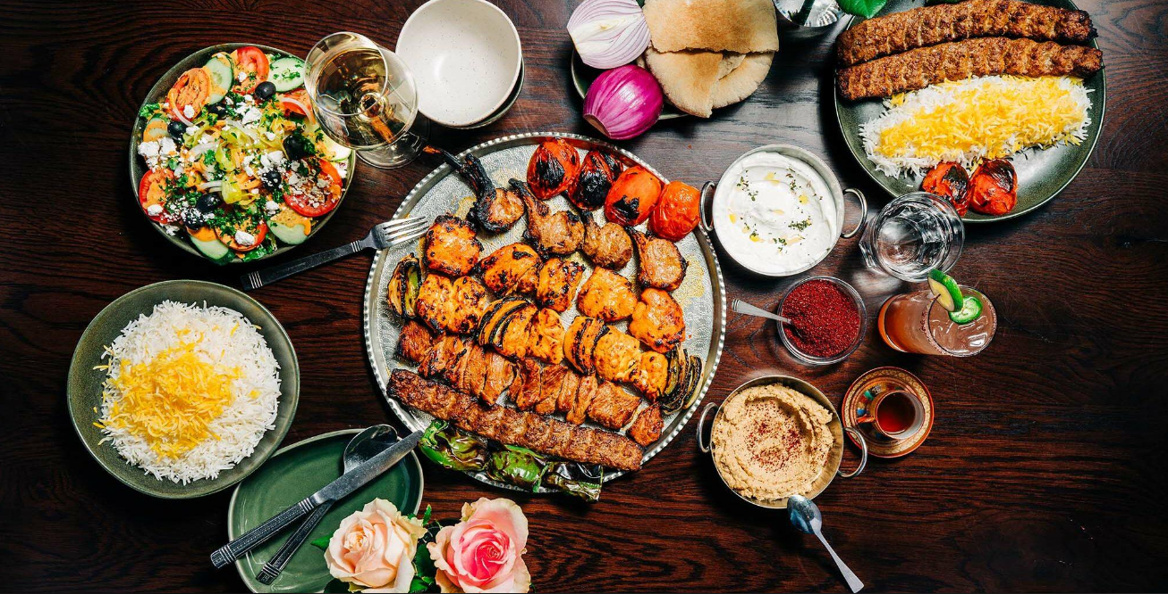

Som Restaurant RTO
PROJECT 14 · SOMALIA 10X CHALLENGE
Real-time ordering that connects every table, waiter, kitchen and cashier, with stock that counts itself
Somali + English · runs on the restaurant's own Wi-Fi
Notes:
Open with the one-line promise: from a QR code at the table to the kitchen screen in under a second, and every dish sold takes its ingredients out of stock automatically. Built solo in 14 days for Project 14.

Slide 2



Paper orders cost time, food and money
Orders get mixed up
The kitchen cannot prioritise
Owners don't know food cost
Handwritten tickets travel between tables, waiters and the kitchen. Dishes go to the wrong table or are forgotten.
Cooks see a pile of paper, not a queue. Nobody knows which table has waited longest.
Without recipes and stock records, nobody knows what a plate of Bariis iyo hilib really costs to make.
Our answer: one system on the local network, with a live screen for every role and stock deducted by recipe.
Notes:
Three pains from the brief. Keep it short; the judges know the problem. Land the answer sentence at the bottom.

Slide 3





From the table to the kitchen in under one second
1
2
3
4
5
Scan & order
Waiter confirms
Kitchen cooks
Ready → served
Bill & pay
Customer scans the table QR (secret token), picks dishes and choices
Stops fake orders. Stock is deducted at this moment
Card appears with a sound, oldest first, green/orange/red timer
Waiter gets a Ready alert; the phone at the table updates live
Split, cash with change or EVC Plus / Zaad / eDahab, receipt
Socket.IO rooms kitchen · waiters · table:<id>. Every change is pushed right after the database transaction commits, and screens reload all open orders when they reconnect.
Notes:
Walk through one order. Stress the two rules from the brief: the waiter confirms before the kitchen sees it, and stock is deducted at confirmation, inside one database transaction.

Slide 4
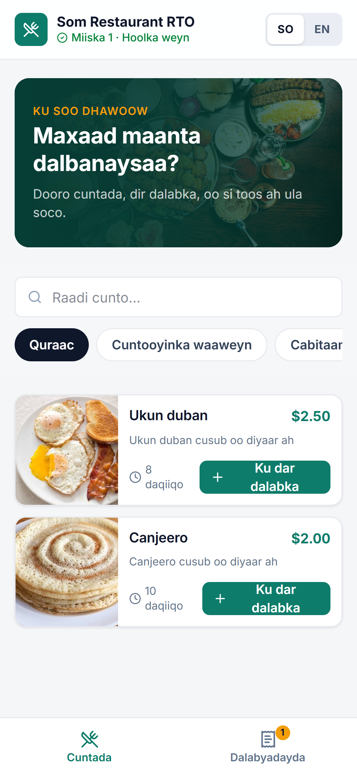



One system, a screen for every role
Customer
Waiter
Orders from the table phone by QR. Several phones share one table bill
Floor map by status, confirms orders, enters orders, moves orders
Kitchen
Cashier & manager
Order cards with timers, one tap: Cooking, then Ready
Bills, splits, payments, menu, recipes, stock, reports, staff
Notes:
Four roles, server-side permissions for each. The phone on the right is the real customer screen in Somali; every screen has an SO/EN switch.

Slide 5
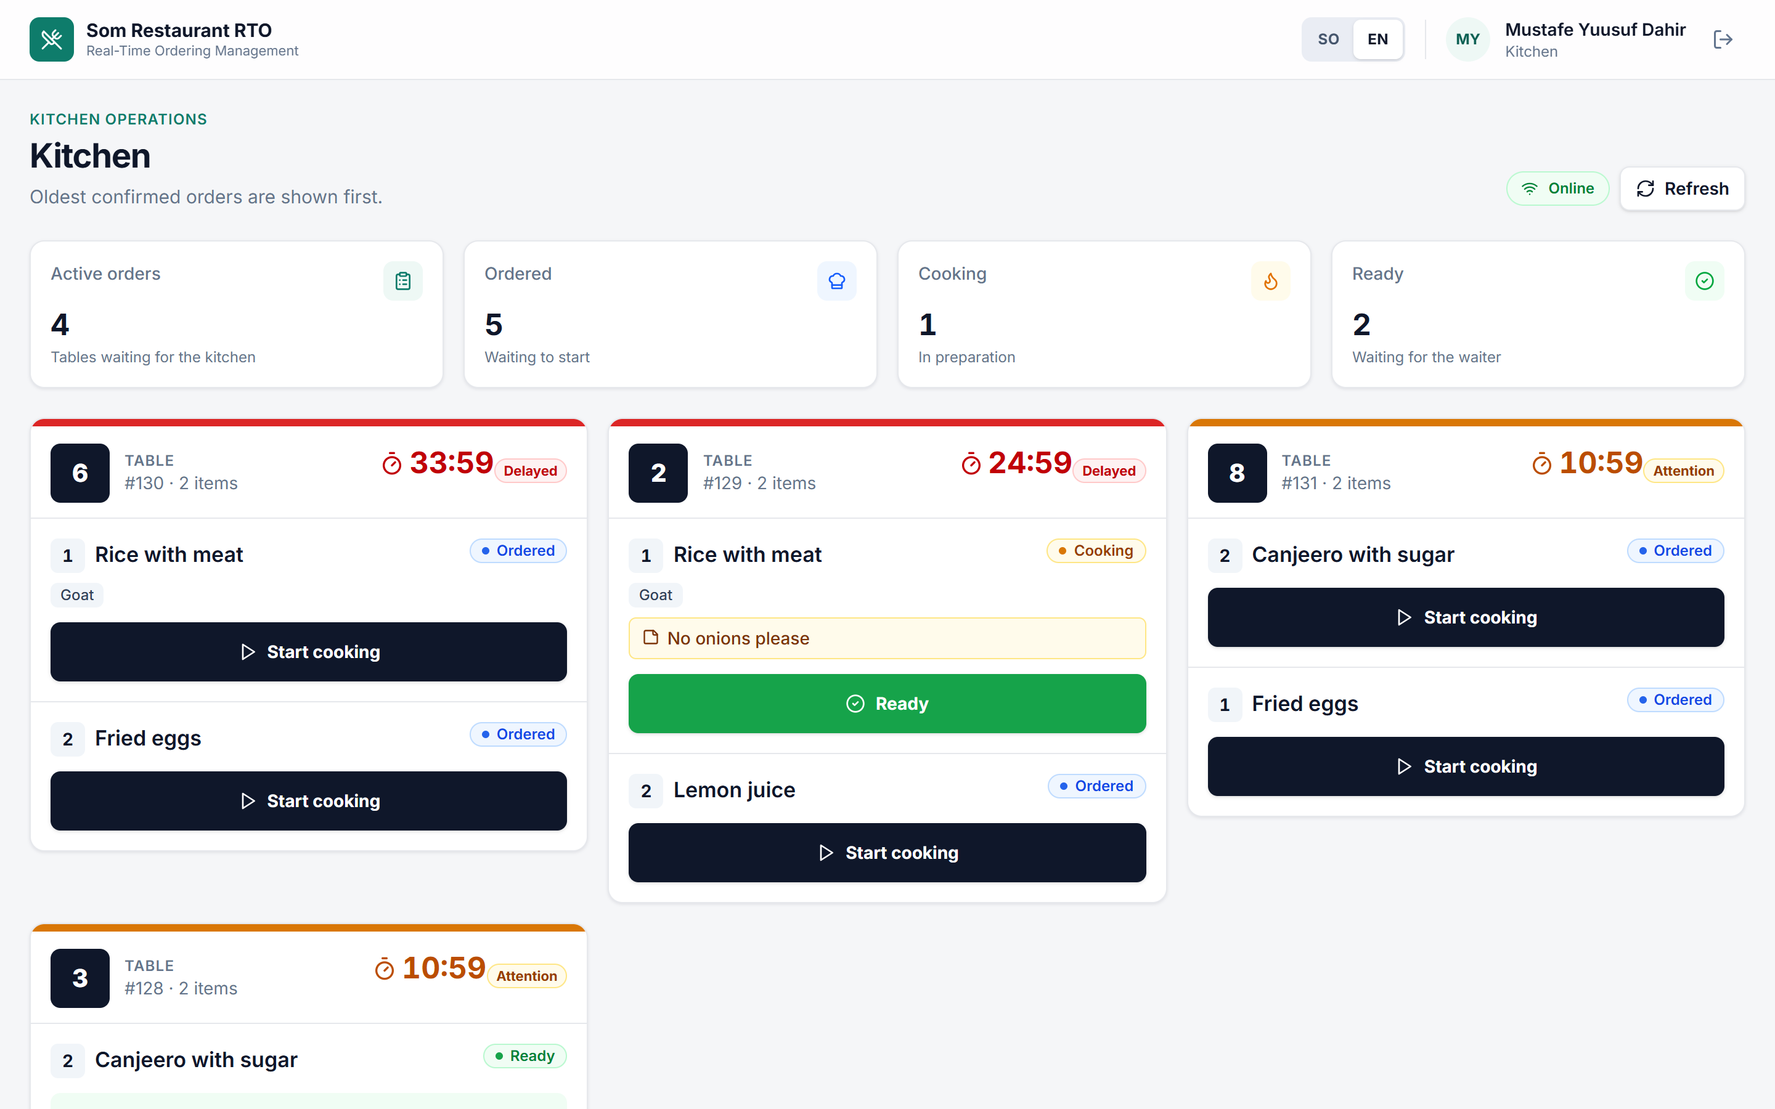



The kitchen sees what to cook first
Timer since confirmation
Green under 10 min, then orange, red after 20 min, plus a text label
Oldest first
New orders appear within a second with a sound
Survives reconnects
The screen reloads all open orders when the connection returns
Notes:
This is the live kitchen display. Point at the red card: 23 minutes. Notes like 'No onions please' are highlighted, modifiers shown as chips.

Slide 6

Every dish has a recipe, and stock counts itself
< 1 s
How it works
order reaches the kitchen screen (tested over a real socket)
Recipe snapshot on each order item, so recipe changes only affect future orders
Deduction in one transaction with SELECT … FOR UPDATE: two waiters can't sell the last portion twice
Modifiers have ingredients too (extra rice uses rice)
Stock never goes below 0; every movement is logged (sale, delivery, waste, adjustment)
Cancelled while cooking: still deducted, marked as waste
10 × recipe
selling 10 portions deducts exactly 10× each ingredient (tested)
0 portions
when an ingredient runs out, the dish greys out on every screen
Notes:
This is worth 25 points. Show the three 'Done when' conditions and say each one has an automated test. Then explain the transaction and row locks if asked.

Slide 7
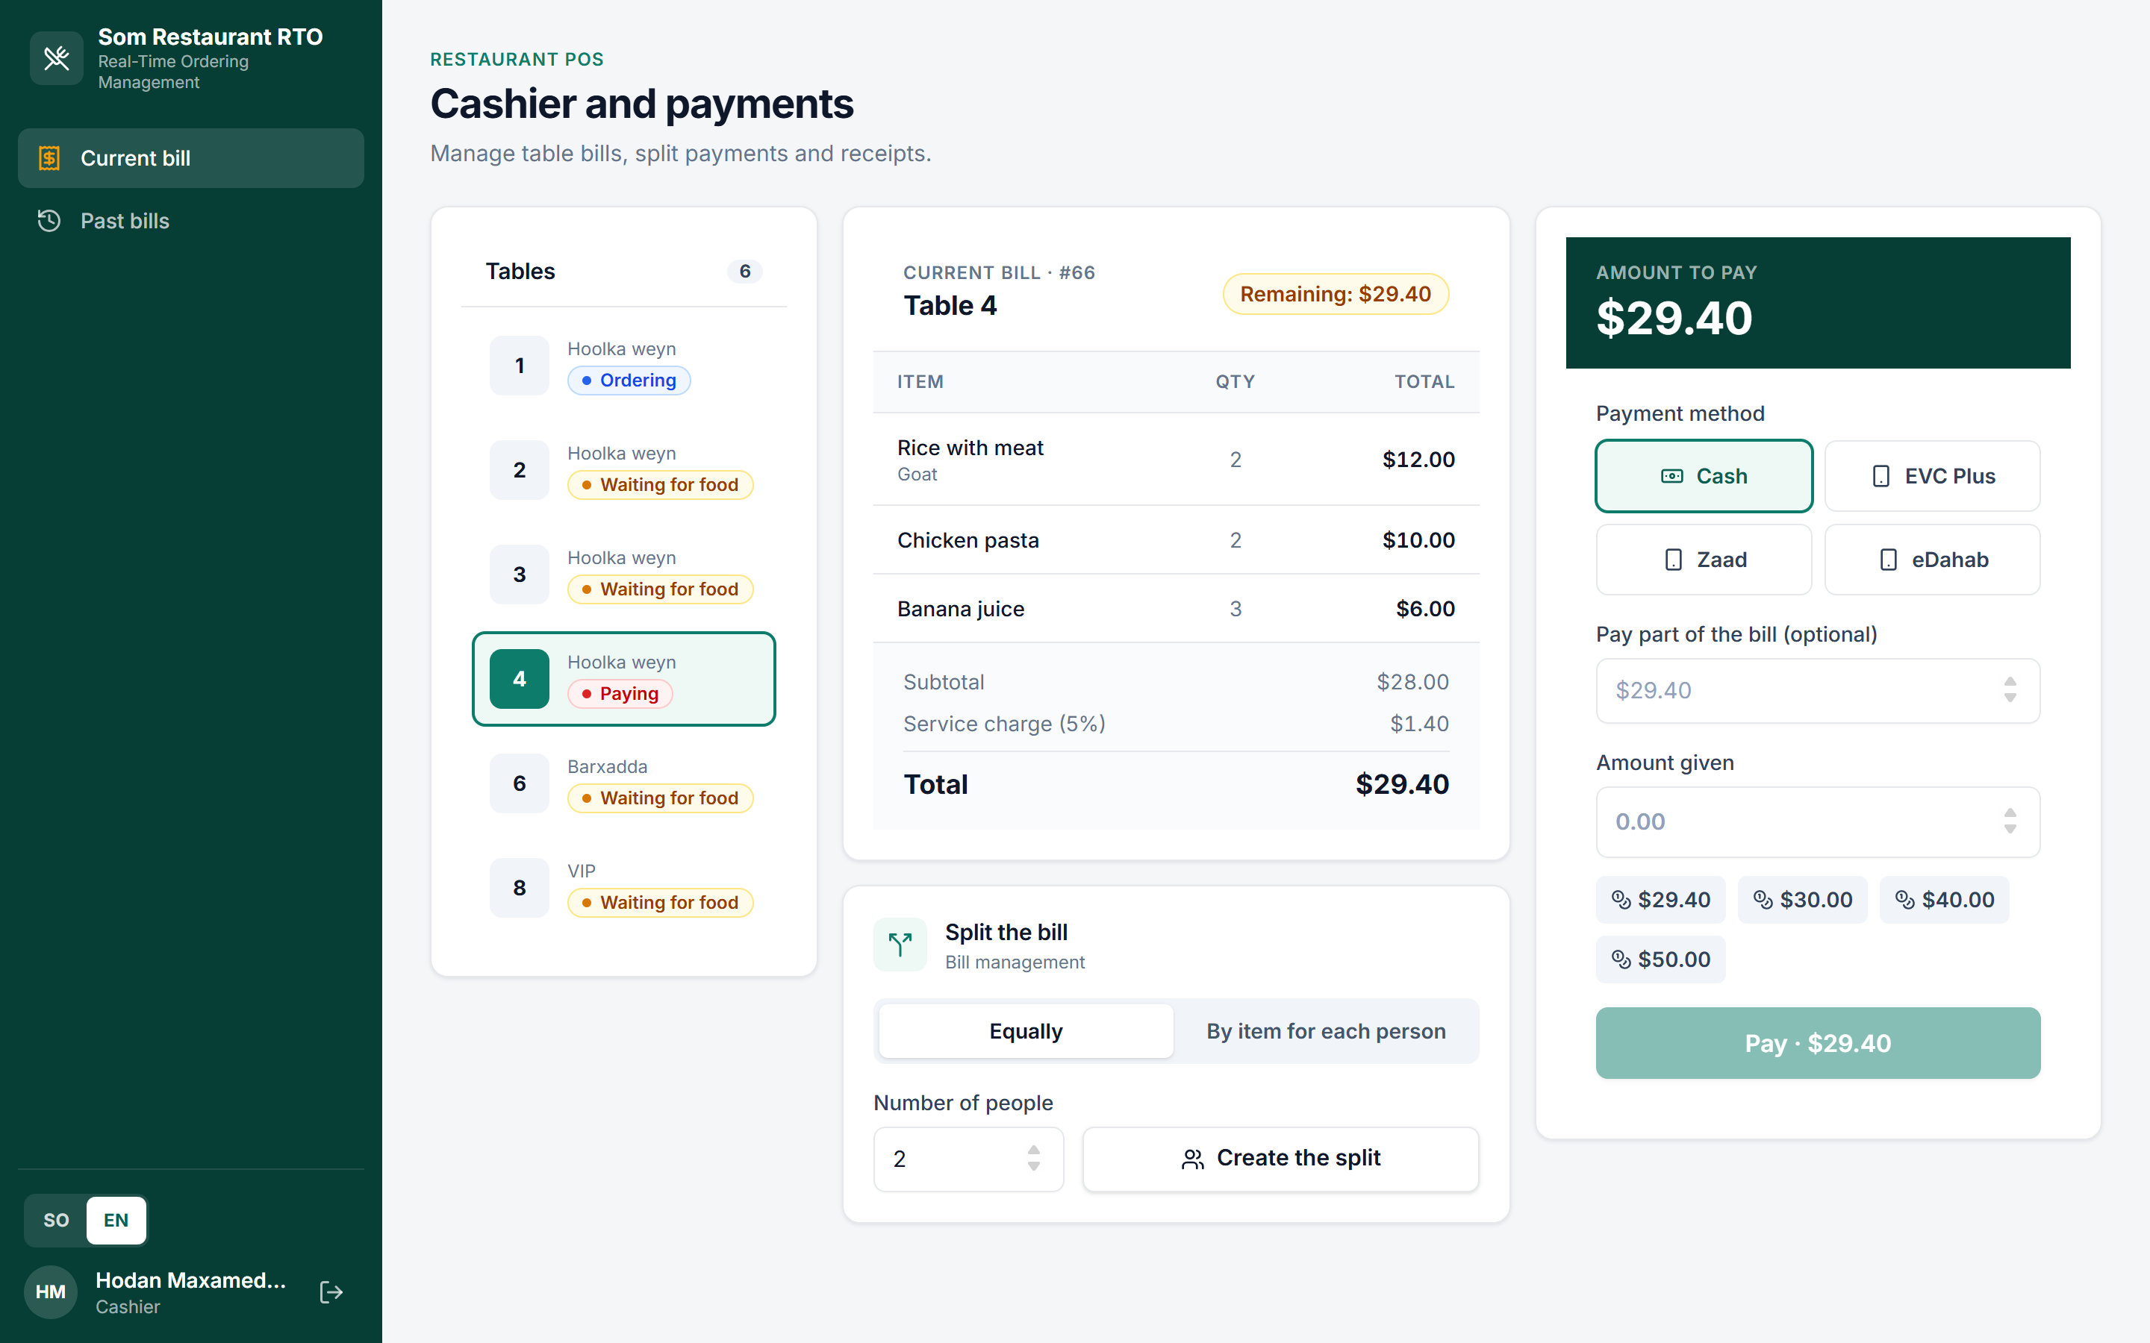



Bills, splits and payments without paper
Split the bill
Equally by people, or by choosing items per person; cents always add up
Cash with change
Quick-amount buttons, change shown live; partial payments stay open
Mock mobile money
EVC Plus, Zaad, eDahab behind an adapter; SMS goes to an in-app outbox
Notes:
Table 4 is paying. The table becomes Free only when the bill and every split are paid; cancelled items never appear on the bill. The receipt prints in Somali and English.

Slide 8
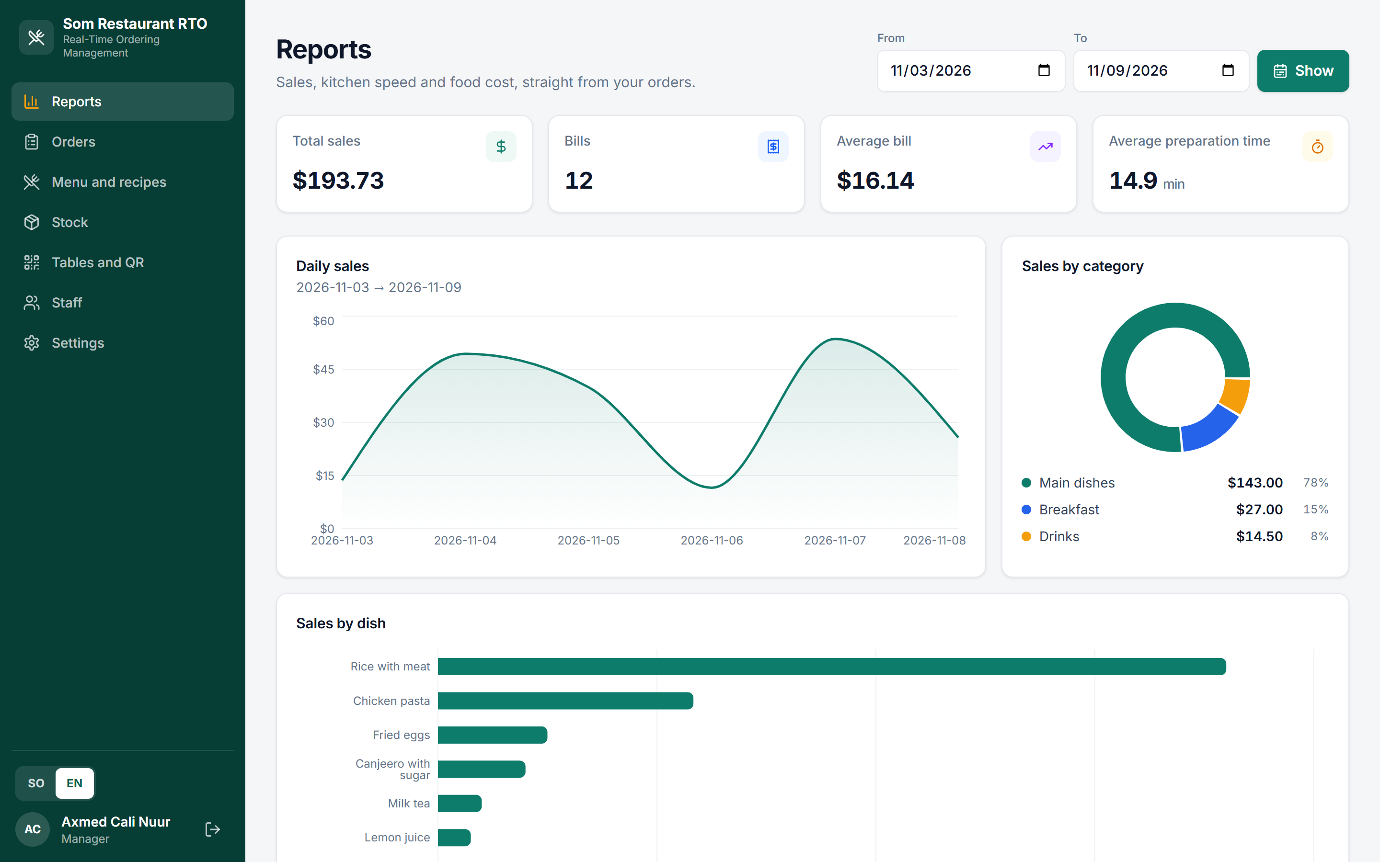


Owners finally see sales and real food cost
From real queries
Daily sales, by dish and category, filterable by date
Kitchen speed
Average time from confirmation to Ready
Food cost per dish
Ingredient cost ÷ price × 100; above 40% is highlighted
Notes:
Numbers on screen come from a sample week of orders. Every chart is a database query, never hard-coded.

Slide 9





Layered architecture: screens never touch the database
React screens
React 19 · Vite · Tailwind · i18next (SO/EN)
Socket.IO 4.8
Routes
Rooms: kitchen, waiters, table:<id>
Express 5 · JWT auth + role check · Zod validation
Services
Business rules, transactions, real-time events
Adapters
Repositories → MySQL
Payment gateway and SMS: simulated, swappable
Knex migrations · 20 related tables · seed data
Notes:
Routes only parse input and call a service; services hold the rules; repositories hold the SQL. Full endpoint list in docs/API.md; database diagram in the README.

Slide 10






Tested, secured and bilingual from day one
62
4
20
2
automated tests, one command, run in GitHub Actions
roles, permissions checked on the server for every request
related tables with migrations and Somali seed data
languages on every screen, button, message and receipt
bcrypt password hashes, JWT sessions
Zod validation of every input
Rate limits on the API, login and public orders
Audit log: who did what, when
Secrets only in .env; .env.example in Git
QR holds a secret token; regenerating it cuts off old phones
Notes:
Covers the 8 baseline items. If asked: tests use a separate test database, so running them never wipes demo data.

Slide 11
Live demo
1
Scan a table QR and order from a phone
2
Watch it appear live on the waiter and kitchen screens
3
Move items to Served, split the bill and pay
Five steps from the judges' checklist, on real phones over Wi-Fi
4
Sell a dish until an ingredient runs out: it switches off
5
Open the daily sales and food cost report
Mahadsanid · Thank you
Notes:
Demo accounts: manager, cashier, waiter1, kitchen (passwords in the README). Before presenting: npm run seed for clean demo data, check the QR base address is the Wi-Fi IP, and allow Node through the firewall.

