Slide 1
Welcome to MERN STACK!
Week-1, Day-1

Slide 2
HOUSEKEEPING
TODO

Slide 3
Where are we headed to?
Get context: What is Mern?
JS Refreshing:
Data types (string, number, boolean, null, undefined);
Structures (objects, arrays);
ES6 vs ES5 syntax;
Destructuring;
Functions/Arrow Functions;

Slide 4
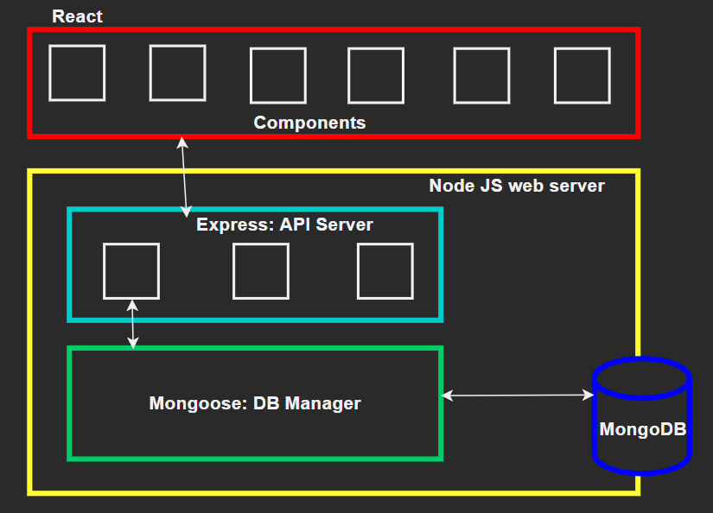
What is MERN?

Slide 5
THANK YOU!

