Slide 1
A TIMEPIECE FOR EVERY SELF
Alberto Watch Company
Time, worn personally.
ALBERTO
2026

Slide 2
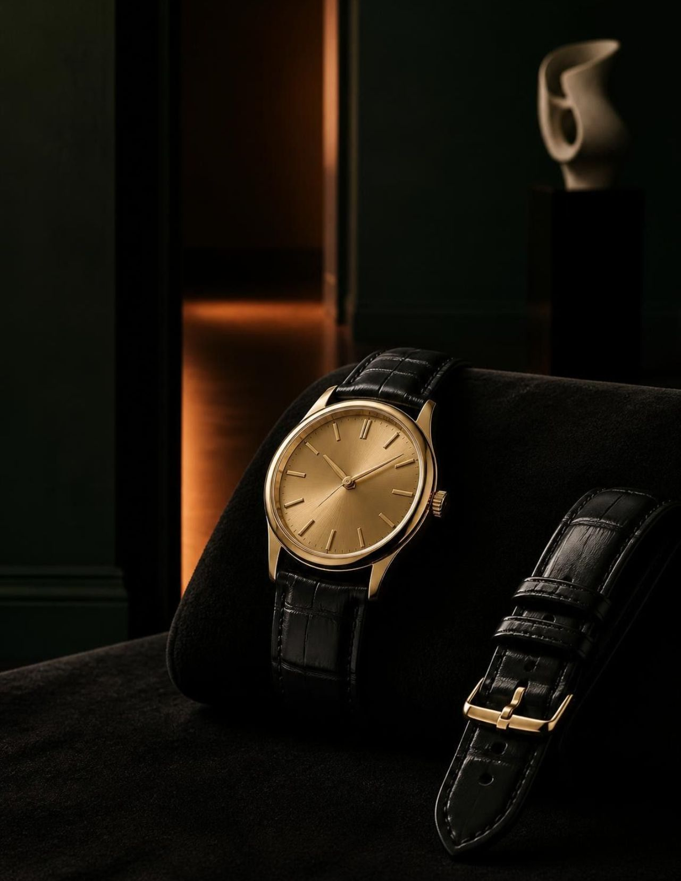
THE HOUSE
Who We Are
Alberto Watch Company is a premium watch brand for people who see timepieces as part of personal style.
Curated collections bring together elegance, everyday wearability, and modern functionality.
Our point of view is refined, versatile, and made for different personalities.

Slide 3
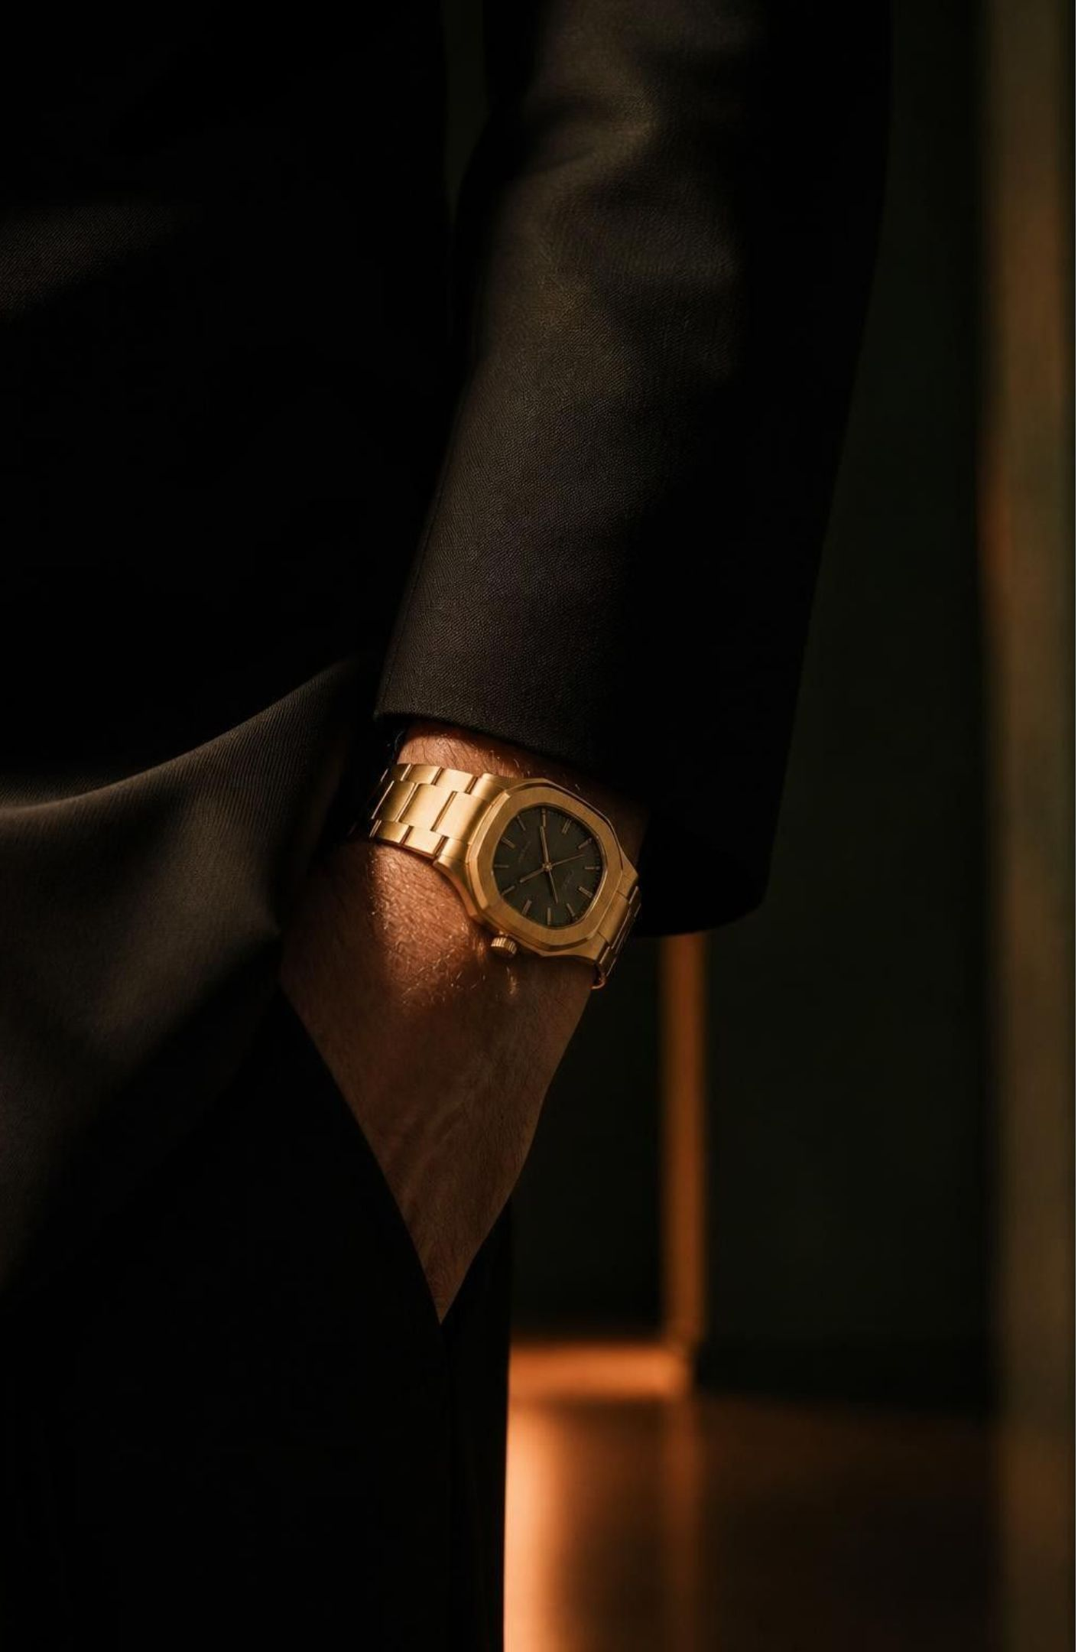
THE BELIEF
A watch is part of who you are.
Alberto Watch Company began with a simple belief: a watch is more than a device for telling time. It becomes part of your style, personality, and everyday identity.

Slide 4
THE ALBERTO POINT OF VIEW
Our Vision and Values
Beautifully considered timepieces that feel personal, useful, and lasting.
01
02
03
04
05
Elegance
Quality
Innovation
Timeless style
Satisfaction
Quiet confidence in every proportion.
Craftsmanship made to be lived with.
Modern usefulness, thoughtfully integrated.
A considered experience, from choice to wear.
Design that outlasts a moment.

Slide 5
THE COLLECTION
Everything you need to wear time well
01
02
Luxury
Vintage
Luxury watches for sophisticated occasions.
Vintage watches inspired by timeless designs.
03
04
Smart
Everyday
Smart watches that combine style with modern digital functionality.
Everyday options for different styles, preferences, and routines.
Four ways to meet the moment. One standard of considered design.

Slide 6
AN EDITORIAL INDEX
Four collections.
One Alberto
point of view.
Luxury
01
Polished presence for the moment that matters.
02
Vintage
Classic character, carried forward.
03
Smart
Beautifully connected to everyday life.
Distinct moods, shared commitments: style, functionality, and versatility.
04
Versatile
One watch, many versions of you.

Slide 7
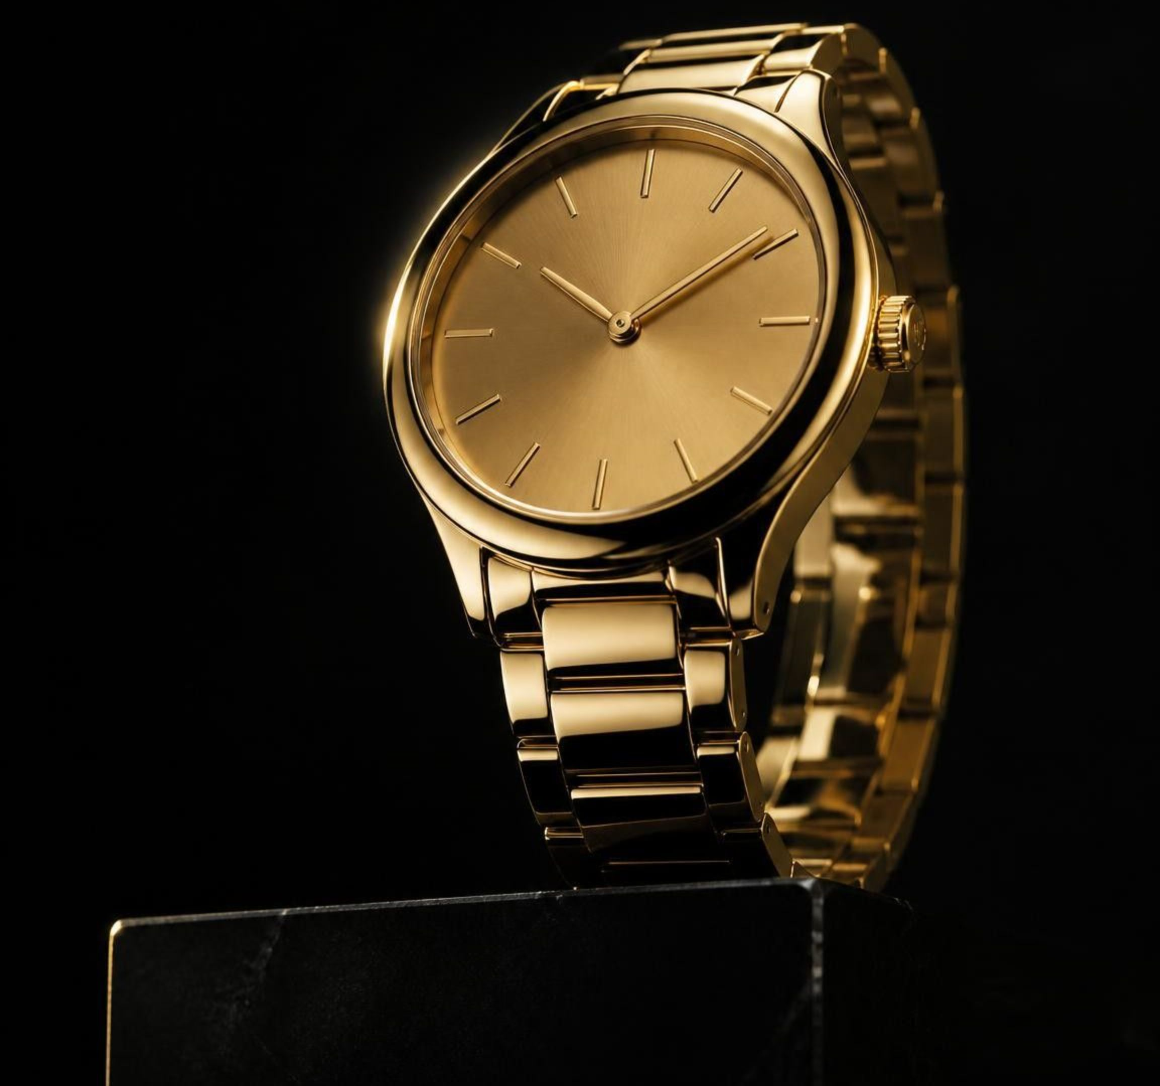
COLLECTION 01 · LUXURY
Luxury watches, made for the moment
Premium-looking designs with a polished, sophisticated presence—made for formal occasions, milestones, and evenings that call for quiet confidence.
Elegance · proportion · finish

Slide 8
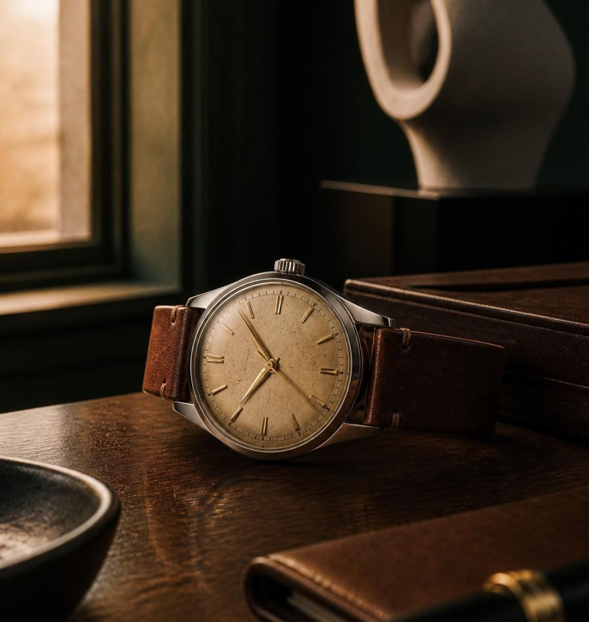
COLLECTION 02 · VINTAGE
Vintage watches, with a memory of style
Inspired by timeless designs and the enduring appeal of classic watchmaking.
For customers drawn to character, heritage, and a sense of story—not nostalgia for its own sake.

Slide 9
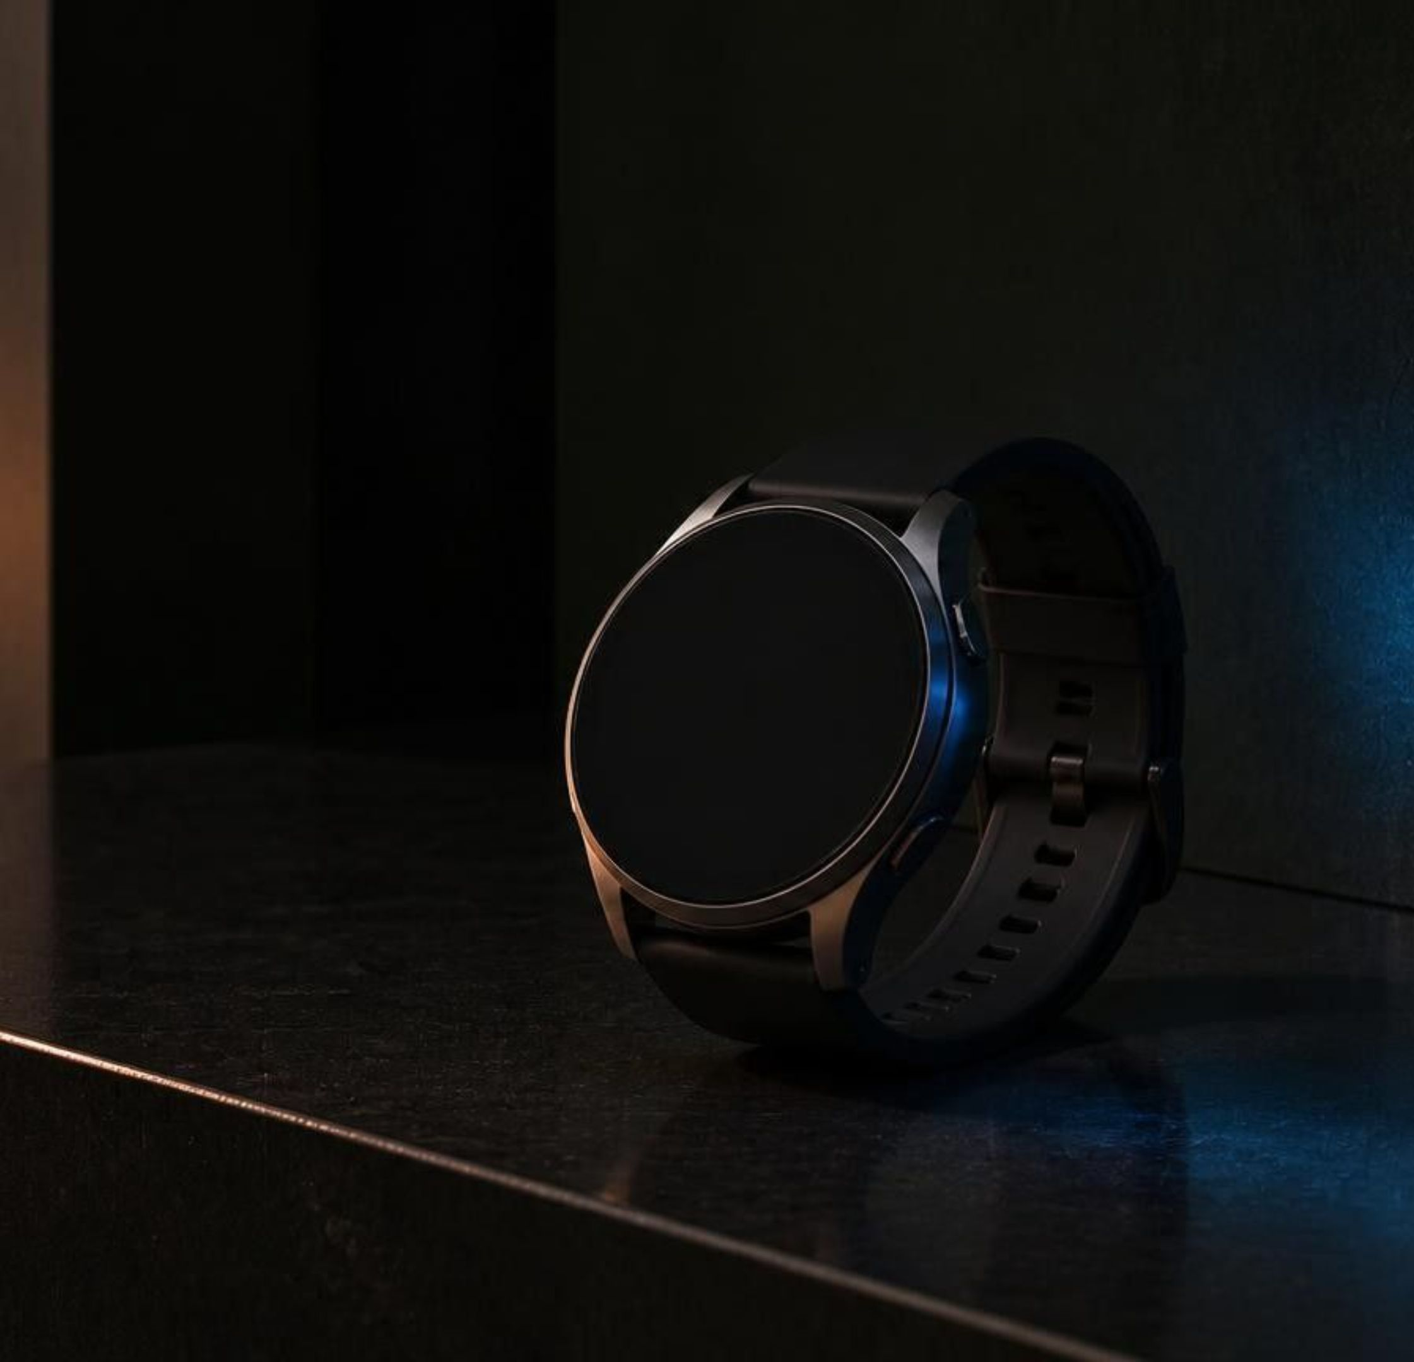
COLLECTION 03 · SMART
Smart watches, beautifully connected
Modern digital functionality without giving up a sense of style.
Useful technology in a refined, wearable form—made for convenience, movement, and everyday versatility.

Slide 10
THE ALBERTO PROMISE
Time, Reimagined.
Classic and modern sensibilities, brought into one collection. Different personalities can find a watch that feels like their own.
Everyday practicality sits alongside premium design.

