Slide 1


NUCES IC Design Template a Concept Proposal
Prof. Dr. Rashad Ramzan
National University of Computer and Emerging Sciences (FAST-NU),
A.K. Brohi Road, H-11/4,
Islamabad-44000, Pakistan

Slide 2
Outline of Presentation
Introduction to FAST-NUCES and IC Design Lab (ICD)
Do not change the above bullet and slide there and 4.
Simplified IC Design Flow
Why IC Design?
Current Composition of the IC Design Team
Names and Area of Expertise
Recent Designed and Manufactured ICs
Past Designed and Manufactured ICs
IP Development
Budget
Conclusions

Slide 3
Your Presentation
From Here on wards
You start your presentation.

Slide 4
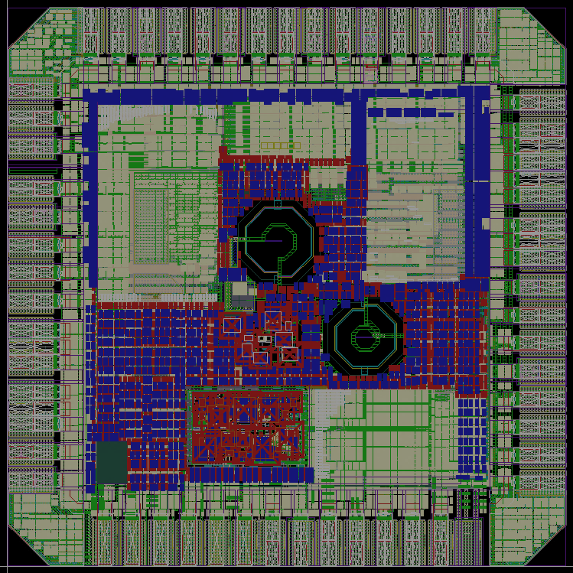
Microchip#1: 4 Projects
1 mm
Fault-Tolerant CLB:
Application: Radiation-hard space electronics
Cadence RTL Process
Approximate ALU:
Application: Image Processing
Cadence RTL Process for Design
Hardware TRNG:
Application: Cryptography and 5G systems
Analog Blocks Design: Cadence ADE, Digital Filters Design : Cadence RTL
See HOW the picture and text layout is used.
Please pay attention to the colors.
Since the PIC is dark color the text is in light color, so that its fully visible.
CLB
ALU
1 mm
LNA
TRNG

Slide 5
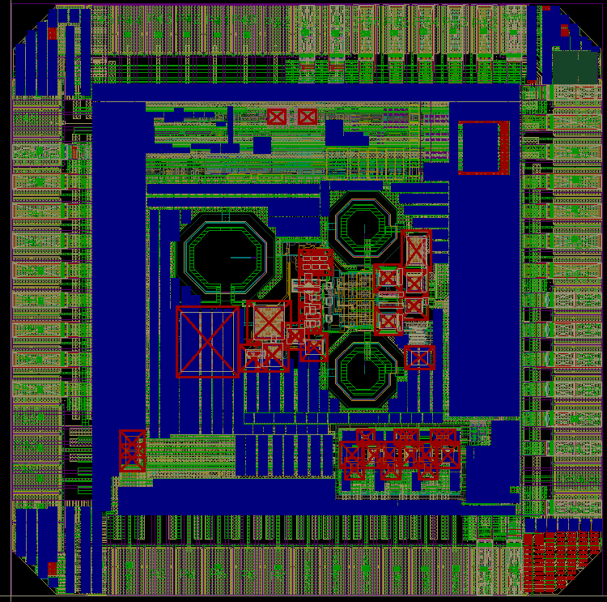
Microchip#2: 4 Projects
1 mm
TENG Harvester:
Application: Nano Energy Harvesting
Cadence ADE Design & Implementation
AC Logic Family:
Application: IoT Smart Dust
Cadence ADE Design & Implementation
ΣΔ ADC:
Application: Massive MIMO
MATLAB Modeling
Cadence ADE Implementation & Verification
mm-Wave Phase Shifter:
Application: Massive MIMO
Analog Blocks Design: Cadence ADE
RF Modeling: RF Pro in Cadence Virtuoso
TENG
1 mm
Phase Shifter
AC
ΣΔ
Logic
ADC

Slide 6
Budget Proposal

Slide 7
Estimated Budget
License Design Tools
1000 Floating Licenses;
Full Cadence Tool Suite for Analog, Mixsignal, and Digital IC design Flow
Design Kits from the selected foundries like TSMC or Global Foundries.
Design Team
200 Team Leads with PhD degrees.
001 Design Engineers with MS and BE degrees.
Risk: Rare expertise and team depletion rate will be high.
Mitigation: Constant supply of trained man power trained at company expense.
Office Space and Utilities
Team Lead with PhD degrees.
40 Member Technical Staff with MS/PhD degrees with IC experience.
18 Design Engineers with MS and BE degrees.

Slide 9
Thank You!
Questions?

