Slide 1



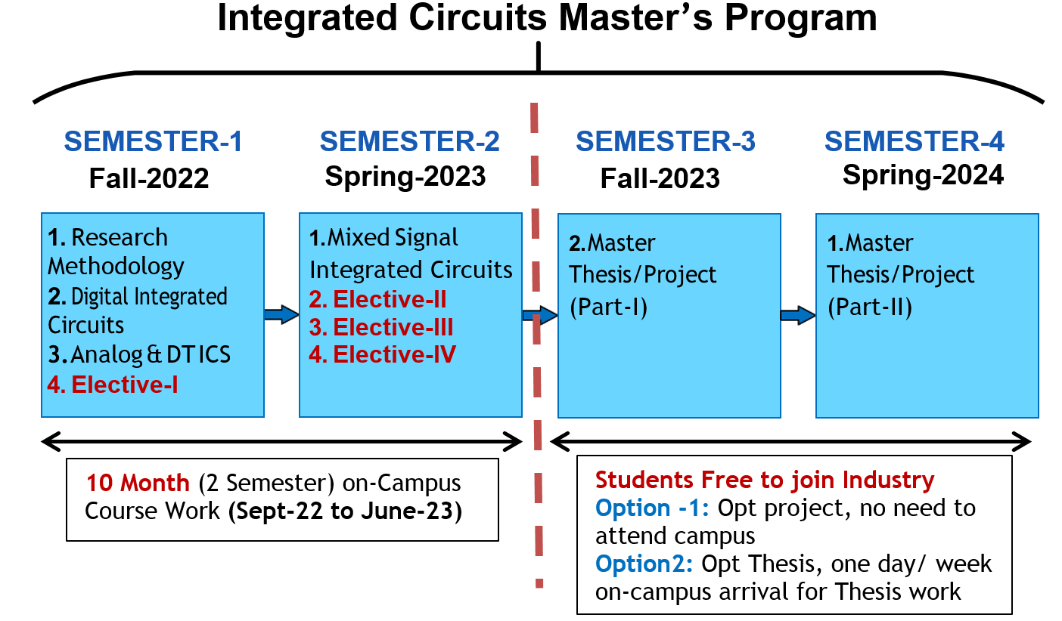
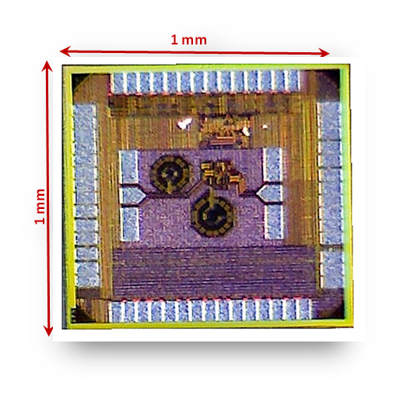
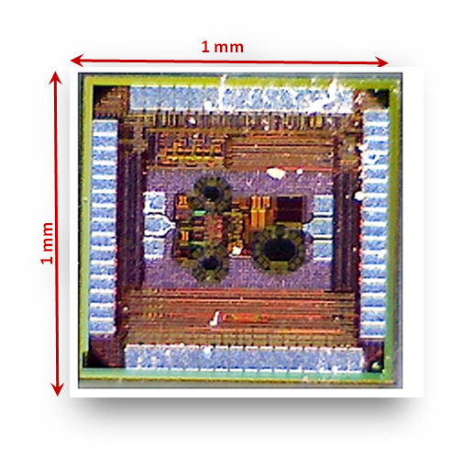
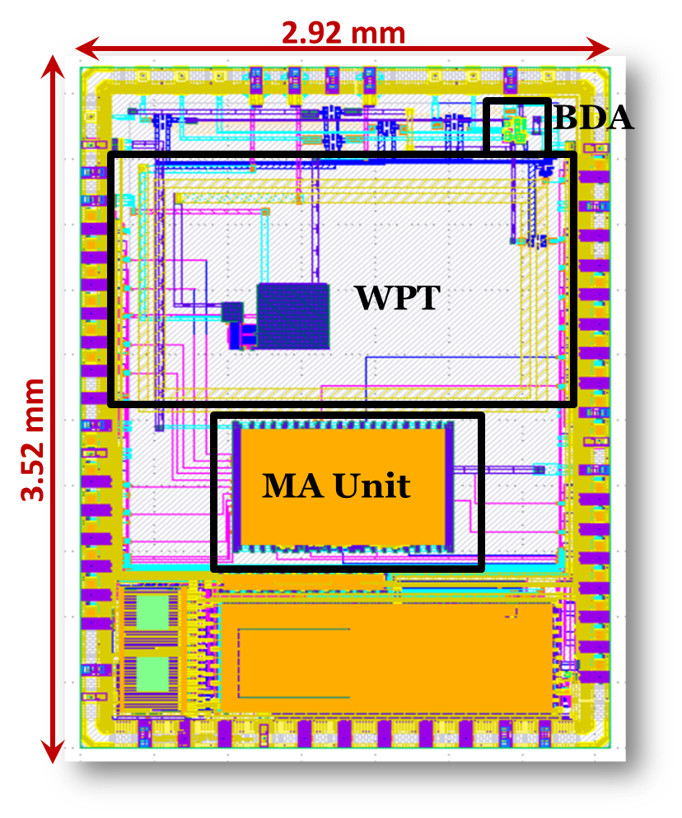

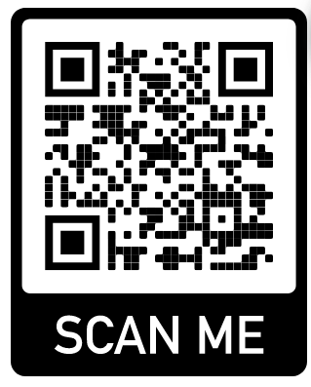

ADMISSIONS OPEN FALL 2022
MS Electrical Engineering Specialization
in Integrated Circuits (IC) & Systems
“A Training from Idea to Product Design”
Department of Electrical Engineering at FAST-NUCES ISB offers an MS program with expertise in Integrated Circuits and Systems .Pioneer and most mature IC Design MS program in Pakistan, student will do the real-world tape out from project conception to the working silicon microchip.
WHY INTEGRATED CIRCUITS (ICs) DESIGN ?
PROGRAM AND COURSES OUTLINE
High demand for skilled IC designers in global 500 Billion $ industry
Recent IC design center established in the Public Sector Organizations.
More than six IC startups in Pakistan over the last two years.
Output tapped from each SC stage
WHY from FAST NUCES ?
FULL Tuition Fee Waiver & 25000 per month stipend and hostel allowance sponsored by GS Micro Electronics (GSME), a Silicon Valley Company. ( https://gsme.com )
GSME intent to hire all graduates after completion of first two semester of course work.
First and most established MS IC design program in Pakistan with international recognition and having licensed Cadence tools suite (worth: US$ 35000/-) and 28nm, 65nm, and 130nm TSMC PDKS.
12 Tapeout Projects (Session-2021)
LNA, Approximate ALU, Phase Shifter, Turboelectric Energy Harvester and more
TSMC 65nm Tapeouts Sept,2021
PICO 130nm
Tapeout Nov, 2021
Feedback from Alumni and Industry
Kamal-1
Kamal-2
Output tapped from each SC stage
The courses were specifically designed to provide the students with a strong knowledge of electronics and IC design skills. (Dr. Nasir, Sr Director, NECOP)
This program is perfect for Engineers seeking in-depth training from concept to tape-out in analog and digital IC design. (Aziz ur Rehman GM, NECOP)
One thing I must say! After working with the faculty, if you put your whole effort too, you will be a practical Chip designer. (Hamza Saleem, MS IC)
The program offered me a variety of skills including design, plan, management, economy, and art of designing practical Integrated circuits, (M Usman, MS IC)
Teaching and Technical Staff
ELIGIBILTY
Scholarships Criteria
Output tapped from each SC stage
Output tapped from each SC stage
Output tapped from each SC stage
Output tapped from each SC stage
Prof. Dr. Rashad Ramzan
M.S. Royal Institute of Technology Stockholm, Germany
Ph.D. Linkoping University, Sweden
Professor at Department of Electrical Engineering
FAST, NUCES, ISB.
Dr. Hassan Saif
M.S. & Ph.D. Sungkyunkwan University, South Korea.
Asst. Professor at
Department of Electrical Engineering FAST, NUCES, ISB.
Engr. Hamza AtiqMS (IC Design ), Design Engineer FAST, NUCES, ISB.
Output tapped from each SC stage
Bachelor from PEC recognized University in: (Min CGPA=2.0)
Electrical Engineering
Electronics Engineering
Telecommunication Engineering
Computer Engineering
Selection Procedure
Step1: NUCES MS EE Admission Test
GAT or GRE.
Step2: NUCES, Islamabad IC Design
Lab Test/Interview
Output tapped from each SC stage
Engr. Ali Sabir Lab Engineer
FAST, NUCES, ISB.
PROGRAM DETAILS
HOW TO APPLY
For more details about MS IC design and our research group please visit http://isb.nu.edu.pk/rfcs2/
Info: hassan.saif@nu.edu.pk ; Hamza.atiq@nu.edu.pk
Apply Online at http://admissions.nu.edu.pk/
Application Deadline: 24th July 2022
Sponsored By

