Slide 1
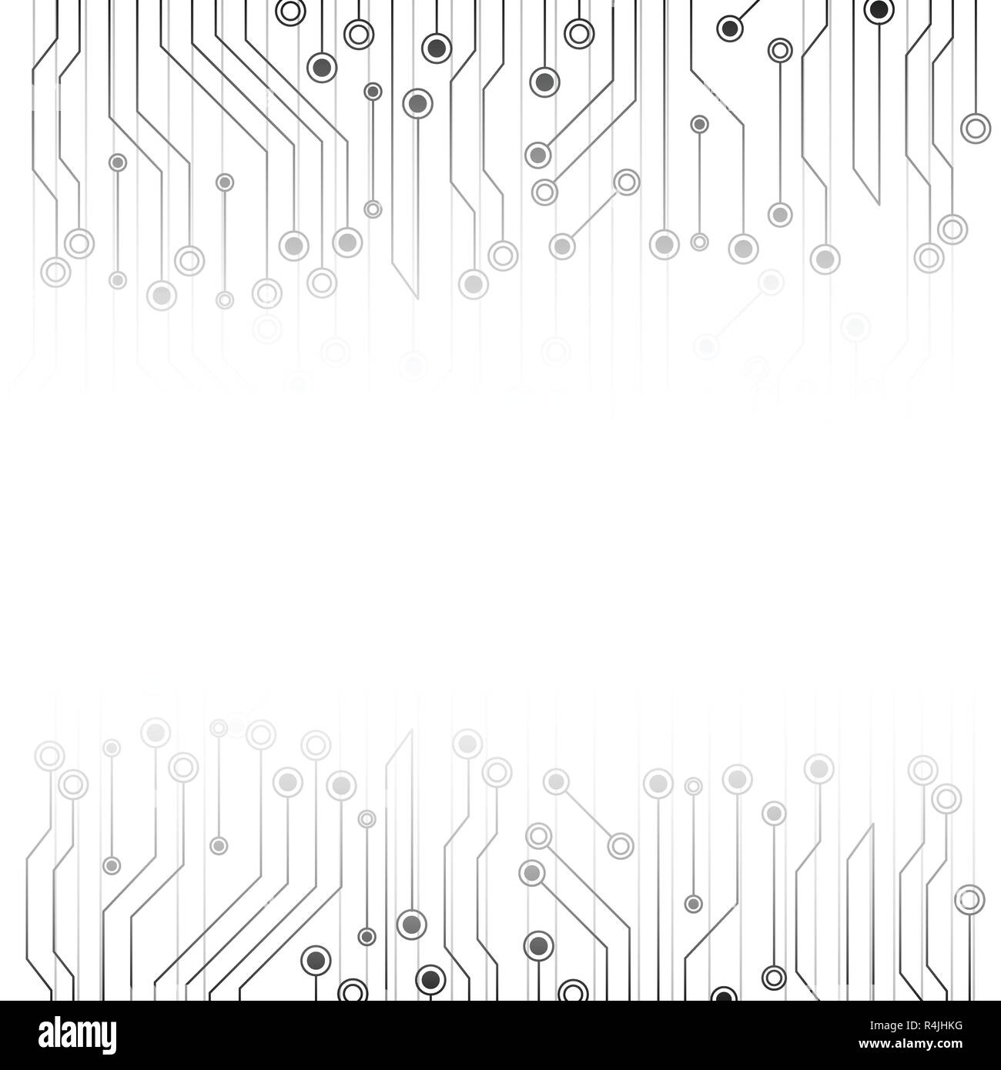
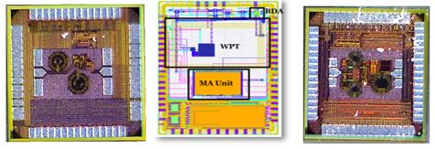

Integrated Circuit Design (ICD) Lab at FAST-NUCES ISL Presents
Seminar Series on recent trends in Integrated Circuit Design regime
KAMAL-1
SSCS-PICO 21’
KAMAL-2
Tentative Schedule
TOPIC | Presenter | Date
Fault Tolerant Circuit Design | Dr. Nasir Mohyudin | March 7, 2022
IC Design Packaging, an Important Arena | Dr. Sajjid Baloch | March 14, 2022
IC Design, The future prospect for young engineers | Dr. Khurram Muhammad | March 21, 2022
RISC-V Architecture State of Art and Future Prospects | Dr. Muhammad Yasir Qadri | March 18, 2022
How to Prepare Yourself for a Career as Design Verification Engineer | Dr. Bilal Zafar | April 6, 2022
Design Techniques for Precision Amplifiers | Dr. Moaaz Ahmed | April 13, 2022
Basics of LNA Design | Dr. Rashad Ramzan | April 18, 2022
mm-Wave CMOS Design, Layout Consideration and Measurements | Dr. Azhar Shaheen | April 20, 2022
Hardware based Random Number Generator | Dr. Rashad Ramzan | May 02, 2022
Triboelectric Energy Harvesters | Dr. Hassan Saif | May 12, 2022
Printed Electronics | Dr. Shaukat Ali | June 13, 2022
Field Programmable Gate Arrays: Architectures, Applications and Trends | Dr. Anees Ullah | June 14, 2022
High Frequency Measurements Demonstration | Mr. Ahmed Shafqat | June 20, 2022
Open Source IC Design Tools and More | Engr. Shahid ,Usman and Hamza | June 24, 2022
Google Meet link will be shared before each session
www.isb.nu.edu.pk/rfcs2

