Slide 1




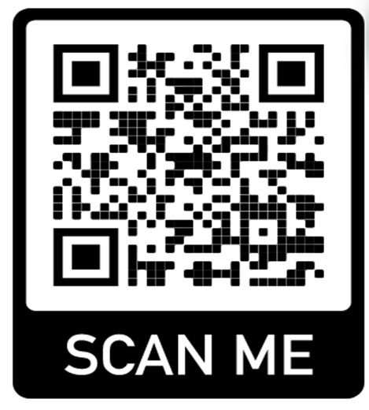

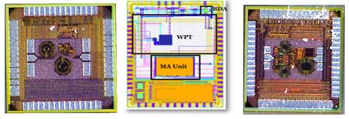

NATIONAL UNIVERSITY
of Computer & Emerging Sciences
Islamabad Campus
ADMISSIONS OPEN Fall 2022
MS Electrical Engineering with Specialization
in Integrated Circuits (IC) & Systems
FULL Tuition Fee sponsored by GSME, a Si Valley Company.(https://gsme.com)
GSME intent to hire all graduates after completion of first two semester of course work.
First and most established MS IC design program in Pakistan with international recognition
For More Details
Please visit or scan
http://isb.nu.edu.pk/rfcs2/MS.htm
Sponsor:
Application Deadline:1st JULY 2022
ICD Lab TSMC 65nm & PICO 130nm Tapeouts Sept,2021

