Slide 1




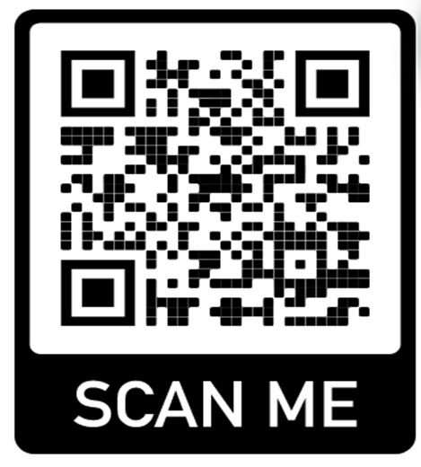

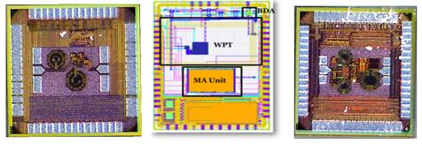

NATIONAL UNIVERSITY
of Computer & Emerging Sciences
Islamabad Campus
ADMISSIONS OPEN Fall 2022
MS Electrical Engineering with Specialization
in Integrated Circuits (IC) & Systems
FULL Tuition Fee Waiver & 25,000 per month stipend and hostel allowance.
For More Details
Please visit or scan
http://isb.nu.edu.pk/rfcs2/MS.htm
Funded By: GS Microelectronics (GSME), a Silicon Valley Company. (https://gsme.com)
GSME intent to hire all graduates after completion of first two semester of course work.
Sponsor:
Extended Application Deadline: 24th July 2022
ICD Lab TSMC 65nm & PICO 130nm Tapeouts Sept,2021

