Slide 1



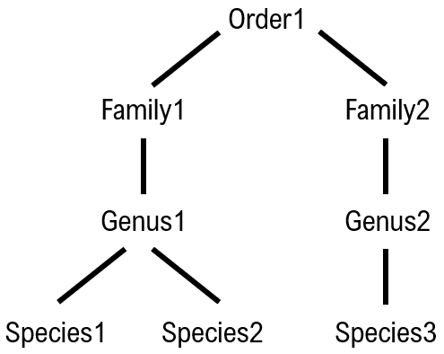

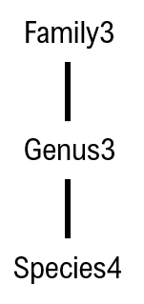

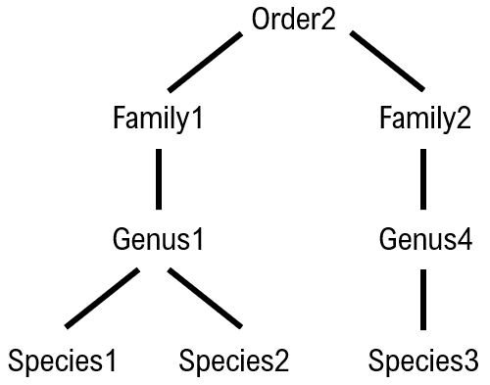
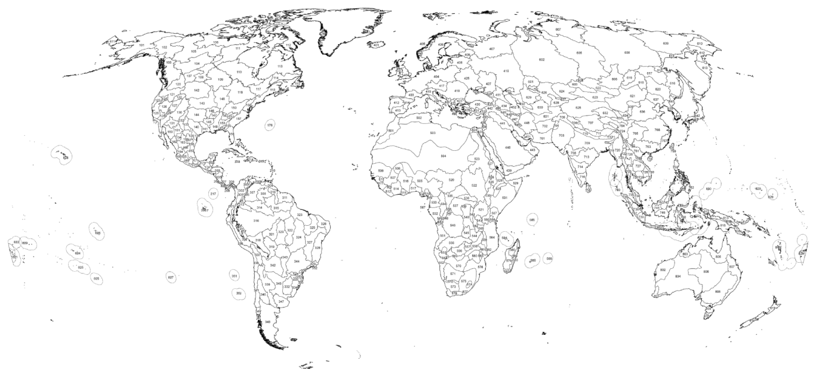

a. Component 1: Equation/trait database
b. Component 2: High-level taxonomic graphs
ID | Taxon | Life-stage | Equation/trait
1 | Genus1 | Adult | M = a + b(L)
2 | Family2 | Nymph | M = c + d(L)
… | … | … | …
n | Genus3 | Larva | M = e + f(L)
c. Component 3: Freshwater ecoregion database
ID - 1
ID - 2
ID - n
Abell et al. (2008)

Slide 2
TD - | Taxonomic distance
BS - | Body size range match
LS - | Life-stage match
R² - | Geographic/habitat match
GH - | Coefficient of determination
Database full
Exclude
TD > max
TD < max
Output (workflow1)
workflow2
workflow1
BS = FALSE
BS = TRUE
LS = FALSE
LS = TRUE
TD > min[TD]
TD = min[TD]
r² + GH < max[r² + GH]
r² + GH = max[r² + GH]
Output (workflow2)

