Slide 1
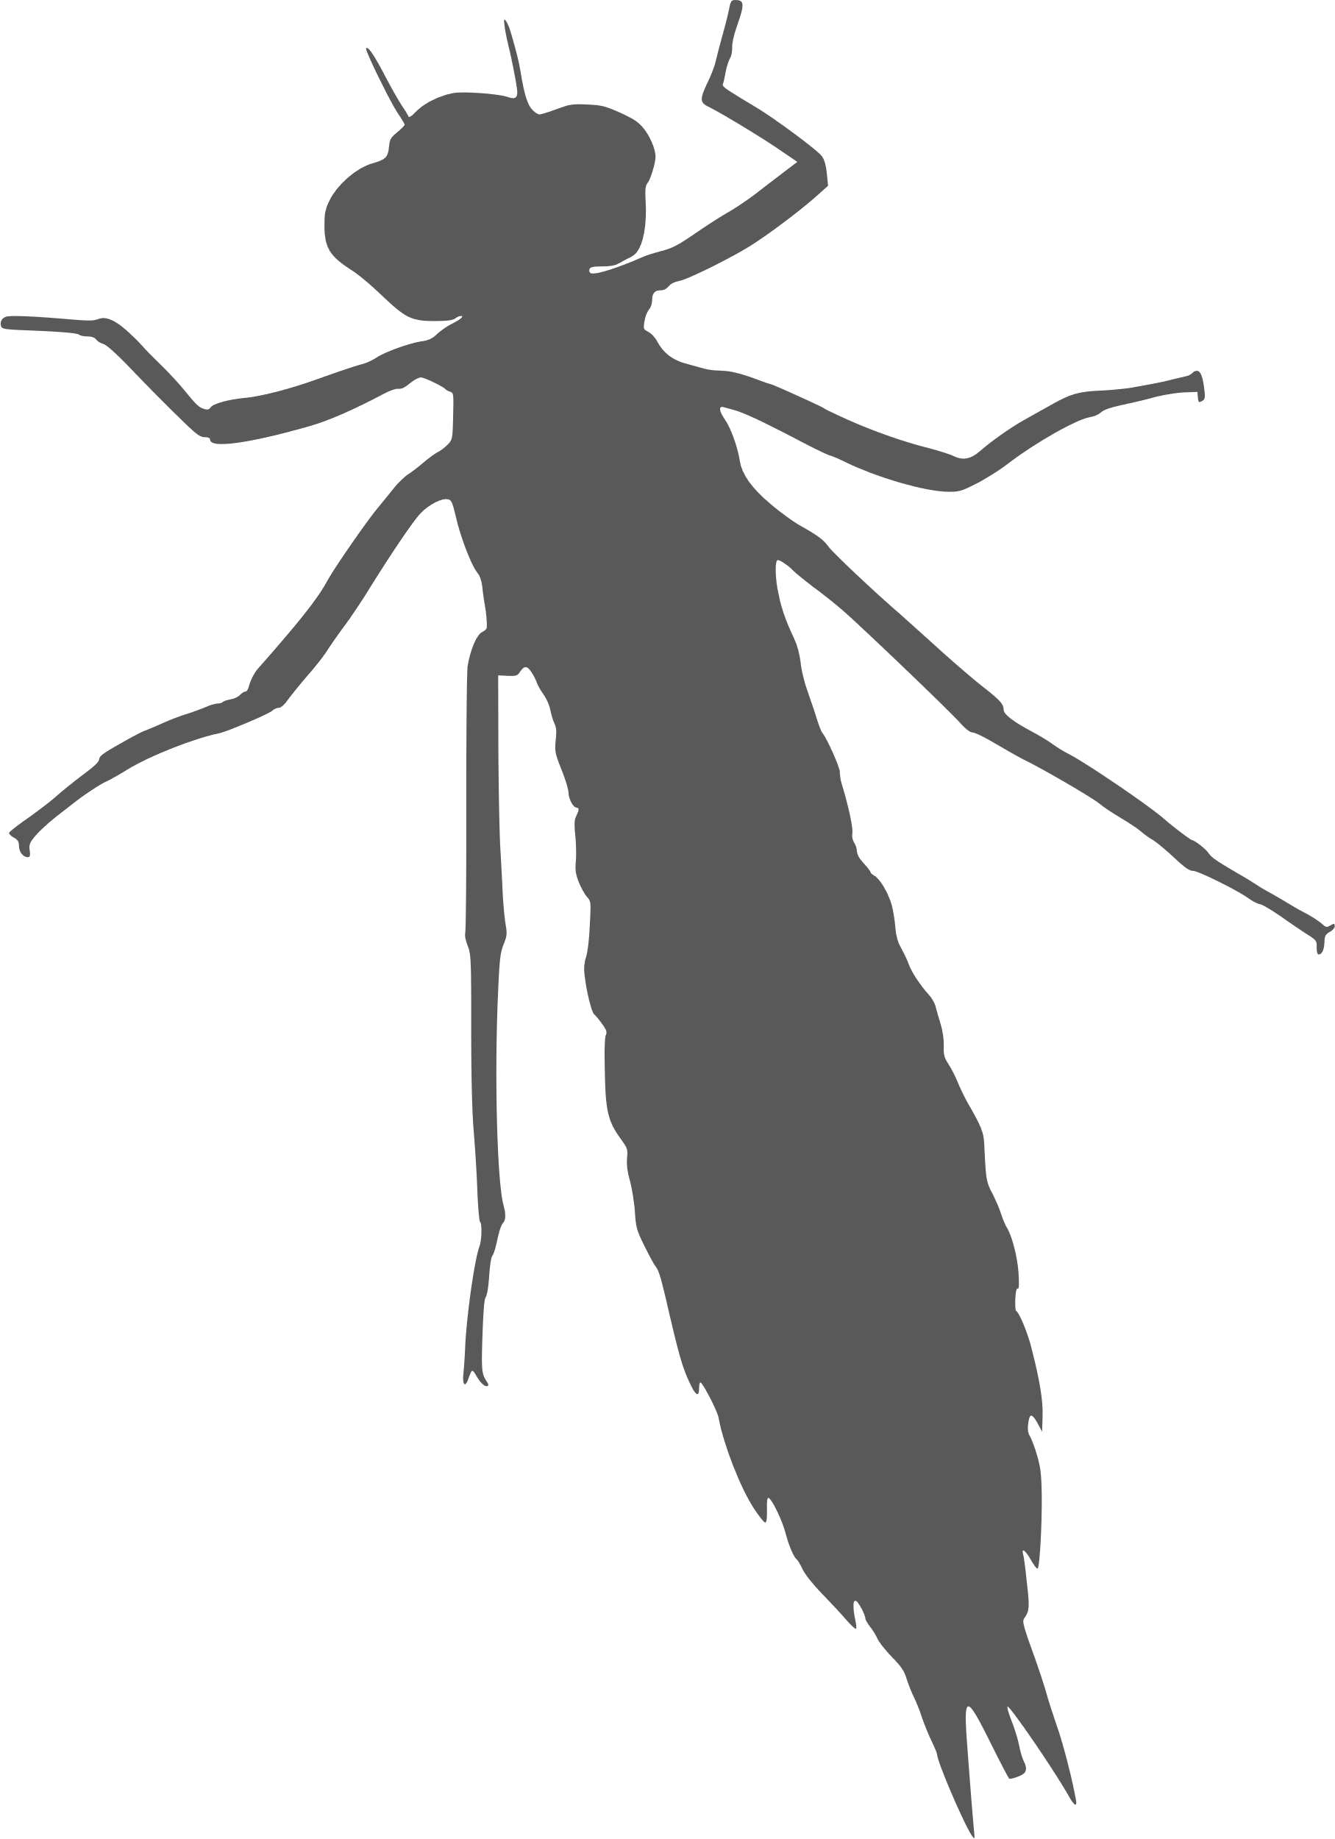
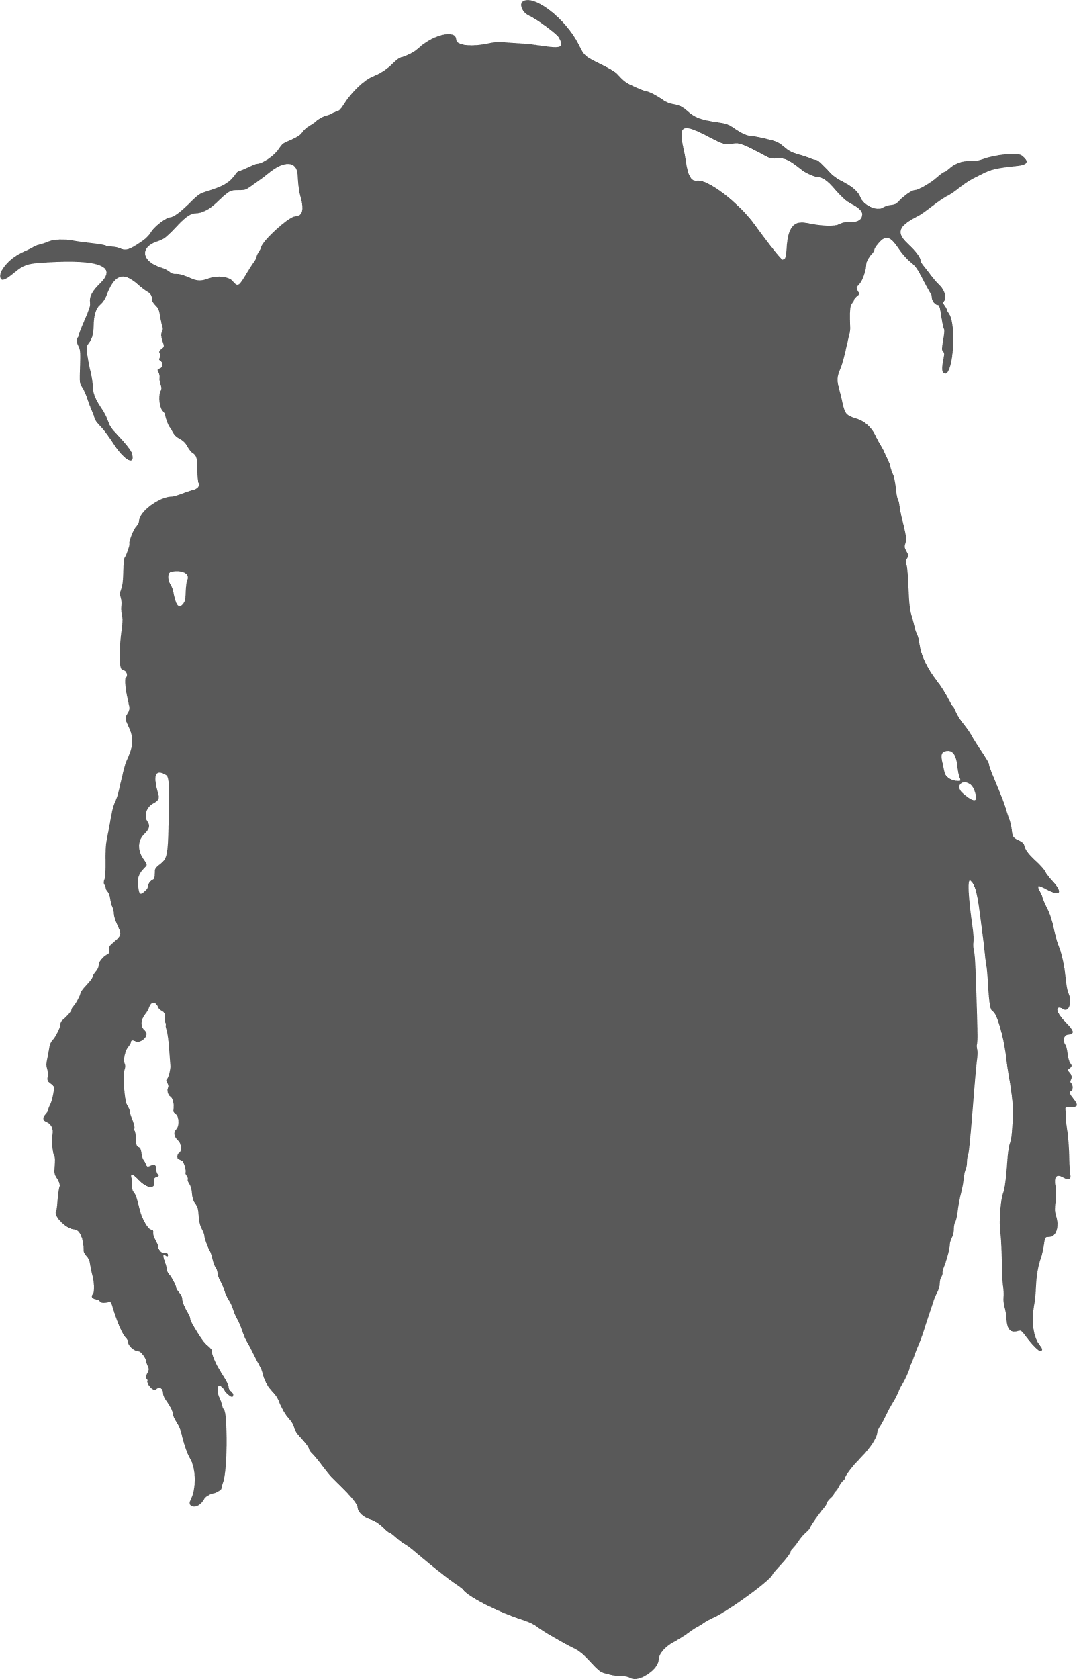
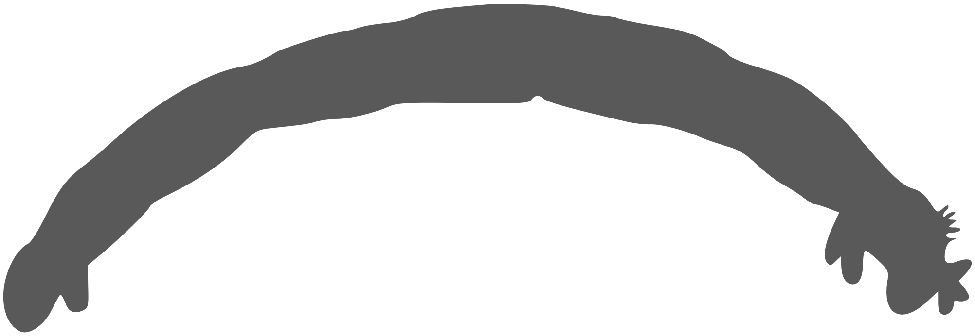
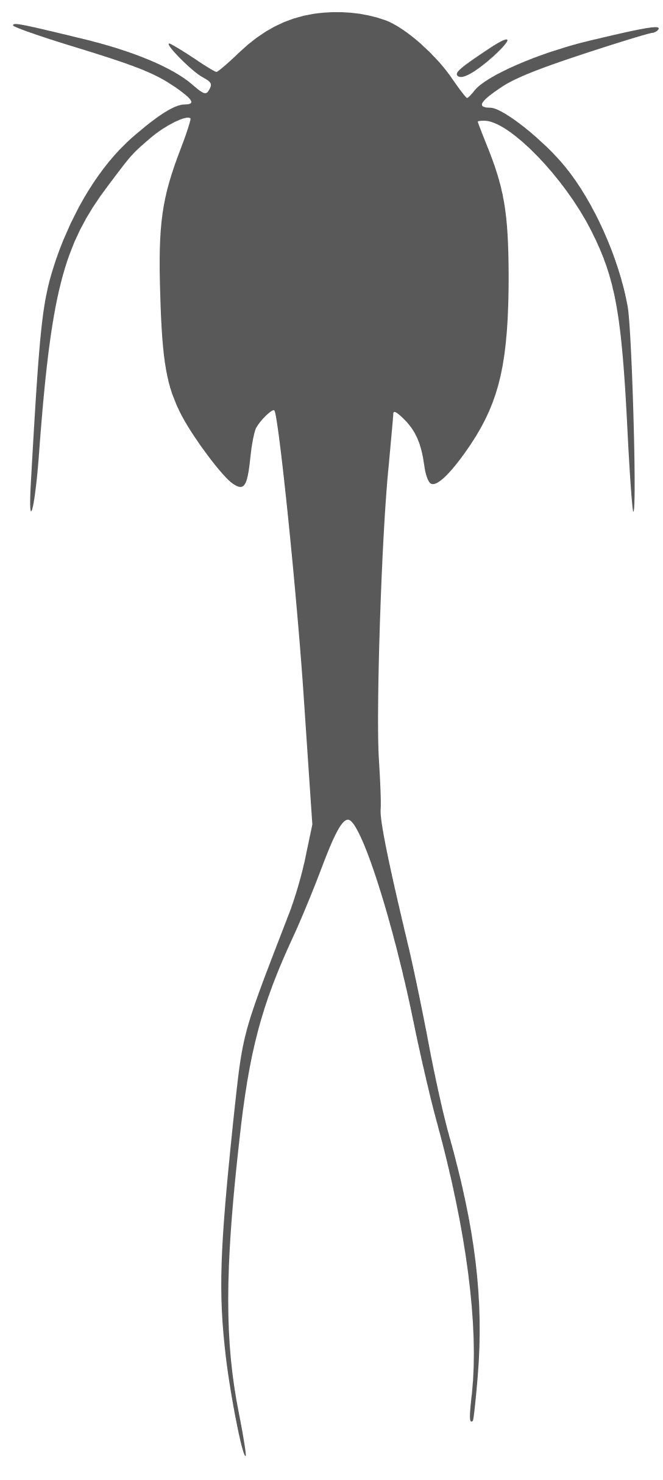
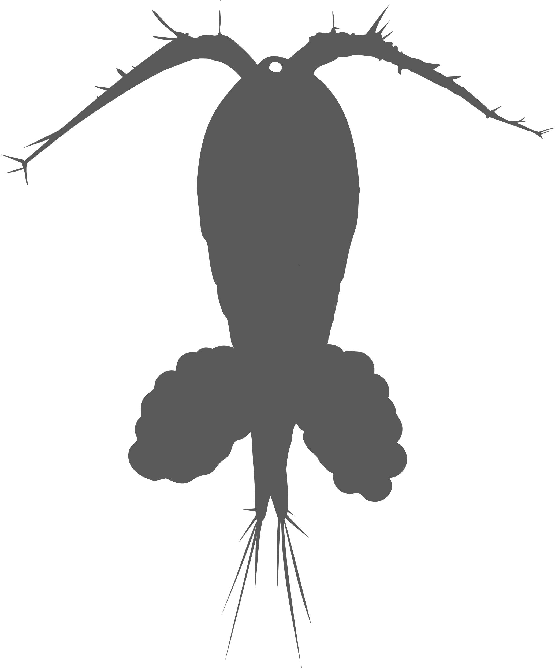
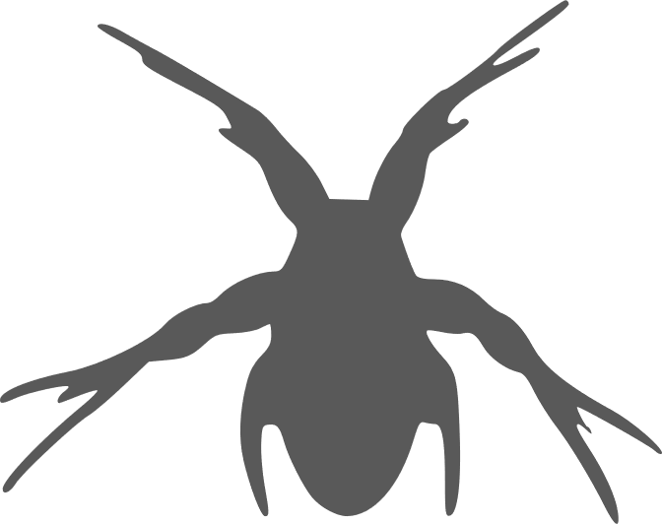
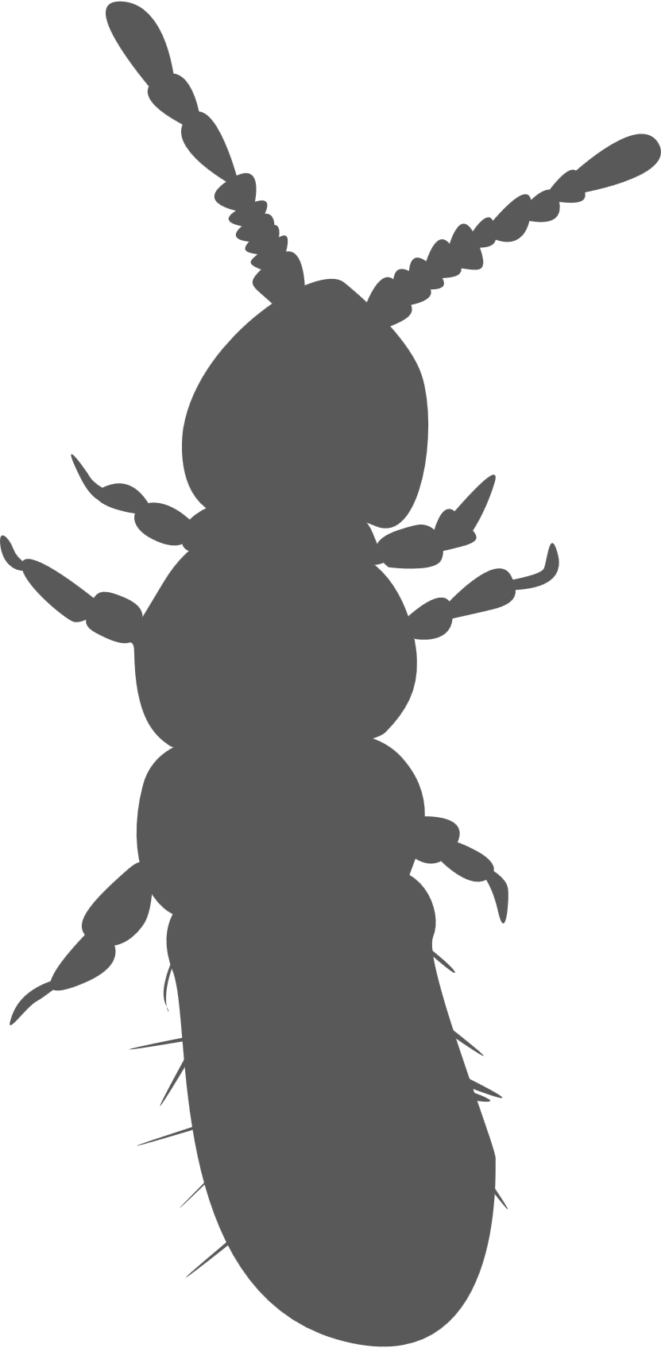
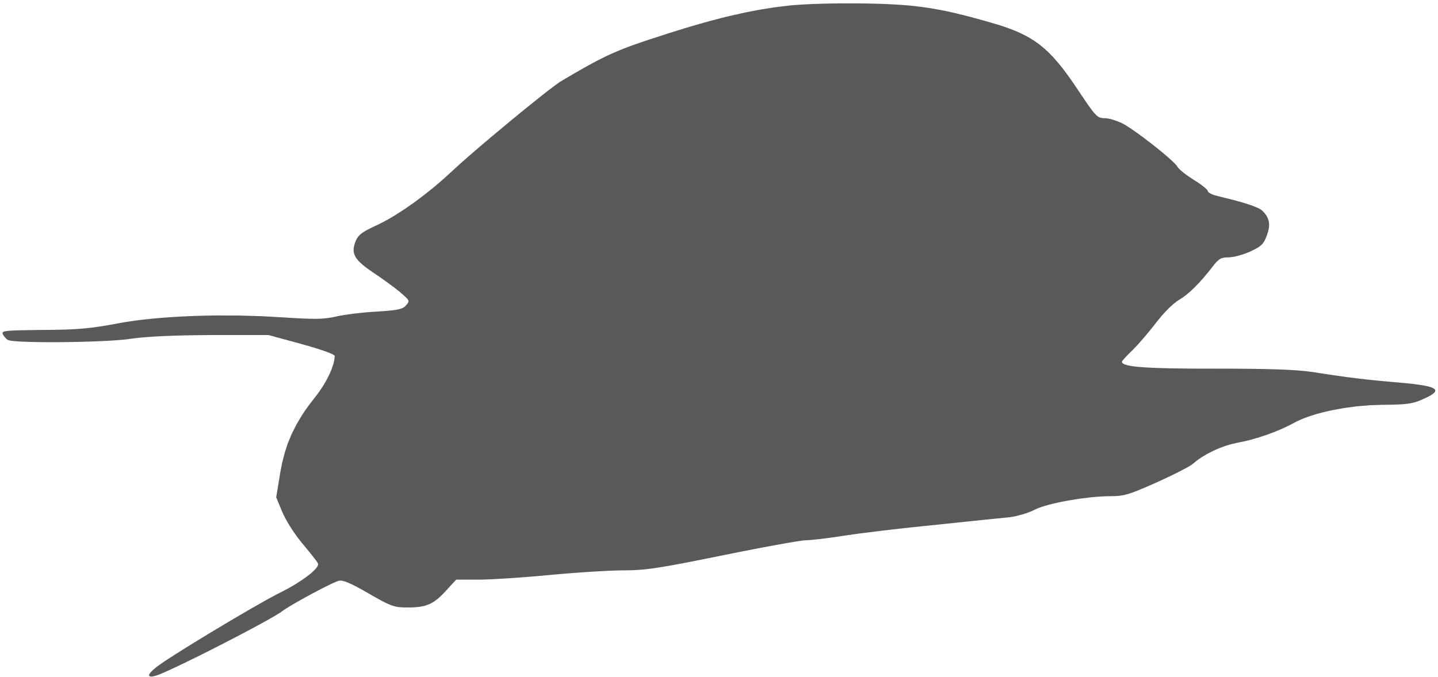

a
b
c
Insecta:
Hemimetabolous:
Odonata
Aeshnidae sp.
Life-stage: nymph
Insecta:
Holometabolous:
Coleoptera:
Dysticus sp.
Life-stage: adult
Insecta:
Holometabolous:
Diptera
Chironomidae sp.
Life-stage: larva
d
e
Crustacea
Branchiopoda:
Notostraca:
Tripos sp.
Life-stage: adult
Crustacea
Copepoda
Cyclopoida sp.
Life-stage:
adult
copepodite
nauplius
f
g
h
Collembola
Folsomia sp.
Life-stage: adult
Mollusca:
Gastropoda:
Physella sp.
Life-stage: none
Mollusca:
Bivalvia:
Theliderma sp.
Life-stage: none

