Slide 1
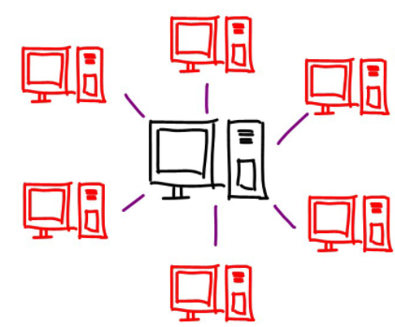
City A
gRPC
REST
gRPC
City B
DB
client
City C
ZooKeeper
Leader election
Fd
membership service
Atomic broadcast

Slide 2
City A
Redirection service
City B
REST
gRPC
client
City C
ZooKeeper
Leader election
Fd
membership service
Atomic broadcast

Slide 3
Rides
First name
Last name
Phone number
Starting position
Ending position
Departure date (DD/MM/YYYY)
Vacancies
Permitted deviation (PD) Requested

Slide 4
Requested
Id
Starting position
Ending position
Date
Option<published>

Slide 5
toDo
REST
gRPC
PostRide (lb->cityS)
PostPathPlanning (lb->cityS) gets stream CostumerRequest (lb path->single request)
GetRideForRout (cityS->cityB) get rout, returns Ride
OccupyRide (cityS->cityB) get ride, return result
cityServer
Consensus – when fulfilling a request (update a Ride vacancies, pd)
Ask for rides from other cities
Locks
Load balancer
RR to replications for dest shard
Failure detection
Replications
Membership service
Atomic broadcast?
Testing

Slide 6
gRPC
Scheme.proto
The service with decl of funcs
All stractures:
Ride
First name
Last name
Phone number
Starting position
Ending position
Departure date (DD/MM/YYYY)
Vacancies
Permitted deviation (PD) Requested
CustomerRequest
Id
Starting position
Ending position
Date
Option<published>

Slide 7
gRPC
Funcs impl:
lbServer
PostRide (lb->cityS)
PostCustomerRequest (lb->cityS)
cityServer
CustomerRequestResult (cityS->lb)
GetExistingRides (cityS->DB)
UpdateRide (cityS->DB)
InsertRide (cityS->DB)

