Slide 1
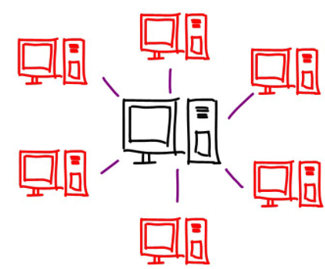
City A
gRPC
REST
gRPC
City B
DB
client
City C
ZooKeeper
Leader election
Fd
membership service
Atomic broadcast

Slide 2

Shard A
Load balancer
Shard B
REST
gRPC
client
Shard C

Slide 3
Rides
First name
Last name
Phone number
Starting position
Ending position
Departure date (DD/MM/YYYY)
Vacancies
Permitted deviation (PD) Requested

Slide 4
Requested
Id
Starting position
Ending position
Date
Option<published>

Slide 5
toDo
REST
gRPC
PostRide (lb->cityS)
PostCustomerRequest (lb->cityS)
CustomerRequestResult (cityS->lb)
GetExistingRides (cityS->DB)
UpdateRide (cityS->DB)
InsertRide (cityS->DB)
lbServer
Main thread
replications
Consensus?
Failure detection
Membership service
Atomic broadcast?

Slide 6
gRPC
Scheme.proto
The service with decl of funcs
All stractures:
Ride
First name
Last name
Phone number
Starting position
Ending position
Departure date (DD/MM/YYYY)
Vacancies
Permitted deviation (PD) Requested
CustomerRequest
Id
Starting position
Ending position
Date
Option<published>

Slide 7
gRPC
Funcs impl:
lbServer
PostRide (lb->cityS)
PostCustomerRequest (lb->cityS)
cityServer
CustomerRequestResult (cityS->lb)
GetExistingRides (cityS->DB)
UpdateRide (cityS->DB)
InsertRide (cityS->DB)

Slide 8
/
Broadcast/
LiveNodes/
electionNode/
shardA/
shardB/
shardA/
shardB/
shardA/
shardB/
Customer
Requests
rides
Customer
Requests
rides
Name: “Shai”
Path: [“a1”, “b2”]
Date: “1/19/21”
Rides: []
aNode-0001
aNode-0002
bNode-0001
bNode-0002
aNode-0001
aNode-0002
bNode-0001
bNode-0002

