Slide 1
Git Intro
Information mostly from Pro Git

Slide 2
Prepare
Start Eclipse, we have a 5-minute exercise later

Slide 3
Sample Disorganized Project
“Hey, Jane, could you send me a copy of those changes you made last Tuesday?”
“Bob, this function doesn’t work anymore. Did you change something?”
“Sorry, I can’t seem to find those old classes. I guess you’ll just have to re-implement them.”
“OK, we’ve all been working hard for the last week. Now let’s integrate everyone’s work together.”

Slide 4
What is version control?
Basic functionality:
  keep track of changes made to files (allows roll-backs)
  merge the contributions of multiple developers
Benefits:
  facilitates backups
  increased productivity (vs manual version control)
  encourages experimentation
  helps to identify/fix conflicts
  makes source readily available – less duplicated effort

Slide 5
Additional benefits
Accountability
  who wrote the code?
  do we have the rights to it?
Support software engineering
  hooks for peer reviews
Software branches
  different versions of software need to be maintained, ensure bug fixes shared
Record Keeping
  Commit logs may tie to issue tracking system or be used to enforce guidelines

Slide 6
More Benefits
Support Distribution of Work
  Telecommuting, outsourcing, open-source projects
  Use in conjunction with “good communication habits” – via email etc.
Rapid Development (XP/Agile)
  Supports frequent refactoring
  Helps automate frequent system builds

Slide 7
More Benefits
Employers use version control – and many (maybe most?) use git
Git is professional grade – learn it now!

Slide 8
Command line basics
Work without a GUI

Slide 9

Simple command line
Open Git Bash terminal
Where am I??
  pwd – print working directory
How do I move around??
  cd – change directory
  cd c:/csm_classes – change to a specific path
  cd .. – change to parent directory.
What files are there?
  ls – list
  ls - l – list with details

Slide 10
More command line
Use up/down arrow to select/repeat commands
Click on icon in top left corner to change properties of the command window OR edit (e.g., copy, paste)
May be able to use tab completion

Slide 11
Git Basics
Summarizing the demo

Slide 12
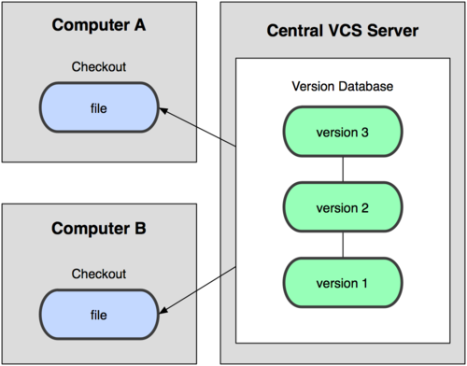
Centralized Version Control
Subversion is like this

Slide 13
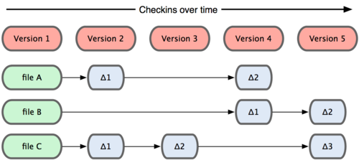
Centralized - Differences

Slide 14
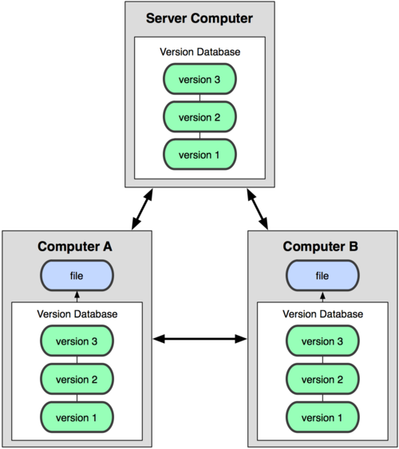
Distributed Version Control

Slide 15
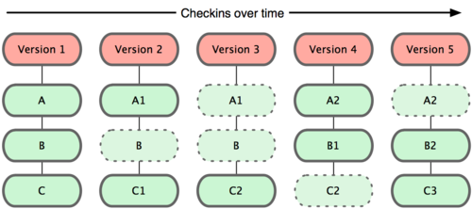
Distributed - Snapshots
Files are stored by SHA-1 hash rather than filename
Stored in git database in compressed format
Database is stored on your local machine
Must “checkout” from database into working directory to edit
In this example, files A, B and C are tracked

Slide 16
Tell Git who you are
Update your config, one time only
  git config --global user.name “Cyndi Rader”
  git config --global user.email crader@mines.edu
  git config --global core.editor notepad++
  git config --list (or git config –l)

Slide 17
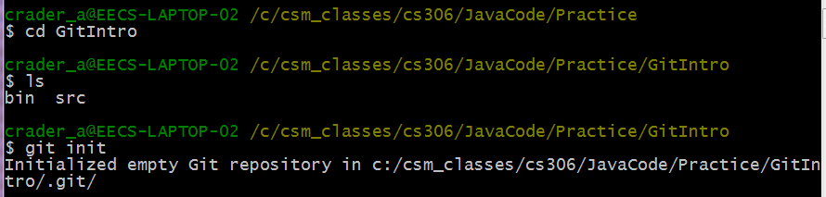
Getting started
Create a Java Project (mine is GitIntro)
cd into project directory
git init
Create a class (mine is HelloGit)

Slide 18
.gitignore
It’s important to tell Git what files you do not want to track
Temp files, executable files, etc. do not need version control (and can cause major issues when merging!)
https://help.github.com/articles/ignoring-files
Example (place in root of repo):
  *.class
  .project
  .classpath
  .settings/
repo
ignore
eclipse
exec
What is a hidden file?

Slide 19
More .gitignore
# Directories #
/build/
/bin/
target/
# OS Files #
.DS_Store
*.class
# Package Files #
*.jar
*.war
*.ear
*.db
# Windows image file caches
Thumbs.db
# Folder config file
Desktop.ini
# OSX
.DS_Store
.svn
# Eclipse
*.pydevproject
.project
.metadata
bin/**
tmp/**
tmp/**/*
*.tmp
*.bak
*.swp
*~.nib
local.properties
.classpath
.settings/
.loadpath
/src/main/resources/rebel.xml
http://www.bmchild.com/2012/06/git-ignore-for-java-eclipse-project.html

Slide 20

Local Operations
Why might you want to stage files?

Slide 21
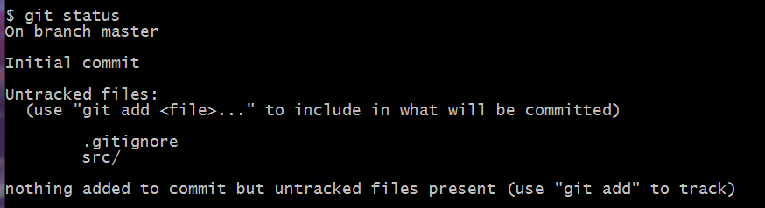
What’s the status?
Nothing tracked yet.
get used to reading helpful messages

Slide 22
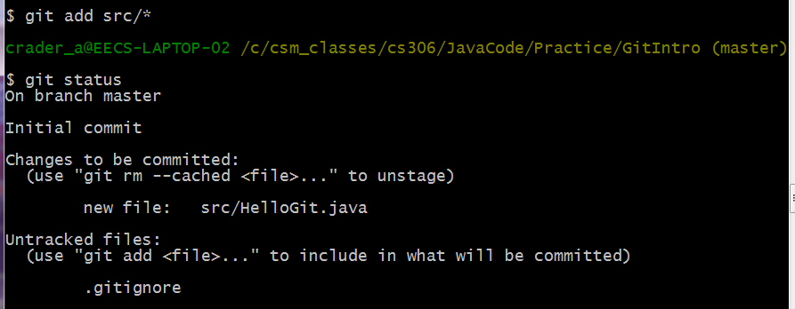
Let’s track a file
git add – tells git to track a file

Slide 23
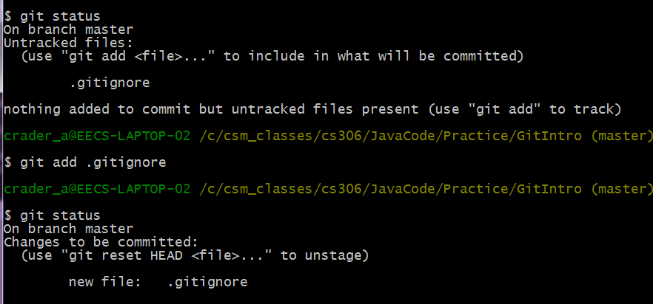
Also good to commit .gitignore
often desirable to have no untracked files

Slide 24
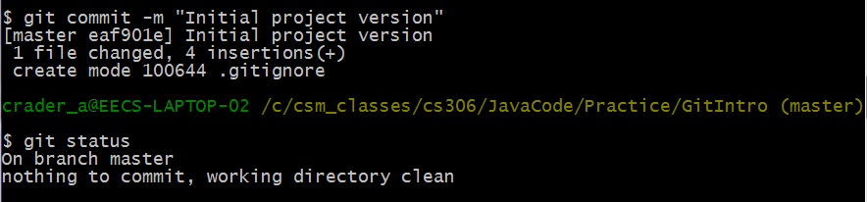
Commit the file to the Git database
When you commit, you must provide a comment (if you forget, Git will open a text editor so you can write one).

Slide 25
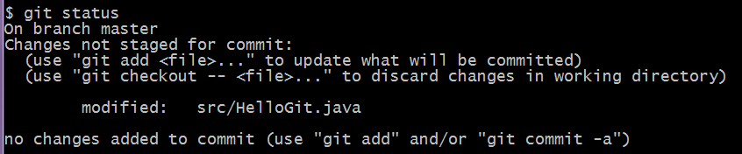

What if you change the file?
Notice more helpful hints Git provides.
You could add to the staging area, OR add & commit in one step.
Be careful if you add to the staging area and then make more changes – the file can appear as both staged and unstaged. For now, I suggest doing –am

Slide 26
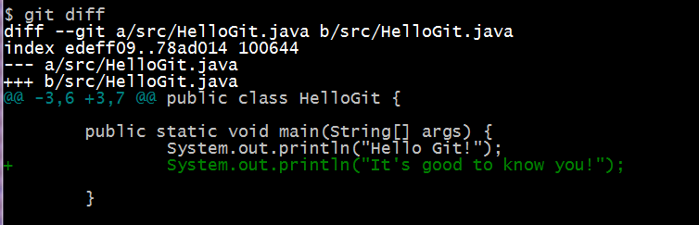
You made some changes – but what did you do?
This command compares your working directory with your staging area.
These are the changes that are not yet staged.

Slide 27
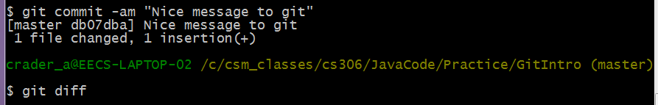
What if you’ve committed all your changes?
diff doesn’t have anything to display

Slide 28
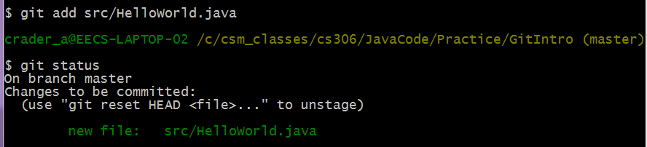
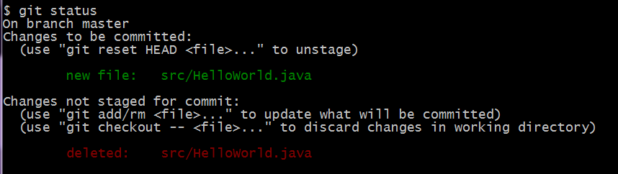
What if I remove a file?
File added not committed
Now I remove HelloWorld.java from inside Eclipse

Slide 29
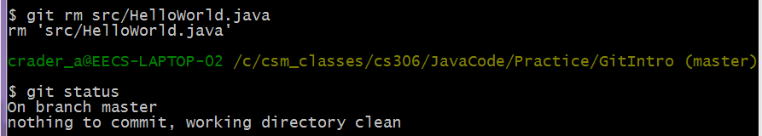
removal, continued
This removes the file from being tracked. If you’ve already committed,
the file is still in the database. -- see github tutorials for info on this.

Slide 30
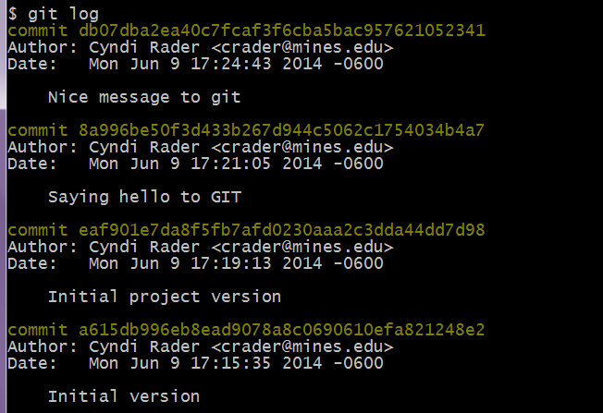
So what all have I done?
There are many useful options for git log.

Slide 31
git log options
Can specify a format, such as:
  git log --pretty=oneline
  MORE options, see documentation
Can filter, such as:
  git log --since=2.weeks
  includes filters like –since, --after, --until, --before, --author etc
Can redirect output to file, such as:
  git log >> gitlog.txt
  .

Slide 32
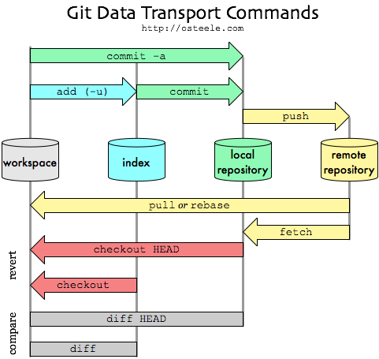
The Big Picture
http://blog.mikepearce.net/2010/05/18/the-difference-between-git-pull-git-fetch-and-git-clone-and-git-rebase/

Slide 33
VERY quick exercise – with a partner
Create a new Java Project
Bring up git Bash
cd to your directory
git init
create a .gitignore
create a new class
add that class (git add src/*)
add .gitignore (git .gitignore)
commit (git commit –m “Initial commit”)

Slide 34
Quick Summary for git bash
cd to your project or source directory
  cd = change directory. Example:
  cd cs306
  cd MyProjects
  cd GitDemo
  OR cd c:\cs306\MyProjects\GitDemo
ls (shows a list of files in that directory)
git init (creates .git repo)
git add src/* (tracks all files in source directory)
git commit -am “Initial commit” (adds files to repo)
git status (see what files have been modified, etc.)
git diff (see what changes you’ve made to files)
git log (see list of commits)

Slide 35
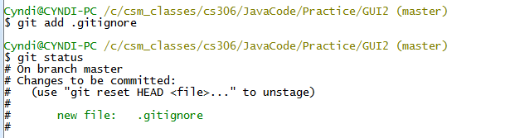
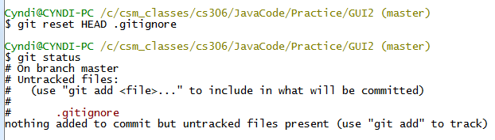
Advanced example 1 (on your own)
Add a file to be tracked, see the status
Decide not to track the file – be careful with this!

Slide 36
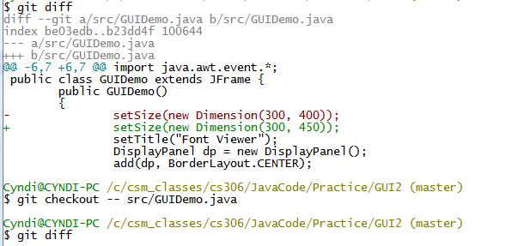
Advanced Example 2
Use diff to see changes – revert to prior version. BE CAREFUL – you’ll lose all your changes. Be sure this is what you want to do.

