Slide 1
TCGA-KIRC
RNA-Seq
TCGA-KIRC
RNA-Seq
352 1ry Tumor
52 Solid Tissue Normal
186 1ry Tumor
20 Solid Tissue Normal
Male
Female
606 DEGS ( 27 upregulated)
247 DEGS ( 12 upregulated)
25 DEMS
29 DEMS
DAVID Enrichment
HMDD 3.2
Cystoscope – STRING Enrichment
Female:mir-144, 346
Male: mir-187, 206
23 KEGG male
X KEGG female
X GO male
X GO female
Network analysis ( TFmiR2.0) Different hotspots between male and female
TAM 2.0 (miRNA Enrichment)

Slide 2
General numbers
Type | Female | Male
Primary Tumor | 186 | 352
Solid Tissue Normal | 20 | 52
Type | Stage I | Stage II | Stage III | Stage IV
Female | 210 | 28 | 86 | 48
Male | 320 | 86 | 160 | 116

Slide 3
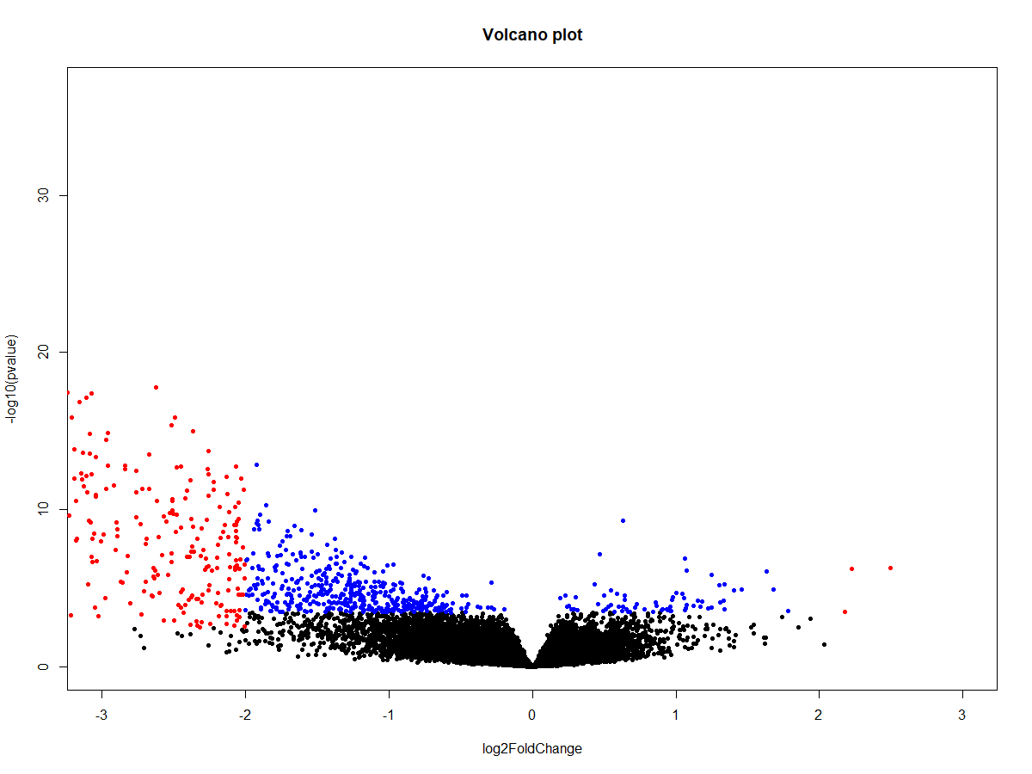
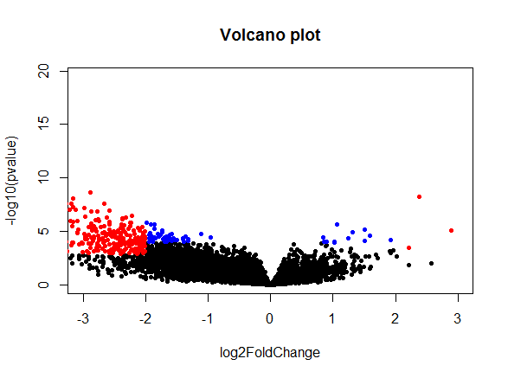
Volcano Plot: Tumor vs Normal (Male)
Volcano Plot: Tumor vs Normal (Female)

Slide 4
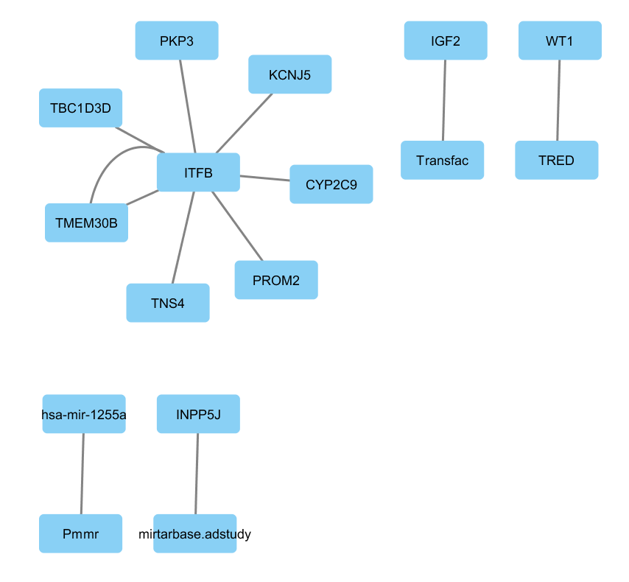
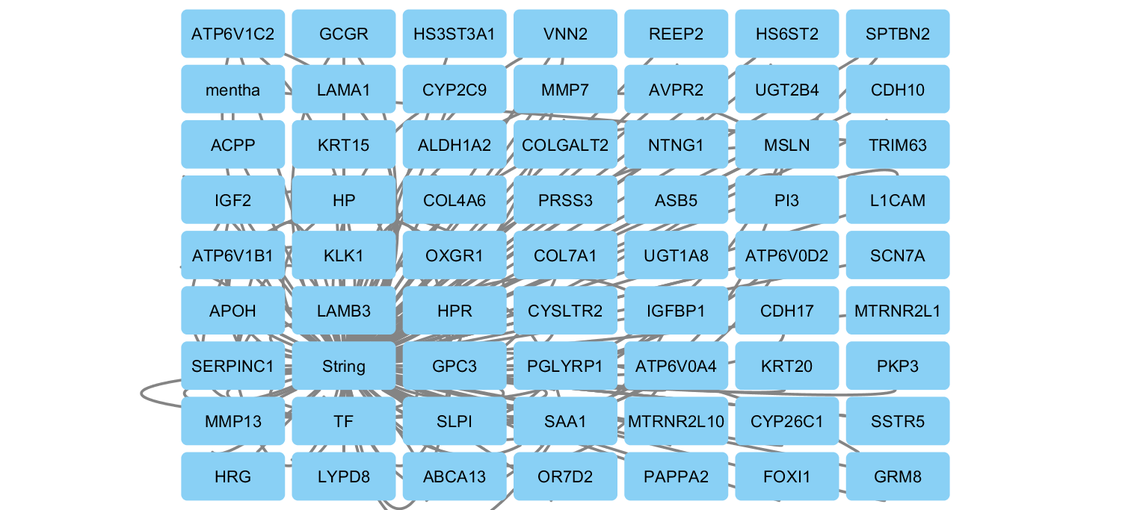
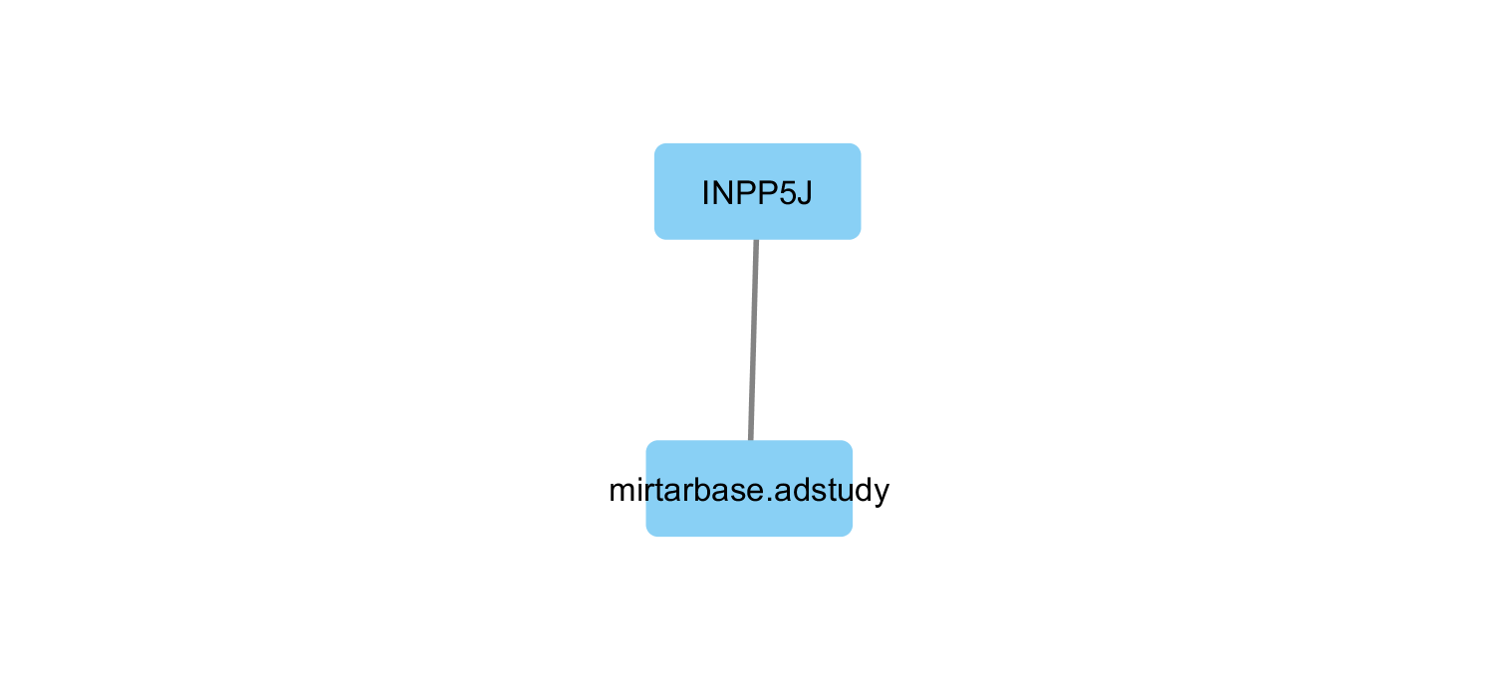
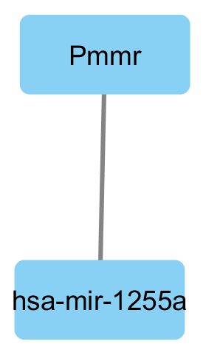
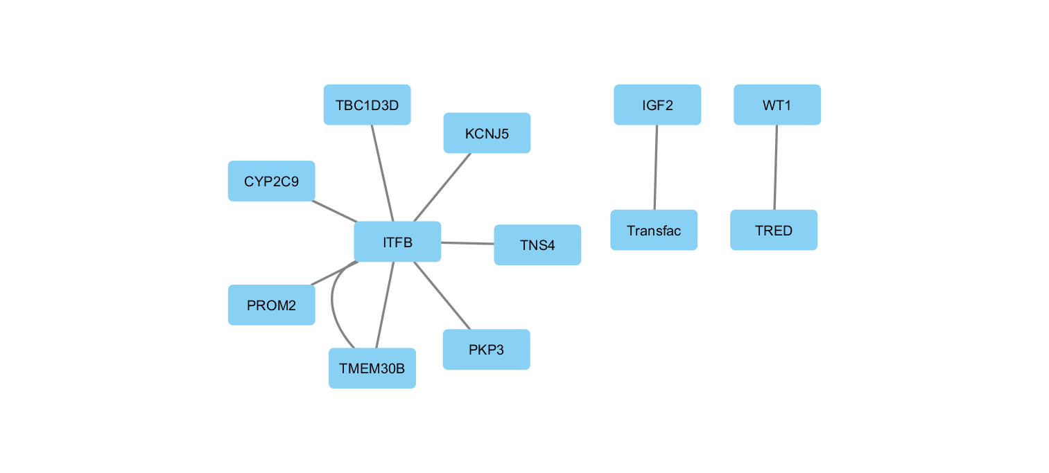
Complete
Gene-Gene
miRNA-Gene
miRNA-miRNA
TF-Gene
FEMALE

Slide 5
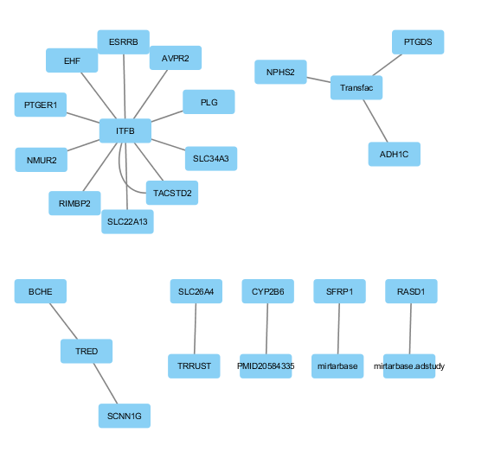
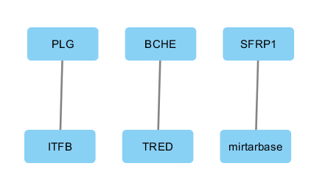
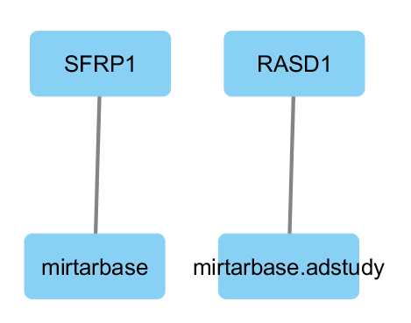
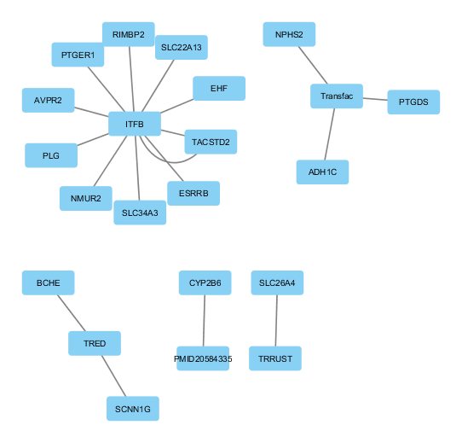
Disease
Complete
miRNA-Gene
MALE
TF-Gene

Slide 6
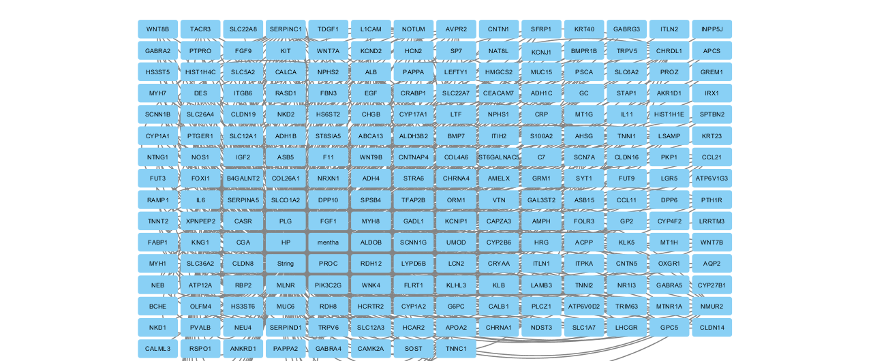
Gene-Gene
MALE

Slide 7
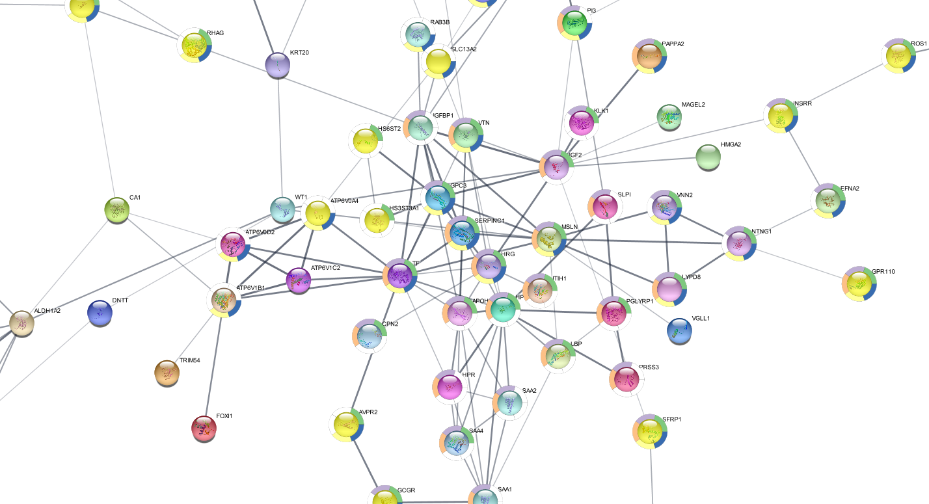
Female Cytoscape STRING Enrichment

Slide 8
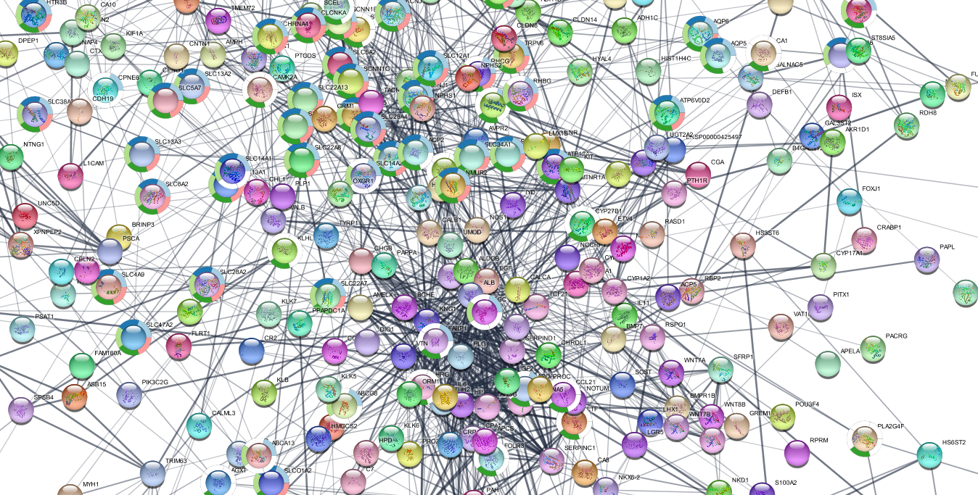
Male Cytoscape STRING Enrichment

Slide 9
ALL
Male
Female
pval.hypergeom.disease.node=
disease.net.coverage.rate.edge=17.4
disease.net.coverage.rate.node=32.31
degree.image.path=/home/chris/TF-site2/tfmir/uploads/tr2a6f5ichpnsiik8cpf92hll6/all/degree.png
graph.nodes.no=229
graph.edges.no=862
graph.density=0.016
graph.diameter=15
graph.avg.path.length=4.698
graph.transitivity=0.61
tissue.hotspots=
degree.hotspots=KNG1, ALB, AHSG, SERPINC1, IL6, APOA2, NOTUM, PROC, SERPIND1, CHRDL1, CHGB, ORM1, ITIH2, EGF, AMELX, NMUR2, CASR, PLG, GRM1, AVPR2, IGF2, HRG, PTGER1
closeness.hotspots=TACSTD2, ESRRB, EHF, ZNF804B, EVX1, KNG1, ALB, EGF, AHSG, APOA2, IL6, CHGB, PLG, ORM1, HRG, IGF2, SERPINC1, NOTUM, CHRDL1, PROC, SERPIND1, ITIH2, AMELX
betweenness.hotspots=EGF, KNG1, AVPR2, ALB, FABP1, AQP2, SLC12A1, APOA2, NOTUM, CYP1A1, WNK4, PLG, GRM1, SYT1, AHSG, ORM1, KIT, GPC5, KLHL3, IL6, CAMK2A, NR1I3, FGF1
eigenvector.hotspots=KNG1, ALB, AHSG, SERPINC1, IL6, APOA2, PROC, SERPIND1, NOTUM, CHRDL1, CHGB, AMELX, ITIH2, EGF, HRG, PLG, ORM1, IGF2, F11, NMUR2, CASR, HP, GC
common.hotspots=KNG1, ALB, AHSG, IL6, APOA2, NOTUM, ORM1, EGF, PLG
union.hotspots=KNG1, ALB, AHSG, SERPINC1, IL6, APOA2, NOTUM, PROC, SERPIND1, CHRDL1, CHGB, ORM1, ITIH2, EGF, AMELX, NMUR2, CASR, PLG, GRM1, AVPR2, IGF2, HRG, PTGER1, TACSTD2, ESRRB, EHF, ZNF804B, EVX1 (up), FABP1, AQP2, SLC12A1, CYP1A1, WNK4, SYT1, KIT, GPC5, KLHL3, CAMK2A, NR1I3, FGF1, F11, HP, GC
MDS.hotspots=TACSTD2, NR1I3, RASD1, hsa-mir-206, ZNF804B, ETV4, AVPR2, SLC26A4, NPHS2, PTGDS
MCDS.hotspots=TACSTD2
Biological.Significance.gene.hotspots=4070, 9970, 51655, 219578, 2118, 554, 5172, 7827, 5730, 3827, 213, 197, 462, 3569, 336, 80350, 147111, 5624, 3053, 91851, 1114, 5004, 3698, 1950, 265, 56923, 846, 5340, 2911, 3481, 3084, 3273, 5731, 2103, 26298, 2128, 2168, 359, 6557, 1543, 65266, 6857, 3815, 2262, 26249, 815, 2246, 2160, 90338, 3240, 3250, 10395, 2638
pval.hypergeom.disease.node=
disease.net.coverage.rate.edge=25
disease.net.coverage.rate.node=33.33
degree.image.path=/home/chris/TF-site2/tfmir/uploads/qard7nc2j7rr7otcvhl0pmoop6/all/degree.png
graph.nodes.no=6
graph.edges.no=4
graph.density=0.111
graph.diameter=1
graph.avg.path.length=1
graph.transitivity=NaN
tissue.hotspots=
degree.hotspots=TRIM63
closeness.hotspots=hsa-mir-346
betweenness.hotspots=INPP5J
eigenvector.hotspots=IGF2 (up)
common.hotspots=
union.hotspots=TRIM63, hsa-mir-346, INPP5J, IGF2
MDS.hotspots=IGF2, INPP5J
MCDS.hotspots=IGF2
Biological.Significance.gene.hotspots=3481, 27124, 84676

Slide 10
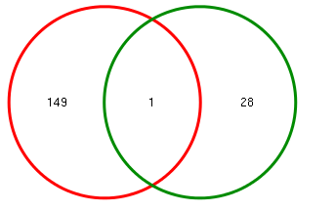
Female: miRNA-miRNA
Male: Disease
pval.hypergeom.disease.node=
disease.net.coverage.rate.edge=100
disease.net.coverage.rate.node=100
degree.image.path=/home/chris/TF-site2/tfmir/uploads/tr2a6f5ichpnsiik8cpf92hll6/disease/degree.png
graph.nodes.no=74
graph.edges.no=150
graph.density=0.027
graph.diameter=5
graph.avg.path.length=2.654
graph.transitivity=0.101
tissue.hotspots=
degree.hotspots=IL6, EGF, PLG, LSAMP, KIT, SFRP1, BMPR1B, ASB15
closeness.hotspots=ZNF804B, EGF, IL6, AHSG, ALB, PLG, KNG1, SERPINC1
betweenness.hotspots=IL6, EGF, KIT, PLG, AHSG, BMPR1B, CRP, ALB
eigenvector.hotspots=EGF, IL6, PLG, ALB, AHSG, KNG1, HRG, IGF2
common.hotspots=IL6, EGF, PLG
union.hotspots=IL6, EGF, PLG, LSAMP, KIT, SFRP1, BMPR1B, ASB15, ZNF804B, AHSG, ALB, KNG1, SERPINC1, CRP, HRG, IGF2
MDS.hotspots=SFRP1, ZNF804B, BCHE
MCDS.hotspots=BCHE
Biological.Significance.gene.hotspots=6422, 219578, 590, 3569, 1950, 5340, 4045, 3815, 658, 142685, 197, 213, 3827, 462, 1401, 1465, 140913, 3084, 3273, 3481
Category.of.Interactions=mirna-mirna
Evidence=Experimental, Predicted
Target.input.set=29
Regulator.input.set=29
ORA.pval.cutoff=0.05
Total.Targets.inDb=216
Total.Regulators.inDb=133
Deregulated.targets.by.inputRegulator=150
Deregulated.targets.of.inputRegulator.and.in.input.targetlist.overlap=1
no.of.resultant.interactions=1
no.of.interactions.associated.with.input.disease=0
venn.pval.hypergeom=0.911988265861695
venn.pval.simulation=0.9123
Venn.image.path=/home/chris/TF-site2/tfmir/uploads/tr2a6f5ichpnsiik8cpf92hll6/mirna-mirna/venn.png

Slide 11
degree.hotspots=KNG1, ALB, AHSG, SERPINC1, IL6, APOA2, NOTUM, PROC, SERPIND1, CHRDL1, CHGB, ORM1, ITIH2, EGF, AMELX, NMUR2, CASR, PLG, GRM1, AVPR2, IGF2, HRG, PTGER1
closeness.hotspots=TACSTD2, ESRRB, EHF, ZNF804B, EVX1, KNG1, ALB, EGF, AHSG, APOA2, IL6, CHGB, PLG, ORM1, HRG, IGF2, SERPINC1, NOTUM, CHRDL1, PROC, SERPIND1, ITIH2, AMELX
betweenness.hotspots=EGF, KNG1, AVPR2, ALB, FABP1, AQP2, SLC12A1, APOA2, NOTUM, CYP1A1, WNK4, PLG, GRM1, SYT1, AHSG, ORM1, KIT, GPC5, KLHL3, IL6, CAMK2A, NR1I3, FGF1
eigenvector.hotspots=KNG1, ALB, AHSG, SERPINC1, IL6, APOA2, PROC, SERPIND1, NOTUM, CHRDL1, CHGB, AMELX, ITIH2, EGF, HRG, PLG, ORM1, IGF2, F11, NMUR2, CASR, HP, GC
common.hotspots=KNG1, ALB, AHSG, IL6, APOA2, NOTUM, ORM1, EGF, PLG
union.hotspots=KNG1, ALB, AHSG, SERPINC1, IL6, APOA2, NOTUM, PROC, SERPIND1, CHRDL1, CHGB, ORM1, ITIH2, EGF, AMELX, NMUR2, CASR, PLG, GRM1, AVPR2, IGF2, HRG, PTGER1, TACSTD2, ESRRB, EHF, ZNF804B, EVX1, FABP1, AQP2, SLC12A1, CYP1A1, WNK4, SYT1, KIT, GPC5, KLHL3, CAMK2A, NR1I3, FGF1, F11, HP, GC
MDS.hotspots=TACSTD2, NR1I3, RASD1, hsa-mir-206, ZNF804B, ETV4, AVPR2, SLC26A4, NPHS2, PTGDS
MCDS.hotspots=TACSTD2

Slide 12
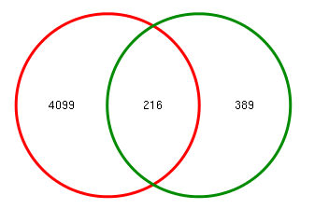
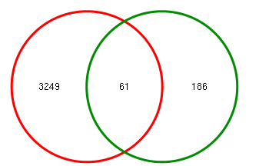
gene-gene
female
Male
Category.of.Interactions=gene-gene
Evidence=Experimental, Predicted
Target.input.set=605
Regulator.input.set=605
ORA.pval.cutoff=0.05
Total.Targets.inDb=14645
Total.Regulators.inDb=14678
Deregulated.targets.by.inputRegulator=4315
Deregulated.targets.of.inputRegulator.and.in.input.targetlist.overlap=0
no.of.resultant.interactions=842
no.of.interactions.associated.with.input.disease=147
venn.pval.hypergeom=1
venn.pval.simulation=1
Venn.image.path=/home/chris/TF-site2/tfmir/uploads/tr2a6f5ichpnsiik8cpf92hll6/gene-gene/venn.png
Category.of.Interactions=gene-gene
Evidence=Experimental, Predicted
Target.input.set=247
Regulator.input.set=247
ORA.pval.cutoff=0.05
Total.Targets.inDb=14645
Total.Regulators.inDb=14678
Deregulated.targets.by.inputRegulator=3310
Deregulated.targets.of.inputRegulator.and.in.input.targetlist.overlap=0
no.of.resultant.interactions=154
no.of.interactions.associated.with.input.disease=26
venn.pval.hypergeom=1
venn.pval.simulation=1
Venn.image.path=/home/chris/TF-site2/tfmir/uploads/qard7nc2j7rr7otcvhl0pmoop6/gene-gene/venn.png

Slide 13
miRNA-gene
Male
female
Category.of.Interactions=mirna-gene
Evidence=Experimental, Predicted
Target.input.set=605
Regulator.input.set=25
ORA.pval.cutoff=0.05
Total.Targets.inDb=4129
Total.Regulators.inDb=1035
Deregulated.targets.by.inputRegulator=144
Deregulated.targets.of.inputRegulator.and.in.input.targetlist.overlap=0
no.of.resultant.interactions=2
no.of.interactions.associated.with.input.disease=1
venn.pval.hypergeom=1
venn.pval.simulation=1
Venn.image.path=/home/chris/TF-site2/tfmir/uploads/tr2a6f5ichpnsiik8cpf92hll6/mirna-gene/venn.png
Category.of.Interactions=mirna-gene
Evidence=Experimental, Predicted
Target.input.set=247
Regulator.input.set=29
ORA.pval.cutoff=0.05
Total.Targets.inDb=4129
Total.Regulators.inDb=1035
Deregulated.targets.by.inputRegulator=199
Deregulated.targets.of.inputRegulator.and.in.input.targetlist.overlap=0
no.of.resultant.interactions=1
no.of.interactions.associated.with.input.disease=0
venn.pval.hypergeom=1
venn.pval.simulation=1
Venn.image.path=/home/chris/TF-site2/tfmir/uploads/qard7nc2j7rr7otcvhl0pmoop6/mirna-gene/venn.png

Slide 14
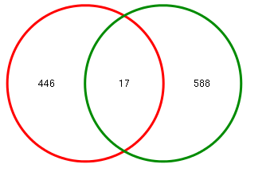

TF-Gene
female
Male
Category.of.Interactions=tf-gene
Evidence=Experimental, Predicted
Target.input.set=605
Regulator.input.set=605
ORA.pval.cutoff=0.05
Total.Targets.inDb=24535
Total.Regulators.inDb=2973
Deregulated.targets.by.inputRegulator=464
Deregulated.targets.of.inputRegulator.and.in.input.targetlist.overlap=0
no.of.resultant.interactions=18
no.of.interactions.associated.with.input.disease=2
venn.pval.hypergeom=1
venn.pval.simulation=1
Venn.image.path=/home/chris/TF-site2/tfmir/uploads/tr2a6f5ichpnsiik8cpf92hll6/tf-gene/venn.png
Category.of.Interactions=tf-gene
Evidence=Experimental, Predicted
Target.input.set=247
Regulator.input.set=247
ORA.pval.cutoff=0.05
Total.Targets.inDb=24535
Total.Regulators.inDb=2973
Deregulated.targets.by.inputRegulator=211
Deregulated.targets.of.inputRegulator.and.in.input.targetlist.overlap=0
no.of.resultant.interactions=10
no.of.interactions.associated.with.input.disease=4
venn.pval.hypergeom=1
venn.pval.simulation=1
Venn.image.path=/home/chris/TF-site2/tfmir/uploads/qard7nc2j7rr7otcvhl0pmoop6/tf-gene/venn.png

Slide 15
TAM 2.0 A tool for miRNA set analysis, Resource type: Web query-driven software. Description: TAM is a web-accessible program that is in the first version. For a given list of miRNAs, for example the deregulated miRNAs from microarray or deep sequencing experiments, TAM is able to identify enriched miRNA sets and explore novel miRNAs related to the input, and therefore is able to predict novel miRNAs for given function and diseases(Lu et al., BMC Bioinformatics 2010). In 2018, TAM 2.0 was released.
Bar plot
This bar plot illustrates the correlations (similarities) between user-provided de-regulated miRNAs and the de-regulated miRNAs in other disease conditions
This heatmap depicts the holistic view of miRNA de-regulation in the CUARATED DISEASE CONDITIONS. The palette correlates with the association score (de-regulation score, corrected for the specificity of miRNA de-regulation). The down-miRNAs are indicated by green boxes while the up-miRNAs are indicated by red boxes.
Citation: Jianwei Li, Xiaofen Han, Yanping Wan, Shan Zhang, Yingshu Zhao, Rui Fan, Qinghua Cui, and Yuan Zhou. TAM 2.0: tool for microRNA set analysis. Nucleic Acids Research, Volume 46, Issue W1, 2 July 2018, Pages:W180–W185. Ming Lu, Bing Shi, Juan Wang, Qun Cao and Qinghua Cui. TAM: A method for enrichment and depletion analysis of a microRNA category in a list of microRNAs. BMC Bioinformatics 2010, 11:41

Slide 16
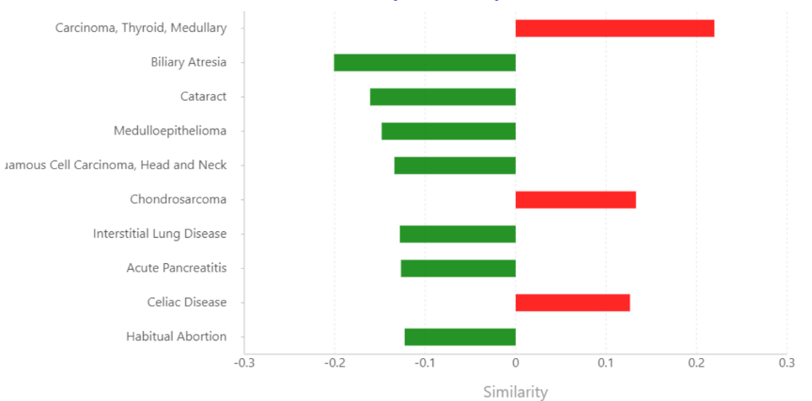
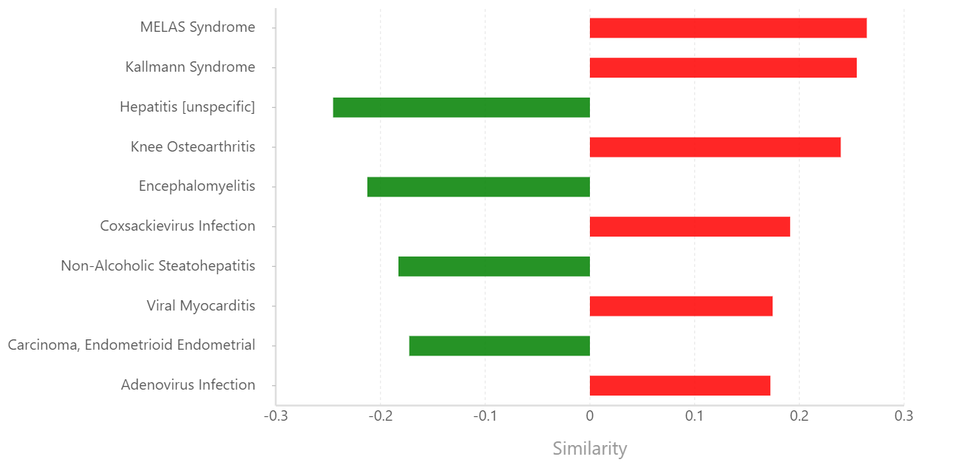
TAM 2.0 for miRNA set analysis
Male
Female
Bar plot depicting the similarities between user-provided de-regulated miRNAs and the de-regulated miRNAs in other disease conditions

Slide 17
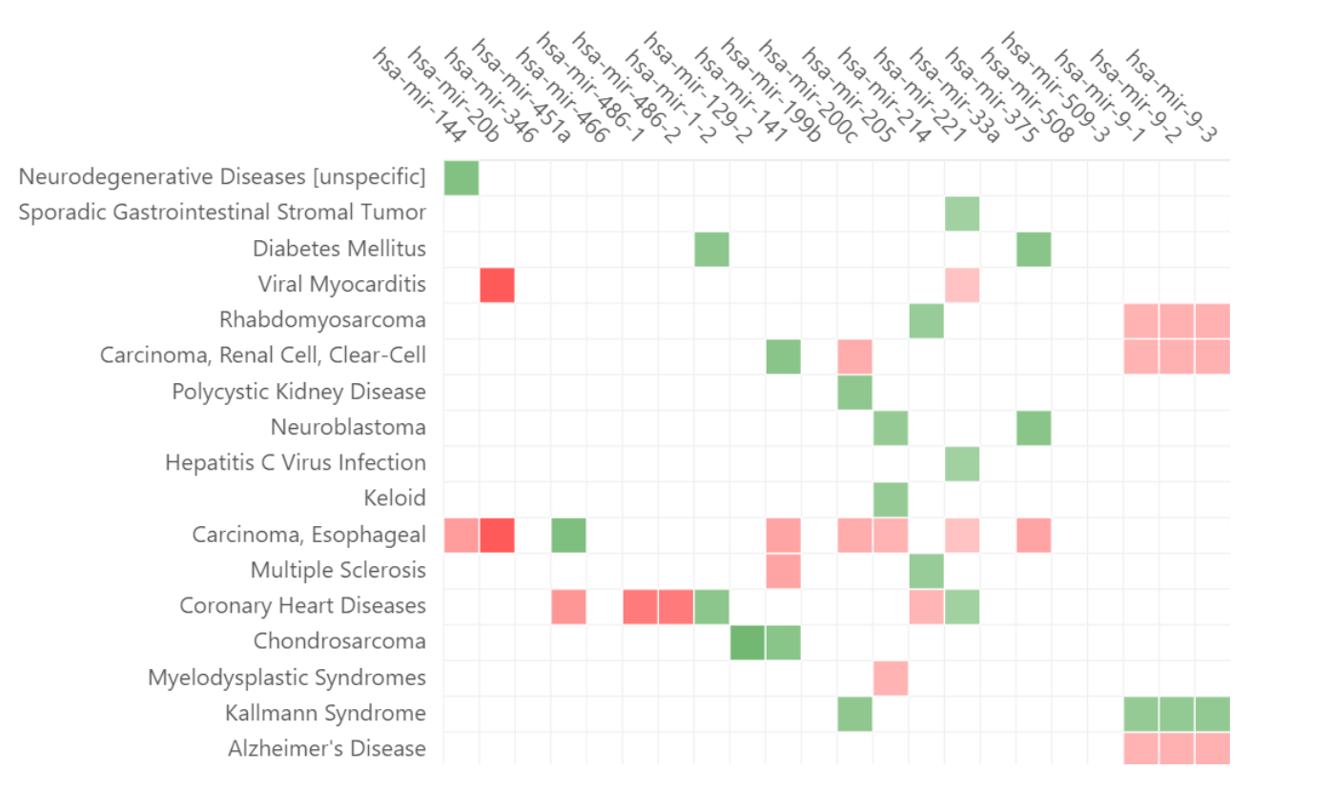
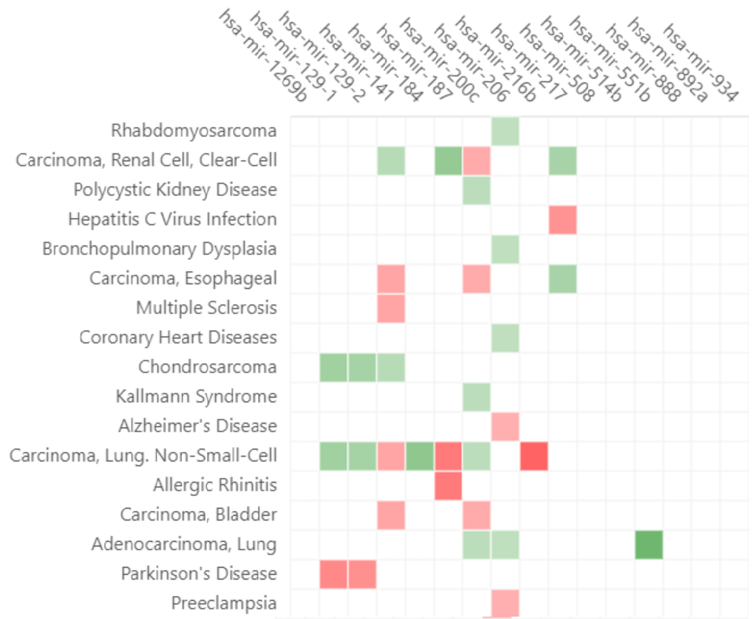
TAM 2.0 for miRNA set analysis
Male
Female
This heatmap depicts the holistic view of miRNA de-regulation in the CUARATED DISEASE CONDITIONS. The palette correlates with the association score (de-regulation score, corrected for the specificity of miRNA de-regulation). The down-miRNAs are indicated by green boxes while the up-miRNAs are indicated by red boxes.

Slide 18
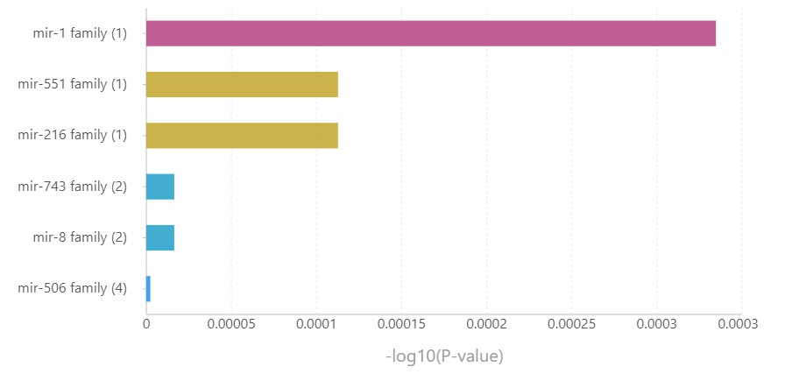
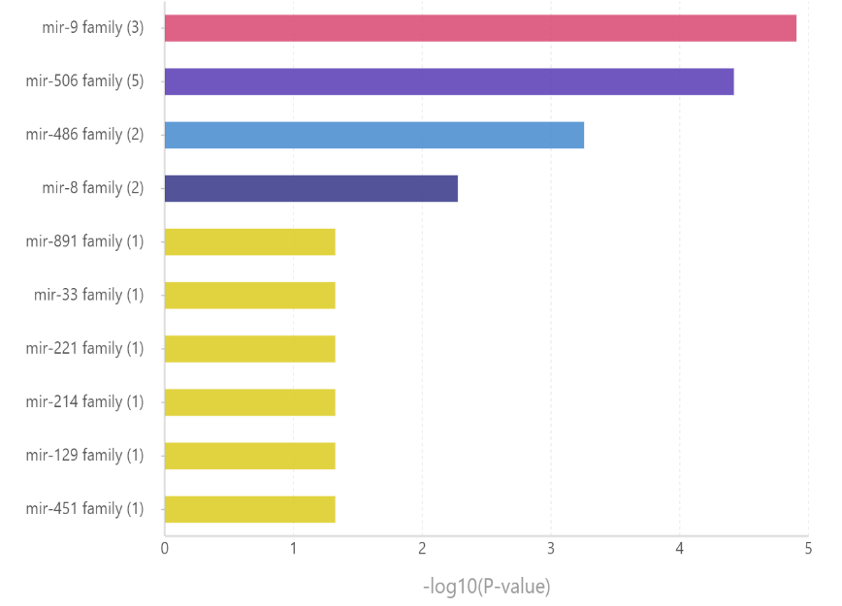
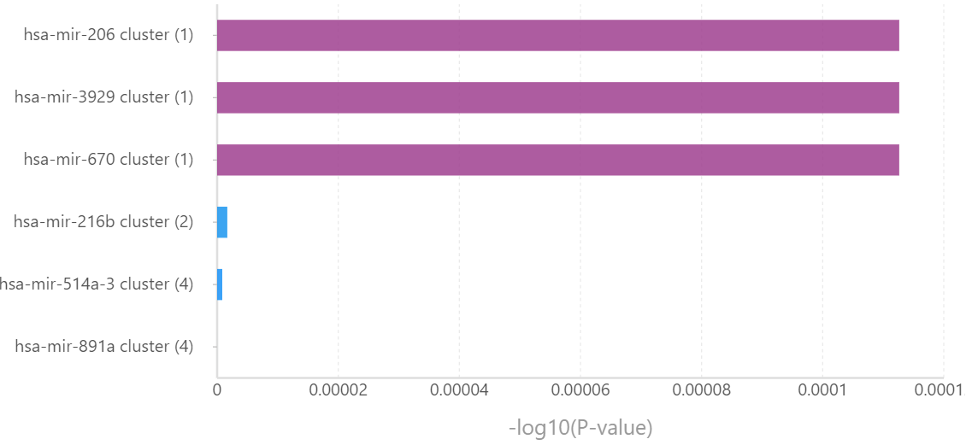
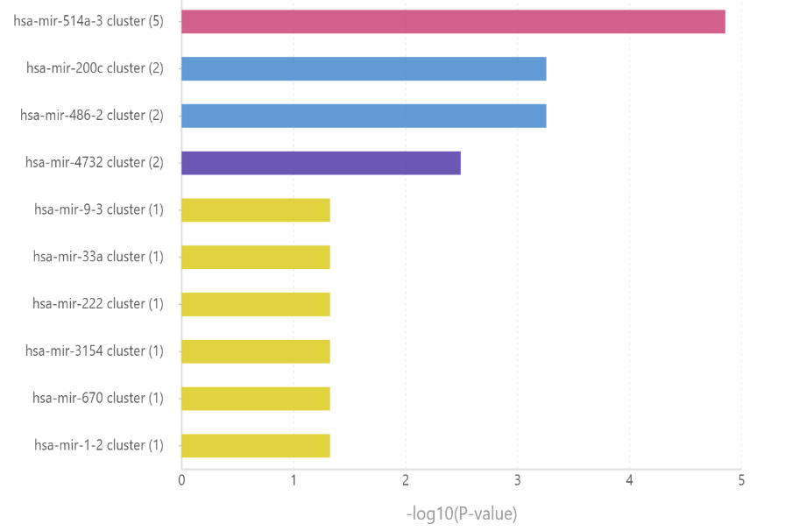
Male ( underrepresentation analysis)
Female (overrepresentation)
TAM 2.0 for miRNA set analysis

Slide 19
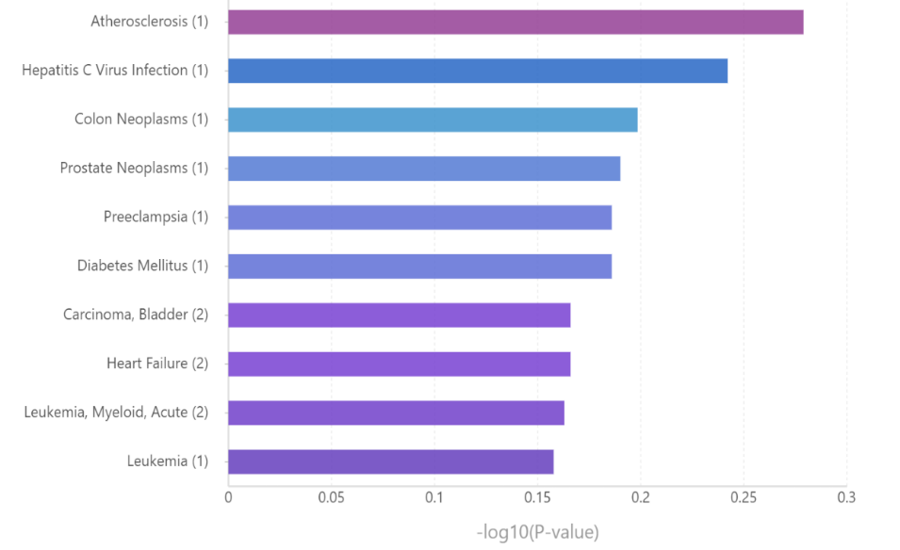
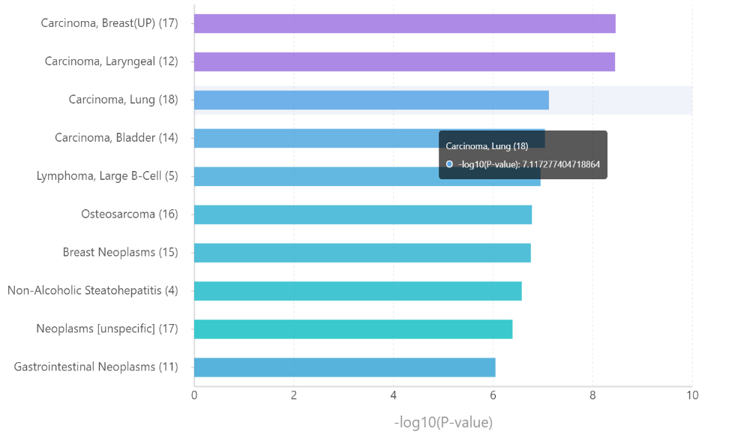
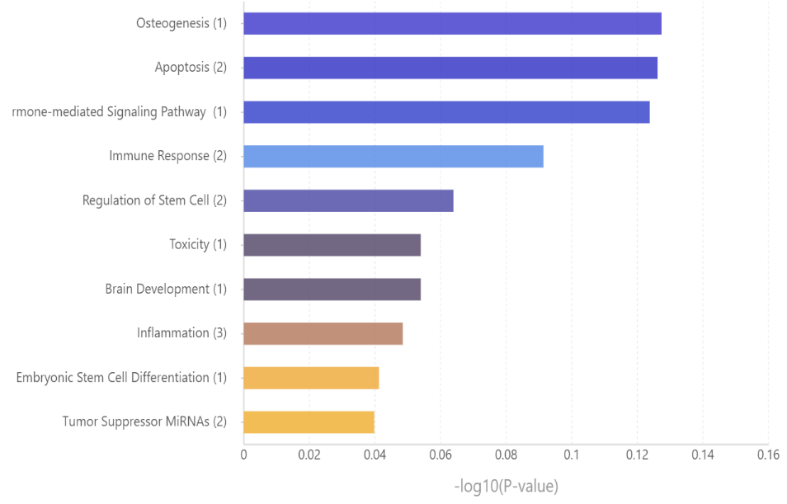
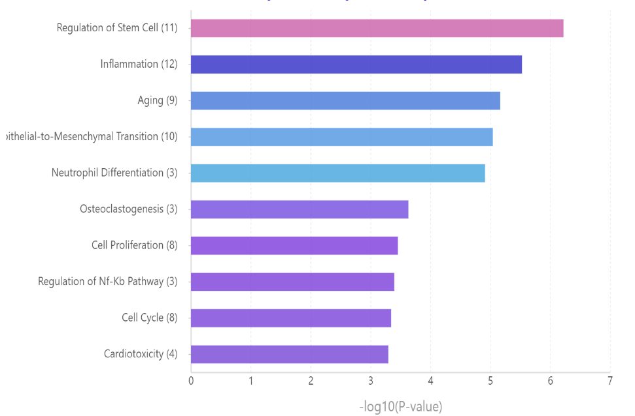
Male ( underrepresentation analysis)
Female (overrepresentation)
TAM 2.0 for miRNA set analysis

Slide 20
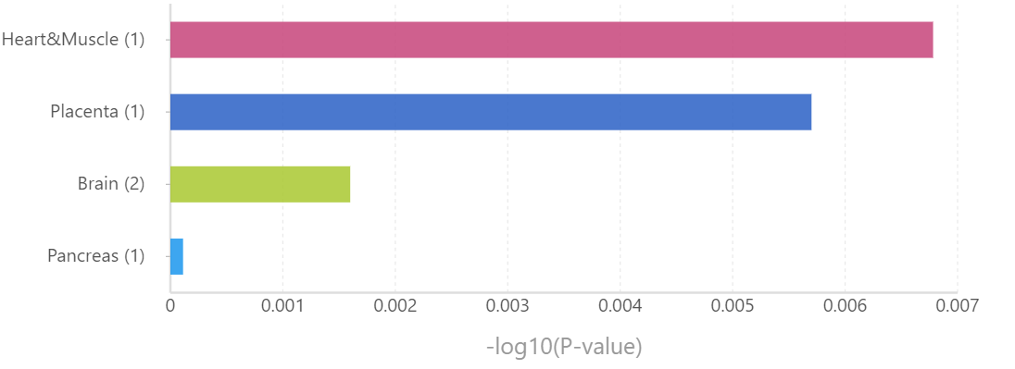
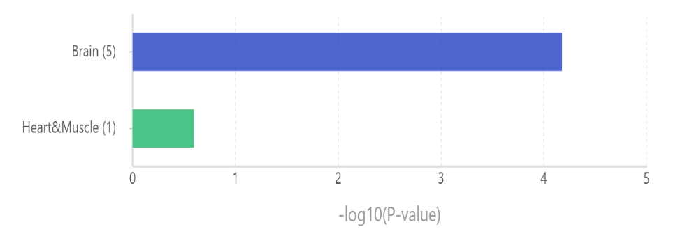
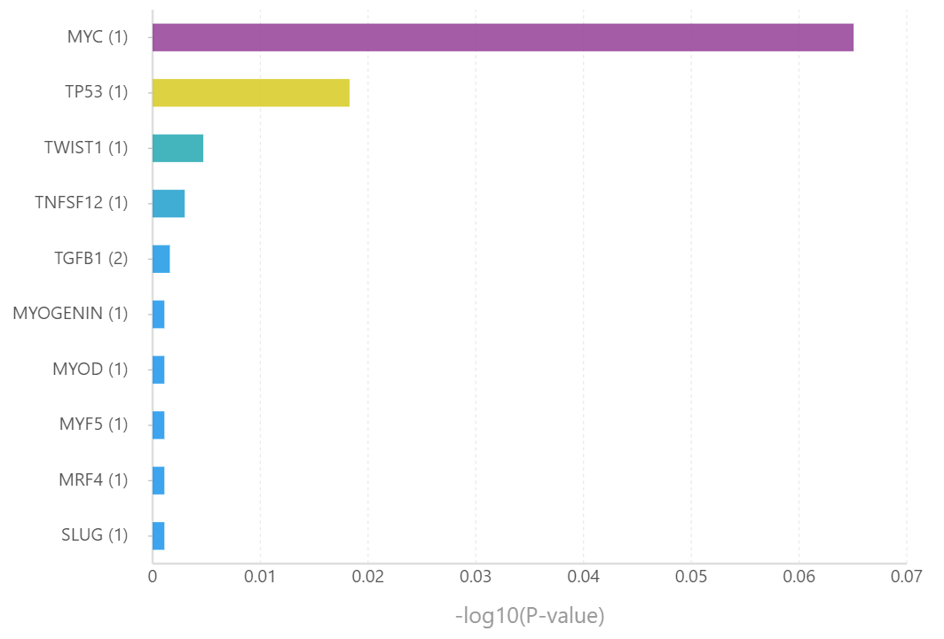
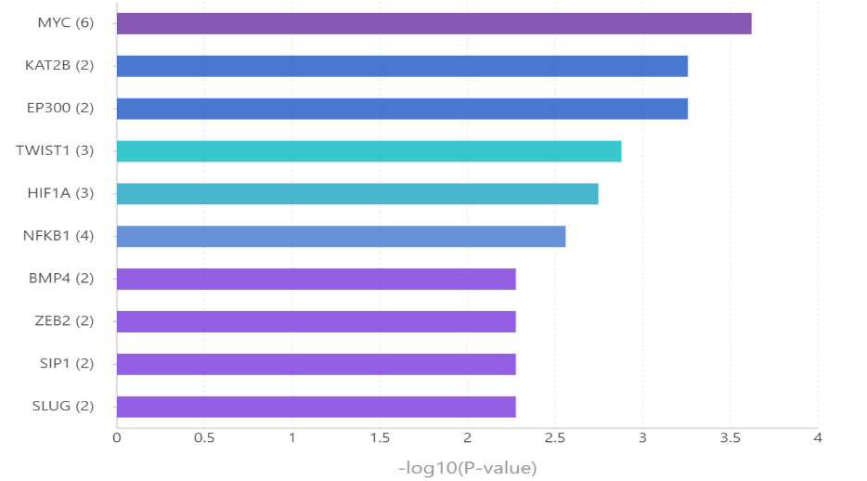
Male ( underrepresentation analysis)
Female (overrepresentation)
TAM 2.0 for miRNA set analysis

Slide 21
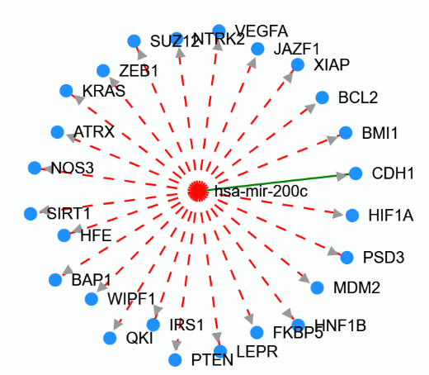
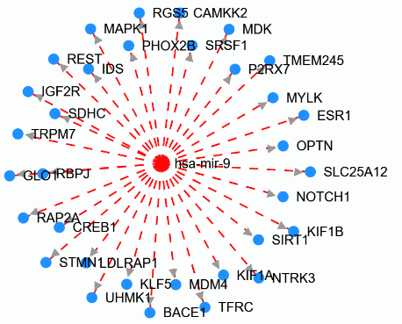
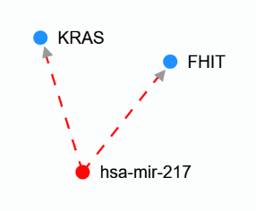
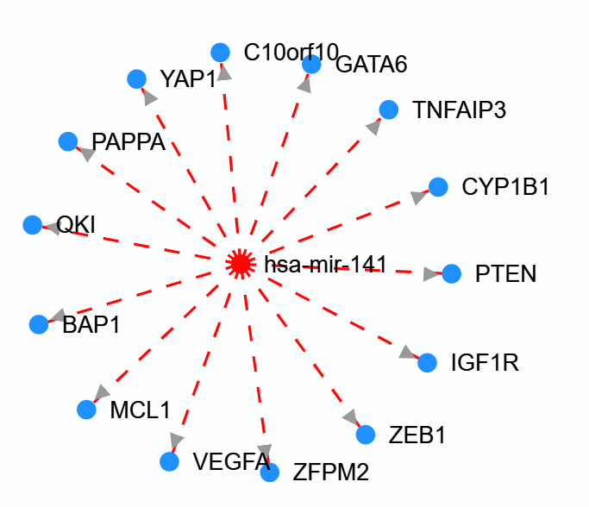
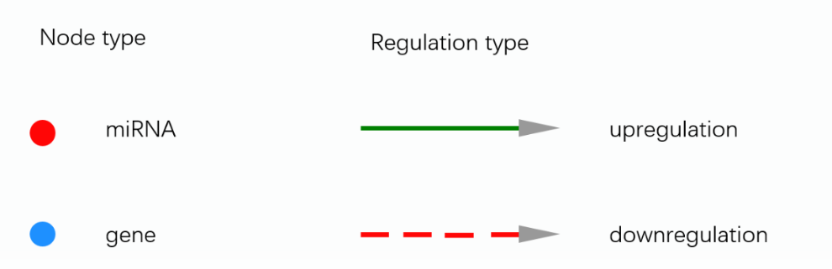
HMDD Database for Driver genes
http://www.cuilab.cn/hmdd

Slide 22
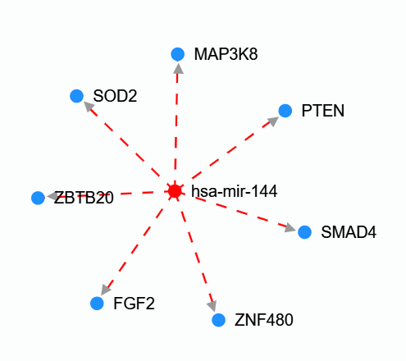
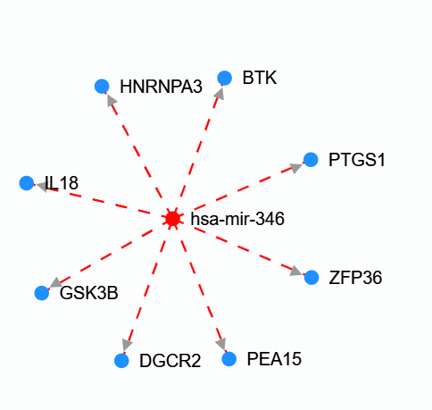
Upregulated miRNA in female (unique)

Slide 23
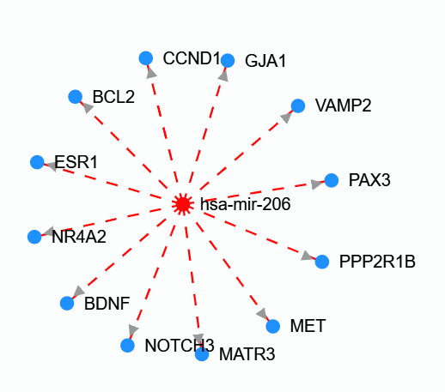
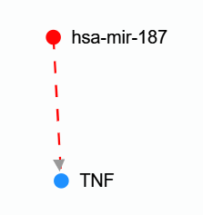
Downregulated miRNA in male( unique)

Slide 24
Male DEGS (upregulated)
Females DEGS (up-regulated)
CST1
EVX1
EVX1-AS
EZHIP
FAM166A
FIBCD1
HCAR2
ITPKA
KCND2
LAMB3
LINC00626
LINC01411
LINC01529
NEB
NKD2
PKP1
SBSN
SHISAL1
SLC1A7
SLITRK6
SP7
SPINK13
STEAP3-AS1
SYBU
TNNI2
WFDC3
SYBU
FRZB
GRM8
GVQW3
HAL
IGF2
KCNJ5
LAMA1
LINC01257
PGLYRP1
RHOXF1P1
SNORA28
VNN2

Slide 25
miRNA female
+1
hsa-mir-1295a
hsa-mir-144
hsa-mir-20b
hsa-mir-346
hsa-mir-451a
hsa-mir-466
hsa-mir-486-1
hsa-mir-486-2
-1
hsa-mir-1-2
hsa-mir-1248
hsa-mir-1255a
hsa-mir-129-2
hsa-mir-141
hsa-mir-199b
hsa-mir-200c
hsa-mir-205
hsa-mir-214
hsa-mir-221
hsa-mir-33a
hsa-mir-375
hsa-mir-508
hsa-mir-509-3
hsa-mir-514a-1
hsa-mir-514a-2
hsa-mir-514a-3
hsa-mir-891a
hsa-mir-9-1
hsa-mir-9-2
hsa-mir-9-3

Slide 26
miRNA male ( all are -1)
hsa-mir-1269b
hsa-mir-129-1
hsa-mir-129-2
hsa-mir-141
hsa-mir-184
hsa-mir-187
hsa-mir-200c
hsa-mir-205
hsa-mir-206
hsa-mir-323a
hsa-mir-375
hsa-mir-4484
hsa-mir-483
hsa-mir-487a
hsa-mir-506
hsa-mir-508
hsa-mir-514a-1
hsa-mir-514a-2
hsa-mir-514a-3
hsa-mir-514b
hsa-mir-551b
hsa-mir-599
hsa-mir-891a
hsa-mir-891b
hsa-mir-934

Slide 27
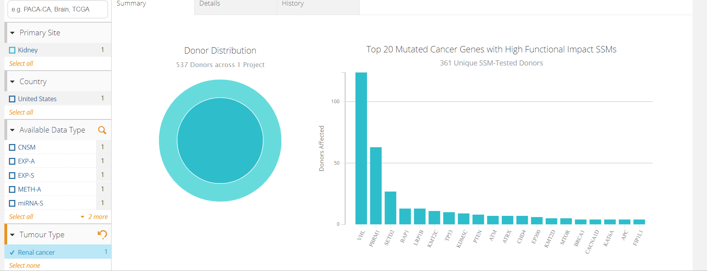
https://dcc.icgc.org/projects?filters=%7B%22project%22:%7B%22tumourType%22:%7B%22is%22:%5B%22Renal%20cancer%22%5D%7D,%22id%22:%7B%22is%22:%5B%22KIRC-US%22%5D%7D%7D%7D&projects=%7B%22from%22:1%7D

