Slide 1
Few-Shot Encrypted Traffic Classification: Exploring Alternative Models
Hagay Cohen , Imri Shai

Slide 2
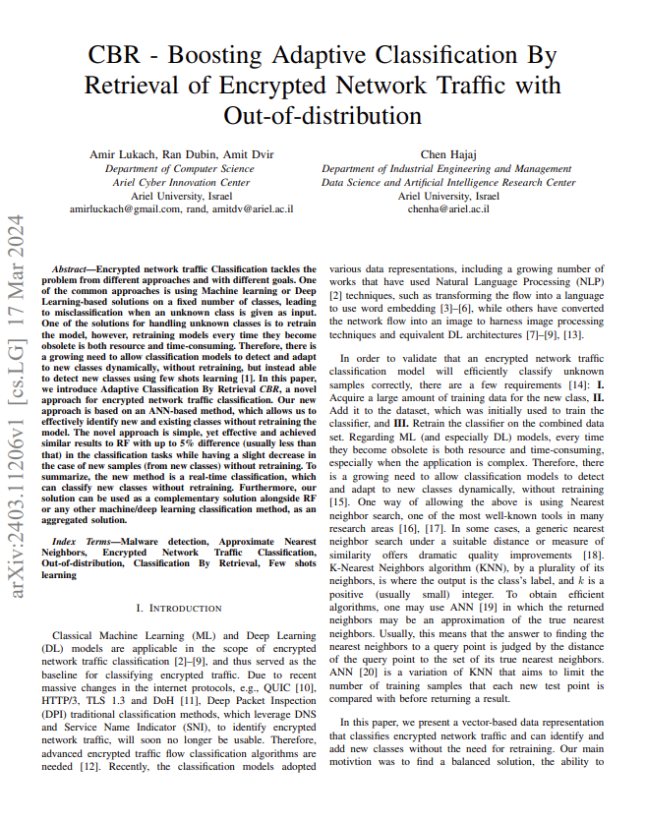
CBR Model
Encrypted traffic classification by using Approximate Nearest Neighbors (ANN).1 This method retrieves the closest matching cases from a pre-indexed database, allowing efficient classification of both existing and new traffic classes without the need for retraining. The model is designed to adapt dynamically to new data while maintaining high accuracy, making it particularly effective for real-time encrypted traffic classification.

Slide 3
Research Question
Can an alternative model outperform the CBR model when applied to the same dataset and feature distribution?

Slide 4
Problem Description Few-Shot Encrypted Traffic Classification
Definition:
Classifying encrypted traffic with very limited labeled data.
Challenges:
Lack of labeled data for new traffic types.
The need for robust models that generalize well in few-shot settings.
Importance:
Helps identify malicious or anomalous traffic patterns efficiently.
Enhances security in encrypted network environments.

Slide 5
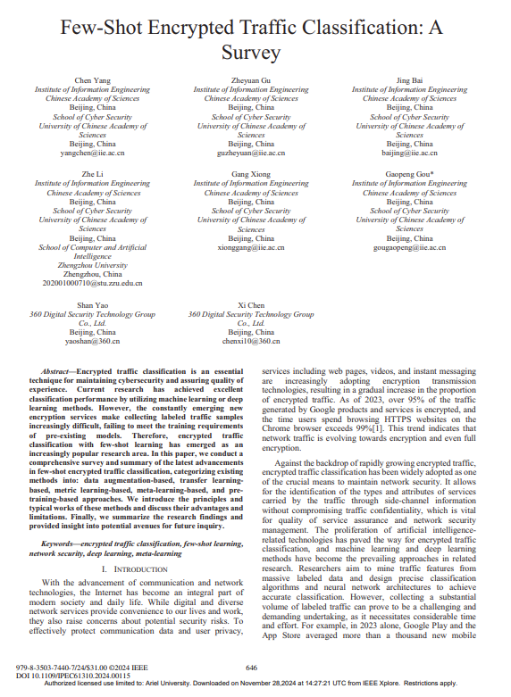
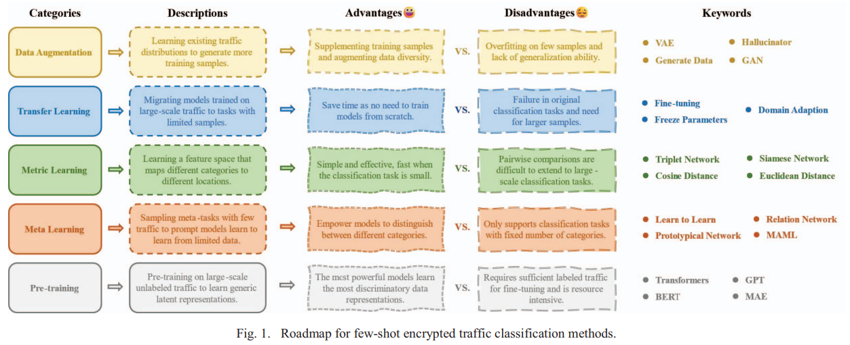
Background Reading
Few-Shot Encrypted Traffic Classification: A Survey
Provides an overview of methodologies for encrypted traffic classification.
Highlights challenges in few-shot learning scenarios.
Discusses state-of-the-art techniques and their applications.

Slide 6
Background Reading
W. Zheng, C. Gou, L. Yan, and S. Mo, “Learning to classify: A flowbased relation network for encrypted traffic classification,” in Proceedings of The Web Conference 2020, ser. WWW ’20. ACM, p. 13–22, 2020.
K. Wu, P. Wang, and Z. Wang, “Few-shot malicious traffic classification based on siamese neural network,” in 2021 IEEE 23rd Int Conf on High Performance Computing amp; Communications; 7th Int Conf on Data Science amp; Systems; 19th Int Conf on Smart City; 7th Int Conf on Dependability in Sensor, Cloud amp; Big Data Systems amp; Application (HPCC/DSS/SmartCity/DependSys). IEEE, pp.1670–1675, 2021
.C. Rong, G. Gou, C. Hou, Z. Li, G. Xiong, and L. Guo, “Umvd-fsl: Unseen malware variants detection using few-shot learning,” in 2021 International Joint Conference on Neural Networks (IJCNN). IEEE, p. 1–8, 2021.

Slide 7
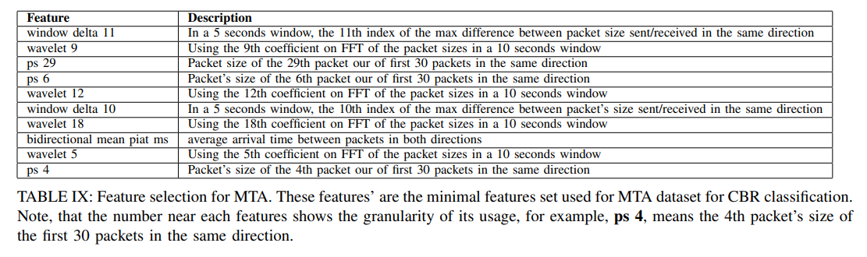
Dataset Overview
Source: The dataset used in this project is based on the one described in the CBR paper, ensuring consistency with the original research.
Features: Includes statistical, time-based, and packet-level attributes extracted from encrypted network traffic, as detailed in the original study.
Purpose: Using the same dataset and feature distribution as CBR was crucial to fairly evaluate alternative models and directly address our research question: Can an alternative few-shot model outperform the CBR model under identical conditions?

Slide 8
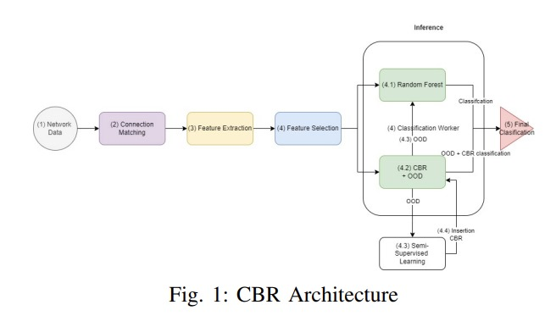
Research Implementation
Research Approach: To address the research question, we explored few-shot learning methods and investigated alternative models.
CBR Model: The CBR model utilizes a metric-learning approach for few-shot classification, leveraging the Elastic Search database to index the data. This provides fast and accurate results for approximate nearest neighbors (ANN).
Alternative Models: For alternative approaches, we implemented models discussed in the survey paper, with a focus on those designed for malicious traffic analysis, such as the CBR model applied to the MTA dataset. Our methods included augmentation, metric learning, and meta-learning, which will be elaborated on in the following slides.

Slide 9

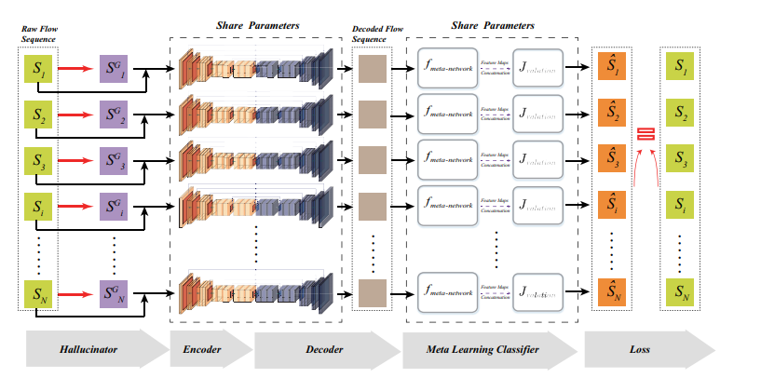
Model Architectures
Data Augmentation Using Hallucinator
We implemented a simplified but functional version of the model described in the paper. The process began with constructing the hallucinator to generate synthetic data for training. This synthetic data was then used to train the Meta-Learning RBRN network to classify the data.
The accompanying diagram illustrates the concept from the paper. In our implementation, we excluded the encoding and decoding steps, as they are only relevant for feature extraction, which was not applicable to our use case.

Slide 10
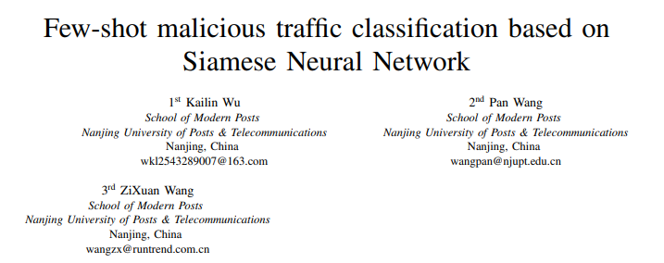
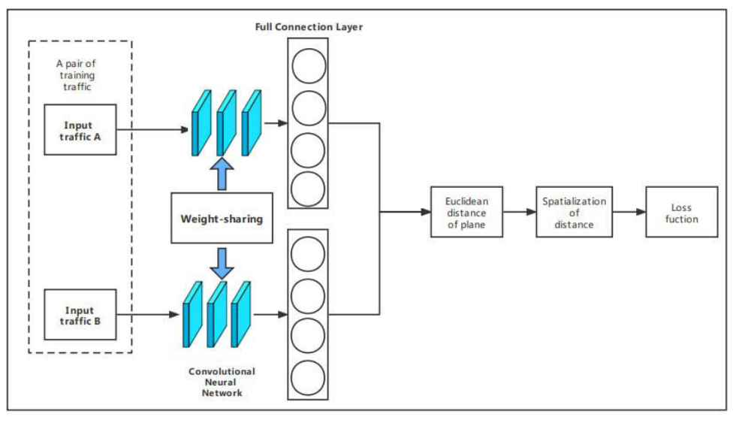
Model Architectures
Metric Learning Using Siamese Neural Network
The Siamese Neural Network takes two input samples and outputs their representations embedded in a high-dimensional space. It compares the similarity between the two samples to enable classification.
Instead of relying on a simple Euclidean distance, the Siamese network learns and constructs a unique method to measure the metric between samples and classes. Similar to previous methods, the feature engineering stage was deemed irrelevant for our implementation.

Slide 11
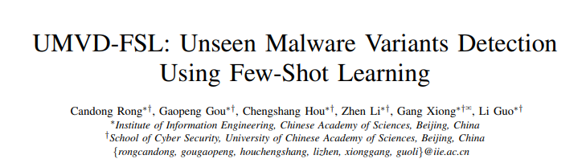
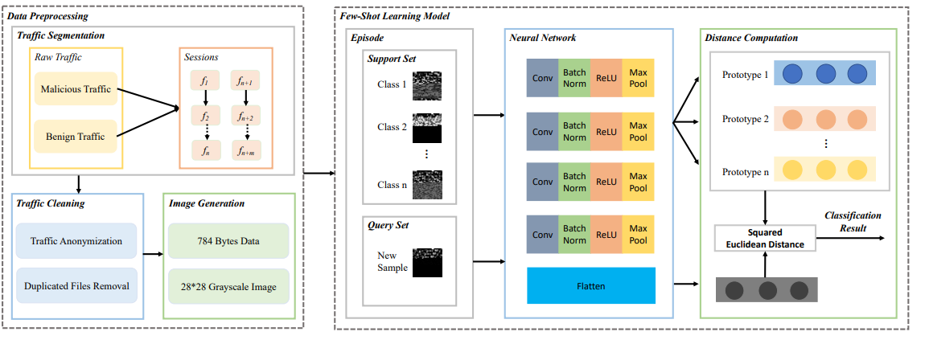
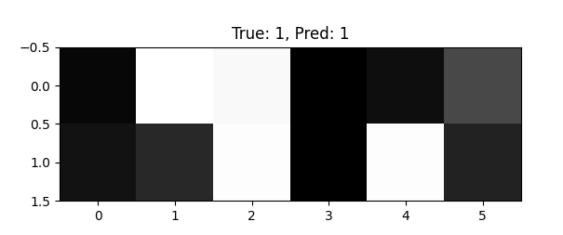
Model Architectures
Meta-Learning Using Image Representation
Network traffic data generated by malware variants is converted into grayscale images. A prototype-based few-shot learning model processes these images as input, leveraging meta-training to enable the meta-learner to adapt to new tasks.
When a new sample is introduced, the model classifies it by calculating its distance from the prototype representation of each class.

Slide 12
Results Comparison –Full Data
Overall Accuracy | F1 | Recall | Precision | Accuracy | Model name
0.985 | 0.98/ 0.99 | 0.98/ 0.99 | 0.98/ 0.99 | 0.981/ 0.989 | Random Forest
0.961 | 0.95/ 0.97 | 0.95/ 0.97 | 0.95/ 0.96 | 0.95/ 0.971 | Elastic(CBR) L2 norm
0.884 | 0.88/ 0.9 | 0.87/ 0.9 | 0.89/ 0.9 | 0.871/ 0.897 | Elastic(CBR) Cosine
0.365 | 0/ 0.57 | 0.03/ 0.7 | 0/ 0.49 | 0.034/ 0.697 | Elastic(CBR) Max inner product
0.94 | 0.91/ 0.97 | 0.91/ 0.97 | 0.92/ 0.97 | 0.911/ 0.969 | Hallucinator
0.452 | 0.28/ 0.57 | 0.45/ 0.7 | 0.21/ 0.49 | 0.452/ 0.697 | Siamese Network
0.3 | 0.23/ 0.44 | 0.3/ 0.36 | 0.31/ 0.66 | 0.3/ 0.355 | UMVD-FSL(Images)

Slide 13
Results Comparison –Full Data

Slide 14
Results Comparison – One Sample
Overall Accuracy | F1 | Recall | Precision | Accuracy | Model name
0.653 | 0.55/ 0.80 | 0.52/ 0.79 | 0.64/ 0.84 | 0.517/ 0.79 | Random Forest
0.68 | 0.59/ 0.80 | 0.56/ 0.80 | 0.68/ 0.81 | 0.564/ 0.796 | Elastic(CBR) L2 norm
0.517 | 0.34/ 0.55 | 0.35/ 0.52 | 0.46/ 0.6 | 0.346/ 0.517 | Elastic(CBR) Cosine
0.352 | 0/ 0.57 | 0.03/ 0.67 | 0/ 0.49 | 0.03/ 0.672 | Elastic(CBR) Max inner product
0.507 | 0.33/ 0.7 | 0.33/ 0.69 | 0.55/ 0.77 | 0.329/ 0.685 | Hallucinator
0.183 | 0.01/ 0.14 | 0.07/ 0.3 | 0/ 0.09 | 0.06/ 0.302 | Siamese Network
0.374 | 0.31/ 0.5 | 0.27/ 0.48 | 0.46/ 0.57 | 0.272/ 0.476 | UMVD-FSL(Images)

Slide 15
Results Comparison – One Sample

Slide 16
Additional Observations
Results Analysis: The Elastic (CBR) model outperformed all other few-shot models we implemented. The Hallucinator model came closest to the CBR results and even surpassed it in terms of precision for the second class when using the full dataset. For one-sample data, the CBR even out performed RF!
Challenges: One notable issue with the Elastic model was its handling of single-sample cases, where there were insufficient samples to produce a result. To address this, we classified such "no result" cases as out-of-distribution (OOD).
Note: The results presented in the previous slides reflect the best run of the Elastic Search model. However, there were instances where the Hallucinator outperformed the CBR model in terms of accuracy. This variability is likely due to the way Elastic Search indexes the data differently with each execution.

Slide 17

Summary
The CBR model demonstrated the best results in terms of accuracy, although some other models required slightly less training time. Additionally, a notable advantage of the Elastic approach is its ability to update in real-time—when a new class is introduced, there's no need for re-training. The class can simply be added to the Elastic database, allowing classification to begin immediately.

Slide 18
Future Work
We propose focusing on improving the other models we presented by implementing them fully as described in the relevant research papers. This includes utilizing the complete dataset instead of performing feature selection beforehand, which could potentially enhance the results. This work might also align well with Ran's next course, where we will delve deeper into DLM and explore its applications more thoroughly.

Slide 19

Questions

Slide 20

Thank You

