Slide 1
Introduction to Docker
By Kim Johansson
Notes:
----- Meeting Notes (10/03/15 21:13) -----

Slide 2
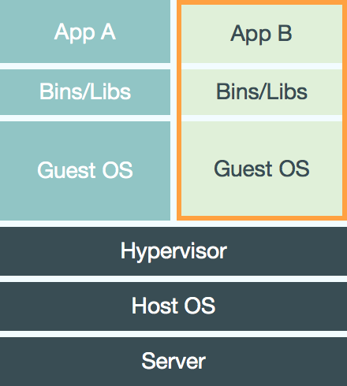
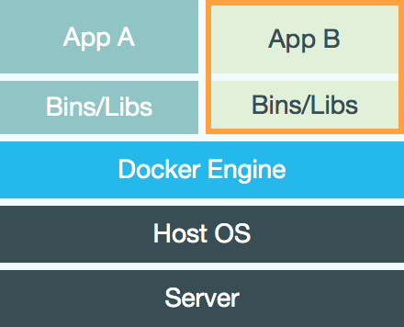
What Docker isn’t
A virtual machine
Notes:
Docker is not a virtual machine. It runs with native or close to native speed. It utilizes namespacing in Linux to create a safe place for your application to live in, being given access to stuff of your choosing. Docker is simply a tool to wrap this and provide a way to distribute the applications and their dependencies.

Slide 3
What Docker is
An application container
An ecosystem to manage applications and their dependencies

Slide 4
Ecosystem
Docker binary – client and server
Repository – hub.docker.com
Images
Containers
Dockerfiles
Volumes
Notes:
Docker: The do-it-all binary. Is the server and the client.
Repository: Hosts Docker images. The default is hub.docker.com, but self-hosting is possible (Available as a Docker container!).
Images: A pre-built Docker application, ready to be used or extended upon.
Containers: An instance of an Image. Contains specializations and current runtime changes.
Dockerfiles: Describes how to create a new Image based upon a previous Image.
Volumes:

Slide 5
Demo 1 – Emulate Ubuntu
docker run –t –i ubuntu /bin/bash
Executes /bin/bash interactively inside the ubuntu image
Runs until you exit
Notes:
cd demo1
./start.sh
# Commands to run
echo ‘Hello world from Docker!’
lsb_release –a
exit
Questions?
-i = Keeps STDIN open even if no tty is attached to the Docker container
-t = Interactive mode, attaches a shell to the Docker container

Slide 6
Do’s and don’t
1. Don’t run applications with write performance constraints (Databases, queues)
2. Don’t create Dockerfiles to build and run the application.
3. Do use Docker to build the application and another Dockerfile to build a Docker image of the application
Notes:
1: As Docker utilises a copy-on-write filesystem, writes are slow. Performance can be improved by using volumes, but volumes aren’t a great fit in a clustered environment. Use a standard server to host databases, message queues, etc.
2/3: Don’t make a do-it-all Docker image. Use one image to build the application, with all the dependencies pre-installed, attach the source and build. Use another Dockerfile to copy the build application and that’s your finished Docker image.

Slide 7
Demo 2 – Hosting PHP
docker build -t demo2 .
docker run -d --name demo2 -p 8080:80 demo2
curl –L http://192.168.59.103:8080/
Notes:
Don’t forget to show them the Dockerfile and PHP source code!
cd demo2
cat Dockerfile
cat start.sh
./start.sh
Questions?

Slide 8
Demo 3 – Multiple versions of PHP
Using an nginx image to proxy traffic between two apache images hosting two different versions of PHP.
Usable to host a given version of Wordpress and another version of PHP to host the main site. (/ + /blog/)
Notes:
Don’t forget to show them the Dockerfile and PHP source code!
cd demo3
cat nginx-config
cat start.sh
cat php54/Dockerfile
cat php56/Dockerfile
cat php54/src/index.php
./start.sh
Questions?

Slide 9
Demo 4 – Upgrading/downgrading
Using vulcand and etcd to upgrade/downgrade versions smoothly.
Notes:
cd demo4
cat start.sh
cat enable.sh
cat disable.sh
cat stop.sh
Open Safari
I know I’m cheating by having all containers open at once, but it doesn’t matter.
./enable.sh v1
./enable.sh v2
./disable.sh v1
Don’t forget to run stop.sh!

Slide 10
Noteworthy tools
docker-swarm
CoreOS
Fig
Shipyard
Kubernetes
Notes:
Docker-swarm: Docker cluster management tool by Docker. Emulates multiple machines to act like a single Docker host.
CoreOS: Complete OS that relies on Docker to host it’s internals. Makes running Docker in a clustered environment easy. Includes etcd and fleet.
Fig: Configures an environment with Docker containers and link them. Similar to Vagrant.
Shipyard: A UI to manage Docker containers.
Kubernetes: Docker orchestration service made by Google.

Slide 11
Questions?
Source: http://bit.ly/1EsrfqD
Twitter: @hagbarddenstore

